Slide 1
Advanced Systems Security:
VMs and Untrusted OSes
Trent Jaeger
Systems and Internet Infrastructure Security (SIIS) Lab
Computer Science and Engineering Department
Pennsylvania State University
March 29, 2011

Slide 2
Conventional OS vs VM System
Conventional OS
  Broken easily and often
VM system
  Coarser control based on isolation
If we trust the VM system and don’t trust the OS, what can we do?
Notes:
This slide illustrates the way our approach works.

Slide 3
Untrusted OS
Don’t trust OS, but need its services
Run programs on a specialized, trusted system
  But use conventional OS like an untrusted network
Run programs directly on VMM
  But use conventional OS like an untrusted network (must use more OS)
How do we accomplish these options?

Slide 4
Options
Microkernels
  Reduce code running in kernel mode
  But, need the same services
  These are just as “trusted” running in user-space
SELinux/AppArmor/Trusted Solaris
  What do you think?
Isolate in VM systems (e.g., Terra)
  Can deploy an application on a custom OS
  Still have to trust all services used though

Slide 5
A solution should…
Ease Adoption
  It is usable…
Support Diverse Applications
  …to a lot of people…
Have an Incremental Path to Higher Assurance
  …also.

Slide 6
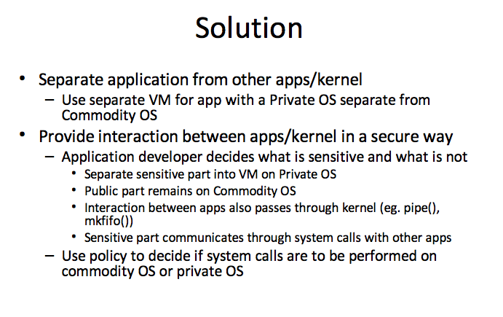
Splitting Interfaces

Slide 7
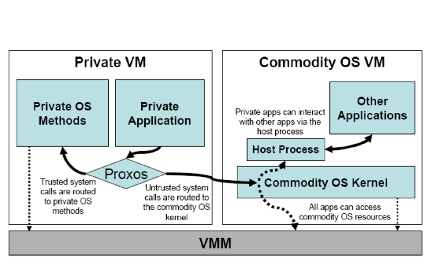
Proxos Architecture

Slide 8
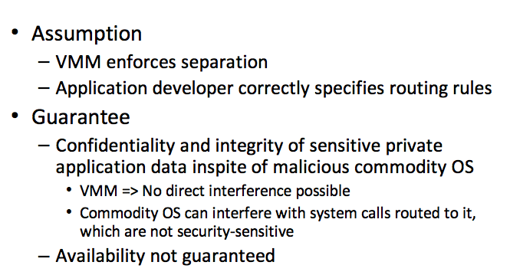
Proxos Guarantees

Slide 9
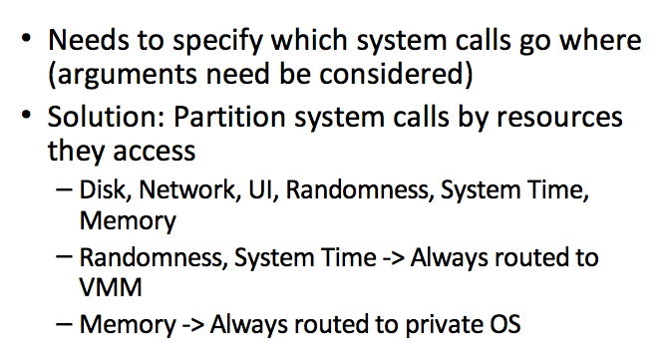
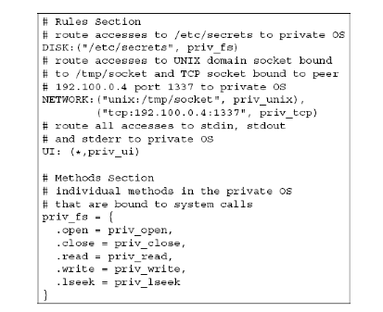
Proxos Routing Language

Slide 10
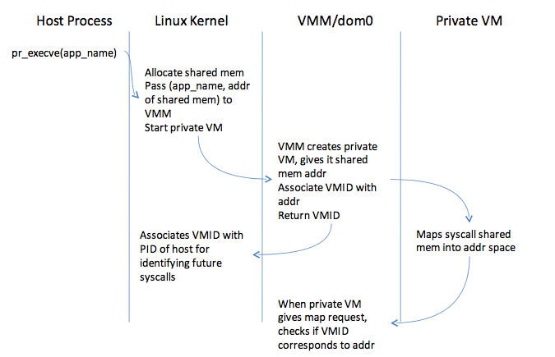
Proxos Implementation

Slide 11
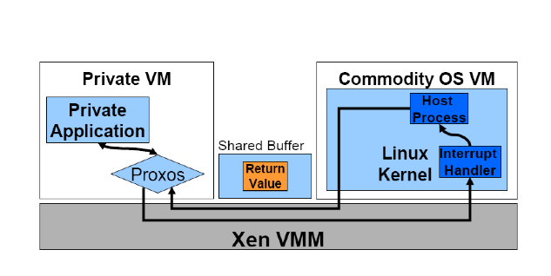
Proxos Implementation

Slide 12
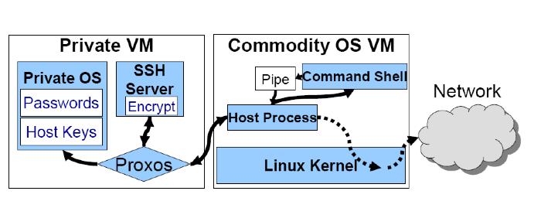
Proxos SSH Server

Slide 13
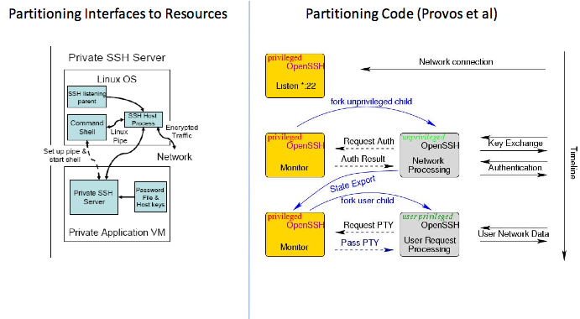
Compare to Privilege Separation

Slide 14
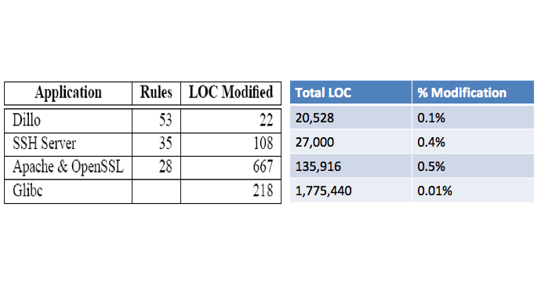
Implementation Effort

Slide 15
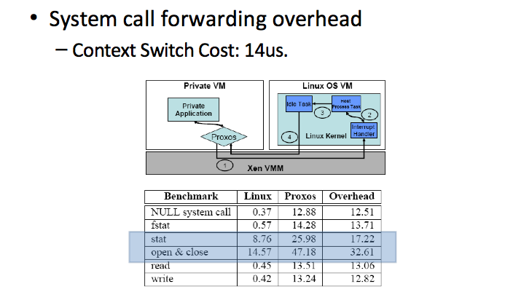
Performance

Slide 16
Remaining Problem
Deploying a custom OS is painful
  Building a special kernel is non-trivial
And it may not be secure itself
  Still need a methodology to determine code correctness and tamperproofing
What if you want to eliminate trust in the OS altogether?

Slide 17
Insight: Shadowing Memory
VMMs need to manage physical to virtual mapping of memory
This is done with a shadow page table
Multi-shadowing give context aware views of this memory
  Use encryption instead

Slide 18
Memory Cloaking
Not new idea
  XOM, LT
Leverage the awesome power of VMMs
Encrypt the pages in memory
  (IV, H) meta data
This is used for writes to disk too
  How do we store the metadata?

Slide 19
Tasks of the Overshadow
Mediate all application interaction with OS to ensure correct cloaking of memory
  Context Identification
  Secure Control Transfer
  System Call Adaptation
  Mapping Cloaked Resources
  Managing Protection Metadata

Slide 20

Shim baby Shim
The key to overshadow is the Shim
  Manages transitions to and from VMM via a hypercall
Shim Memory protects application
  CTC protects control registers
Uncloaked Shim
  Neutral ground
  Trampoline!

Slide 21
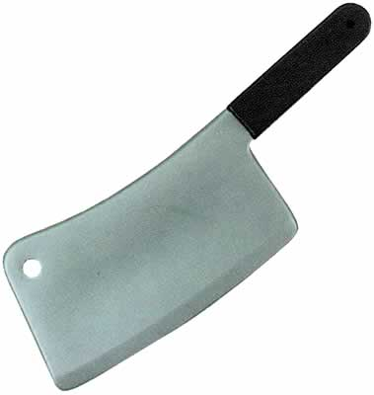
Loading Applications
The Shim uses a Loader program
Sets up the cloaked memory with a hypercall
The loader / shim must be trusted
  Metadata on the CTC checks for compromise
  Here is the meat of the problem
    Is it even used?
Propagate shims to spawned applications

Slide 22
Its not that easy…
Lot of OS interfaces that must be handled
Faults / Interrupts
System Calls
  Pass control to the VMM
  The shim catches this and stores registers
    Clear the registers to prevent side channels

Slide 23
Complex Syscalls
Some syscalls are easy
  No side effects
  Nice, getpid, sync
Others, less so…
  Pipe, r/w (Zero data)
  Clone
  Fork
  Signal Handling

Slide 24
Performance
Microbenchmarks
  Not so hot 15-60%
  Although a lot better than Proxos
Application Benchmarks
  SPEC isn’t so bad
  High bandwidth hits some bottlenecks
  Why?

Slide 25
Take Away
VM Systems provide isolation
  At OS granularity: some can be untrusted
OS provides services used by applications
  Access to devices demultiplexed among VMs
Can we use VM isolation to prevent compromise of applications by OS compromise?
  Proxos: use a “trusted” OS and redirect service requests
  Overshadow: use OS as untrusted communication media

