Slide 1
Advanced Systems Security:
Assurance
Trent Jaeger
Systems and Internet Infrastructure Security (SIIS) Lab
Computer Science and Engineering Department
Pennsylvania State University
March 31, 2011

Slide 2

Problem
Suppose you go to some trouble to build a system to satisfy the reference monitor concept
  How would you evaluate that your system correctly satisfies that concept?
Notes:
This slide illustrates the way our approach works.

Slide 3

Practical Problem
Commercial systems are not designed to satisfy the reference monitor concept
  Can we do something to encourage improvement?
  Can we layout a path that could result in a commercial system that satisfies the concept?

Slide 4
Assurance
A set of evaluations aiming to show that a system provides a correct security function
Motivated by work on security kernels
  (1) Implement a specific security policy
  (2) Design a veriﬁable protection behavior of the system as a whole
  (3) Implementation must be shown to be faithful to the system’s design
Develop distinct sets of requirements to be fulfilled for such an approach

Slide 5
Formal Assurance
Throughout the 1970’s and 1980’s researchers examined methods to prove security properties
Peter Neumann: Provably Secure Operation System
  Formal design and proofs of security (1976)
Padilla and Benzel: Evaluation of SCOMP
  First “assured” system (1985)
Popek, Kemmerer, Walker: Verification of UCLA UNIX Security Kernel (1980)
  Completely Validated Software (ICSE 1989)
  Integrating into Development Process (IEEE Soft 1990)

Slide 6
Formal Assurance
Throughout the 1970’s and1980’s researchers examined methods to prove security properties
Feiertag, Levitt, Robinson: Proving Multilevel Security of a System Design (SOSP 1977)
Neumann, Feiertag, Levitt, Robinson: Software Development and Proofs of Multi-Level Security (ICSE 1976)

Slide 7
What Do We Want To Know?
Complete Mediation
  Each structure member access to a security-sensitive object must be mediated (domination)
    Find objects that enable an information flow between subjects
  Mediation must authorize all security-sensitive operations (AND of all accesses)
    Can we compute all operations that are dominated?
  Thus, uncommon accesses may require additional mediation (consistent across code)
    Is a set of accesses embodied in an operation elsewhere? (mediated differently)

Slide 8
What Do We Want To Know?
Tamperproofing
  Start with known, good code and data (integrity verification)
  Each information flow to kernel or TCB must be from trusted entity (Biba integrity) OR
  Each information flow from an untrusted entity to kernel or TCB must be filtered (attack surface)
  Filters must be acceptable (type safety, FSA, legal sequence of interfaces, …)

Slide 9
What Do We Want To Know?
Verification
  Code must correctly implement security-sensitive function (security function: build queries, execute queries, etc)
  Policy must correctly describe data security requirements – all authorized information flows (tamperproofing and user/app data)
Design
  Validate these in design
Implementation
  Verify mapping to implementation (what if no design?)

Slide 10
Assurance Criteria
First proposal
  Nibaldi proposed first criteria in 1979
  “Laboratory Evaluations”
Eventually led to Rainbow Series of TCSEC
Criteria goals
  Security policy
  Mechanisms contributing to effective enforcement of policy
  Assurance that mechanisms are functioning

Slide 11
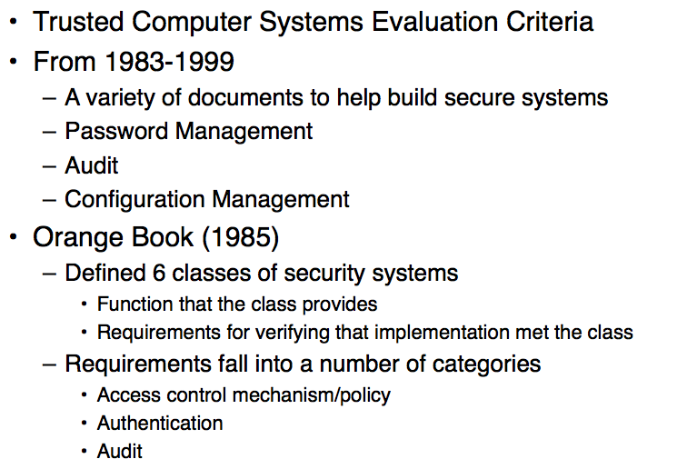
Rainbow Series

Slide 12
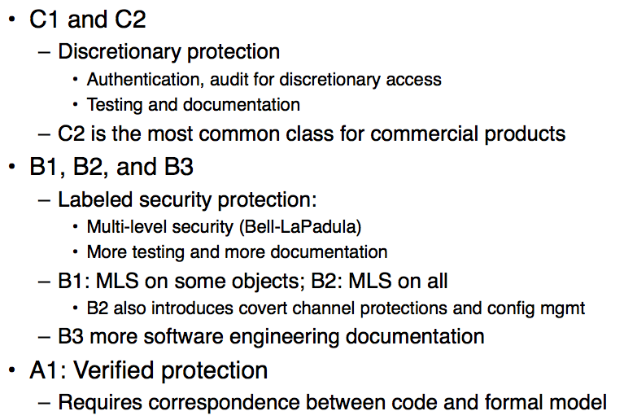
Orange Book Classes

Slide 13
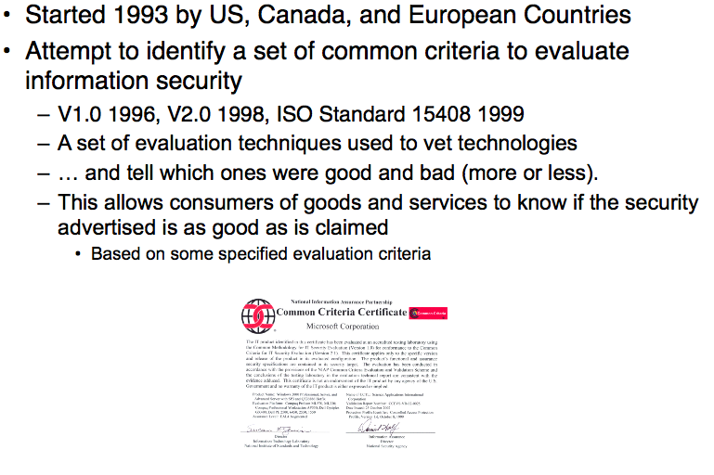
Common Criteria

Slide 14
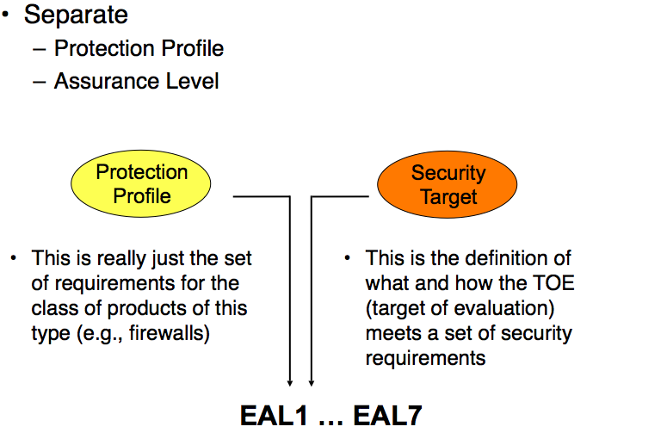
Common Criteria

Slide 15
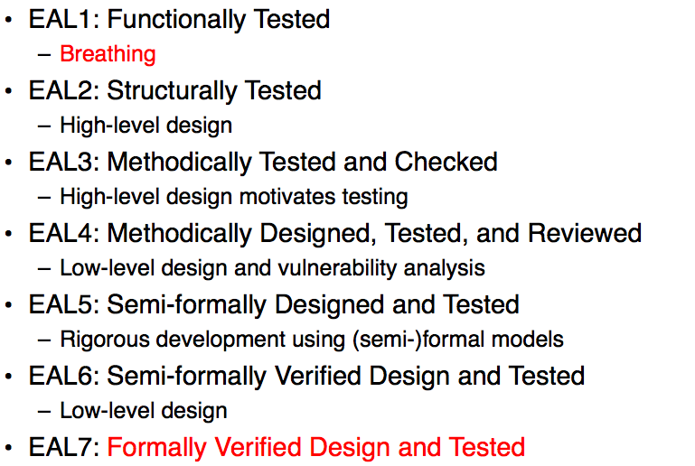
EAL Levels

Slide 16
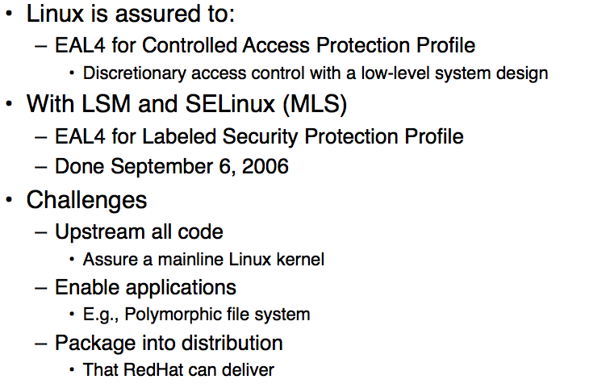
Common Criteria in Practice

Slide 17
Common Criteria in Practice
Solaris 10 with Trusted Extensions (MLS)
  Has been assured to EAL4+ for
  LSPP, CAPP, and RBAC
  Original Solaris was a C2 system, but is now EAL4 for CAPP and RBAC
Windows Server 2003 and XP are EAL4 (for CAPP)
  Windows 7 also aims for EAL4

Slide 18
Assurance Results
Is Assurance achieving its goals?
  Proving a system is “secure”
  Encouraging the development of more secure systems
Should we try something else?
  What?
  Can anything be automated?
  On code?

Slide 19
seL4

Slide 20
Take Away
VM Systems provide isolation
  At OS granularity: some can be untrusted
OS provides services used by applications
  Access to devices demultiplexed among VMs
Can we use VM isolation to prevent compromise of applications by OS compromise?
  Proxos: use a “trusted” OS and redirect service requests
  Overshadow: use OS as untrusted communication media

