Slide 1
Advanced Systems Security: Introduction
Trent Jaeger
Systems and Internet Infrastructure Security (SIIS) Lab
Computer Science and Engineering Department
Pennsylvania State University
January 13, 2011

Slide 2
Cross-site Scripting (XSS)
Aim: Get a client to run an attackers’ code at higher privilege (Privilege Escalation)
Attack details
  http://www.sans.org/top-cyber-security-risks/#tutorial
Resolutions
  Where are problems?
  Can we eliminate them?
This is our paradigm: penetrate-and-patch
  Alternatives?
Notes:
We know that we can translate program and system policies to information flow policy graphs.
Each node has an associated label. That label indicates security requirements for that node.
An information flow policy is a directed graph that shows the flows allowed by the policy. The nodes represent the subjects and objects that the policy rules and the edges represent the flows that are allowed between them

Slide 3
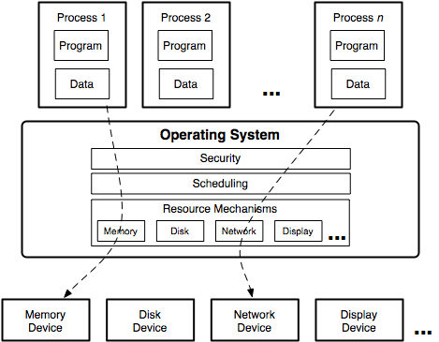
Operating Systems

Slide 4

Systems Enable Interaction
If it was solely about isolating processes, security would be easy
However, process interaction is fundamental to operating systems
  Interactions in XSS?
  How does OS manage?
  Other enforcement?
Challenge: ensure security goals are met given all means of interaction

Slide 5
Secure Operating System
Provides security mechanisms that ensure that the system’s security goals are enforced by trusted components despite threats from attackers
  Security goals?
  Trust model?
  Threats?
Can we build a truly secure operating system?
Notes:
Why are we interested in trusted programs?
Trusted programs are expected to only perform safe operations although they have permissions to perform unsafe operations.
As a consequence if trusted programs in a system do not work in the expected way, the system can not guarantee anything to other applications

Slide 6

Security Goals
Lots of unsatisfying definitions
  Users can perform only authorized operations (safety)
  Processes perform only their necessary operations (least privilege)
  Operations can only permit information to be written to more secret levels (MLS)
We’ll discuss these
  Defining practical and effective security goals is a difficult task

Slide 7

Trust Model
For operating system
  Trust model == TCB
What’s in a TCB?
What are we trusting?
  Aim: as little as possible
Notes:
Historically administrators just trusted those applications. Because there was no other option.
New tools are available that allow us to change that. Now we have security typed languages and user-level reference monitors. Those tools enable us to develop applications that enforce a given security policy.
We also have tools to express and enforce system policy.
So what we want to ensure that a trusted program complies with the security policy of the system on which it is going to run

Slide 8

Threat Model
Threats are means that an attacker can use to violate security goals
  Where do threats come from?
  What operations are possible via threats?
  What do threats threaten?
Secure OS (TCB) must protect processes against threats
  Is this sufficient?
Notes:
Informally it means that the application achieves its job, enforces the system policy and at the same time the application is protected by the system from other applications.
The figure summarizes our assumptions about program and system policy. They are required for us to evaluate compliance. Also we assume they are different.

Slide 9
Security Model Against XSS
Components
  Web server, Web client, Media player
  Client OS, Root processes, Attacker
Trust Model
  Which are trusted?
Threat Model
  What are threats?
Lots of (Possible) Goals
  Prevent unauthorized remote access, control user processes, prevent root escalation
Notes:
We know that we can translate program and system policies to information flow policy graphs.
Each node has an associated label. That label indicates security requirements for that node.
An information flow policy is a directed graph that shows the flows allowed by the policy. The nodes represent the subjects and objects that the policy rules and the edges represent the flows that are allowed between them

Slide 10
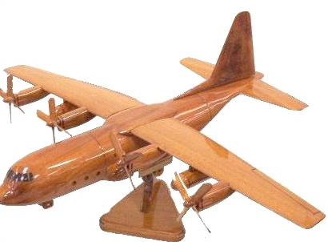
Effective Security Models
Can we develop an effective approach?
What security principles can we leverage?
Notes:
We know that we can translate program and system policies to information flow policy graphs.
Each node has an associated label. That label indicates security requirements for that node.
An information flow policy is a directed graph that shows the flows allowed by the policy. The nodes represent the subjects and objects that the policy rules and the edges represent the flows that are allowed between them

Slide 11
Trusted Computing Base
Historically, OS treats applications as black boxes
  OS controls flows among applications
  Security requirements determined by allowed flows
Appl
Appl
Appl
Operating System
Policy

Slide 12
Policy Enforcement in Apps
Appl
Application policy enforcement: databases, JVM, X Windows, daemons, browsers, email clients, servers
Policy
Appl
Appl
Operating System
Policy

Slide 13
Multi-Layered Enforcement
Appl
Policy
Appl
Appl
Operating System
Policy
Virtual Machine Monitors
Policy
Network

Slide 14

Network Layer
Network Access Control == Firewall
  Protect a network from external malice
    This is a beneficial view of the world
  But, is the internal network (hosts) ready for the approved messages?

Slide 15
Virtual Machine Layer
Key technology: Isolation
  We can isolate the bad stuff from one another!
How do we get a productive computation from isolated versions of bad stuff?
  E.g., How can we use VM isolation to improve security for web applications?
Notes:
Why are we interested in trusted programs?
Trusted programs are expected to only perform safe operations although they have permissions to perform unsafe operations.
As a consequence if trusted programs in a system do not work in the expected way, the system can not guarantee anything to other applications

Slide 16
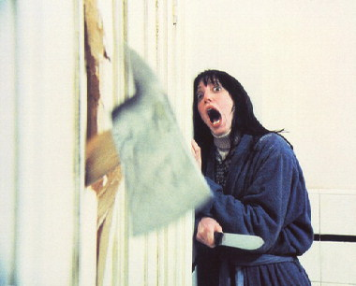
Application Layer
Do not trust applications
  Why not?
But, we need to depend on some application enforcement
  Many root processes
  Have more semantics
  May be able to break system
Cannot treat apps as black boxes anymore
Notes:
Historically administrators just trusted those applications. Because there was no other option.
New tools are available that allow us to change that. Now we have security typed languages and user-level reference monitors. Those tools enable us to develop applications that enforce a given security policy.
We also have tools to express and enforce system policy.
So what we want to ensure that a trusted program complies with the security policy of the system on which it is going to run

Slide 17
Security Enforcement
Several applications include access control
  Databases, window servers, web servers, browsers, …
Some programming systems include access control to system resources
  Java, Safe-Tcl, Ruby, Python, Perl – Jif, Flow Caml (information flow);
Some systems recognize that programs may contribute to access control
  User-level policy server for SELinux
  Integrity: CW-Lite, UMIP, PPI
  Distributed Information Flow Control (Flume, HiStar)
Requirement: Ensure that all layers are using their authority in a manner consistent with system security goals
Notes:
The features of our system meet the requirements of the reference monitor concept

Slide 18
Whose Responsible?
What should we expect from the parties involved in the computation?
  Programmers (may be multiple groups)
  OS Distributors
  Administrators
  Users
  Service Providers
  Content Providers
Notes:
Informally it means that the application achieves its job, enforces the system policy and at the same time the application is protected by the system from other applications.
The figure summarizes our assumptions about program and system policy. They are required for us to evaluate compliance. Also we assume they are different.

Slide 19
Programmers
What are their goals?
  Function
  Ease of distribution
  ??
Security Decisions
  Trust Model: themselves and OS (admin)
  Threat Model: interfaces (which?) and possible actions (?)
  Security Model+: test apps
Problems: testing is incomplete, deployment unknown
Notes:
Informally it means that the application achieves its job, enforces the system policy and at the same time the application is protected by the system from other applications.
The figure summarizes our assumptions about program and system policy. They are required for us to evaluate compliance. Also we assume they are different.

Slide 20
OS Distributors
What are their goals?
  Usable configuration
  Lots of people can use
  ??
Security Decisions
  Trust Model: OS and system TCB
  Threat Model: installation, untrusted code, network
  Security Model+: test OS and confine apps
Problems: broken TCB programs, non-std configs
Notes:
Informally it means that the application achieves its job, enforces the system policy and at the same time the application is protected by the system from other applications.
The figure summarizes our assumptions about program and system policy. They are required for us to evaluate compliance. Also we assume they are different.

Slide 21
Administrators
What are their goals?
  Function
  Ease of management
  ??
Security Decisions
  Trust Model: VMM and OS (some)
  Threat Model: network
  Security Model+: firewall
Problems: testing is incomplete, deployment unknown
Notes:
Informally it means that the application achieves its job, enforces the system policy and at the same time the application is protected by the system from other applications.
The figure summarizes our assumptions about program and system policy. They are required for us to evaluate compliance. Also we assume they are different.

Slide 22
Users
What are their goals?
  Function
  Function
  ??
Security Decisions
  Trust Model: entire system
  Threat Model: what threats?
  Security Model+: ignore some dialog boxes, spam, …
Problems: too many security decisions at runtime
Notes:
Informally it means that the application achieves its job, enforces the system policy and at the same time the application is protected by the system from other applications.
The figure summarizes our assumptions about program and system policy. They are required for us to evaluate compliance. Also we assume they are different.

Slide 23
Put It Together
How do we define what is necessary (for success)?
How do we define enforcement for individual layers comprehensively?
How do we compose the enforcement of all the layers into a coherent security architecture?
How do we prove success?
How do we do it without much (any) user intervention?
Is this enough?
Notes:
Informally it means that the application achieves its job, enforces the system policy and at the same time the application is protected by the system from other applications.
The figure summarizes our assumptions about program and system policy. They are required for us to evaluate compliance. Also we assume they are different.

Slide 24
Take Away
Identify core security approach
  Goals, trust model, threat model
Map these to the system components
  What software must be enlisted in the trust model
Enable participants to customize, refine security in practical ways
  Requires understanding of security model and functionality

