Slide 1
Advanced Systems Security:
Program Information
Flow Control
Trent Jaeger
Systems and Internet Infrastructure Security (SIIS) Lab
Computer Science and Engineering Department
Pennsylvania State University
April 7, 2011

Slide 2
Problem
A program is trusted to enforce a system’s policy
  How do we know?
Integrity models don’t cover this
UMIP, CW-Lite don’t evaluate entire program
So what can we do?
Notes:
This slide illustrates the way our approach works.

Slide 3
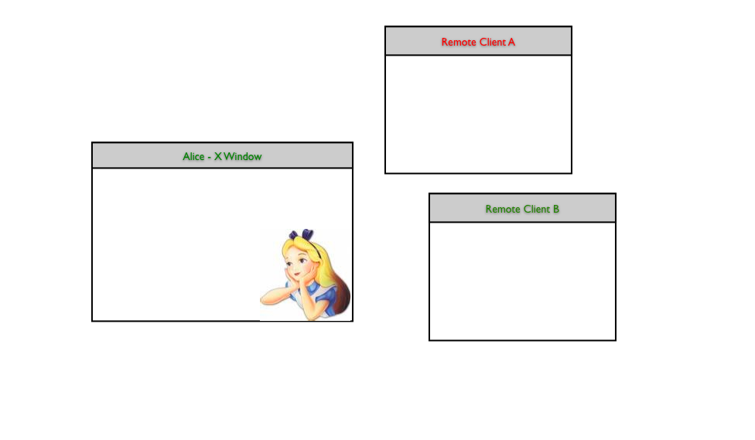
Problem
Notes:
This slide illustrates the way our approach works.

Slide 4
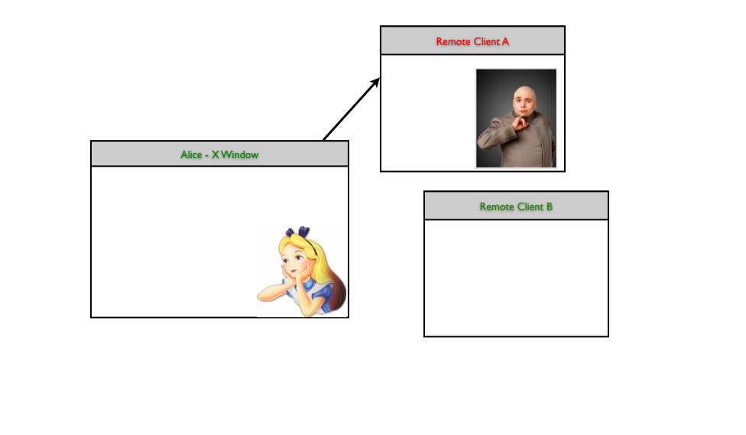
Problem
Notes:
This slide illustrates the way our approach works.

Slide 5
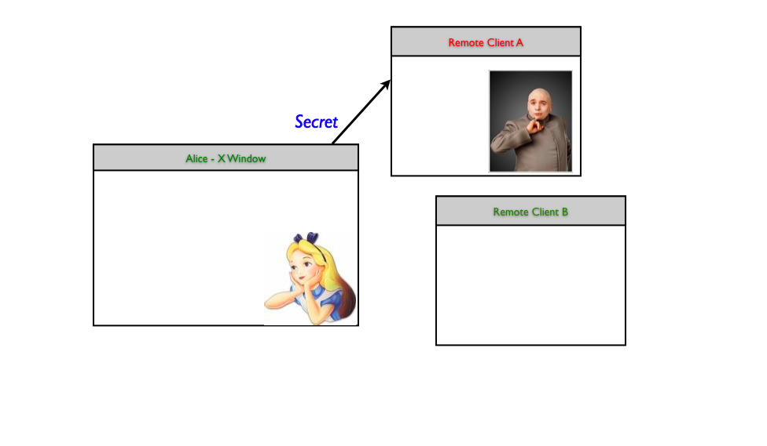
Problem
Notes:
This slide illustrates the way our approach works.

Slide 6

Problem
Notes:
This slide illustrates the way our approach works.

Slide 7
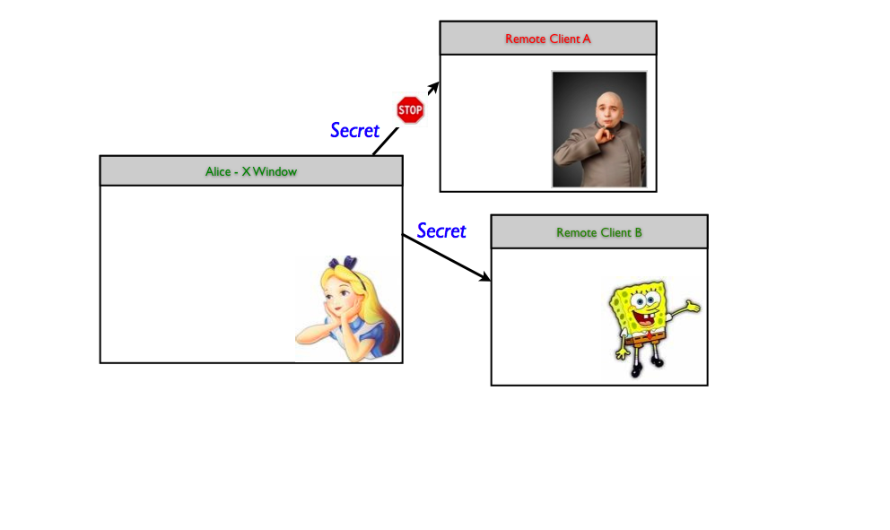
Problem
Notes:
This slide illustrates the way our approach works.

Slide 8
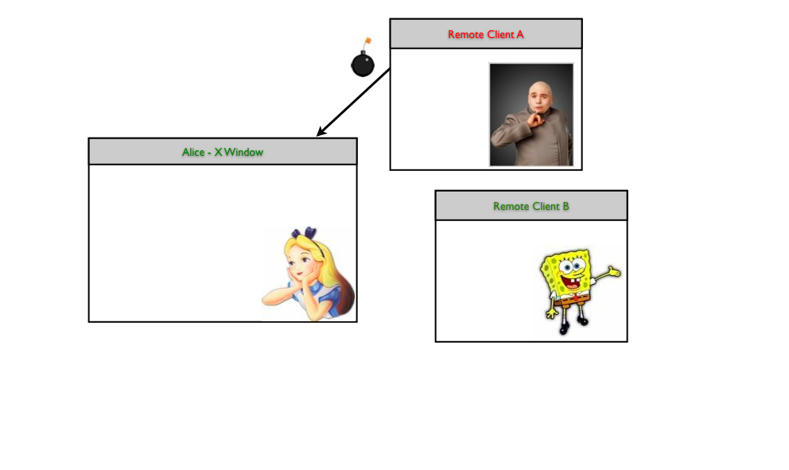
Problem
Notes:
This slide illustrates the way our approach works.

Slide 9
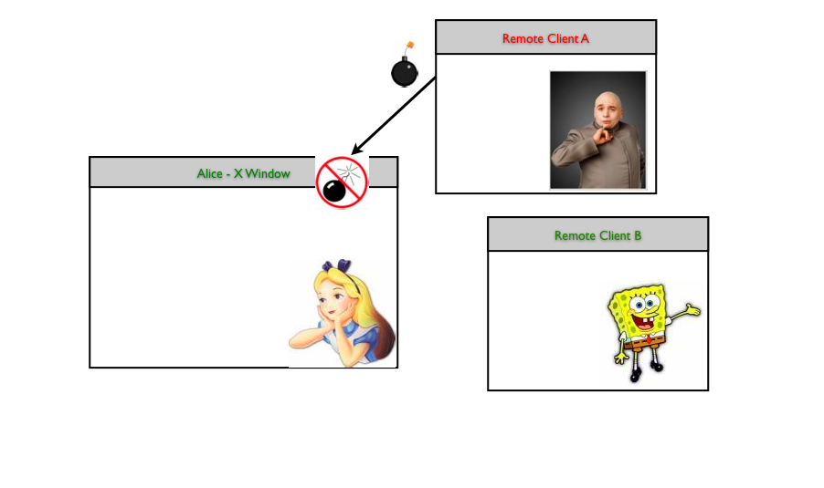
Problem
Notes:
This slide illustrates the way our approach works.

Slide 10
What’s a Program?
Program parts
  Instructions, Variables, Control Ops, Procedures, Arguments, System calls/Library calls (sources/sinks)
What does a program look like from a security perspective?
  Variables have data (may have secrecy/integrity reqs)
  Variable values may come from external sources
  Variable values may be assigned to one another
  Variables may be written out of the program (sink)
Notes:
This slide illustrates the way our approach works.

Slide 11
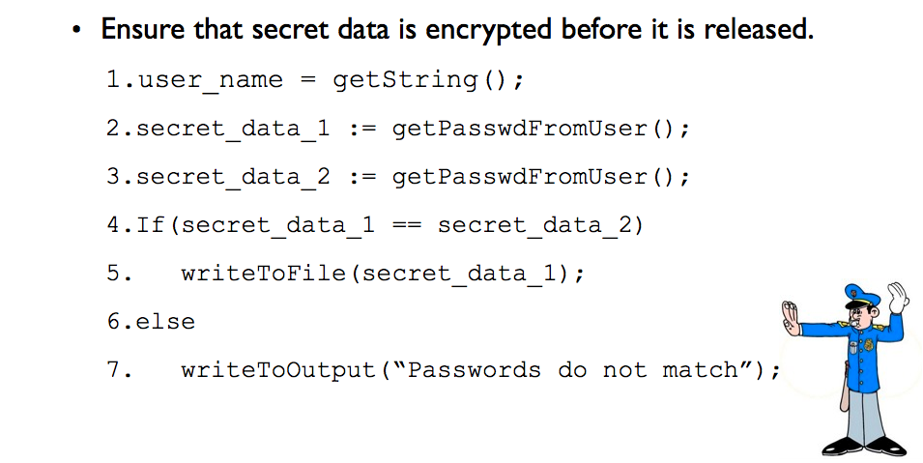
What’s a Program?
Notes:
This slide illustrates the way our approach works.

Slide 12
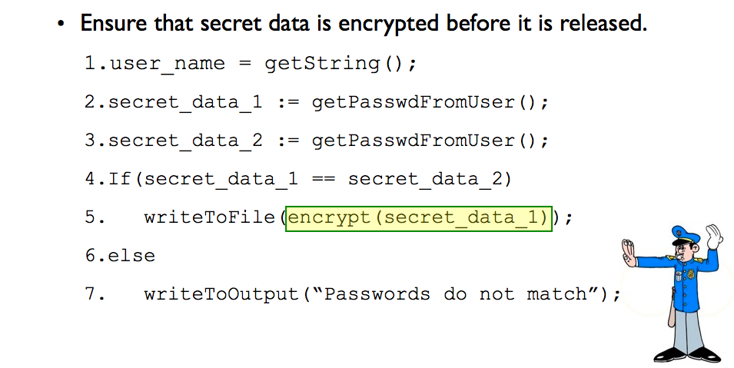
What’s a Program?
Notes:
This slide illustrates the way our approach works.

Slide 13
It’s the Data Flow!!
Data input to a program may have security requirements
  E.g., it is secret
The program operations enable the data to “flow” through the program
  Track each variable’s label (based on the data it’s seen)
Enforce a data security requirements on information flows
  Can that data be sent out to a file?
Can connect OS/VM and program enforcement

Slide 14
Concepts
Attach security labels to program data
Enable static checking of information flows
  Compatible with Denning’s model
  Only a program with legal information flows will compile
Programmers can declassify labels
  Upgrade integrity
  Downgrade secrecy
Remove restrictions
  Label polymorphism
  Run-time label checking

Slide 15
Denning’s Lattice Model
Formalizes information flow models
  FM = {N, P, SC, , }
Shows that the information flow model instances form a lattice
  N are objects, P are processes,
  {SC, } is a partial ordered set,
  SC, the set of security classes is finite,
  SC has a lower bound,
  and  is a lub operator
Implicit and explicit information flows
Semantics for verifying that a configuration is secure
Static and dynamic binding considered
Biba and BLP are among the simplest models of this type

Slide 16
Implicit and explicit flows
Explicit
  Direct transfer to b from a (e.g., b = a)
Implicit
  Where value of b may depend on value of a indirectly (e.g., if a = 0, then b = c)
Model covers all programs
  Statement S
  Sequence S1, S2
  Conditional c: S1, …, Sm
Implicit flows only occur in conditionals

Slide 17
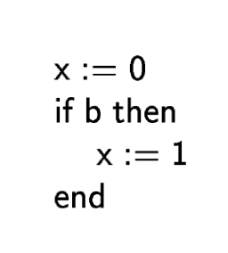
Preventing Implicit Flows
Hard to do without static analysis
Consider code fragment
Assume b is more sensitive than x
With a runtime check
  x=1, then b is obviously leaked, but not if x=0
Need a static analysis to detect

Slide 18
Static and Dynamic Binding
Static binding
  Security class of an object is fixed
  This is the case for BLP and Biba
  This is the case for most system models
Dynamic binding
  Security class of an object can change
  For b = a, then the security class of b is b  a
  E.g., High-water mark secrecy, LOMAC, IX, …

Slide 19
Semantics
Program is secure if:
  Explicit flow from S is secure
  Explicit flow of all statements in a sequence are secure (e.g., S1; S2)
  Conditional c: S1, …, Sm is secure if:
    The explicit flows of all statements S1, …, Sm are secure
    The implicit flows between c and the objects in Si are secure

Slide 20
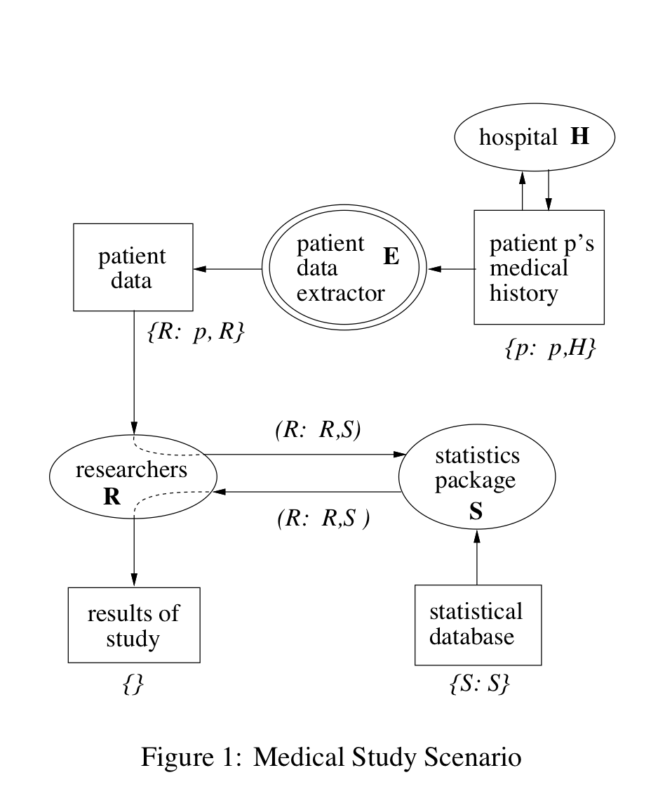
Example

Slide 21
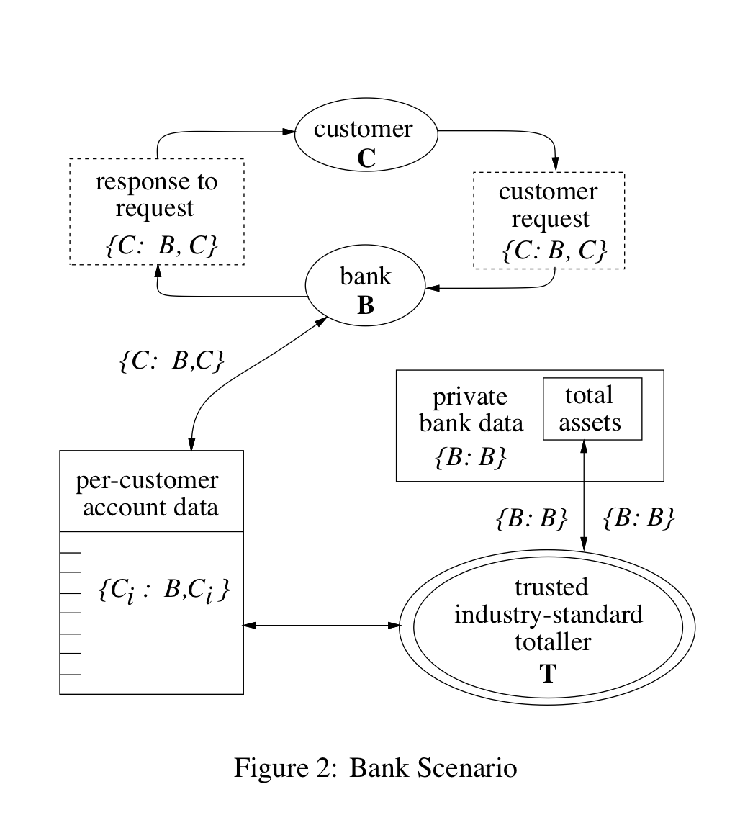
Example

Slide 22
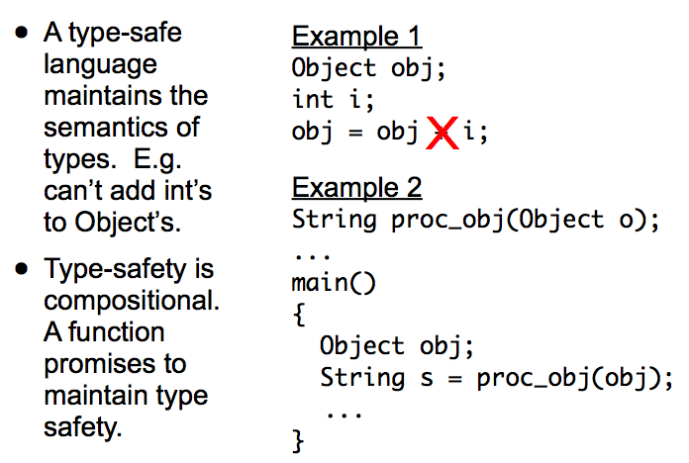
Type Safety

Slide 23
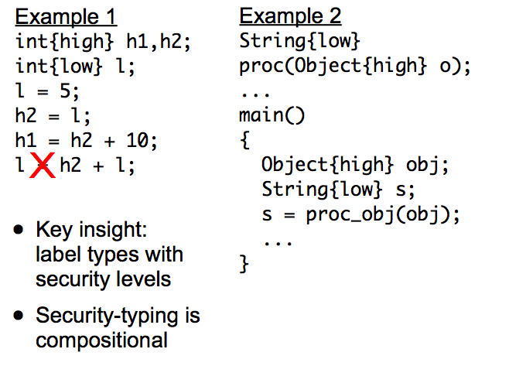
Security Types

Slide 24
Decentralized Label Model
Labels have owners and readers
  Owner: whose data was observed to generate value
  Reader: principals allowed by an owner to read
  Readers are specified by each owner
Label representation
  L = {o1: r1, r2; o2: r2, r3}
Channel
  Values are written to output channels
  Each channel has a set of readers
Effective Readers
  Intersection of all reader sets of the label
  Effective readers of L are {r2} because only it can read from o1 and o2
Act for
  Readers can “act for” others, using their permissions
Semantics
  A value can be written to a channel only if each channel reader has authority to act for some effective reader for the value

Slide 25
Relabeling Semantics
Basics
  Assignment causes a relabel of value
  Default is restriction according to *-property
    A new label contains the owners of the old, but same or fewer readers
Declassification semantics
  An authority for an owner can
    Remove that owner
    Add readers for that owner

Slide 26
Combination Semantics
Join (e.g., multiply 2 numbers)
  Assign value of label L to variable with value of label L’ results in a join of L and L’
  Least restrictive combination
  Least upper bound
  Union owners and intersect readers
Meet (dual of join):
  Most restrictive label that can apply to each input for join to be possible
  Greatest lower bound
  Both sets of owners, union of readers per owner?
  Requires refinement of unknowns

Slide 27
Label Hierarchies
Acts-for defines a hierarchy
  HMO acts-for A
  B acts-for doctors
  Secret acts-for classified
Labels as flows -- Forms an information flow lattice
Constraints
  Reader constraint: flows contain (o, r) and r’ acts-for r, then set contains (o, r’)
  Owner constraint: flows contain (o,r) and o’ acts-for o, then set contains (o’, r)
    Or flow set does not contain (o’, r) and o’ acts-for o, then set does not contain (o, r)

Slide 28
Example
Hierarchy
E acts for p:
Changes owner to R
Declassify
R removes p and adds reader S

Slide 29
Example
Access
C controls its own data
Hierarchy
T acts for C:
T removes Ci from owner

Slide 30
Language Support
Java Information Flow (Jif) has runtime and compilers
  Several applications of Jif have been developed
Challenge: labeling and error resolution
  How do you annotate data with security?
  How do you fix errors?
    Many occur due to implicit flows
Research in automatic retrofitting of programs with security type annotations and mediation

Slide 31
Take Away
Programs may have the authority to protect security-sensitive data
  OS may allow them to access data with multiple security requirements
Program data flows for the basis for reasoning about how program authority is used
  Can secrets flow to public objects? Can untrusted data flow to trusted?
Denning model defines secure information flow
DLM model generalizes to arbitrary policies

Slide 32
Sound relabeling
Based on static hierarchy (actsFor)
Claim: cannot use static correctness
Example:
  L1={docs: pA; B: pA, pB}
  L2={docs: docs, pA; B: pA, pB}
If B => docs
  L2={docs: pA; B: pA, pB} -- B overrules docs
If pB => docs at runtime
  L1={docs: pA, pB; B: pA, pB} -- pB is allowed by B
  Inconsistent

Slide 33
Sound and complete relabeling
Choices
  A reader may be dropped from some owner’s reader set
  A new owner may be added with a reader set
  A reader may be added when it actsFor an existing reader in reader set
  An owner may be replaced by an owner that actsFor it
This is all the sound relabelings
What does this mean in the previous case?

Slide 34
Meet Semantics Clarified
Most restrictive label that can be relabeled to both
  For inference
Join of all pairwise components
  Unrelated owners ==> { }
  Related owners ==> o’ actsFor o
    {o: r1, r2} meet {o’: r3, r4} = {o: r1, r2, r3, r4}

