Slide 1
Advanced Systems Security:
Trusted Computing
Trent Jaeger
Systems and Internet Infrastructure Security (SIIS) Lab
Computer Science and Engineering Department
Pennsylvania State University
April 14, 2011

Slide 2
Problem
My computer is running a process
It makes a request to your computer
  Asks for some secret data to process
  Provides an input you depend on
How do you know it is executing correctly?
Example
  ATM machine is uploading a transaction to the bank
  How does the bank know that this ATM is running correctly, so the transaction can be considered legal?
Notes:
This slide illustrates the way our approach works.

Slide 3
What would you do?
Nothing
Proof by authority (Certificates)
  Tells you who, but not what
Constrain the system (Secure Boot)
  Effective limiting, but proof is implied
Inspect the runtime state (Authenticated Boot)
  Flexible, attestable, but difficult to prove semantics

Slide 4
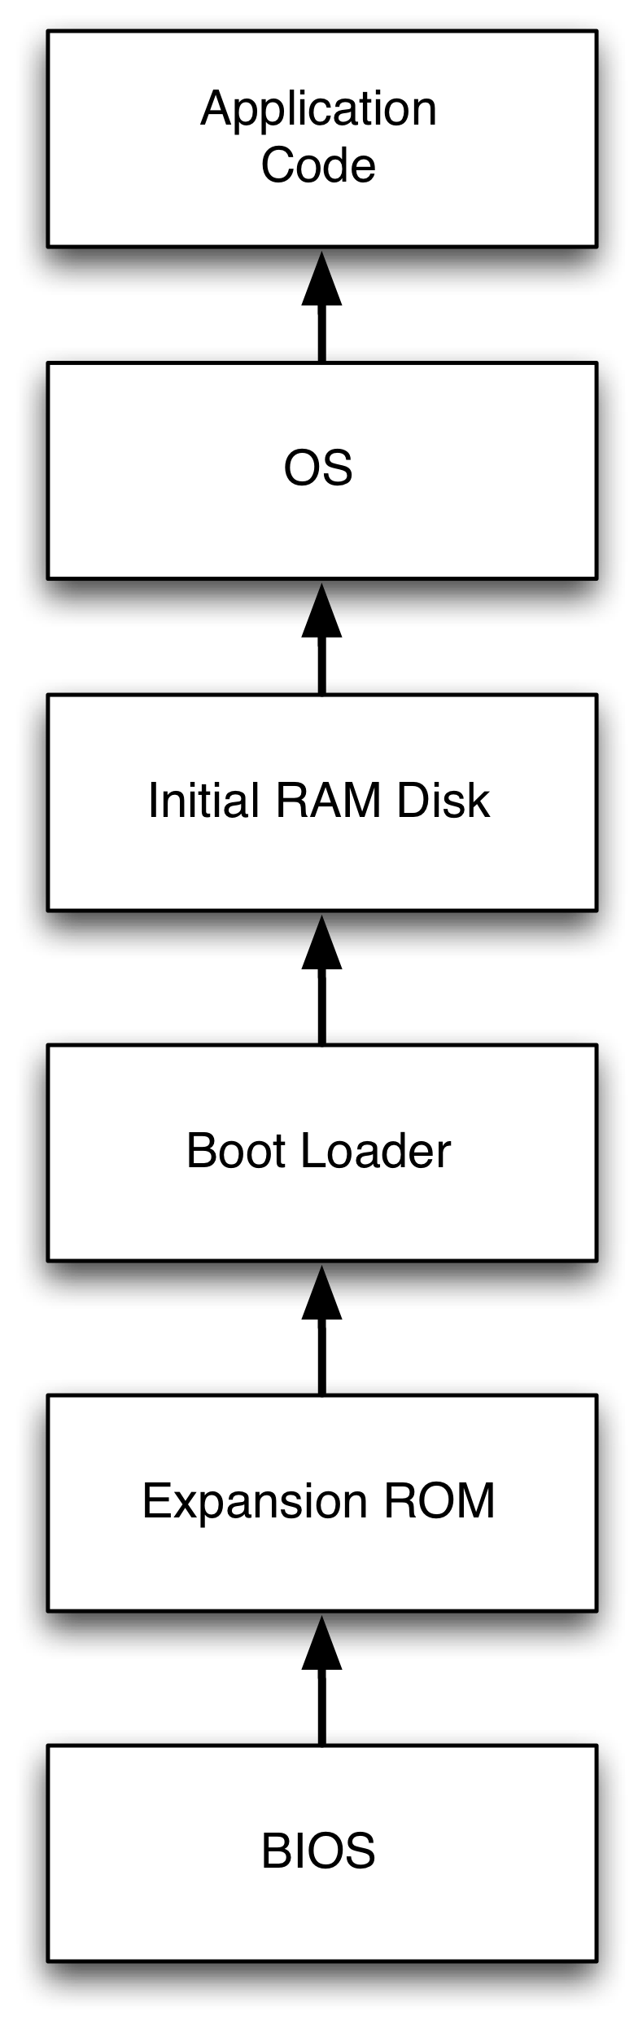
Secure Boot
Check each stage in the boot process
  Is code that you are going to load acceptable?
  If not, terminate the boot process
Must establish a Root-of-Trust
  A component trusted to speak for the correctness of others
  Assumed to be correct because errors are undetectable
Notes:
This slide illustrates the way our approach works.

Slide 5
AEGIS
AEGIS architecture (1997)
  ROM checks the BIOS
  BIOS checks expansion ROMs and boot block
  Boot Loader checks the OS
Why not just boot from a floppy (DVD now)?
Is this a root of trust?
What can it verify?
How do we know it booted securely?

Slide 6
Authenticated Boot
Secure boot enforces requirements and uses special hardware to ensure a specific system is booted
  Implied verification (Good because it is)
By contrast, we can measure each stage and have a verifier authenticate the correctness of the stage
  Verifier must know how to verify correctness
  Behavior is uncertain until verification
  Can you verify yourself?
What is our root-of-trust?
Notes:
This slide illustrates the way our approach works.

Slide 7
Trusted(?) Computing
The Trusted Platform Module (TPM) brought authenticated boot into the main stream
Essentially, the TPM offers few primitives
  Measurement, cryptography, key generation, PRNG
  Controlled by physical presence of the machine
  BIOS is Core Root of Trust for Measurement (CRTM)
Spec only discussed how to measure early boot phases and general userspace measurements

Slide 8
Authenticated Boot
  A lot of FUD and hate was generated around what it does and does not do
Palladium/NGSCB architecture (Microsoft, 2002)
  Use virtualization to split system
  Measure the “trusted” part to prove its integrity before responding
“Meet the emerging requirements of an interconnected world” -- Microsoft
Take over the world – Ross Anderson and others
Notes:
This slide illustrates the way our approach works.

Slide 9
Linux Integrity Measurement
Problem: How can we verify the software environment of networked systems?
Solution: Extend TPM measurement architecture to measure system’s runtime (Software Stack)
Additional Goals
  Load-time integrity
  Unobtrusive
  Tamper-evident
  Usability

Slide 10
Limitations
What does IMA prove?
Can a system with a valid IMA attestation be malicious?
What else can be done to improve attestations?

Slide 11
Outbound Authentication
Applied to the IBM 4758 by Smith (ESORICS 2002, Int J Inf Security 2004)
Goals: Securely boot the 4758 and prove to remote parties (combines secure boot and attestation)
More specifically, relying party P wants to prove that only entity E holds key K
  E is high integrity despite depending on several integrity-relevant events (e.g., boot and upgrade)
Defines a precise logic for reasoning about such properties
  But, the 4758 is a very limited system (one application)
Notes:
Describe this model

Slide 12
IBM 4758
“A relying party needs to conclude that a particular
key pair really belongs to a particular software entity within a particular untampered coprocessor.”
Why does this prove the integrity of the processing environment?
What is needed to make this connection between the key and entity’s correctness?
IBM 4758 Secure coprocessor contains various hardware protections to isolate memory, manage keys, and perform updates.

Slide 13
Configurations and Epochs
A Layer N configuration is the maximal period in which that layer is run-able, with an unchanging software environment in Layers 1, …, N
A Layer N epoch is the maximal period in which the layer can run and accumulate state.
Software runs for an epoch, but any change to the software (integrity-relevant event) results in a new configuration
  Hardware constrains these events
What are other integrity-relevant events in conventional systems?
Notes:
dependency - == integrity - need a practical, comprehensive model

Slide 14
Execution History
E wishes to prove it “owns” K by presenting a
Chain(E, K, H) of certificates
  H shows the chain of entities that certify E’s K before the current run R.
  The chain speaks for the correctness of K, which the relying party P should trust.
Implications: Only these entities should have access to the secrets and configuration of E
  Hardware limits the set of integrity-relevant operations that can affect E
  General purpose systems allow more operations
Notes:
history - lots of events of general - must ensure integrity in general purpose - enforce

Slide 15
Dependency (Integrity)
Each entity E has a dependency set D(E)
  An entity E depends on entities that have read/write access to its secrets and write access to its code
    In general purpose systems, it is primarily dependence on untrusted data that leads to integrity problems
TrustSet(P) – set of entities that P trusted
  TrustSet(P) should be a superset of the measured dependencies
Implications
  Dependency must be comprehensively defined
    Initialization, Code Load, Subsequent Reads
Notes:
dependency - == integrity - need a practical, comprehensive model

Slide 16
Validation
P wants to verify E depends only on its TrustSet(P)
  A run R, prefixed by H, defines an entity’s D_{R}(E)
  Hardware protections imply D_{R}(E)
  If D_{R}(E) is in P’s trust set, then the chain is valid
OA requires an entity E’s dependencies satisfy the trust set of P to validate that E owns K
Notes:
validate - push on relying party -- ad hoc -- remove with detailed base and enforcement protocol

Slide 17
Validation Implications
  Difficult for P to verify all entities, integrity relevant events, and dependencies
      We just want a green light (iTurtle)
  Enforcement simplifies the protocol
      OA makes this seem easy, but has a lot of constraints to simplify the problem

Slide 18
Take Away
Programs on systems may be security-critical
  How do we determine if they are up to the task?
Secure and authenticated boot processes enable a party to prove a system’s integrity satisfies some requirements
  Secure boot proves to local parties
  Authenticated boot for remote parties
OA provides secure boot and authenticate boot for comprehensive control – of a simple device
IMA provides authenticated boot for Linux

Slide 19
IMA Implementation
Place hooks throughout Linux kernel
  Later added as an LSM and then special LIM hooks
Extend TPM PCR at file load-time
  PCR = SHA1(File || PCR)
Applications instrumented to measure inputs
  Bash scripts, interpreters…
Verifying all events is difficult
  Need known “good” values to validate measurements
  Leverage OS distribution definitions

