Slide 1
Advanced Systems Security:
Trusted Computing
Trent Jaeger
Systems and Internet Infrastructure Security (SIIS) Lab
Computer Science and Engineering Department
Pennsylvania State University
April 20, 2010

Slide 2
Problem
My computer is running a process
It makes a request to your computer
  Asks for some secret data to process
  Provides an input you depend on
How do you know it is executing correctly?
Example
  ATM machine is uploading a transaction to the bank
  How does the bank know that this ATM is running correctly, so the transaction can be considered legal?
Notes:
This slide illustrates the way our approach works.

Slide 3
Secure Boot
Check each stage in the boot process
  Is code that you are going to load acceptable?
  If not, terminate the boot process
AEGIS architecture (1997)
  ROM checks the BIOS
  BIOS checks expansion ROMS and boot block
  Bootloader checks the OS
Why not just boot from a floppy (DVD now)?
  Is this a root of trust? What can it verify?
Notes:
This slide illustrates the way our approach works.

Slide 4
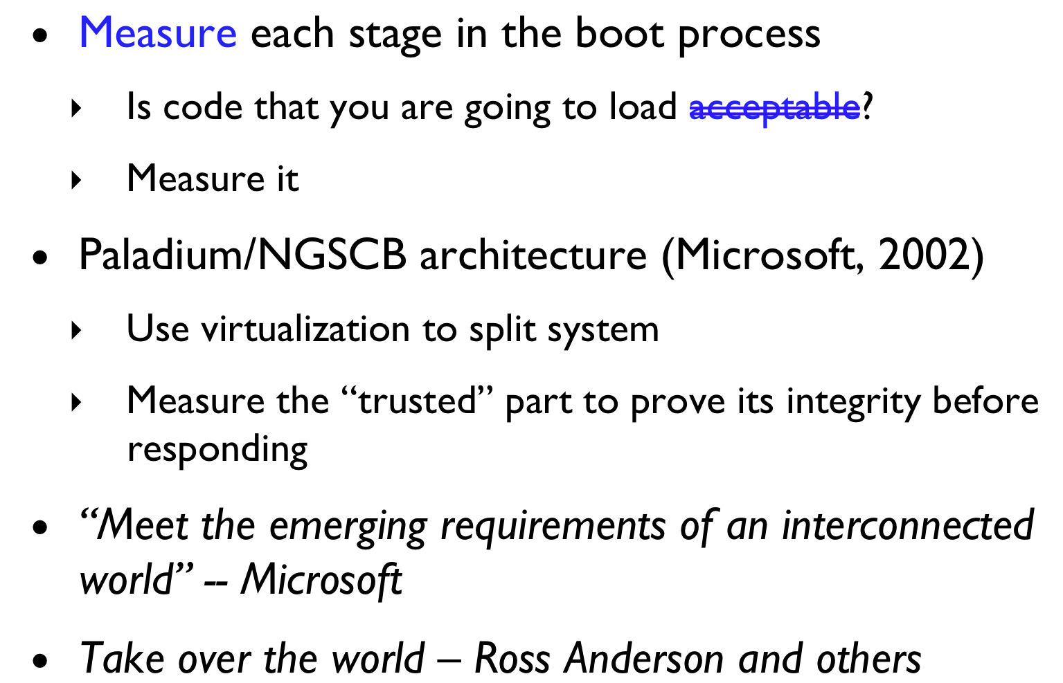
Authenticated Boot
Notes:
This slide illustrates the way our approach works.

Slide 5
Authenticated Boot
Can show the video here
TC is not discussed in 543
Notes:
This slide illustrates the way our approach works.

Slide 6
Secure v Authenticated Boot
Secure boot enables you to tell if your machine is secure
  But remote parties cannot tell
Authenticated boot enables remote parties to tell if your machine is secure
  But you cannot tell by looking at it
Some combination would be necessary
Notes:
This slide illustrates the way our approach works.

Slide 7
Outbound Authentication
Applied to the IBM 4758 by Smith (ESORICS 2002, Int J Inf Security 2004)
Goals: Securely boot the 4758 and prove to remote parties (combines secure boot and attestation)
More specifically, relying party P wants to prove that only entity E holds key K
  E is high integrity despite depending on several integrity-relevant events (e.g., boot and upgrade)
Defines a precise logic for reasoning about such properties
  But, the 4758 is a very limited system (one application)
Notes:
outbound auth - secure boot, measure, logic (no integrity model not distribution)

Slide 8
Configurations and Epochs
A Layer N configuration is the maximal period in which that layer is runnable, with an unchanging software environment in Layers 1, …, N
A Layer N epoch is the maximal period in which the layer can run and accumulate state.
Software runs for an epoch, but any change to the software (integrity-relevant event) results in a new configuration
  Hot update, complete reinstall, …
What are other integrity-relevant events in conventional systems?
Notes:
dependency - == integrity - need a practical, comprehensive model

Slide 9
Execution History
History H is a sequence of computation on device
  Define the entity E wishes to prove it “owns” K by presenting a Chain(E, K, H) of certificates
    H is the history before the run
    Then, measure the run R
  Does the entity own a key? It is certified to based on a history, then consider the run
Implications
  In 4758, events are few (load one of 4 layers), upgrade layer
    Large number of integrity-relevant events in conventional systems
Notes:
history - lots of events of general - must ensure integrity in general purpose - enforce

Slide 10
Dependency (Integrity)
Each entity E has a dependency set D(E)
  An entity E depends on entities that have read/write access to its secrets and write access to its code
    In general purpose systems, it is primarily dependence on untrusted data that leads to integrity problems
TrustSet(P) – set of entities that P trusted
  TrustSet(P) should be a superset of the measured dependencies
Implications
  Dependency must be comprehensively defined
    Initialization, Code Load, Subsequent Reads
Notes:
dependency - == integrity - need a practical, comprehensive model

Slide 11
Validation
D(E) subset-eq TrustSet(P) ➔ Validate(P, Chain(E, K, H))
  OA requires that an entity E’s dependencies satisfy the trust set of P to validate that E owns K
    Difficult for P to determine this for all E and all integrity relevant events
Implications
  P must validate everything
    But, we don’t want to – we just want a green light (iTurtle)
Notes:
validate - push on relying party -- ad hoc -- remove with detailed base and enforcement protocol

Slide 12
Linux Integrity Measurement

Slide 13
Take Away
Programs on systems may be security-critical
  How do we determine if they are up to the task?
Secure and authenticated boot processes enable a party to prove a system’s integrity satisfies some requirements
  Secure boot proves to local parties
  Authenticated boot for remote parties
OA provides secure boot and authenticate boot for comprehensive control – of a simple device
IMA provides authenticated boot for Linux

