Slide 1
Advanced Systems Security:
Web Security
Trent Jaeger
Systems and Internet Infrastructure Security (SIIS) Lab
Computer Science and Engineering Department
Pennsylvania State University
April 22, 2010

Slide 2
Problem
The Internet
  World-wide Web enabled anyone anywhere to talk
What happens next?
Notes:
This slide illustrates the way our approach works.

Slide 3
What the Web Means to Me
Server Side
Web Server is a portal to a wide variety of application content
  Web server design needs to be as general as possible
  Otherwise, it would limit application developers
  But, this means that the web server is like an OS for the web applications
But is it?
Notes:
This slide illustrates the way our approach works.

Slide 4
What the Web Means to Me
Client Side
Web Client is a portal to a wide variety of application content
  Web client design needs to be as general as possible
  Otherwise, it would limit application developers
  But, this means that the web client is like an OS for the web applications
But is it?
Notes:
This slide illustrates the way our approach works.

Slide 5
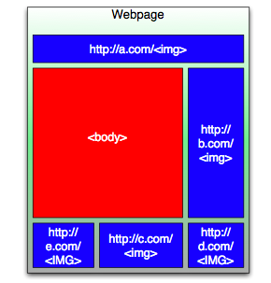
Web Server Systems
They started out so simple
Servers produced static content on demand
Clients render the content (no executable content)
Notes:
outbound auth - secure boot, measure, logic (no integrity model not distribution)

Slide 6
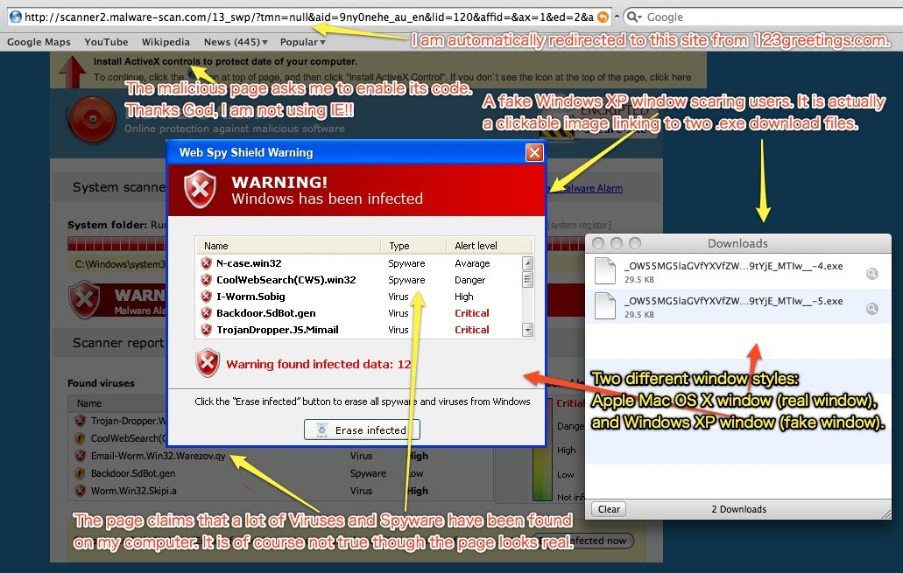
Web Server Systems
Then things got complicated
Web servers compute dynamic contents
And offload some of the computation to the client
Notes:
outbound auth - secure boot, measure, logic (no integrity model not distribution)

Slide 7
Web Server Systems
Server-side
Receives input
  From anyone in the world
Submits it to a web application component
  Processing defined by others
Which may or may not protect itself from malicious input
  But, web applications may have valuable data (your credit card numbers)
What then…
Notes:
outbound auth - secure boot, measure, logic (no integrity model not distribution)

Slide 8
Web Server Systems
Client-side
Receives input
  From anyone in the world
Some input is executable
  Often, not clear what
So, need to find and isolate execution
  Except when executables need to interact
  Need a policy to describe this (Same-origin policy)
What then…
Notes:
outbound auth - secure boot, measure, logic (no integrity model not distribution)

Slide 9
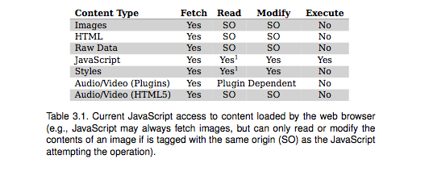
Same Origin Policy
Notes:
outbound auth - secure boot, measure, logic (no integrity model not distribution)

Slide 10
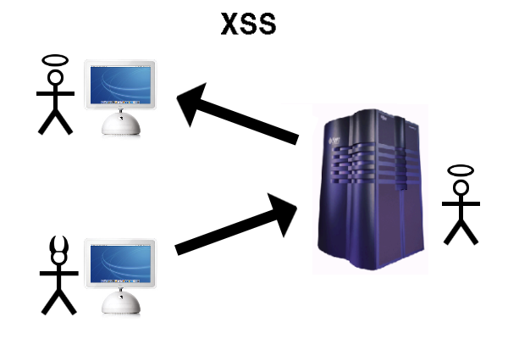
Some Web System Bugs
Cross-site scripting
Server receives malicious input, which it distributes to clients (as if from itself)
  Web application does not adequately sanitize
Same-origin policy does not prevent – why not?
Notes:
outbound auth - secure boot, measure, logic (no integrity model not distribution)

Slide 11
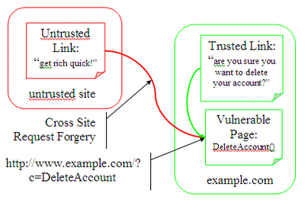
Some Web System Bugs
Cross-site request forgery
Malicious (or compromised) server sends malicious content to client
  That tries to trick the user to interact with a target
Same-origin policy does not prevent – why not?
Notes:
outbound auth - secure boot, measure, logic (no integrity model not distribution)

Slide 12
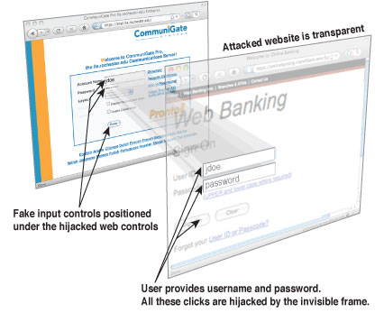
Some Web System Bugs
Clickjacking
Malicious (or compromised) server sends malicious content to client
  That generates web requests to a target
Same-origin policy does not prevent – why not?
Notes:
outbound auth - secure boot, measure, logic (no integrity model not distribution)

Slide 13
Reference Monitor with MPS
OK, so we can solve all problems with a reference monitor
  What is missing here?
But, we need to enforce an MPS
  What is missing wrt that?
Other problems?
  Hint: Not exactly satisfying Biba integrity
Notes:
outbound auth - secure boot, measure, logic (no integrity model not distribution)

Slide 14
Securing Your Web Server
2001: http://windows.stanford.edu/docs/IISsecchecklist.htm
2005: http://www.petefreitag.com/item/505.cfm
2010: http://krebsonsecurity.com/2010/01/firm-to-release-database-web-server-0days/
Notes:
This slide illustrates the way our approach works.

Slide 15
Saner
Problem: Web applications perform mission critical tasks, are accessible to attackers, and are built with ad hoc input validation
  What integrity principles does this violate?
Solution: More principled input validation
Lessons: Overall approach and techniques
Notes:
dependency - == integrity - need a practical, comprehensive model

Slide 16
A Saner Approach
Model the way that the application processes input values
Check that model (statically) to identify likely errors in sanitization
Use a runtime technique to verify legitimate errors in sanitization
Notes:
history - lots of events of general - must ensure integrity in general purpose - enforce

Slide 17
Approaches
Static taint checking
Approach: Identify tainted sources and see whether they flow to sinks that require them to be untainted
Identify tainted sinks
  Label a program variable or expression (e.g., with a type)
Identify untainted sinks
  Label a program variable, expression, or function arg (e.g., with a type incompatible with tainted data)
Type checking detects incompatibility
Notes:
dependency - == integrity - need a practical, comprehensive model

Slide 18
Problems_x0018__x0013__x0013_
Static taint checking problems
Sinks have different requirements for sanitization
  Just changing from tainted to untainted is not expressive enough
  E.g., Protecting data structure integrity does not prevent SQL injection
Identifying operations that do sanitization in code
  Some are well-known
  But, some are custom
Check sinks to identify whether malicious inputs reach based on sanitization operations
Notes:
dependency - == integrity - need a practical, comprehensive model

Slide 19
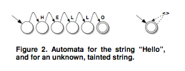
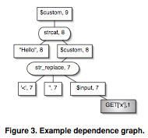
Their Approach: Static
Use automata to represent an arbitrary set of strings
  Represent value and which parts are tainted
Find dependence among variables
Notes:
validate - push on relying party -- ad hoc -- remove with detailed base and enforcement protocol

Slide 20
Their Approach: Static
Postorder traversal of the dependence tree
Combine string automata based on descendants
  Known function behaviors are modeled as precisely as possible to generate new automata
  Unknown function behaviors generate “any string” of either type tainted or untainted
    Former if any input is tainted
Tricky to deal with cycles

Slide 21
Their Approach: Dynamic
Static analysis may generate false positives
  Is conservative, so some executions may be assumed that are not really possible
Use runtime analysis to validate statically found positives
  Which part to run? In what initial state?
Generate runtime inputs and see if they cause problems
  How to generate the runtime inputs?

Slide 22
Their Approach: Dynamic
Build the sanitization graph
  Interprocedural data flow graph
    Build summary functions of each procedure’s data flow and connect
  Keep only nodes relevant to sanitization
    String operations
    Sanitization functions
Build a test suite of strings
  For SQL injection and XSS attacks

Slide 23
Saner Summary
Method for bug finding
  Specific to language, domain, sanitizers, known attacks
Compare to CFI, DFI
Compare to UMIP, CW-Lite

Slide 24
Browsing Problems
Problems in browsers
  Script Attacks
    XSS, XSRF, Clickjacking, …
  Plugins and extensions
Symantec Report (2007)
  Internet Explorer: 93 security vulnerabilities; Mozilla: 74, Safari: 29; and Opera: 9
  301 reported vulnerabilities in browser plugins

Slide 25
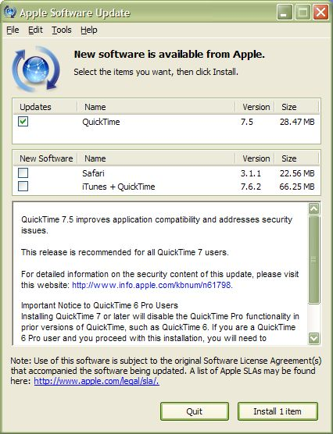
Plugins and Extensions

Slide 26
Browser Plugins
Allow browsers to view additional mime types
  Loaded as a DLLs or shared objects
  Communicate with the browser via a well-defined API
Run in the same address space as the browser
    Complicates security as they are given unchecked access to browser internals
    Successful attack on a plugin can lead to a full system compromise

Slide 27
Modify Existing Browsers
Script Accent
  Domain specific “accents” for scripts and HTML object names
    “An Analysis of Browser Domain-Isolation Bugs and A Light-Weight Transparent Defence Mechanism” - Shuo Chen et al. - CCS 07
Dynamic Tainting
  Track flow of sensitive information inside the web browser
    “Cross Site Scripting Prevention with Dynamic Tainting and Static Analysis” - Phillip Vogt et al. – NDSS 07
Different isolation policy
  Enforces access using server’s X.509 certificates and keys
    Locked Same-origin Policies - Chris Karlof et al. - CCS 07
    Same-origin Mutual Authorization – Oda et al. – CCS 08

Slide 28
OP Principles
Strong isolation between browser components
  Prevents unanticipated and unaudited interactions
Simple and explicit communication between components
  Explicit interfaces reduce number of control flow paths
Monitor components to ensure faithful execution
  Delegate some security logic
Compatible with existing technologies
  Goal is to secure web browsing
Result: Reference Monitoring for a Browser

Slide 29
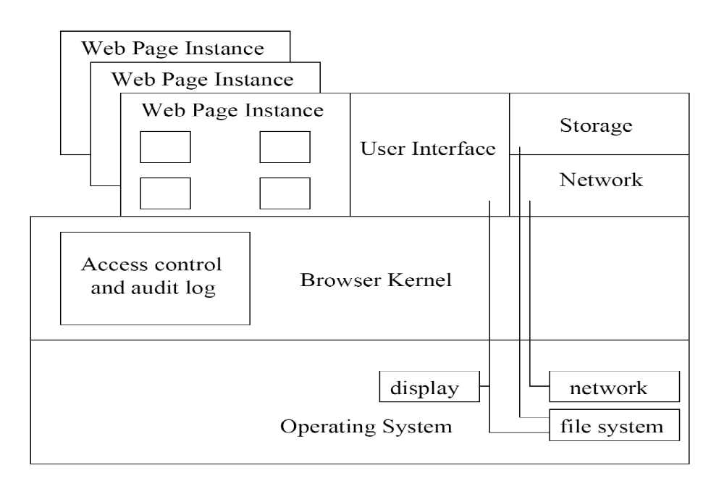
OP Architecture

Slide 30
Browser Kernel
Manage subsystems
  Creates and deletes all processes and subsystems
    Creates web-page instances on demand
  Manages communication between subsystems
    interposes on all message communication (via pipes)
Manages access control
  Browser processes tagged with a security context
  Tag depends on initial messages intercepted
Maintains detailed security audit log

Slide 31
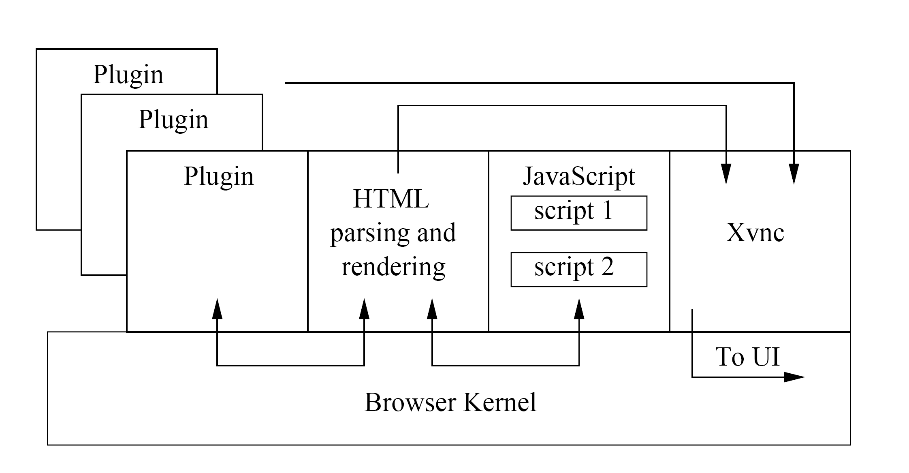
Web Page Subsystem

Slide 32
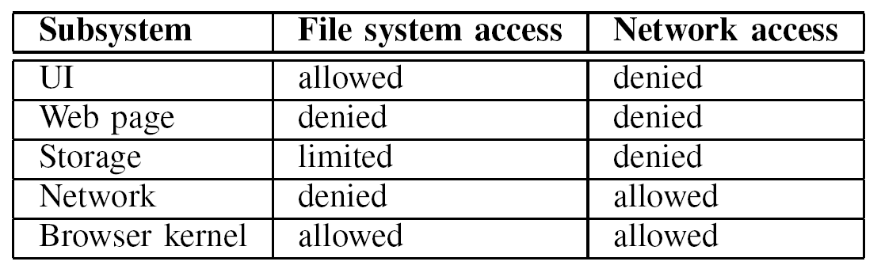
Subsystem Privileges

Slide 33
OP and Plugin Security
Plugin Security Policies
  Provider domain policy
    allows a plugin in a page to use the permissions of the plugin content source
  Plugin freedom policy
    allows additional outgoing network accesses for plugins to support peer-to-peer applications
    can only talk to network and storage subsystems

Slide 34
Formal Verification
OP browser modeled using Maude (reasoning engine)
  Both interpreter and language
Formally specify browser components in terms of invariants over finite space
  Program invariants include access control policies
  Visual invariants include UI tampering
    Address bar spoofing
Maude checks for states that violate invariants

Slide 35
Chrome Browser

Slide 36
VM-based Browser Arch
Also, may use virtual machines as protection boundaries
Tahoma
  Each VM has a browser that may access URLs specified by the server for which the initial page was downloaded
FlowwolF
  Each VM has a browser that may access URLs based on the label of the VM
    URLs are labeled like files by a “URL mapper”
  Also, the browser tabs implement DLM

Slide 37
Take Away
Web systems are just another operating environment for applications
  Except they enable anyone in the world to participate
Claim: They need enforcement to satisfy reference monitor concept with an MPS
  They don’t satisfy that
Major problem: the requirement for interaction with untrusted parties
  Sanitization of inputs in ad hoc
  Saner provides a testing mechanism for that

