Slide 1
Advanced Systems Security: Principles
Trent Jaeger
Systems and Internet Infrastructure Security (SIIS) Lab
Computer Science and Engineering Department
Pennsylvania State University
January 18, 2011

Slide 2
XSS Problems
Web browser/Media player
  Failure to identify malicious input
  Failure to filter malice from input
Operating system
  Failure to confine media player (HTTPS backdoor)
  Failure to limit access to/of root processes (not in TCB?)
TCB process
  Failure to filter malicious input
Failure to prevent malicious function at several stages

Slide 3
Authorization and Authentication
Authentication
  Def: Verifying someone or something’s identity
  E.g., XSS content and media player code
Authorization
  Def: Deciding whether a subject can perform a requested operation on an object
  Deciding whether the media player can read content
Combination
  Authentication is performed for authorization

Slide 4

Protection System
Manages the access control policy for a system
  Security goal
It represents
  Protection state
  Protection state operations
It describes what operations each subject (via their processes) can perform on each object

Slide 5
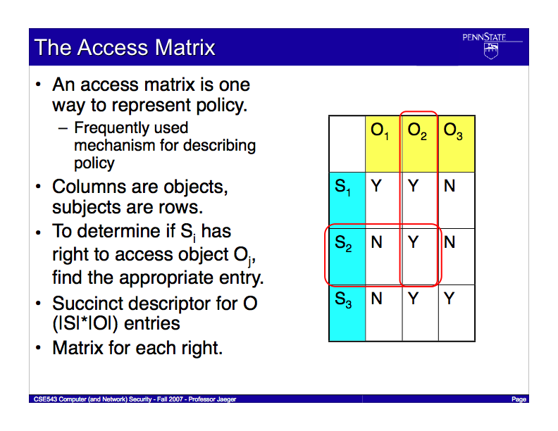
Protection State
Notes:
We have an additional requirement. For a program policy and a system policy to be compliant the system policy must protect application components.

Slide 6
Access Matrix Protection System
Protection State
  Current state of matrix
Can modify the protection state
  Via protection state operations
  E.g., can create subjects and objects
  E.g., owner can add a subject, operation mapping for their objects
Lampson’s “Protection” paper
  Can even delegate authority to perform protection state ops
Notes:
We realized that the requirements we defined for our system are also the requirements of a Reference Monitor

Slide 7
XSS Problems
Protection system approach is inadequate
Web application/Media player
  Can access any web object (no labeling)
  Like creating a new file in p-state with default rights for that user (modify p-state)
Operating system and TCB
  Media player runs as user (does anything user can do)
  Including access to root processes (change passwd?)
  Root processes are not confined (any can break system)
What do we need to achieve necessary controls?

Slide 8
Define and Enforce Goals
Claim: If we can define and enforce a security policy that ensures security goals, then we can prevent such attacks
How do we know the policy expresses effective goals?
  Will look into this in depth later
How do we know the enforcement mechanism will enforce policy as expected?
  Look into this today

Slide 9
Mandatory Protection System
Is a protection system that can be modified only by trusted administration that consists of
  A mandatory protection state where the protection state is defined in terms of a set of labels associated with subjects and objects
    Label set is defined by trusted administration
  A labeling state that assigns system subjects and objects to those labels in the mandatory protection state
  A transition state that determines the legal ways that subjects and objects may be relabeled
MPS is immutable

Slide 10
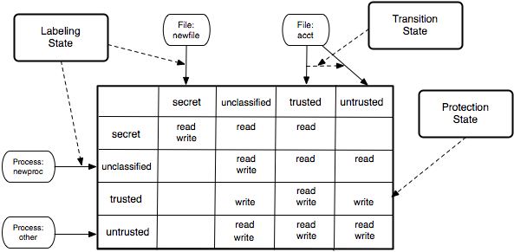
Mandatory Protection System
Notes:
Problem to test compliance.

Slide 11
Mandatory Protection State
Immutable table of
  Subject labels
  Object labels
  Operations authorized for former upon latter
MPS for OS
  Media player process can only read from browser and write to file system (in safe place)
  No network access
MPS restricts media player to operations based on its label (trusted vs untrusted input)

Slide 12
Labeling State
Immutable rules mapping
  Subjects to labels (in rows)
  Objects to labels (in columns)
Labeling State of OS
  Browser, Media Player have own subject labels
  Label inputs from network (network connection)
  Root and TCB program files have labels based on their trust
Defines requirements for determining labels of all objects

Slide 13
Transition State
Immutable rules mapping
  Subject labels to conditions that change their subject labels
  Object labels to conditions that change their object labels
Transition State of OS
  Change label of processes that receive untrusted input
  Change label of files that receive secret input
Transition State of Programs
  Server, Browser, Media Player may be trusted to change their labels (down only?)

Slide 14
Managing MPS
Challenge
  Determining how to set and manage an MPS in a complex system involving several parties
Parties
  What does programmer know about deploying their program securely?
  What does an OS distributor know about running a program in the context of their system?
  What does an administrator know about programs and OS?
  Users?

Slide 15

Reference Monitor
Purpose: Ensure enforcement of security goals
  Mandatory protection state defines goals
  Reference monitor ensures enforcement
Every component that you depend upon to enforce your security goals must be a reference monitor

Slide 16
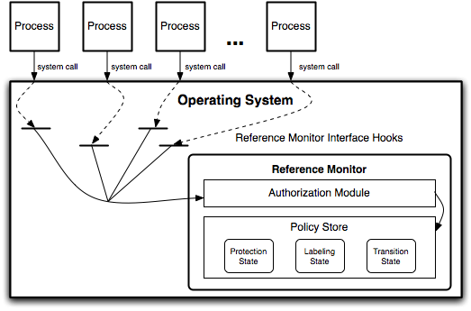
Reference Monitor
Components
  Reference monitor interface (e.g., LSM)
  Authorization module (e.g., SELinux)
  Policy store (e.g., policy binary)

Slide 17
Reference Monitor Guarantees
Complete Mediation
  The reference validation mechanism must always be invoked
Tamperproof
  The reference validation mechanism must be tamperproof
Verifiable
  The reference validation mechanism must be subject to analysis and tests, the completeness of which must be assured
Notes:
We propose an approach to solve the problem of relating two policies.
This approach is based on some simple observations.

Slide 18
Complete Mediation
Every security-sensitive operation must be mediated
  What’s a “security-sensitive operation”?
  Operation that enables a subject of one label to access an object that may be a different label
How do we validate complete mediation?
  Every such operation must be identified
  Then we can check for dominance of mediation
Mediation: Does interface mediate?
Mediation: On all resources?
Mediation: Verifably?
Notes:
This slide illustrates the way our approach works.

Slide 19
Tamperproof
Prevent modification by untrusted entities
  Interface, mechanism, policy of reference monitor
  Code and policy that can affect reference monitor mods
How to detect tamperproofing?
  Transitive closure of operations
  Challenge: Often some untrusted operations are present
Tamperproof: Is reference monitor protected?
Tamperproof: Is system TCB protected?
Notes:
This slide illustrates the way our approach works.

Slide 20
Verification
Test and analyze reference validation mechanism
  And tamperproof dependencies
  And what security goals the system enforces
Determine correctness of code and policy
  What defines correct code?
  What defines a correct policy?
Verifiable: Is TCB code base correct?
Verifiable: Does the protection system enforce the system’s security goals?
Notes:
This slide illustrates the way our approach works.

Slide 21
Evaluation
Mediation: Does interface mediate?
Mediation: On all resources?
Mediation: Verifably?
Tamperproof: Is reference monitor protected?
Tamperproof: Is system TCB protected?
Verifiable: Is TCB code base correct?
Verifiable: Does the protection system enforce the system’s security goals?
Notes:
This slide illustrates the way our approach works.

Slide 22
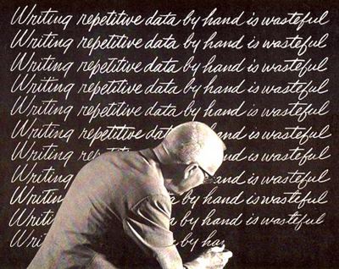
Multiple Reference Monitors
The reference monitor concept approach was designed with a centralized reference validation mechanism in mind
  What about the case where there are several such mechanisms grouped together?

Slide 23
Take Away
Mandatory Protection System
  Means to define security goals that applications cannot impact
Reference Monitor Concept
  Requirements for a reference validation mechanism that can correctly enforce an MPS
  NOTE: This will be a major focus of this course
Until we come up with coherent approach to defining MPS and validating reference monitor guarantees, we will continue to have insecure systems
  That is the challenge of systems security research

