Slide 1
Advanced Systems Security:
Multics
Trent Jaeger
Systems and Internet Infrastructure Security (SIIS) Lab
Computer Science and Engineering Department
Pennsylvania State University
January 20-25, 2011

Slide 2

Common Knowledge
Paraphrase
  If people just used Multics, we would be secure
  UNIX and Windows are insecure
What is the basis for these statements?

Slide 3

Secure OS Requirements
Mandatory Protection System
Implemented by a Reference Monitor

Slide 4
Evaluation Criteria
Mediation: Does interface mediate?
Mediation: On all resources?
Mediation: Verifably?
Tamperproof: Is reference monitor protected?
Tamperproof: Is system TCB protected?
Verifiable: Is TCB code base correct?
Verifiable: Does the protection system enforce the system’s security goals?
Does Multics satisfy these?
Notes:
This slide illustrates the way our approach works.

Slide 5
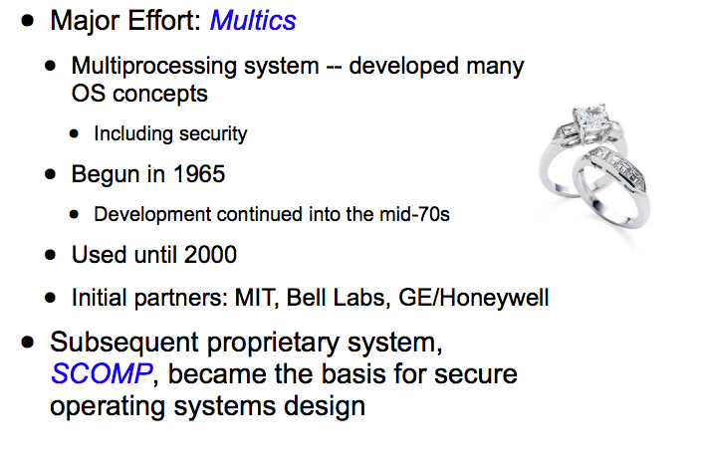
Multics

Slide 6
Multics Security
What were the security goals for Multics?
  Evolved as the system design evolved
  First system design to consider such goals
Secrecy
  Prevent leakage – even if running untrusted code
Integrity
  Prevent unauthorized modification – layers of trust
Comprehensive control (enforce at lowest level)

Slide 7
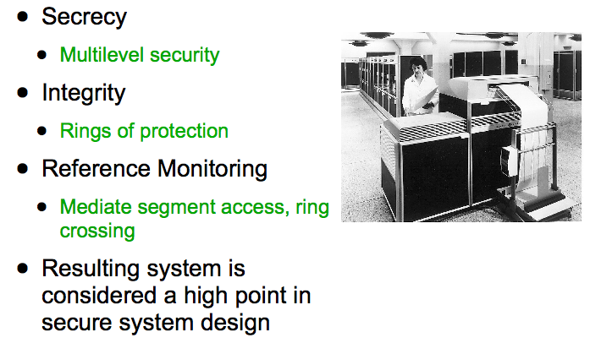
Multics Security

Slide 8
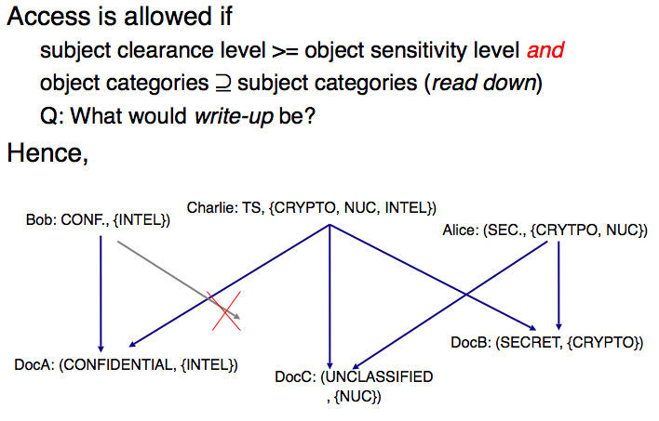
Multilevel Security
Subject clearances and object sensitivity levels
  And categories (need to know)
Read access (simple security property)
  clearance >= level
  subject categories are a superset of object categories
Write access is opposite (*-security property)
sjahdjasdakldflkadfjkadjfadkfjXJCJC

Slide 9
MLS Secrecy
Prevent leakage
  Suppose a top-secret process includes a Trojan horse
  A Trojan horse is a program which performs a useful function and a malicious function
Can the top-secret Trojan horse leak top-secret data to a secret process?
  Why not?
We will cover this in detail later

Slide 10
MLS as MPS
Is MLS a Mandatory Protection System?
Protection State:
  Labels are fixed
  Information flows defined and fixed
Labeling State:
  Subjects login at a label
  Objects are labeled at creation (according to MLS rules)
Transition State:
  No transitions of secrecy (covert channels)

Slide 11
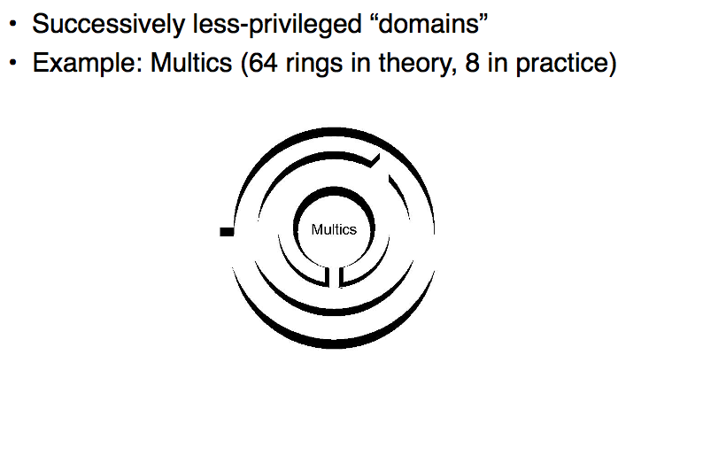
Protection Rings

Slide 12
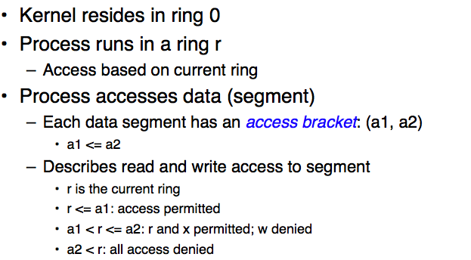
Ring Brackets

Slide 13
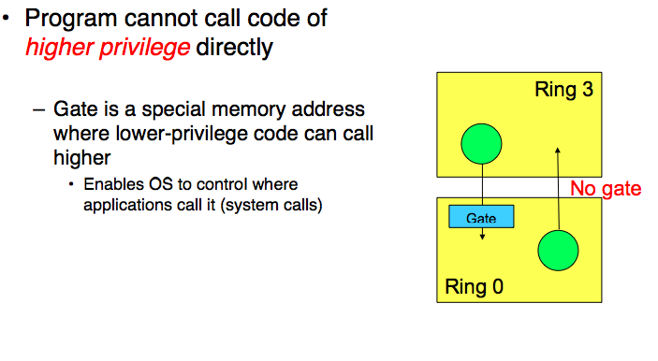
Process Invocation

Slide 14
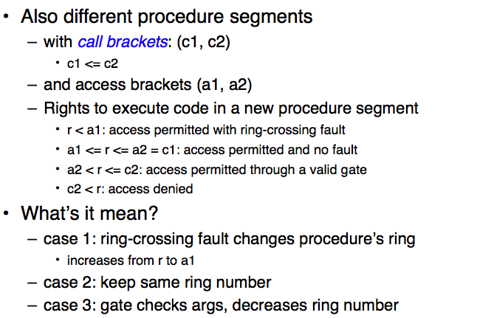
Procedure Invocation Brackets

Slide 15
Brackets Examples
Authorized or not?
Process in ring 3 accesses data segment
  access bracket: (2, 4)
  What operations can be performed?
Process in ring 5 accesses same data segment
  What operations can be performed?
Process in ring 5 accesses procedure segment
  access bracket (2, 4) and call bracket (4, 6)
  Can call be made? How do we determine the new ring? Can new procedure segment access the data segment above?

Slide 16
Brackets as MPS
Are brackets a Mandatory Protection System?
Protection State:
  Rings are fixed in a hierarchy
  Protection state can be modified by owner
Labeling State:
  Ring determined statically
  Owner can change object’s ring
Transition State:
  Thru call brackets (guarded by gates)

Slide 17
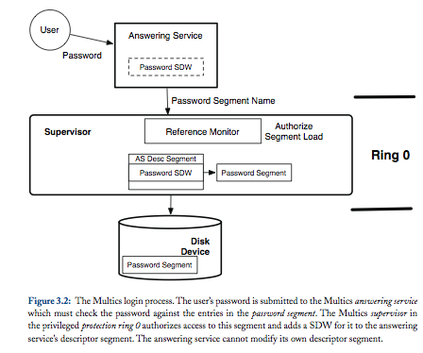
Multics Reference Monitor

Slide 18
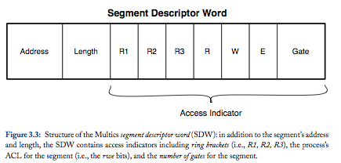
SDW Format
Process uses SDW to access a segment
  Directory stores a mapping between segments and secrecy level
  Each segment has a ring bracket specification
    Copied into SDW
  Each segment has an ACL
    Authorized ops in RWE bits

Slide 19
SDW Examples
Authorized or not?
Secrecy
  Clearance of process secret
  Access class of segment confidential
Brackets
  Process in ring 2
  Access bracket (2-3); Call bracket (4-5)
Access control list
  RWE

Slide 20
Multics Reference Monitor
Mediation
  Security-sensitive operations on segments
  All objects are accessed via a named hierarchy of segments
    Predates file system hierarchies; other objects?
Tamperproofing
  Reference monitor is part of the kernel ring
  Minimize dependency on software outside kernel
Verifiability
  Lots of code
  MLS for secrecy and rings for integrity (not mandatory)

Slide 21
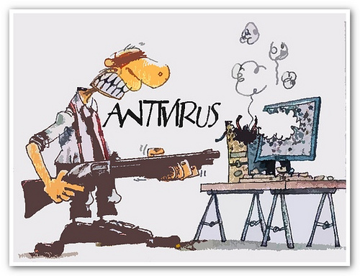
So How Secure?
So, Multics fails to meet reference monitor concept guarantees – is that so bad?
  Still possible to configure integrity (if TCB cannot be compromised)
  There’s a lot of code and complex concepts, but we can handle it
  Right?

Slide 22
Vulnerability Analysis
Background
  Evaluation of Multics system security 1972-1973
  Roger Schell and Paul Karger
    Schell: security kernel architecture, GEMSOS; architect of Orange Book
    Karger: capability systems, covert channels, virtual machine monitors
Criteria: Multics is “secureable” (1.3.3)
  Based on security descriptor mediation
  Ring protection

Slide 23
Vulnerability Analysis
Criteria details
  Look for Multics vulnerabilities
  Is reference monitor practical for Multics?
  Identify necessary security enhancements
  Determine scope of a certification effort
Logistics
  At MIT (developers/users) + At Rome ADC (Air Force users)
  Honeywell 645 running a Multics system (old HW)

Slide 24
Other Design Details
Master Mode
  Procedures used in ring 0 to run privileged function
    What are these analogous too in modern systems?
  “Pseudo-operation code” at location 0 in ring 0
    Start at a well-known location
  Test the entry point for validity
    Only run known function from known locations
Avoid trying to run privileged code that may be impacted by users

Slide 25
Vulnerability Analysis
Section 3
Findings:
  Design is sound, implementation is ad hoc
  Vulnerabilities in hardware, software and procedures
Conditions
  ½ time – find one vulnerability per area; “not exhaustive or systematic”
  Use system in standard way
  Extract information w/o detection
Change access fields in SDW, add trapdoor, get passwd, etc

Slide 26
Hardware Vulnerability
Run the system for a long time
  Didn’t crash, but
  Found one undocumented instruction and one vulnerability
Indirect Addressing
  Address provided includes the actual address to use
  Mechanism only checked the first address
Result
  Bypass access checking (complete mediation)

Slide 27
Hardware Vulnerability
How to attack?
  Execute instruction with RE access in first segment
  Object instruction in word 0 of second segment with R permission
  Word for reading or writing in a third segment
  Third segment must already be in the page table
Access checks for third segment are ignored
  Do whatever to contents on this third segment
Motivate need for correctness to be verified

Slide 28
Software Vulnerability
Master mode vulnerability
  Run privileged code with ring 0 perms
  Requires a trap to ring 0
  Expensive as some privileged operations occur frequently (page faults)
Change: Handle a page fault without a transition
  Justification: It has a restricted interface
  But inputs not checked
Bingo – Be careful regarding the security impact of performance improvements

Slide 29
Software Vulnerability
What developers did wrong?
  Move the master mode signaller to run in same ring as caller
  Signaller needs access to a privileged register
  Should audit this code (not done)
How to use?
  Specify 0 to n-1 entry points for master mode
  Out of bounds – transfers to mxerror
  Mxerror believes that a register points to signaller, but register can be modified by user (still in user’s ring)

Slide 30
Other Software Problems
Argument validation
  Check only direct args
Crash system from user space arbitrarily
Assume that a register always had a value with same semantics
  Then it was changed, but not all code was updated
  Could then plant a trapdoor (until next reboot)
Others and carry over to new hardware

Slide 31
Procedural Vulnerabilities
Procedural Attacks
  Tamper with the configuration of the reference validation mechanism and its dependencies
A variety of attacks (many still used)
  Patch utility
  Forge identity
  Modify password file
  Hide existence of malware

Slide 32
Final Kernel Report
Resultant system: two major problems (1974)
  Complex
    54K LOC of code touched by hundreds of programmers
      Compare to today’s systems
  Security mechanisms were ad hoc
    Multiple mechanisms, some overlapping semantics
Security kernel design is possible
  Tackle later

Slide 33
Multics Issues
Main goals
  Simplify the Multics supervisor
  Simplify security model
Is it feasible to…
  Audit a kernel implementation?
  Make a usable security model?
  Make security with acceptable performance?
Answer: still working on these today…

Slide 34
Project Plan
In this case:
Use MLS (Bell-La Padula model) for security
  What about integrity?
Parallel efforts of design and implementation for the new supervisor
  To enable audited implementation
  Use language that enables verification for kernel implementation
    We’ll examine this in the context of seL4 later
We’ll get back to – discuss security kernels

Slide 35
Results
Explore structure and dependencies
  Layered architecture
  Vs. interdependent components
Reduce size
  Many things in supervisor don’t need privilege
  “Privilege separation” – hard to do automatically
  Did reduce supervisor to 28K LOC
Performance
  Looked at memory management – not much change

Slide 36
Evaluation Criteria
Mediation: Does interface mediate correctly?
  Mediates on object references
  But some indirection via directory for MLS labels
Mediation: On all resources?
  All objects are segments
  What would happen if network was introduced?
Mediation: Verifiably?
  Uh, working on it
  Some use complex formats, so such verification is required
Notes:
This slide illustrates the way our approach works.

Slide 37
Evaluation Criteria
Tamperproof: Is reference monitor protected?
  In supervisor, with trusted code
  Access via gates and master mode in controlled way (mostly)
Tamperproof: Is system TCB protected?
  Managed by brackets
  Can modify brackets; moved master mode code out of ring 0
Verifiable: Is TCB code base correct?
  Trying to verify
  Didn’t verify (did later, but not fully)
Verifiable: Does the protection system enforce the system’s security goals?
  Not an MPS

Slide 38
Take Away
Multics originated the development of a “secure operating system”
  Real attempts were made to achieve reference monitor guarantees and provide a mandatory protection system (e.g., MLS)
However, it is not easy to satisfy reference monitor guarantees, even when you try
  Especially, if your system maintainers are not trying
And if you are not trying to enforce RM guarantees
  You won’t have anything close (UNIX and Windows)

