Slide 1
Advanced Systems Security:
Ordinary Operating Systems
Trent Jaeger
Systems and Internet Infrastructure Security (SIIS) Lab
Computer Science and Engineering Department
Pennsylvania State University
February 3, 2010

Slide 2
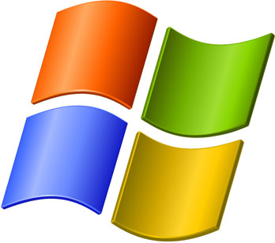
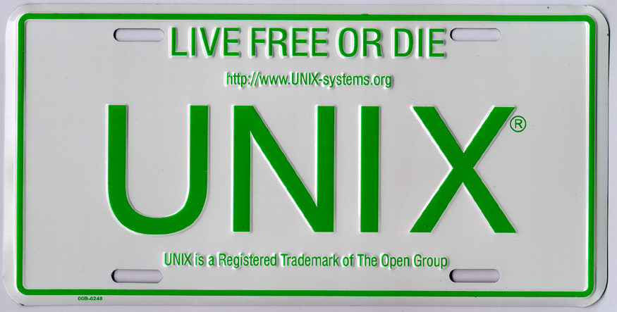
UNIX and Windows
If you want to run an application, you have to install one of these
  Where UNIX encompasses Linux and Mac OS X
Common understanding
  They are insecure
Why?

Slide 3
UNIX Access Control
On Files
  All objects are files
  Not exactly true
Classical Protection System
  Limited access matrix
  Discretionary protection state operations
Practical model for end users
  Still involves some policy specification

Slide 4

UNIX Mode Bits

Slide 5
Windows Access Control
On Objects
  Arbitrary classes can be defined
  New classes can be defined (Active Directory)
Classical Protection System
  Full-blown ACLs (even negative ACLs)
  Discretionary protection state operations
Not so usable
  Few people have experience

Slide 6
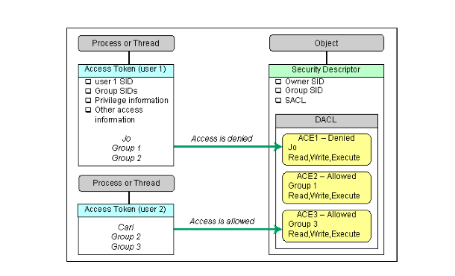
Windows Access Control

Slide 7
Vulnerabilities
Function run by one subject that enables an attacker to gain unauthorized privileges (i.e., the subject’s)
  Privilege escalation
Two views
  Subject could do something for the attacker
  Attacker could “take over” process
Either way, the attacker can use the subject’s privileges
  May use these to compromise an even more privileged subject

Slide 8
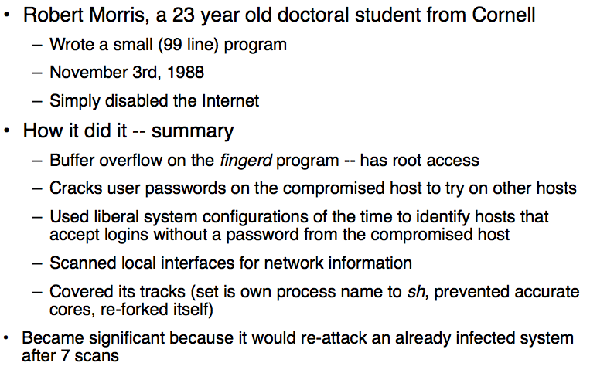
The Morris Worm

Slide 9

Confused Deputy
A server process has the privileges necessary to service requests from all its clients
  Can a client trick the server into using its permissions for the client?
Have the server access an object whose name is supplied by a client

Slide 10
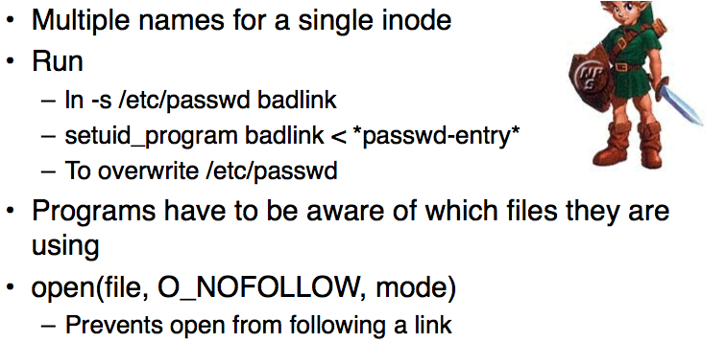
Links

Slide 11

Unknown Origin
A server may use a file under the control of a client
  Client may provide file by name or predict the name of a file the server may create/use
Such a file provides guidance that the server trusts
  Enabling the client to control how the server runs

Slide 12
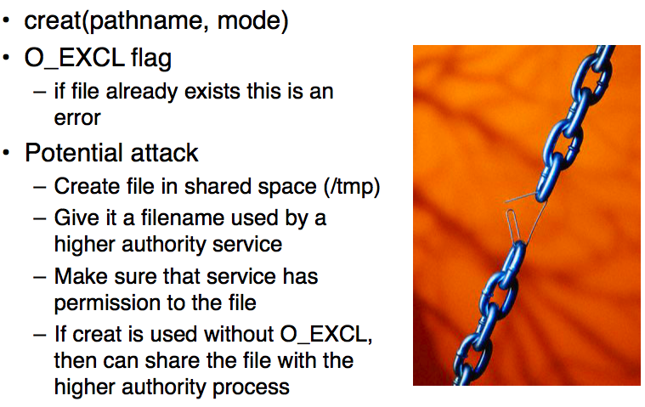
/tmp Vulnerability

Slide 13
Others
Overflow (Buffer or Heap)
  Inject code into server
Libraries (Path or input)
  Inject code into server
TOCTTOU
  Cause an authorization to pass
Integer overflow
  Cause different control path

Slide 14
The OS Will Protect Me
User-space vulnerabilities are expected
  Those processes are untrusted
OS policies will protect the system from harm
  Only the OS and a few processes need to be trusted
Just need to specify the access control policy
  We can specify anything we want
  We have an access matrix

Slide 15
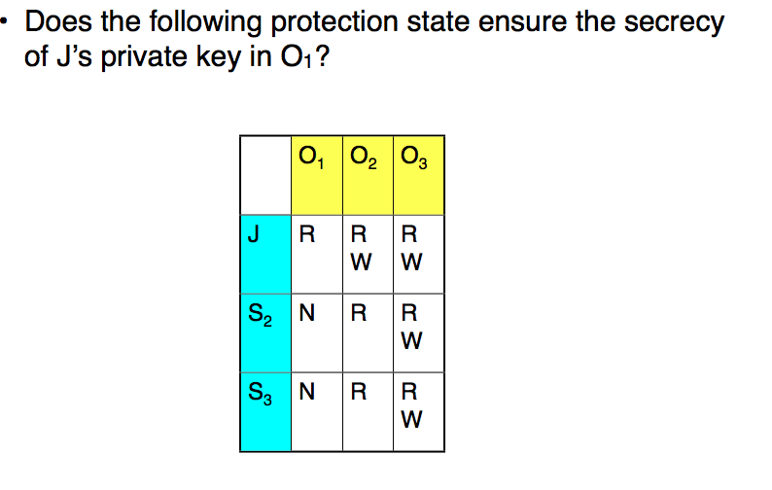
Secrecy

Slide 16
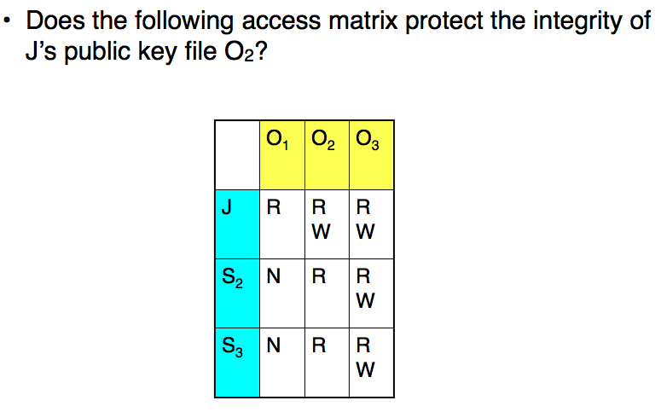
Integrity

Slide 17
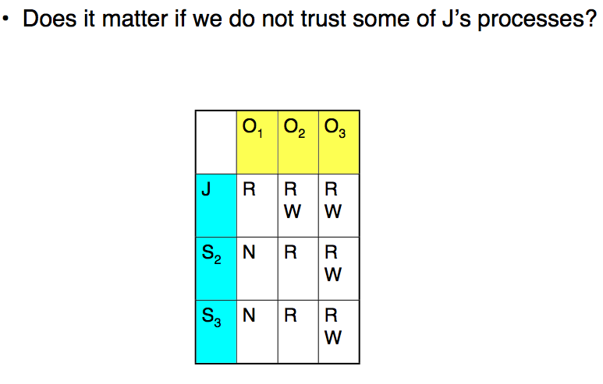
Benign vs. Byzantine

Slide 18
Protection and Security
Protection
  Security goals met under benign processes
  Protects against error by non-malicious entity
Security
  Security goals met under byzantine processes
  Any benign process can come under the control of an attacker
  Protects against any malicious entity
For J: A benign process won’t accidentally leak a key, but it would under attackers’ control

Slide 19

Is Fixing the Policy Enough?
No, as these systems do not satisfy the reference monitor concept

Slide 20
Complete Mediation
Mediation: Does interface mediate correctly?
  No. Several operations impact security that are ignored.
Mediation: On all resources?
  UNIX: No. No network.
  Windows: Could.
Mediation: Verifably?
  Ha.
Notes:
This slide illustrates the way our approach works.

Slide 21
Tamperproof
Tamperproof: Is reference monitor protected?
  Operating system is not protected (see Rootkits)
  Kernel modules, trusted processes, extensible function
  Policy can be modified by untrusted processes (discretionary)
Tamperproof: Is system TCB protected?
  We don’t really know what this is
  All root and setuid processes and ones they depend on
  Plus anything an admin runs as root
Notes:
This slide illustrates the way our approach works.

Slide 22
Verification
Verifiable: Is TCB code base correct?
  No.
Verifiable: Does the protection system enforce the system’s security goals?
  Goals?
  See Protection v. Security again
Notes:
This slide illustrates the way our approach works.

Slide 23
Take Away
Conventional operating systems are insecure
They run programs that suffer from many types of vulnerabilities
They are designed to enable protection under benign programs, not secure a system from a directed attacker
They do not satisfy reference monitor concept
  Also fail to implement a mandatory protection system
Notes:
This slide illustrates the way our approach works.

