Slide 1
Topics in Systems and
Program Security
Trent Jaeger
Systems and Internet Infrastructure Security (SIIS) Lab
Computer Science and Engineering Department
Pennsylvania State University
September 29, 2008

Slide 2
Project Analysis
Due 10/24
  Evaluate the security of your research project (as it is currently) against reference monitor guarantees
Identify your project’s reference monitor (2 pages max)
  Components that make up the reference monitor and its trusted computing base
Evaluate your reference monitor’s satisfaction of the reference monitor guarantees (4 pages max)
  Answer the questions in Section 2.4
Identify tasks to enable approximation of reference monitor guarantees (2 pages max)

Slide 3
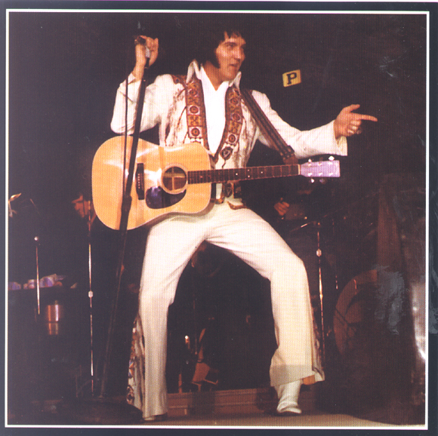
Multics circa 1976
Final research report
  Slower than desired
  Bigger than desired
  Expensive ($7M)
  Low market share
  UNIX winning mindshare
Next generation systems?

Slide 4

Two Directions
Focus on Generality and Performance
  Limited security
  Focus: UNIX
  Put us in our current state
Focus on “verifiable” security
  Security kernels
  Lots of systems
    KSOS, PSOS, Secure LAN, Secure Ada Target, various guard systems
Notes:
This slide illustrates the way our approach works.

Slide 5

MITRE Project
Started in 1974
  OS in 20 subroutines
    Less than 1000 lines of code
  System to manage physical resources
What are the advantages of such an approach?

Slide 6
Security Kernel
Goals
(1) Implement a specific security policy
(2) Deﬁne a veriﬁable protection behavior of the system as a whole
(3) Must be shown to be faithful to the security model’s design
Recommend a special issue
  IEEE Computer, 16(7), July 1983

Slide 7
Verification
Became the focus of the approach
  Verify that the implementation is faithful to the model
  Which supports a specific security policy
What are the formal limits of verification?
What is it going to take in this case?

Slide 8
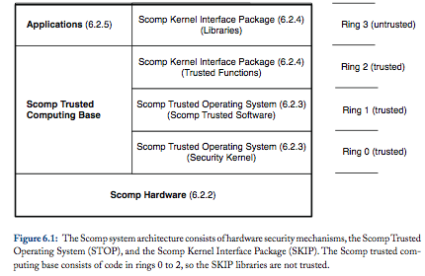
Scomp
Secure Communications Processor (Scomp)

Slide 9
Scomp
Like Multics
Access is control via segments
  Memory segments and I/O segments
  Files are defined at a higher level
Security Goals
  Secrecy: MLS
  Integrity: Ring brackets

Slide 10
Scomp
Unlike Multics
Mediation on Segments
  Although all access control and rings are implemented in hardware
Formal verification
  Verify that a formal model enforces the MLS policy
  Trusted software outside the kernel is veriﬁed using a procedural speciﬁcation
Separate kernel from system API functions
  In different rings (e.g., for file access)

Slide 11
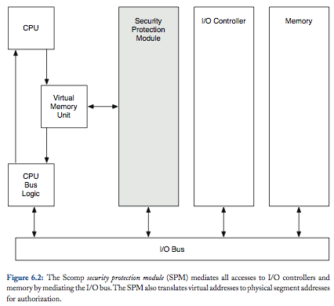
Scomp Hardware

Slide 12

Scomp Drivers
I/O Device Drivers in Scomp can be run in user-space
Why can’t we do that in a normal OS?
How can we do that in Scomp?

Slide 13
Scomp OS
Whole thing is called Scomp Trusted Operating Program (STOP)
  Lives on in BEA Systems XTS-400
Security Kernel in ring 0
  Provides “memory management, process scheduling, interrupt management, auditing, and reference monitoring functions”
  In 10K lines of Pascal
  Ring transitions controlled by 38 gates (APIs)

Slide 14
Trusted Software
Officially part of STOP
  But runs outside ring 0
Software trusted to with system security goals
  Like process loader
System policy management and use
  Such as authentication services
23 such processes, consisting of 11K lines of C code
  All interaction requires a trusted path

Slide 15
Scomp Kernel Interface
Like a system call interface for user processes
  Trusted operations on user-level objects (e.g., files, processes, and I/O)
  Still trusted not to violate MLS requirements
Is accessible via a SKIP library
  But that library runs in user space (ring 3)

Slide 16
Scomp Applications
May also by MLS-Trusted Applications
Mail Guard
  Makes sure that secrets are not leaked in communications to less secret subjects
  Mail guard obtains labeled communications
    Has ad hoc filters to prevent leakage
Why is Scomp appropriate to support such an application?

Slide 17
Scomp Evaluation
Complete Mediation: Correct?
  In hardware
  In Trusted programs? In Mail guards?
Complete Mediation: Comprehensive?
  At segment level
  For files? For mail data?
Complete Mediation: Verified?
  Hardware; Trusted programs? Mail guards?

Slide 18
Scomp Evaluation
Tamperproof: Reference Monitor?
  In hardware, in kernel, in guard
Tamperproof: TCB?
  TCB is well-defined in rings, and protected by gates
Verify: Code?
  Performed verification on implementation using semi-automated methods
  Led to assurance criteria and approach
Verify: Policy?
  MLS is security goal; Integrity is more difficult

Slide 19
Scomp Challenges
Why don’t we all use Scomp-based systems now?

Slide 20
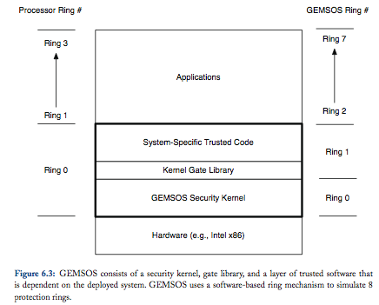
GEMSOS
Similar system goals to Scomp
Built for the ‘new’ x86 processor
Notes:
This slide illustrates the way our approach works.

Slide 21
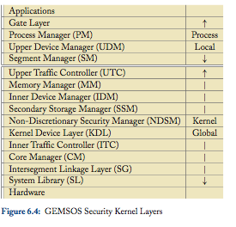
GEMSOS
Also, is still around
  Aesec corporation
Fine-grained kernel design
Eventually, UNIX (POSIX) emulation
File system is inside the security kernel
  Kernel and trusted software depends on data layout in files

Slide 22
Take Away
Security kernel design approach was designed to address security shortcomings of Multics
  In particularly, size and complexity
Security kernel design approach
  Documented in a book by Morrie Gasser
  Led to the assurance approach in the Orange Book
When people speak of how to build “secure OSes” they probably mean these systems
So, we aren’t we building systems this way?
What ideas/approaches can we take into current systems?

