Slide 1
Advanced Systems Security:
Security Goals
Trent Jaeger
Systems and Internet Infrastructure Security (SIIS) Lab
Computer Science and Engineering Department
Pennsylvania State University
February 4, 2010

Slide 2
A Secure System
Consists of a mandatory protection system enforced by a reference validation mechanism that satisfies the reference monitor concept
Can we choose a mandatory protection state to enforce?
Why is one better than another?

Slide 3
Mandatory Protection States
Is smaller state better?
  Fewer labels? Fewer permissions?
Are more isolated labels better?
  Fewer permissions to other labels
How are labels related?
  Are some better than others?
What about labeling state and transition state?
  What dynamics make sense?

Slide 4
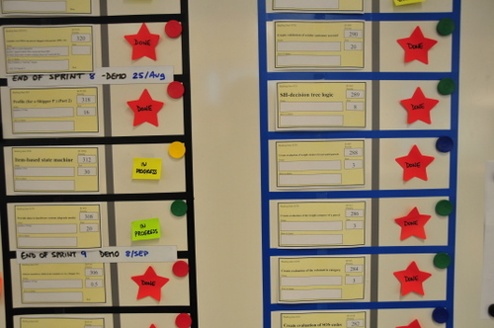
Choosing Security Goals
How do we define security for our systems?

Slide 5
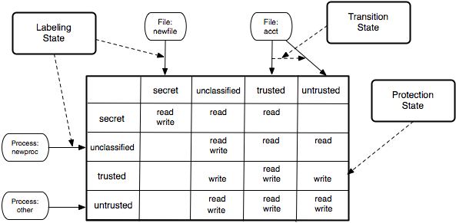
Access Matrix

Slide 6
Access Matrix Goal
Protection State represents policy, and the policy should enforce a goal
Difficult to write a goal in terms of a low-level policy
We want a goal to be easily understandable
  Policy need not be if it complies

Slide 7
Least Privilege
The protection mechanism should force every process to operate with the minimum privileges needed to perform its task.
Due to Saltzer and Schroeder (of Multics project)
One of many “design principles” in their paper “The Protection of Information in Computer Systems” (1975)
Others
  Principle of Psychological Acceptability
  Principle of Fail Safe Defaults

Slide 8
Least Privilege
How to compute least privilege?
  Aim: Determines the permissions required for the program to run effectively
Various systems provide support
  SELinux audit2allow: take denied permissions and add them to policy
  AppArmor Profile Wizard: Build an approximate profile statically and
  http://www.novell.com/documentation/apparmor/book_apparmor21_admin/?page=/documentation/apparmor/book_apparmor21_admin/data/sec_apparmor_repo.html
  Run the program and see what permissions are used

Slide 9
Least Privilege
Is a good goal because…
Is a poor goal because…
Can we use it to verify a policy is secure?

Slide 10
Least Privilege
Is a good goal because…
  Unnecessary permissions lead to problems (confused deputy)
  Accounts for function
Is a poor goal because…
  Task permissions may conflict with security
  How do we know when a permission is necessary, but makes the system insecure?
Can we use it to verify a policy is secure?
  No. It defines a policy based on function, not security.

Slide 11
Information Flow
Another approach looks at the authorized flow of information among processes via objects

Slide 12
Idealized Security
Multilevel Security (MLS) for secrecy
  Secrecy requirement: Do not leak data to unauthorized principals
  Only permit information to flow from less secret to more secret principals/objects
  E.g., Can only read a file if your clearance dominates that of the file
Biba Integrity
  Integrity requirement: Do not depend on data from lower integrity principals
  Only permit information to flow from high integrity to lower integrity
  E.g., Can only read a file if your integrity level is dominated by the file’s

Slide 13
Information Flows
Secrecy (MLS): If the OS permits a secret application/object to flow to a public application/object, then there may be a leak (e.g., Trojan horse)
Integrity (Biba): If the OS permits a low integrity input to flow to a high integrity application/object, then there may be a dependency (e.g., buffer overflow)
Secret
Public
Low
High

Slide 14
Information Flow Goals
Can be represented as a graph: G = (V, E)
  A set of vertices (one for each label) and the directed edges between them (authorized operations)
    Note that edge (u, v) implies either that u writes to v or v reads from u
A goal can be stated as reachability constraint in such a graph
  No flow from x to y in G
  Must flow from x to z in G
A system is secure if all reachability constraints are satisfied

Slide 15

Practical vs. Ideal
Do these idealized approaches based on information flow enable practical realization of OS enforcement?
Secrecy is possible in some environments
  Implemented in a paper world, previously
Integrity has not been realized in practice
    Many processes provide high integrity services to others
Result: Depend on many applications to manage information flows

Slide 16
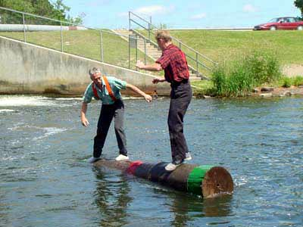
Example: logrotate
Logrotate is a service that swaps logs
It rotates logs through sequence
  Secrecy: Logs may span all security levels on system
  Thus, logrotate is trusted in SELinux
It reads a configuration to tell it what to do
  Integrity: Logs must not leak into configuration files
  Configurations must not cause file leakage

Slide 17
SELinux/MLS Trusted Programs
The OS trusts that privileged applications preserve system secrecy (30+ programs)
SELinux/MLS:
Policy management tools secadm, load_policy, setrans, setfiles, semanage,
restorecon, newrole
Startup utilities bootloader, initrc, init, local_login
File tools dpkg_script, dpkg, rpm, mount, fsadm
Network utilities iptables, sshd, remote_login, NetworkManager
Auditing, logging services logrotate, klogd, auditd, auditctl
Hardware, device mgmt hald, dmidecode, udev, kudzu
Miscellaneous services passwd, tmpreaper, insmod, getty, consoletype, pam_console
Notes:
We checked the SELinux policy and found out that several applications are trusted to correctly handle data of multiple levels.
The table presents the list of the system applications that are trusted by SELinux.
Now the thing is that these applications are assigned special privileges because they require those to work. But is that enough?
If a user-level application requires such privileges because you know users handle different levels of security levels, how do an administrator decide if such privileges should be assigned?

Slide 18
Situation Is Much Worse
Clients
  Lots of client programs are entrusted with information with different secrecy/integrity requirements
  Email, browser, IM, VOIP, …
Servers
  Historically, many servers have enforced security policies because they handle multiple clients
  Web servers, databases, mail, respositories, …
Information flow alone is not enough to build a secure system!

Slide 19
What Do We Do?
Unsatisfying Solution #1: Ignore Exceptions
  Processes are outside the model
  E.g., so-called “Trusted Readers/Writers” in MLS
  Result: Accept that some processes can violate policy, often blindly
Unsatisfying Solution #2: Dump Info Flow Entirely
  Change to a more general policy model
  No meaningful security goal (is least privilege adequate?)
  Result: Systems are complex -- 50K SELinux rules

Slide 20
Information Flow
Is a good goal because…
Is a poor goal because…
Can we use it to verify a policy is correct?

Slide 21
Information Flow
Is a good goal because…
  No false negatives – an attack requires an illegal information flow
  Can define data and functional security requirements
Is a poor goal because…
  Function may conflict with security
  How do we know when a permission is illegal, but is necessary for functional requirements?
Can we use it to verify a policy is correct?
  Yes. It defines a policy based on security. But what about exceptions?

Slide 22
Information Flow for Others
Q: Can we use information flow goals for non-information flow models (e.g., access matrix)?

Slide 23
Noninterference
Information Flow may not be enough
An information flow graph may not include all possible edges (covert channels)
May create an information flow through shared, physical resources
  Use same disk device (storage channel)
  Use same CPU (timing channel)
A noninterference goal requires that the user u outputs have no affect on user u’ behavior, if u > u’
  User u’ is unaffected by u

Slide 24
Noninterference
An operation authorized at runtime may enable a covert flow
  Allow u to write resource x
  Allow u’ to write resource y
  Where y is dependent on the operation of writing x
  Fill a disk; see a CPU delay; see a value of y that implies a value of x
In general, purge(u’, hist.cmd(u)) = purge(u’, hist) when SC(u) > SC(u’)
  u’ does not see output that is affected by any cmd(u)

Slide 25
Impact on Labeling and Transition
How should security goals impact labeling and transitions?
Labeling – assignment of objects to labels
  What are the requirements for various secrecy/integrity levels?
Transitions – conditions that determine when a label will change
  What are the requirements for causing a label change?
What experience do we have?

Slide 26
Labeling
How do we choose the label of a subject or object when created?
  Traditional: same label as creator
Alternatives
  Based on certification
    E.g., code hashes for integrity verification
  Based on location of created object
    Store this with garbage, so make it garbage
  Based on creator preference
    Trust the creator to decide (within a range)

Slide 27
Transitions
When do we change the label of a subject or object? And to what?
  Traditional: don’t change
Alternatives
  Based on operations performed by subject or on object
    Low-water mark integrity; High-water mark secrecy
    There are access control models based on these
  Based on operations of others
    E.g., When another process receives untrusted input, downgrade the whole system

Slide 28
Take Away
To build a secure system, we need to define a mandatory protection system
  But, what should guide the design?
Security goals
  Usually serves as a rough guide
Types of security goals – biased toward security or function
  Functional: least privilege; Security: information flow
Need to develop approaches to design goals for entire mandatory protection system – from function and security

