Slide 1
Advanced Systems Security:
Security Kernels
Trent Jaeger
Systems and Internet Infrastructure Security (SIIS) Lab
Computer Science and Engineering Department
Pennsylvania State University
February 15, 2011

Slide 2
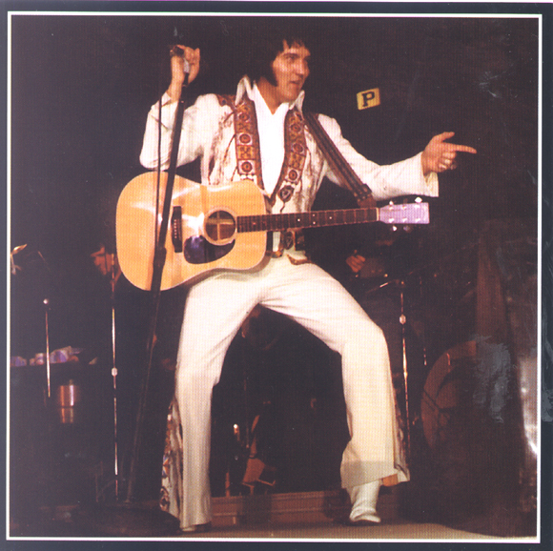
Multics circa 1976
Final research report
  Slower than desired
  Bigger than desired
  Expensive ($7M)
  Low market share
  UNIX winning mindshare
Next generation systems?

Slide 3

Two Directions
Focus on Generality and Performance
  Limited security
  Focus: UNIX
  Put us in our current state
Focus on “verifiable” security
  Security kernels
  Lots of systems
    KSOS, PSOS, Secure LAN, Secure Ada Target, various guard systems
Notes:
This slide illustrates the way our approach works.

Slide 4

MITRE Project
Started in 1974
  OS in 20 subroutines
    Less than 1000 lines of code
  System to manage physical resources
What are the advantages of such an approach?

Slide 5
Security Kernel
Goals
(1) Implement a specific security policy
(2) Deﬁne a veriﬁable protection behavior of the system as a whole
(3) Must be shown to be faithful to the security model’s design
Recommend a special issue
  IEEE Computer, 16(7), July 1983

Slide 6
Verification
Became the focus of the approach
  Verify that the design enforces a policy model correctly (implementation is faithful to the design)
  Which supports a specific security policy
What are the formal limits of verification?
What is it going to take in this case?

Slide 7
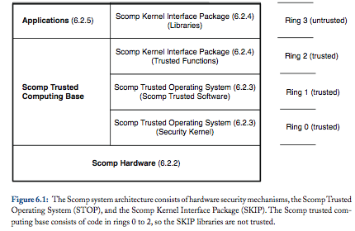
Scomp
Secure Communications Processor (Scomp)

Slide 8
Scomp
Like Multics
Access is control via segments
  Memory segments and I/O segments
  Files are defined at a higher level
Security Goals
  Secrecy: MLS
  Integrity: Ring brackets

Slide 9
Scomp
Unlike Multics
Mediation on Segments
  All access control and rings are implemented in hardware
Formal verification
  Verify that a formal model enforces the MLS policy
  Trusted software outside the kernel is veriﬁed using a procedural speciﬁcation
Separate kernel from system API functions
  In different rings (e.g., for file access)

Slide 10
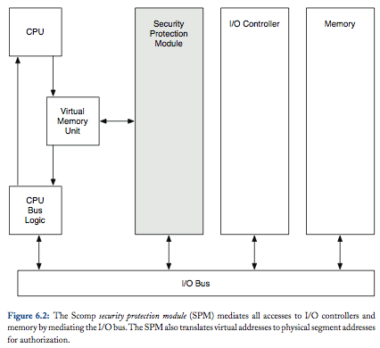
Scomp Hardware

Slide 11

Scomp Drivers
I/O Device Drivers in Scomp can be run in user-space
Why can’t we do that in a normal OS?

Slide 12
Scomp OS
Whole thing is called Scomp Trusted Operating Program (STOP)
  Lives on in BEA Systems XTS-400
Security Kernel in ring 0
  Provides “memory management, process scheduling, interrupt management, auditing, and reference monitoring functions”
  In 10K lines of Pascal
  Ring transitions controlled by 38 gates (APIs)

Slide 13
Trusted Software
Officially part of STOP
  But runs outside ring 0
Software trusted to with system security goals
  Like process loader
System policy management and use
  Such as authentication services
23 such processes, consisting of 11K lines of C code
  All interaction requires a trusted path

Slide 14
Scomp Kernel Interface
Like a system call interface for user processes
  Trusted operations on user-level objects (e.g., files, processes, and I/O)
  Still trusted not to violate MLS requirements
Is accessible via a SKIP library
  But that library runs in user space (ring 3)

Slide 15
Scomp Applications
May also be MLS-Trusted Applications
Mail Guard
  Makes sure that secrets are not leaked in communications to less secret subjects
  Mail guard obtains labeled communications
    Has ad hoc filters to prevent leakage
Why is Scomp appropriate to support such an application?

Slide 16
Scomp Evaluation
Complete Mediation: Semi-formal op mediation?
  In hardware (segments); elsewhere, not so well-defined
  What about DMA?
Complete Mediation: Semi-formal for all classes?
  At segment level
  For files? For mail data? Presumably so…
Complete Mediation: Formal op mediation for all classes?
  Hardware; Trusted programs; Interface? Mail guards?

Slide 17
Scomp Evaluation
Tamperproof: Reference Monitor?
  In hardware, in kernel, protected by gates
Tamperproof: TCB?
  TCB is well-defined in rings, but system calls and guards
Verify: Code?
  Performed verification on implementation using semi-automated methods
  Led to assurance criteria and approach
Verify: Policy?
  MLS is security goal; Integrity is more difficult

Slide 18
Scomp Challenges
Why don’t we all use Scomp-based systems now?

Slide 19
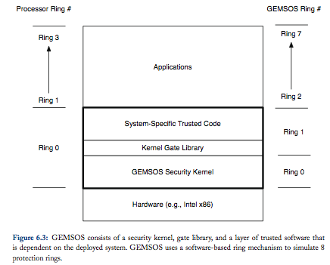
GEMSOS
Similar system goals to Scomp
Built for the ‘new’ x86 processor
Notes:
This slide illustrates the way our approach works.

Slide 20
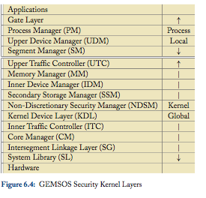
GEMSOS
Also, is still around
  Aesec corporation
Fine-grained kernel design
Eventually, UNIX (POSIX) emulation
File system is inside the security kernel
  Kernel and trusted software depends on data layout in files

Slide 21
Take Away
Security kernel design approach was designed to address security shortcomings of Multics
  In particularly, size and complexity
Security kernel design approach
  Documented in a book by Morrie Gasser
  Led to the assurance approach in the Orange Book
When people speak of how to build “secure OSes” they probably mean these systems
So, we aren’t we building systems this way?
What ideas/approaches can we take into current systems?

Slide 22
Driver Isolation
A big claim in Scomp was the ability to run drivers securely in user space
  By mediating access between the CPU and I/O Bus
  But, later technology resulted in incomplete mediation
The introduction of IOMMUs may enable effective driver isolation
  How?
  How do we use it effectively?
Those are the topics of Herder et al

Slide 23
Why are drivers a problem?
System errors cause the biggest problems
  Unplanned downtime is mainly due to faulty system software
Many system errors are caused by drivers
  Responsible for “majority of OS crashes”
  2/3 of the code base is due to “extensions”, but they have an error rate 3-7 times higher than other code
  65-83% of all crashes in Windows XP due to drivers
How do we reduce such problems?

Slide 24
Can we fix drivers?
There are many drivers and they change and new ones emerge rapidly
They are a large portion of the kernel code
  3M lines compromising nearly 60%
We know that we must isolate drivers
  But how?
News: IOMMU

Slide 25
Driver isolation previously
Build on: trusted kernel and MMU
Isolate drivers and wrap their invocations
  MMU enables drivers operations to be isolated from the kernel
  But drivers can cause devices to write to privileged memory
  So, the trusted kernel needs to check requests sent to the device (for many drivers and devices)
Also, use programming language, virtual machine, etc.
My experience SawMill Linux Multiserver [11]

Slide 26
MMU
What exactly does an MMU do?
  Maps virtual to physical addresses using the process’s page tables
Placing a driver in a limited memory context restricts which pages it can access
We get a boundary, but there are many holes thru
  But the driver has to access the device (DMA)
  And it also performs operations that the OS depends upon (OS services)

Slide 27
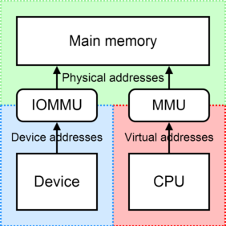
IOMMU

Slide 28
Limitations
In addition to memory protection
Must deal with multiple devices sharing an interrupt line
  One may block the line
Sharing of the PCI bus
  Conflicts between devices
Performance overhead of isolation
  10-25% in macrobenchark
  A lot more on microbenchmarks

Slide 29
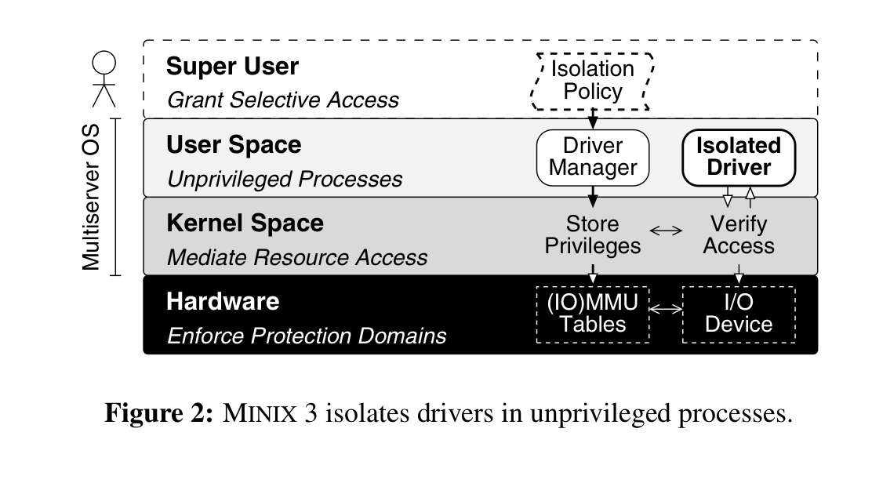
Overview of Approach

Slide 30
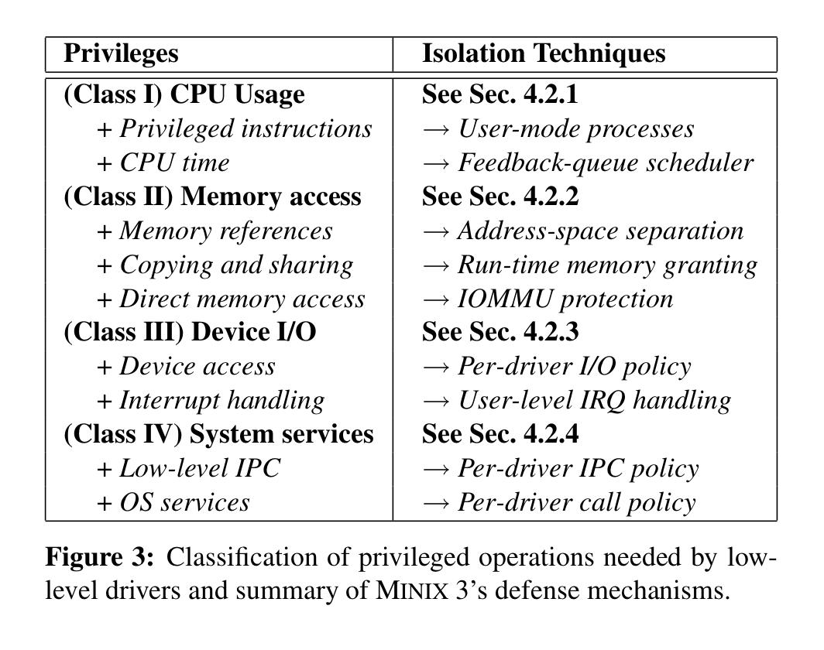
Classification of Privilege Mgmt

Slide 31
Complete Mediation
Privilege Instructions
  Driver in user-space
CPU time
  Scheduling
Memory References
  Address space isolation
DMA
  IOMMU protection
IRQ
  User-level IRQ handling
Sharing with driver
  Grant mechanism
Access to services
  Driver syscall policy
Driver access
  Driver I/O policy
IPC
  Driver IPC policy

Slide 32
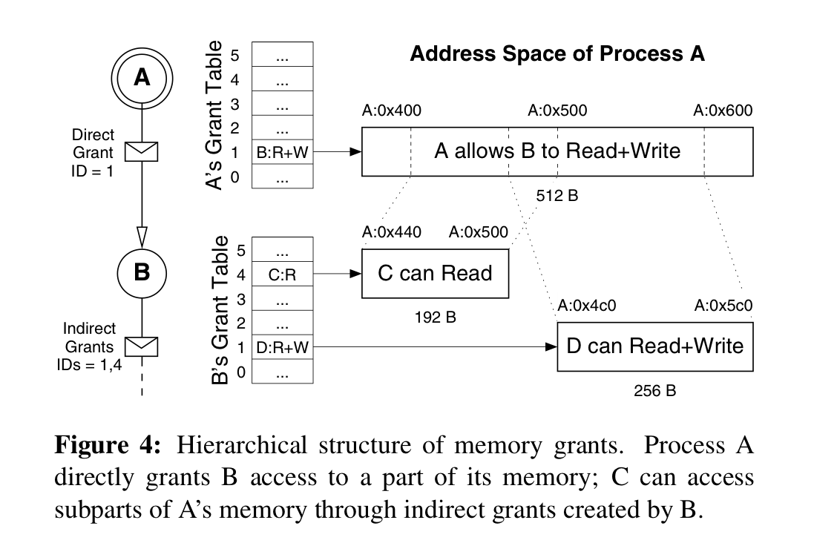
Sharing with Drivers

Slide 33
Other Policies
Specify a declarative, least privilege policy for each driver
Driver I/O
  PCI: device or class
  ISA: I/O ports and IRQs
IPC
  Who can the device send IPC to?
OS Services
  What kernel interfaces are available? OS space services?

Slide 34
Mandatory Protection System
Does this approach implement a mandatory protection system?
Protection State: devices and interfaces
  Fig 5 policy – mandatory?
  Distributed among several components
  Sharing – setup under discretion, but?
Labeling State
Transition State

Slide 35
Security Analysis
Complete Mediation?
  Who does mediation?
  Are they all reference monitors?
Tamperproofing
  Reference monitors and who they depend upon
Verification
  Code and Policy
Does this approach satisfy reference monitor concept?

