Slide 1
Project 1
Buffer Overflow
Trent Jaeger
Systems and Internet Infrastructure Security (SIIS) Lab
Computer Science and Engineering Department
Pennsylvania State University
January 19, 2010

Slide 2
Project Overview
Due: Jan 28, 2010
Given
  Vulnerable Program: cse544-victim.c
  Attack Program: cse544-attack.c
Configure attack program to overflow buffer and take control of victim program
  Identify vulnerable buffer
  Overflow buffer to call function “shell”
  Correct injection causes the execution of a new shell
Notes:
We know that we can translate program and system policies to information flow policy graphs.
Each node has an associated label. That label indicates security requirements for that node.
An information flow policy is a directed graph that shows the flows allowed by the policy. The nodes represent the subjects and objects that the policy rules and the edges represent the flows that are allowed between them

Slide 3
The Players
A buffer in the victim
  Allocated on the stack
Attack code
  Call the victim with inputs necessary to overflow buffer
  Overwrites the return address on the stack
Exploit
  In a specific manner necessary to gain control of the execution
  Jump-to-libc (actually a local function) attack
Notes:
We know that we can translate program and system policies to information flow policy graphs.
Each node has an associated label. That label indicates security requirements for that node.
An information flow policy is a directed graph that shows the flows allowed by the policy. The nodes represent the subjects and objects that the policy rules and the edges represent the flows that are allowed between them

Slide 4
The Players
A buffer in the victim
  Allocated on the stack
Attack code
  Call the victim with inputs necessary to overflow buffer
  Overwrites the return address on the stack
Exploit
  In a specific manner necessary to gain control of the execution
  Jump-to-libc (actually a local function) attack
Notes:
We know that we can translate program and system policies to information flow policy graphs.
Each node has an associated label. That label indicates security requirements for that node.
An information flow policy is a directed graph that shows the flows allowed by the policy. The nodes represent the subjects and objects that the policy rules and the edges represent the flows that are allowed between them

Slide 5
Vulnerability
Find an appropriate buffer in cse544-victim.c
  Not hard as there are not that many
Notes:
We know that we can translate program and system policies to information flow policy graphs.
Each node has an associated label. That label indicates security requirements for that node.
An information flow policy is a directed graph that shows the flows allowed by the policy. The nodes represent the subjects and objects that the policy rules and the edges represent the flows that are allowed between them

Slide 6
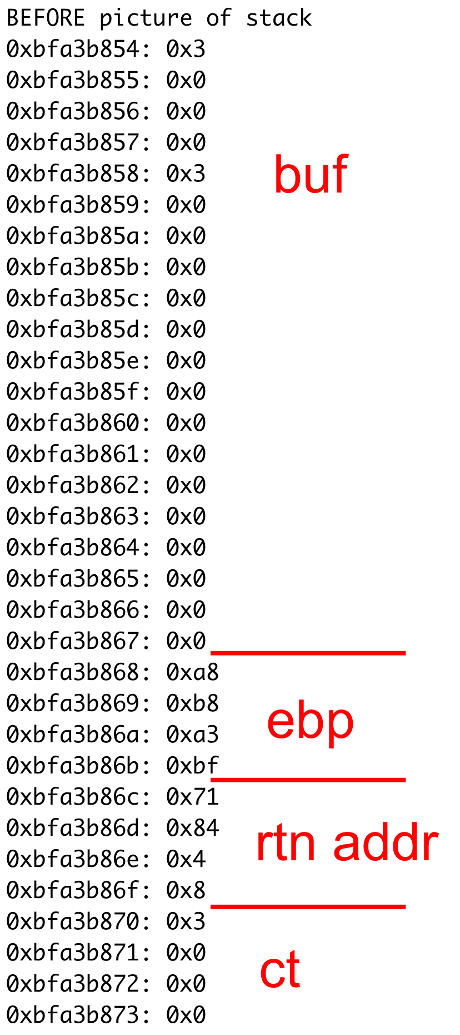
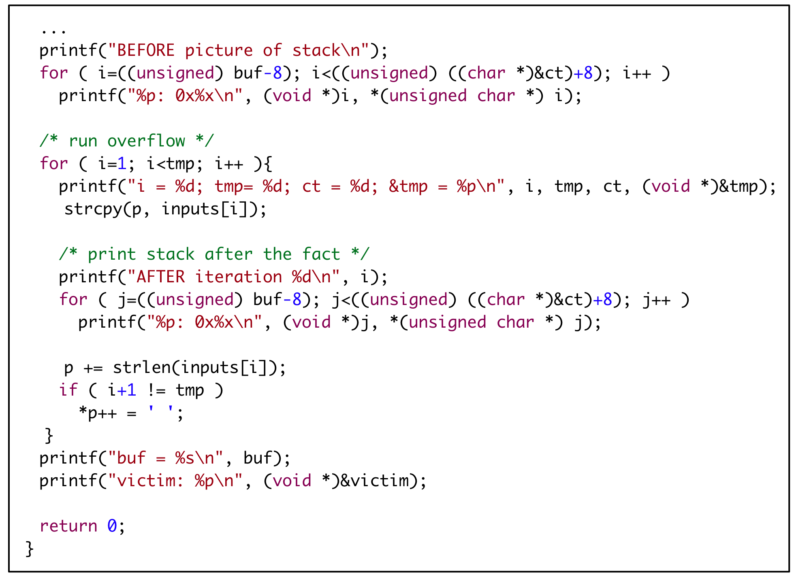
Determine how to attack
Examine stack as victim runs
  Build: make victim
  Run: ./victim foo bar
Notes:
We know that we can translate program and system policies to information flow policy graphs.
Each node has an associated label. That label indicates security requirements for that node.
An information flow policy is a directed graph that shows the flows allowed by the policy. The nodes represent the subjects and objects that the policy rules and the edges represent the flows that are allowed between them

Slide 7
Configure Attack
Configure following
  Distance to return address from buffer
    Where to write?
  Location of start of attacker’s code
    Where to take control?
  What to write on stack
    How to invoke code (jump-to existing function)?
  How to launch the attack
    How to send the malicious buffer to the victim?
Notes:
We know that we can translate program and system policies to information flow policy graphs.
Each node has an associated label. That label indicates security requirements for that node.
An information flow policy is a directed graph that shows the flows allowed by the policy. The nodes represent the subjects and objects that the policy rules and the edges represent the flows that are allowed between them

Slide 8
Return Address
x86 Architecture
  Build 32-bit code for Linux environment
Remember integers are represented in “little endian” format
Take address 0x8048471
  See trace at right
Notes:
We know that we can translate program and system policies to information flow policy graphs.
Each node has an associated label. That label indicates security requirements for that node.
An information flow policy is a directed graph that shows the flows allowed by the policy. The nodes represent the subjects and objects that the policy rules and the edges represent the flows that are allowed between them

Slide 9
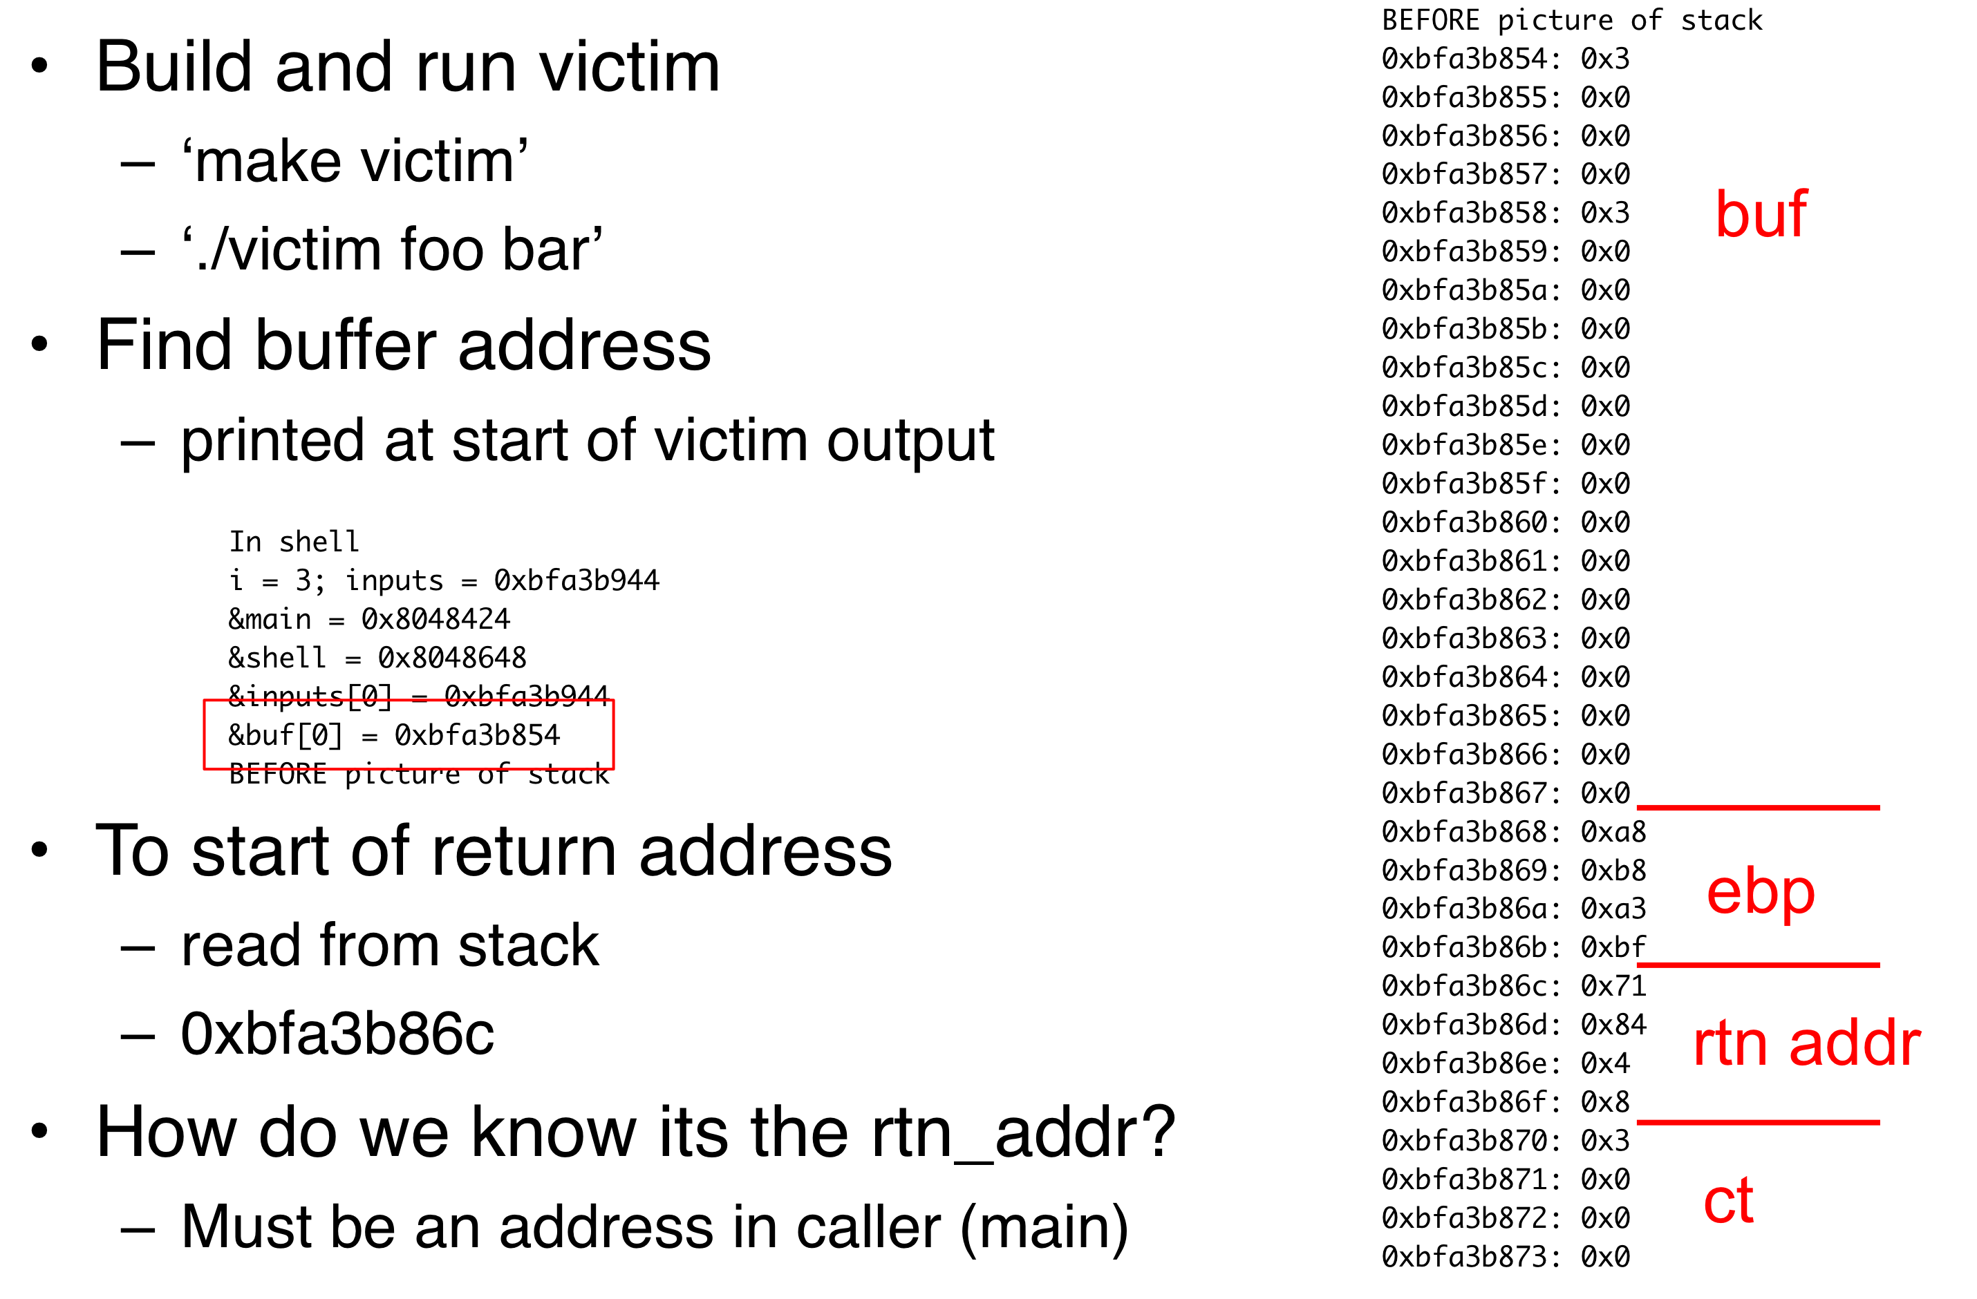
Find Return Address Offset
Notes:
We know that we can translate program and system policies to information flow policy graphs.
Each node has an associated label. That label indicates security requirements for that node.
An information flow policy is a directed graph that shows the flows allowed by the policy. The nodes represent the subjects and objects that the policy rules and the edges represent the flows that are allowed between them

Slide 10
Exploit
Run code determined by attacker
Jump-to-libc attack
  Configure the stack to run code in the victim’s address space
Choose code: function shell (see cse544-victim.c
  Need to get the address to call this function
  Need to prepare the stack for the call
Notes:
We know that we can translate program and system policies to information flow policy graphs.
Each node has an associated label. That label indicates security requirements for that node.
An information flow policy is a directed graph that shows the flows allowed by the policy. The nodes represent the subjects and objects that the policy rules and the edges represent the flows that are allowed between them

Slide 11
Find Addr to Call Shell Fn
Jump to location where call to shell function occurs (In main function)
What address is this at?
  Need to look at assembly code
Step 1:
  Build victim in assembly
  ‘make victim.s
Step 2:
  Insert label before call to shell and rerun
  ‘make victim-label’
Notes:
We know that we can translate program and system policies to information flow policy graphs.
Each node has an associated label. That label indicates security requirements for that node.
An information flow policy is a directed graph that shows the flows allowed by the policy. The nodes represent the subjects and objects that the policy rules and the edges represent the flows that are allowed between them

Slide 12
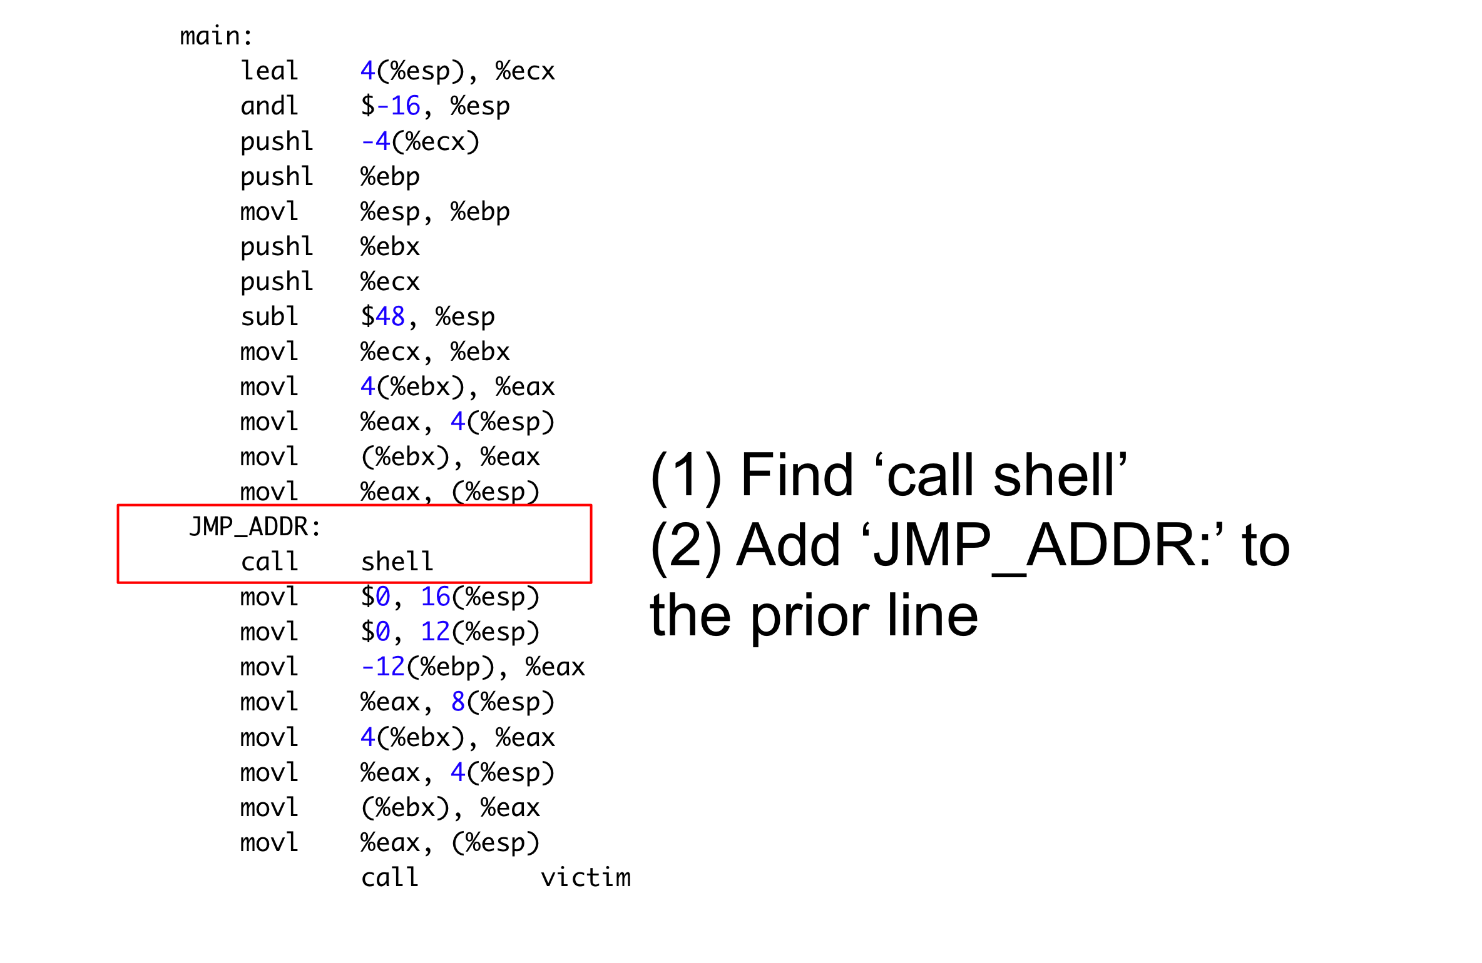
Add Label before Call
In cse544-victim.s
Notes:
We know that we can translate program and system policies to information flow policy graphs.
Each node has an associated label. That label indicates security requirements for that node.
An information flow policy is a directed graph that shows the flows allowed by the policy. The nodes represent the subjects and objects that the policy rules and the edges represent the flows that are allowed between them

Slide 13
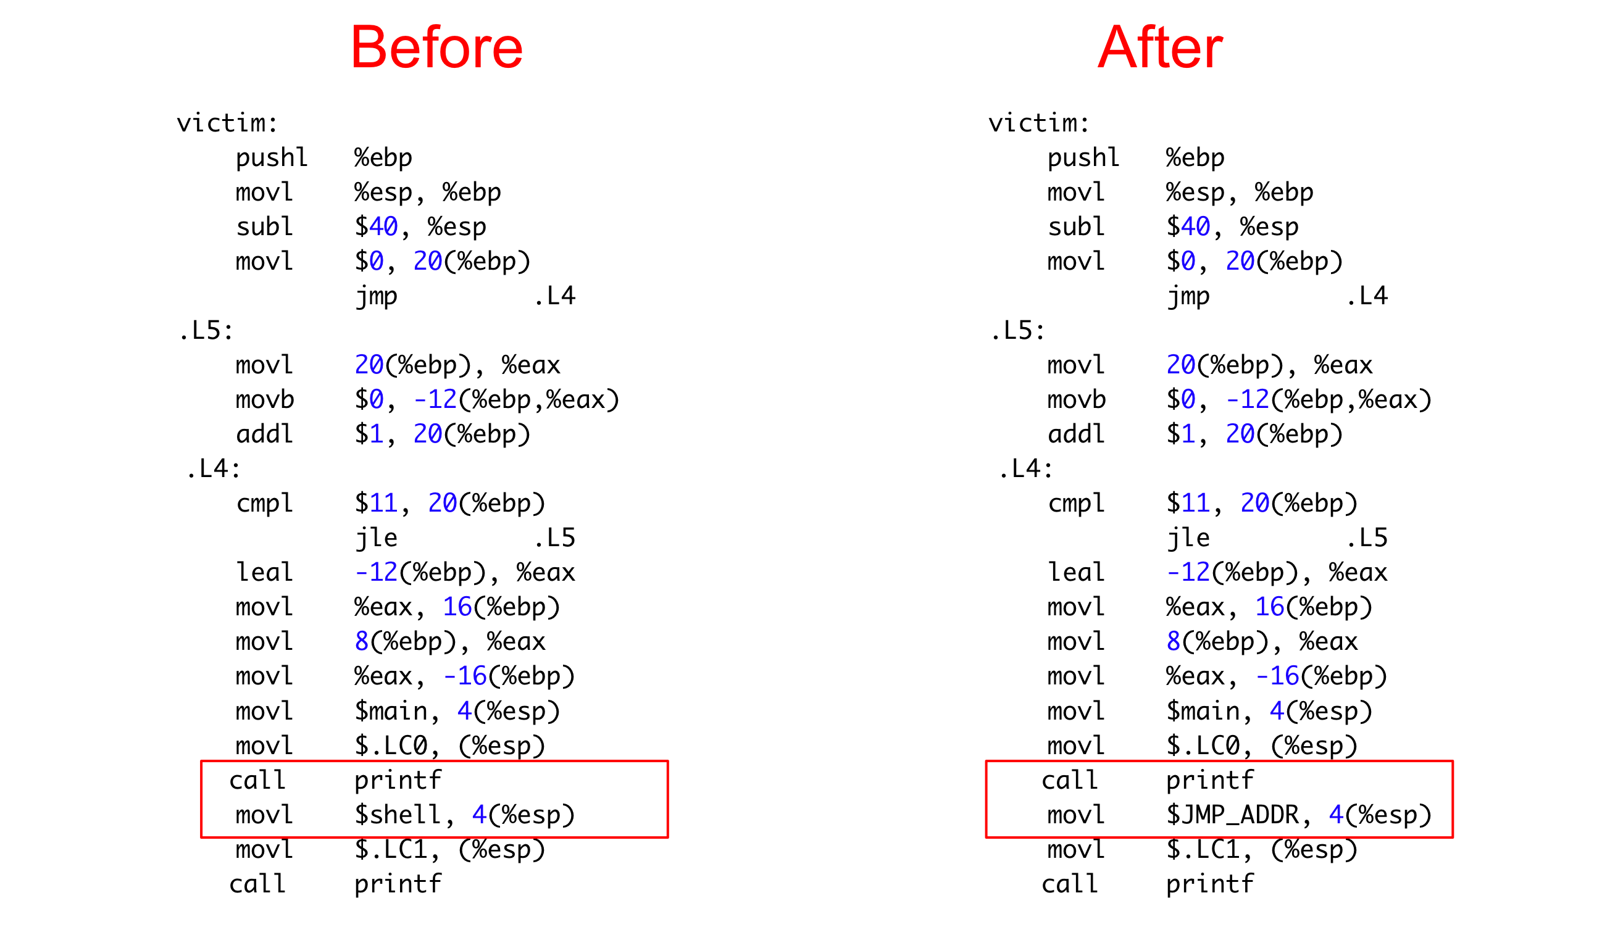
Print Label Value
In cse544-victim.s
Notes:
We know that we can translate program and system policies to information flow policy graphs.
Each node has an associated label. That label indicates security requirements for that node.
An information flow policy is a directed graph that shows the flows allowed by the policy. The nodes represent the subjects and objects that the policy rules and the edges represent the flows that are allowed between them

Slide 14
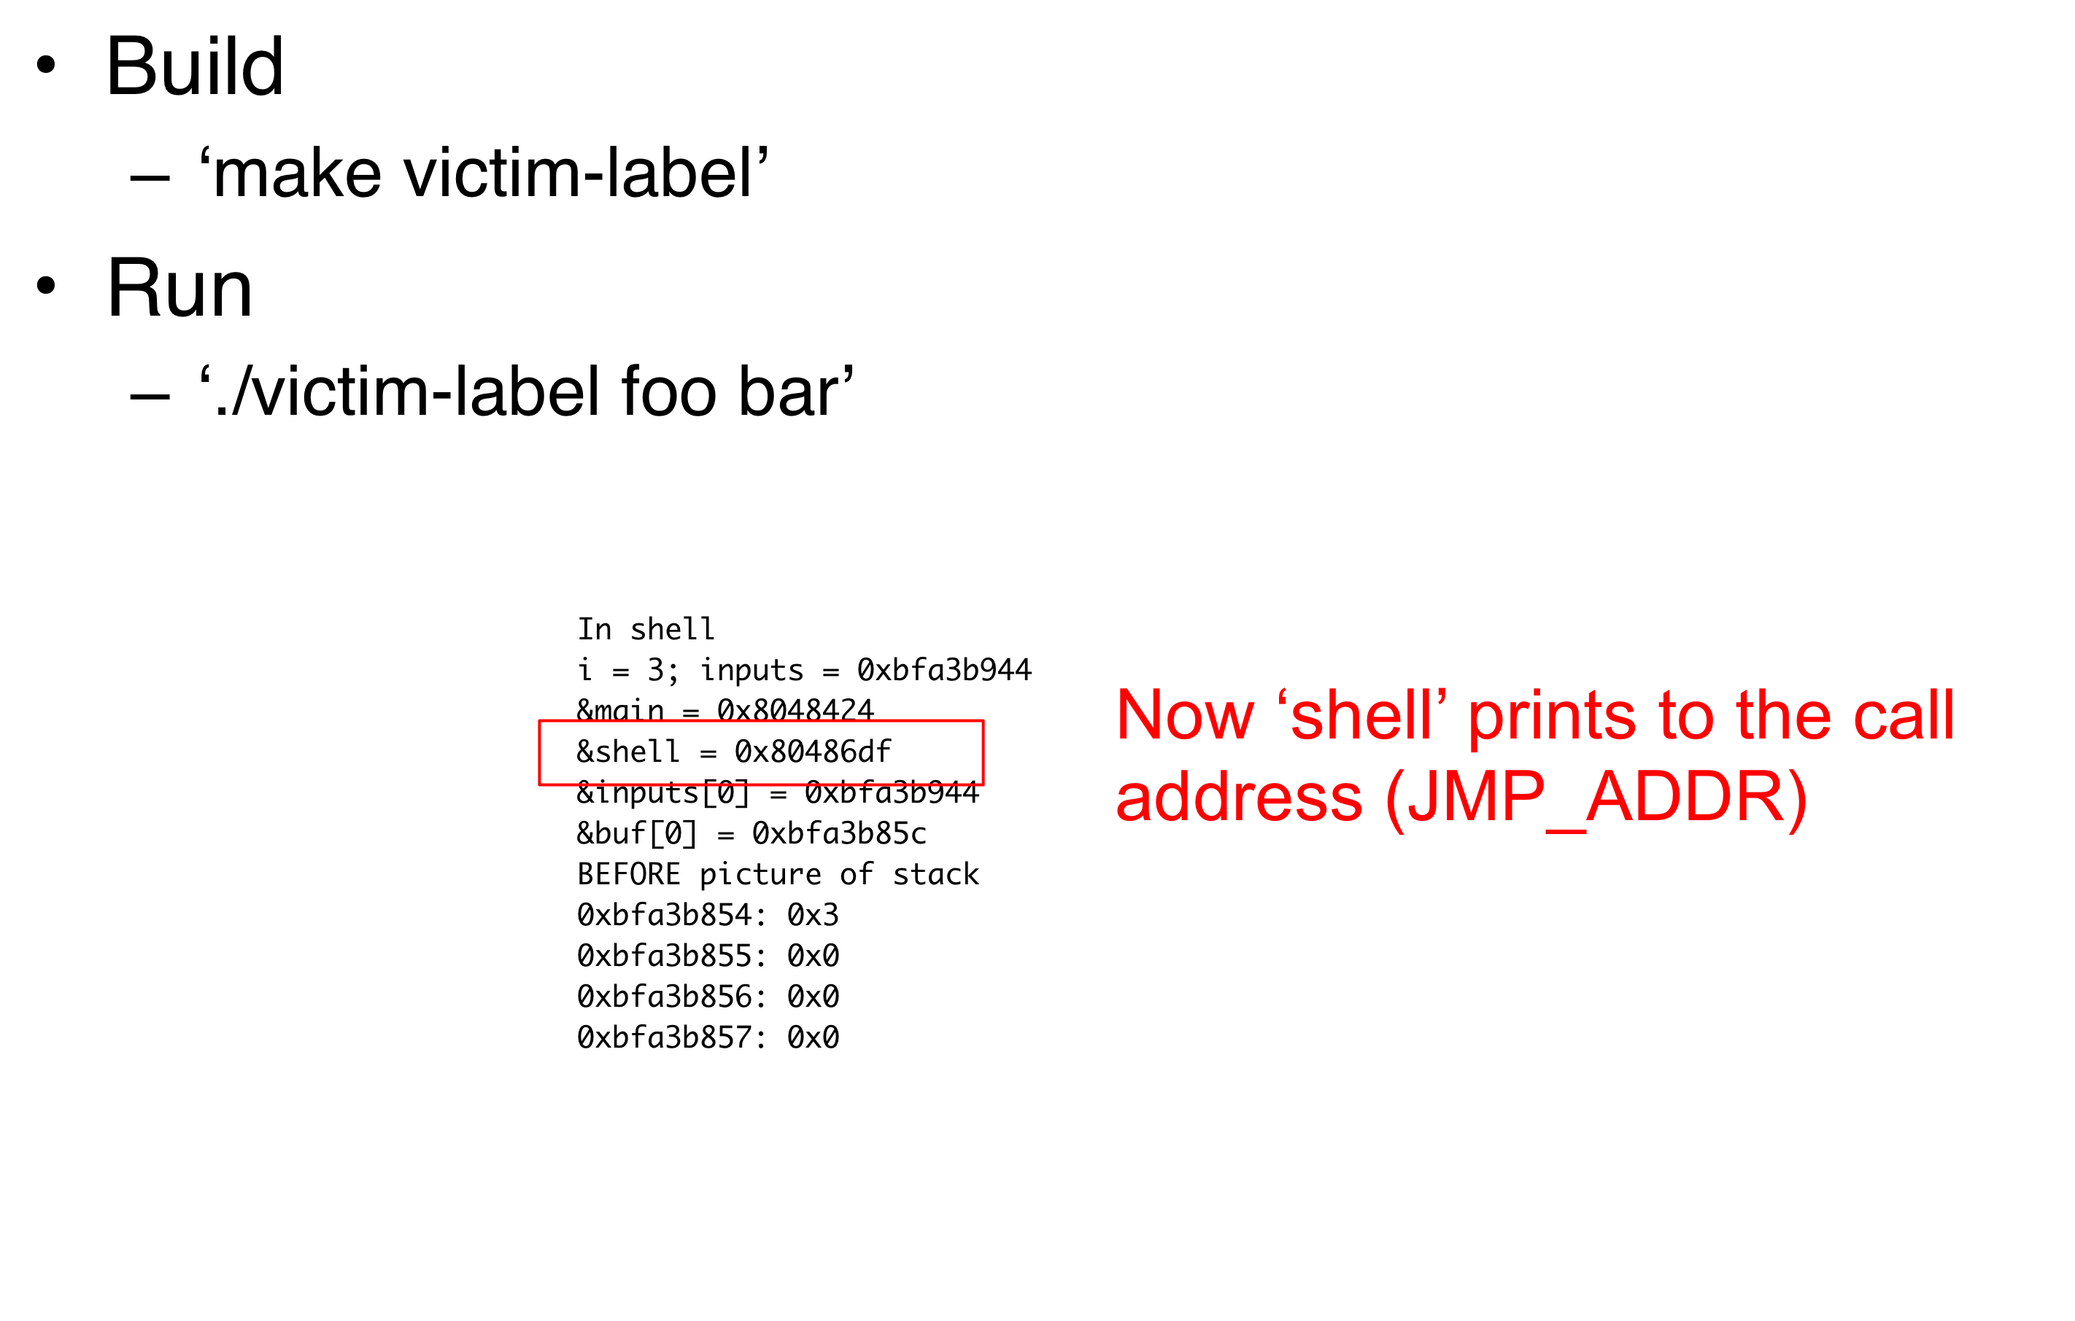
Build and Run Modified Victim
Notes:
We know that we can translate program and system policies to information flow policy graphs.
Each node has an associated label. That label indicates security requirements for that node.
An information flow policy is a directed graph that shows the flows allowed by the policy. The nodes represent the subjects and objects that the policy rules and the edges represent the flows that are allowed between them

Slide 15
Modify Attack Program
Add return address offset to rtn_addr_distance
Add replacement return address (for calling shell) to rtn1 to rtn4. 8-bit hex values.
Add code to build buffer replaces the return address
Need to include the two arguments to shell function in the buffer (0, address of argv) after the return address
Notes:
We know that we can translate program and system policies to information flow policy graphs.
Each node has an associated label. That label indicates security requirements for that node.
An information flow policy is a directed graph that shows the flows allowed by the policy. The nodes represent the subjects and objects that the policy rules and the edges represent the flows that are allowed between them

Slide 16
Modify Attack Program
Execute the victim program with the malicious buffer
  From the attack program
  Use the system system call to involve the exec system call on victim
Notes:
We know that we can translate program and system policies to information flow policy graphs.
Each node has an associated label. That label indicates security requirements for that node.
An information flow policy is a directed graph that shows the flows allowed by the policy. The nodes represent the subjects and objects that the policy rules and the edges represent the flows that are allowed between them

Slide 17
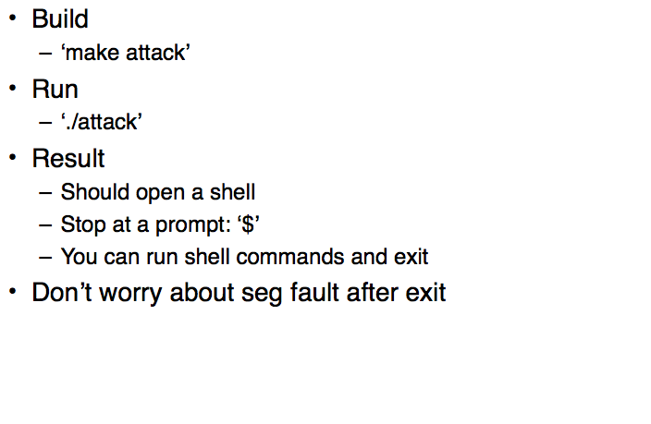
Run the Attack
Notes:
We know that we can translate program and system policies to information flow policy graphs.
Each node has an associated label. That label indicates security requirements for that node.
An information flow policy is a directed graph that shows the flows allowed by the policy. The nodes represent the subjects and objects that the policy rules and the edges represent the flows that are allowed between them

