Slide 1
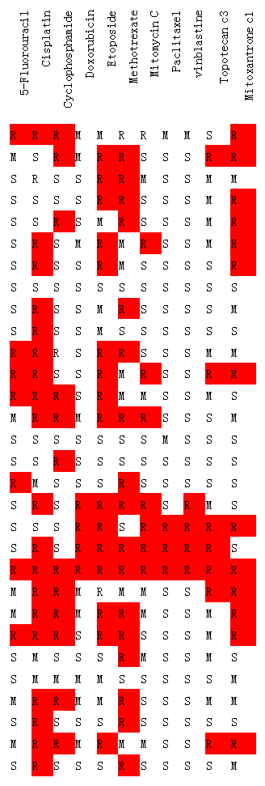
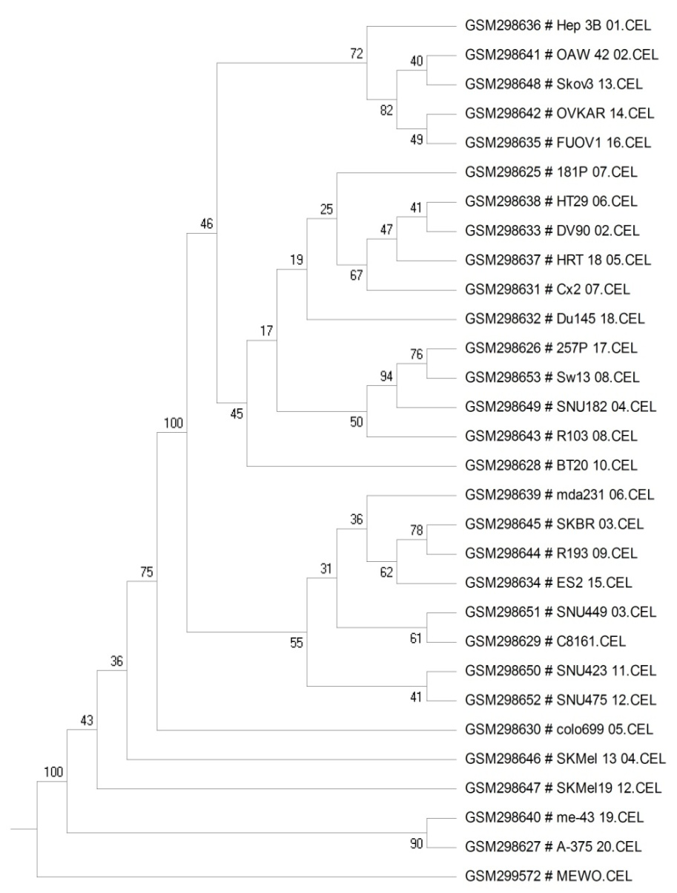
Origin
HCC
ovarian ca
ovarian ca
ovarian ca
ovarian ca
pancerease ca
colon ca
lung ca
colon ca
colon ca
prostate ca
gastric ca
prostate ca
HCC
breast ca
breast ca
breast ca
breast ca
breast ca
ovarian ca
HCC
melanoma
HCC
HCC
lung ca
melanoma
melanoma
melanoma
melanoma
melanoma
Notes:
It should be pinted that there is a grop that we named MDR. All of the group have at least five or four with many mediate drug resistant. These two group with good bootstrap support. The most important is that both of them include a cell line which is sensitive to most of the drug.
Our method cluster the most of the cell line with more than six resisitant drug except the SW13.
These results indicate that the genetic redundance play a key role in multiple drug resistance.

Slide 2
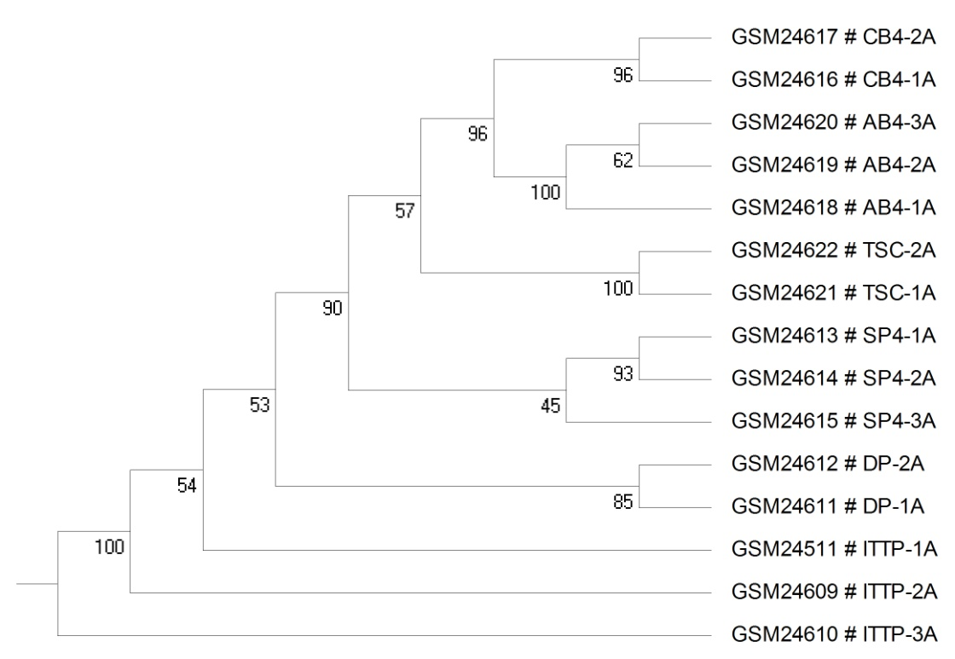
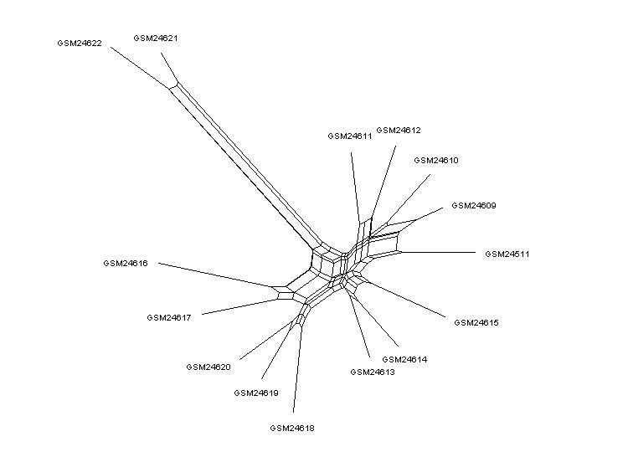
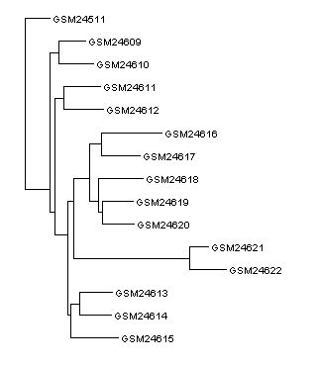
;
NJ-BOOTSTRAP100
NJ
NJ-Net
Notes:
结论：
1 时间序列
2 TSC细胞
3 NJ细胞树
4 bootstrap

Slide 3
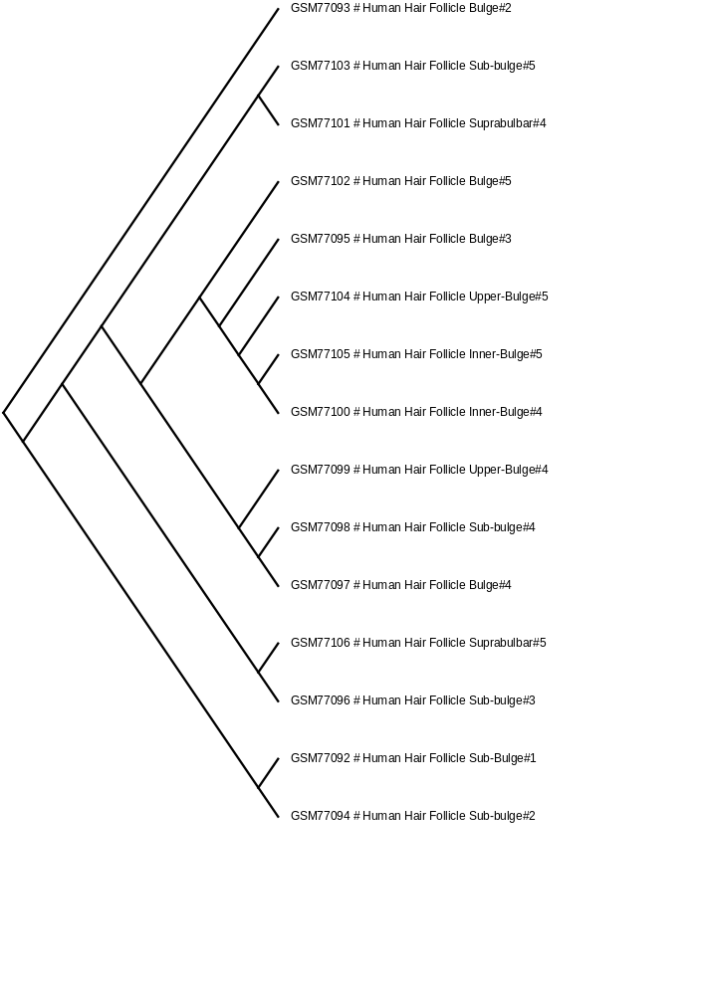

Slide 4
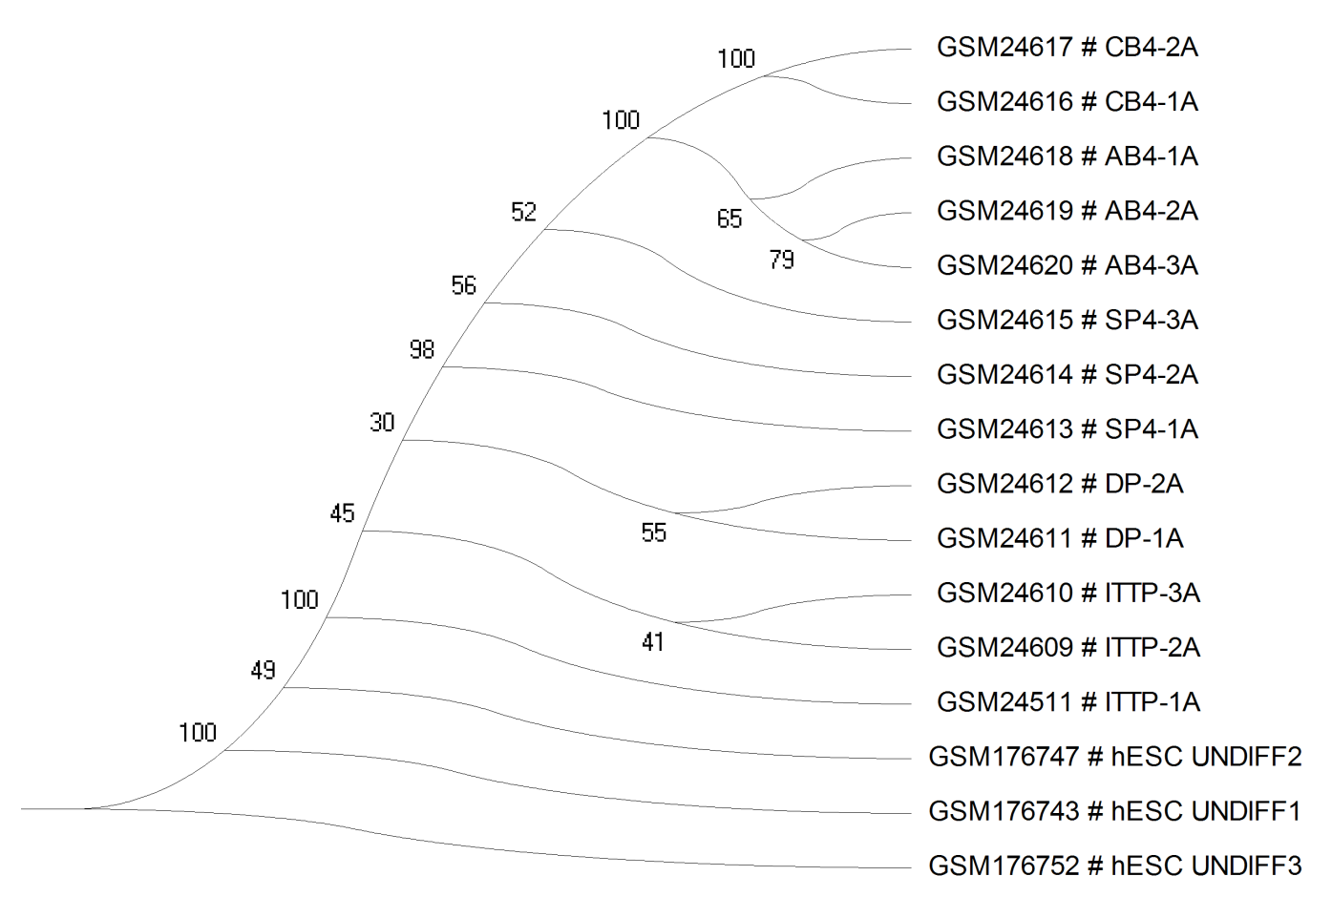
Cord/Adult Blood CD4
Single Positive 4
double positive
T progenitor
Stem cell
Notes:
这张图是用parsimony方法，利用PDO的0 、1矩阵构建的。

Slide 5
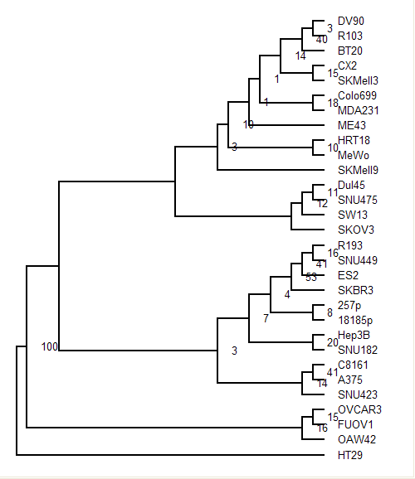
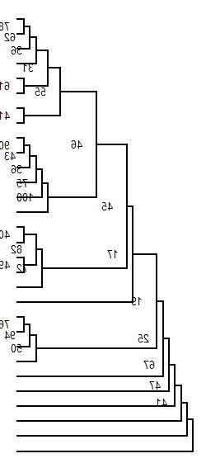
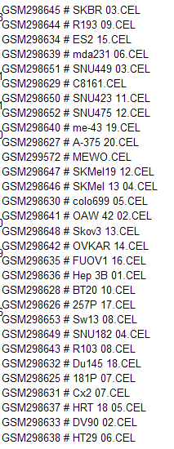

Slide 6
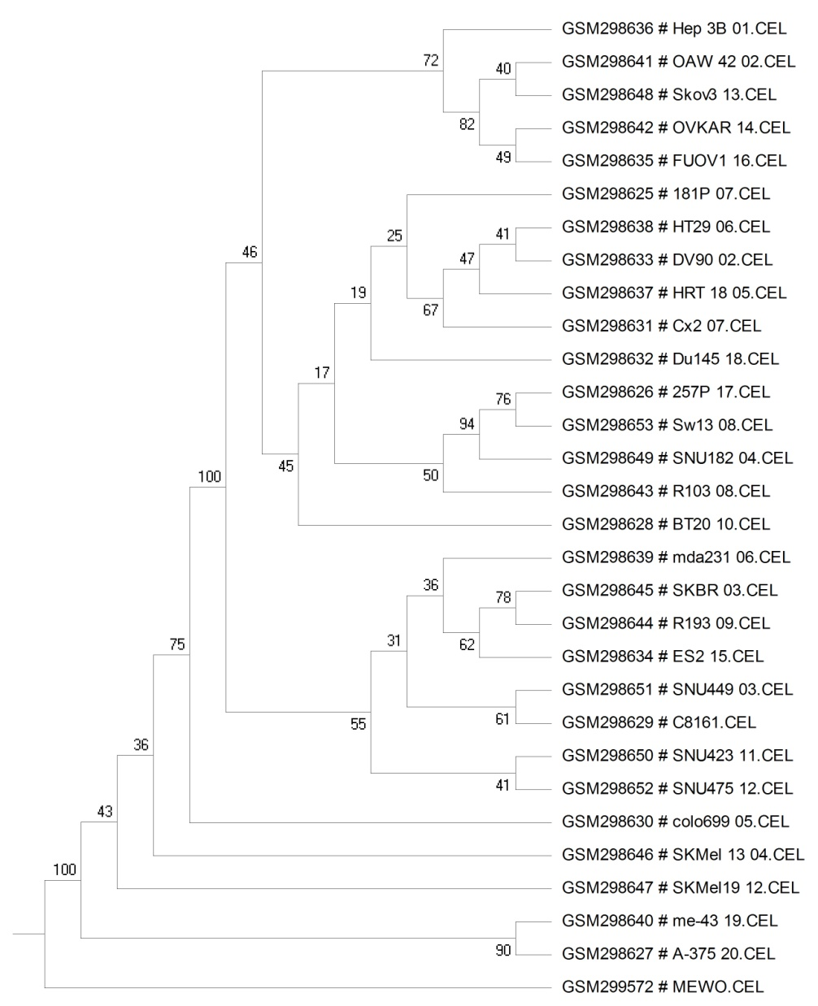
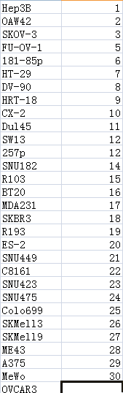
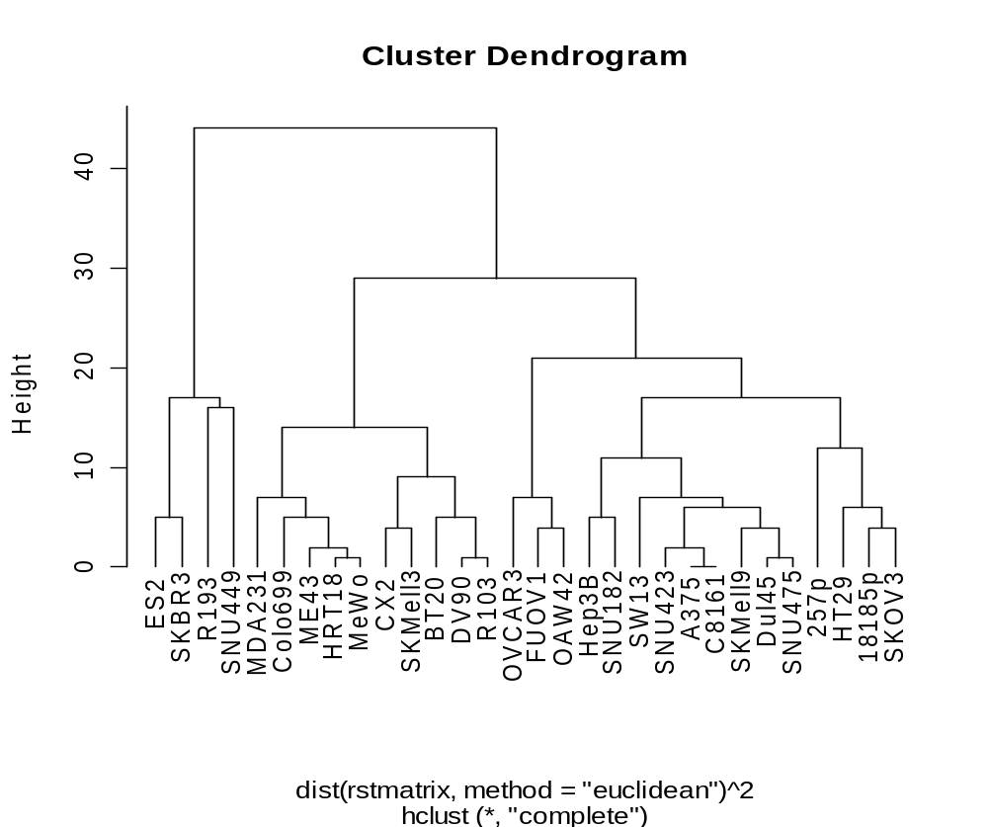

Slide 7
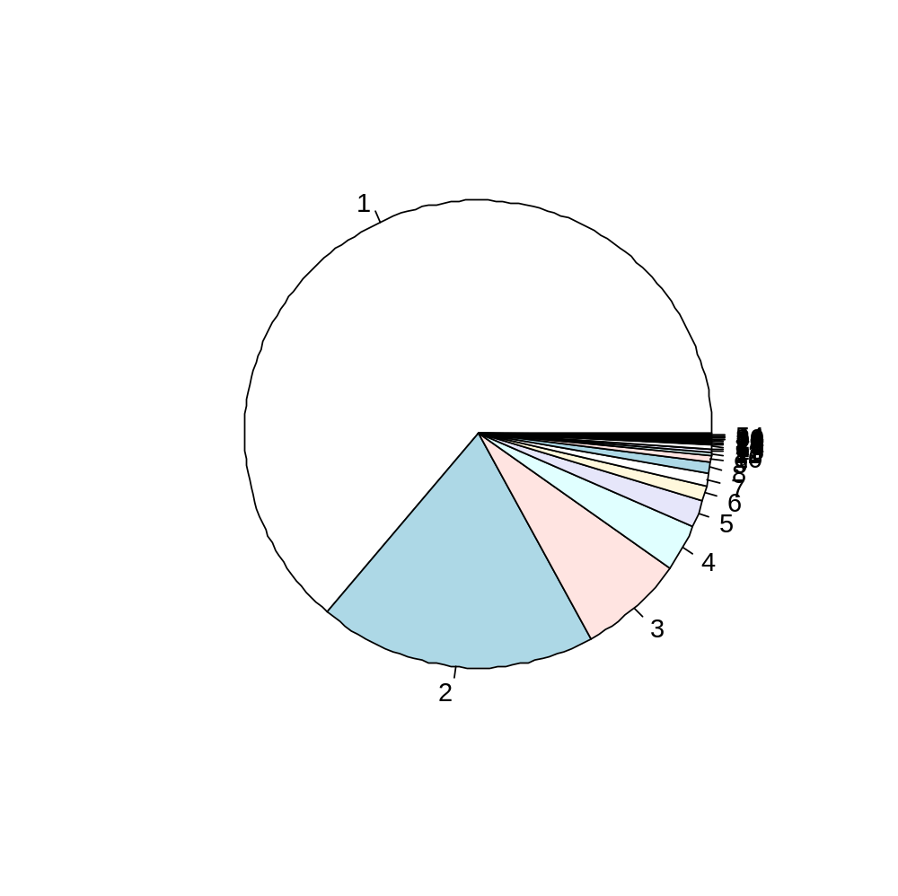
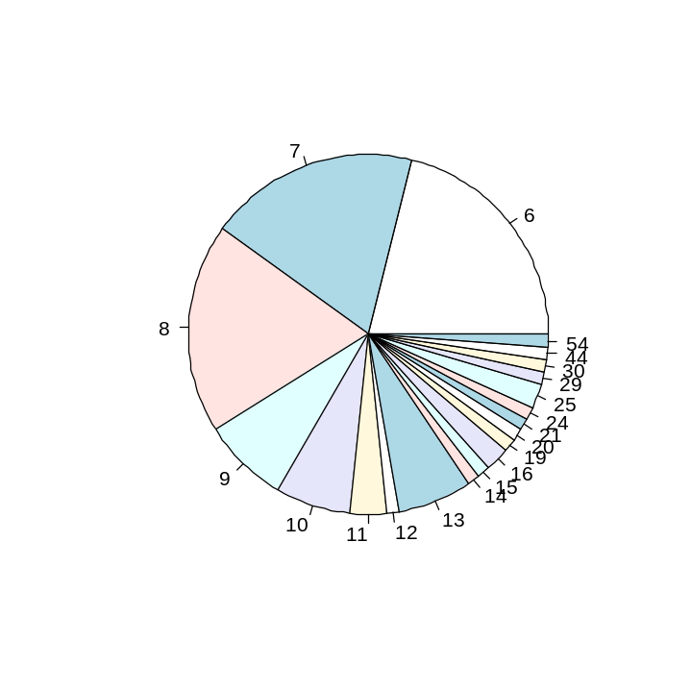
F
63.8%
4.6%
19.2%
Notes:
Figure 2

Slide 8
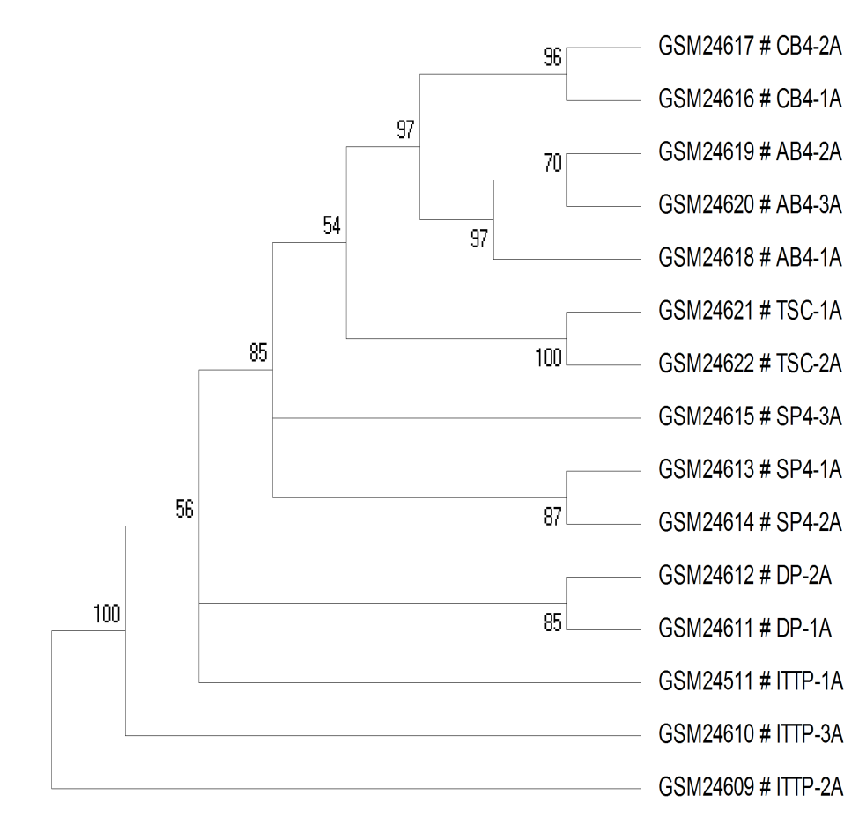
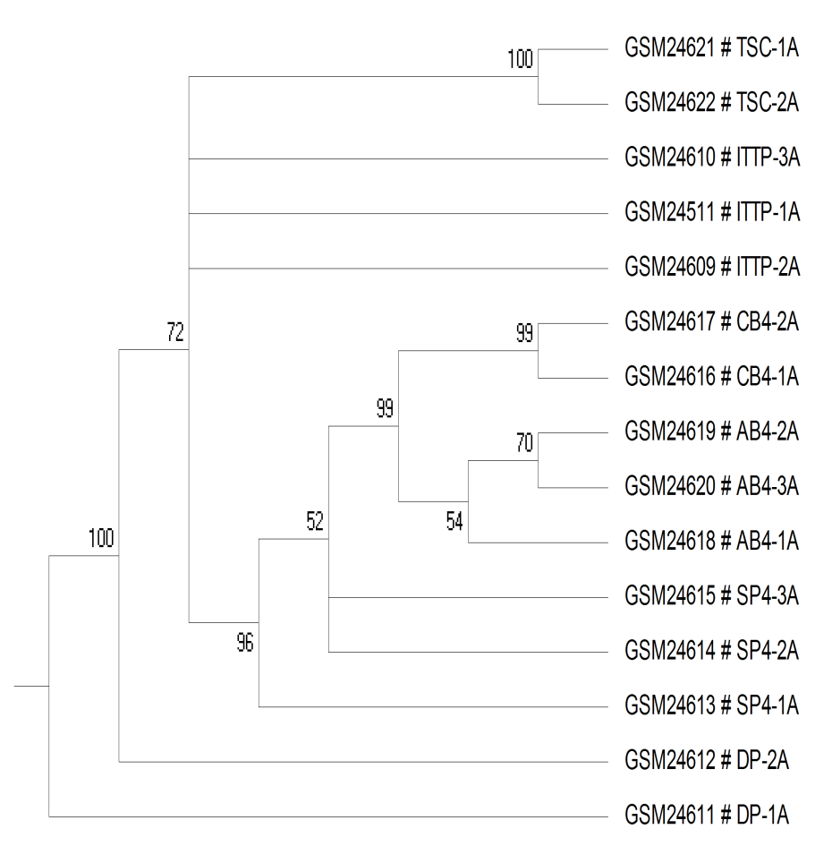
a
b
Neighbor Join
Parsimony
Notes:
Fig3

Slide 9
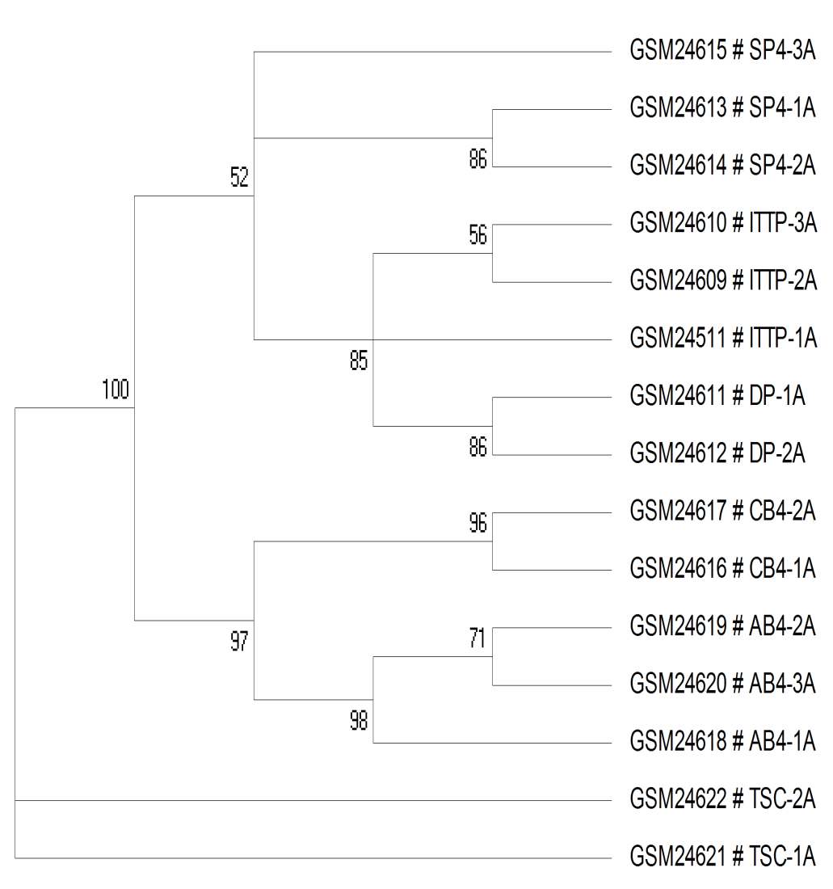
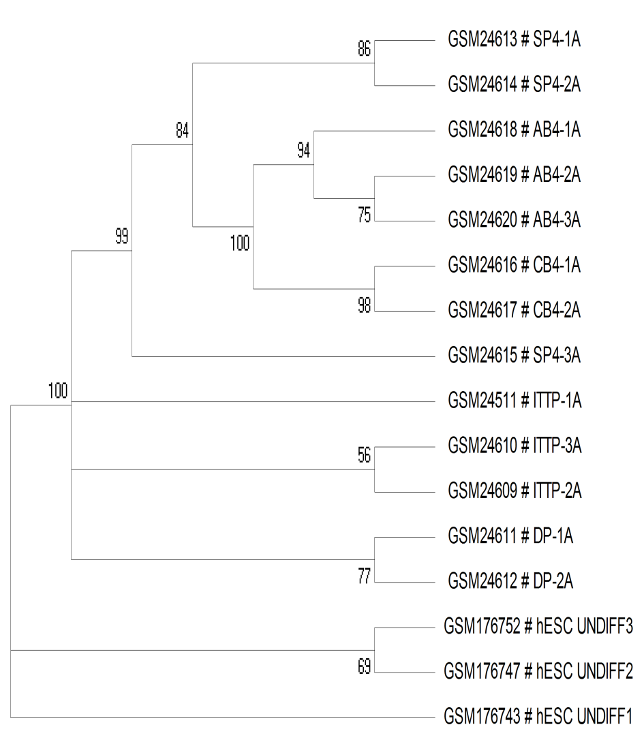
a
b
TSC
hSECs
Notes:
Figure 4

Slide 10
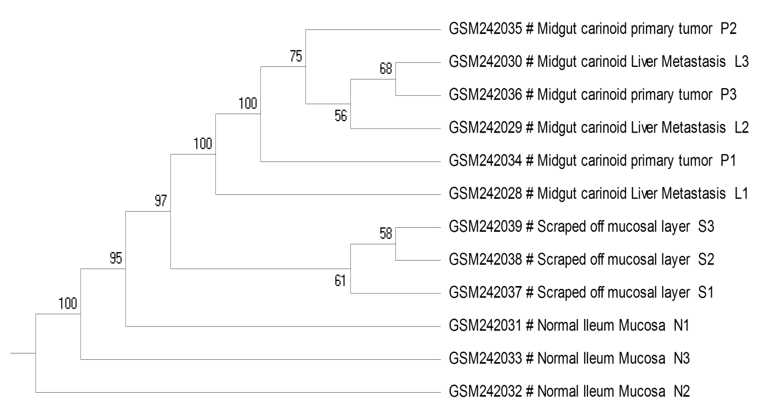
Tumor
Normal
Notes:
Figure 7

