Slide 1


Deciphering Archaeological Spatial Structure
on Domestic Sites
Fraser D. Neiman
Monticello-UVA Archaeological Field School | Anthropology 5589 | Summer 2026 | Week 4

Slide 2
Archaeological Spatial Structure
Two Components of Archaeological Spatial Structure*
Site Structure: the spatial distribution of subsurface features across sites (e.g. remains of structures, fences, pits, etc).
Intra-Site Artifact Distributions: the spatial distribution of artifacts an across sites ~ artifact density surfaces.
Wandsnider, LuAnn, 1996, Describing and Comparing Archaeological Spatial Structure. Journal of Archaeological Method and Theory 3(4): 319-384. https://digitalcommons.unl.edu/anthropologyfacpub/70/
A Little History
Serious interest in spatial structure is relatively recent.
Culture History (c. 1920s to 1960s). Primary focus: The distribution of “cultures” in time and space. Sites are "homogeneous artifact mines."
New or Processual Archaeologists (post 1960’s). How cultures function is important too, e.g. social and social organization. Archaeological spatial structure offers essential clues

Slide 3
Archaeological Spatial Structure
If we want the evidence from archaeological spatial structure to be useful, we have to make inferences about the causal dynamics responsible for the spatial patterns .
We need to think about two sets of processes.
Systemic context processes*
Site structure: what factors affect the spatial organization of activities and the facilities or non-portable artifacts (whose archaeological traces are “features”) with which activities are associated?
Artifact Distributions: what factors affect where artifacts are used and discarded?
Archaeological context processes
Site Structure: What factors affect the ways in which facilities are represented as the features we see in the record? (e.g. preservation)
Artifact Distributions: What factors affect spatial patterns after artifact deposition and site abandonment? (e.g. plowing, erosion, )
* Schiffer, M.B., 1972: Archaeological context and systemic context, American Antiquity 37, 156–65. See also… Furlan G. 2024: Revising the concepts of systemic context and archaeological context: a proposal. Archaeological Dialogues. 31(2):208-219.

Slide 4
Systemic Context Processes
Spatial organization of activities and the facilities with which they are associated: a simple model.
Imagine a domestic site where all activities (e.g eating, sleeping, food preparation, bulk processing, storage) all happen in the same place.
The extent to which one activity will be spatial segregated from others is a function of
Benefits of moving scale inversely with interference potential:
activities take up lots of space
activities are dangerous
activities require uninterrupted time
Higher interference potential means activities are more likely to be moved
farther away.
Costs of moving the interfering activity
Greater distance means greater travel costs to and from
Greater access frequency also increases travel costs.

Slide 5
General vs. Special Activity Areas
General Activity Areas
-sleeping, eating, socializing, cooking
-sleeping, cooking often separate within them
-Family (kin based)
-Communal (cross cut kin lines e.g. gender based)
a.k.a, “nuclear” (John Yellen)
“intensive” (Lewis Binford”
“household” (O’Connell)
General
Activity Area
Special Activity Areas
-ecologically variable
-e.g. kangaroo roasting, car repair
-cooking for large numbers (signals)
-bulk processing and storage of agricultural
produce
-lots of refuse, space, time
Special
Activity Areas

Slide 6
Implications for Site Structure ….
Source:
O’Connell, James, 1987, “Alyawara Site Structure and Its Archaeological Implications. American Antiquity 52(1):74

Slide 7
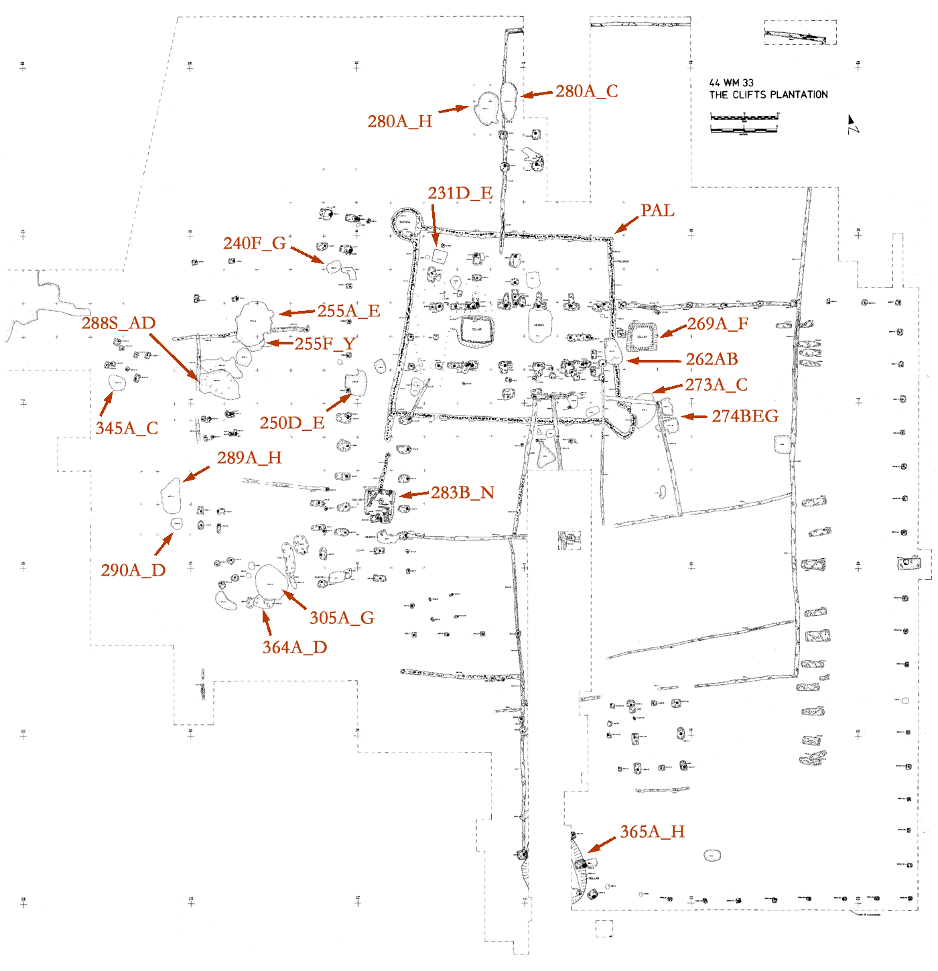

Slide 8
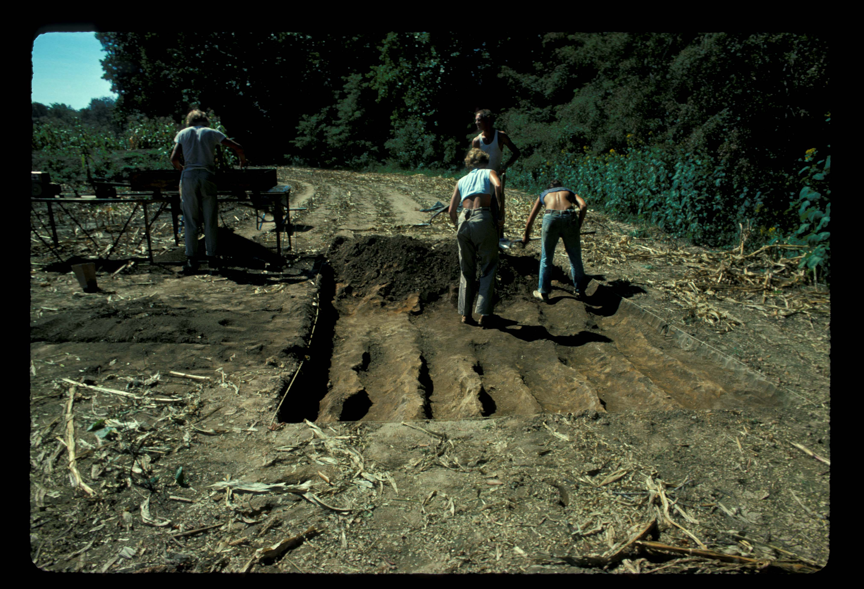

Slide 9
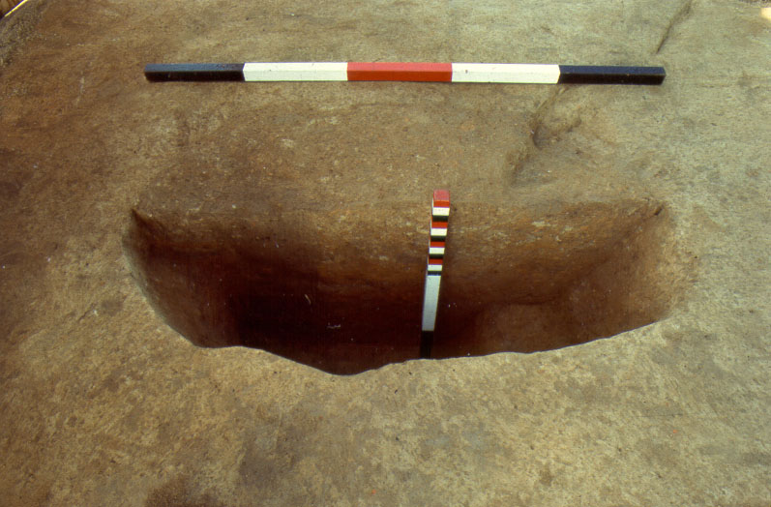

Slide 10
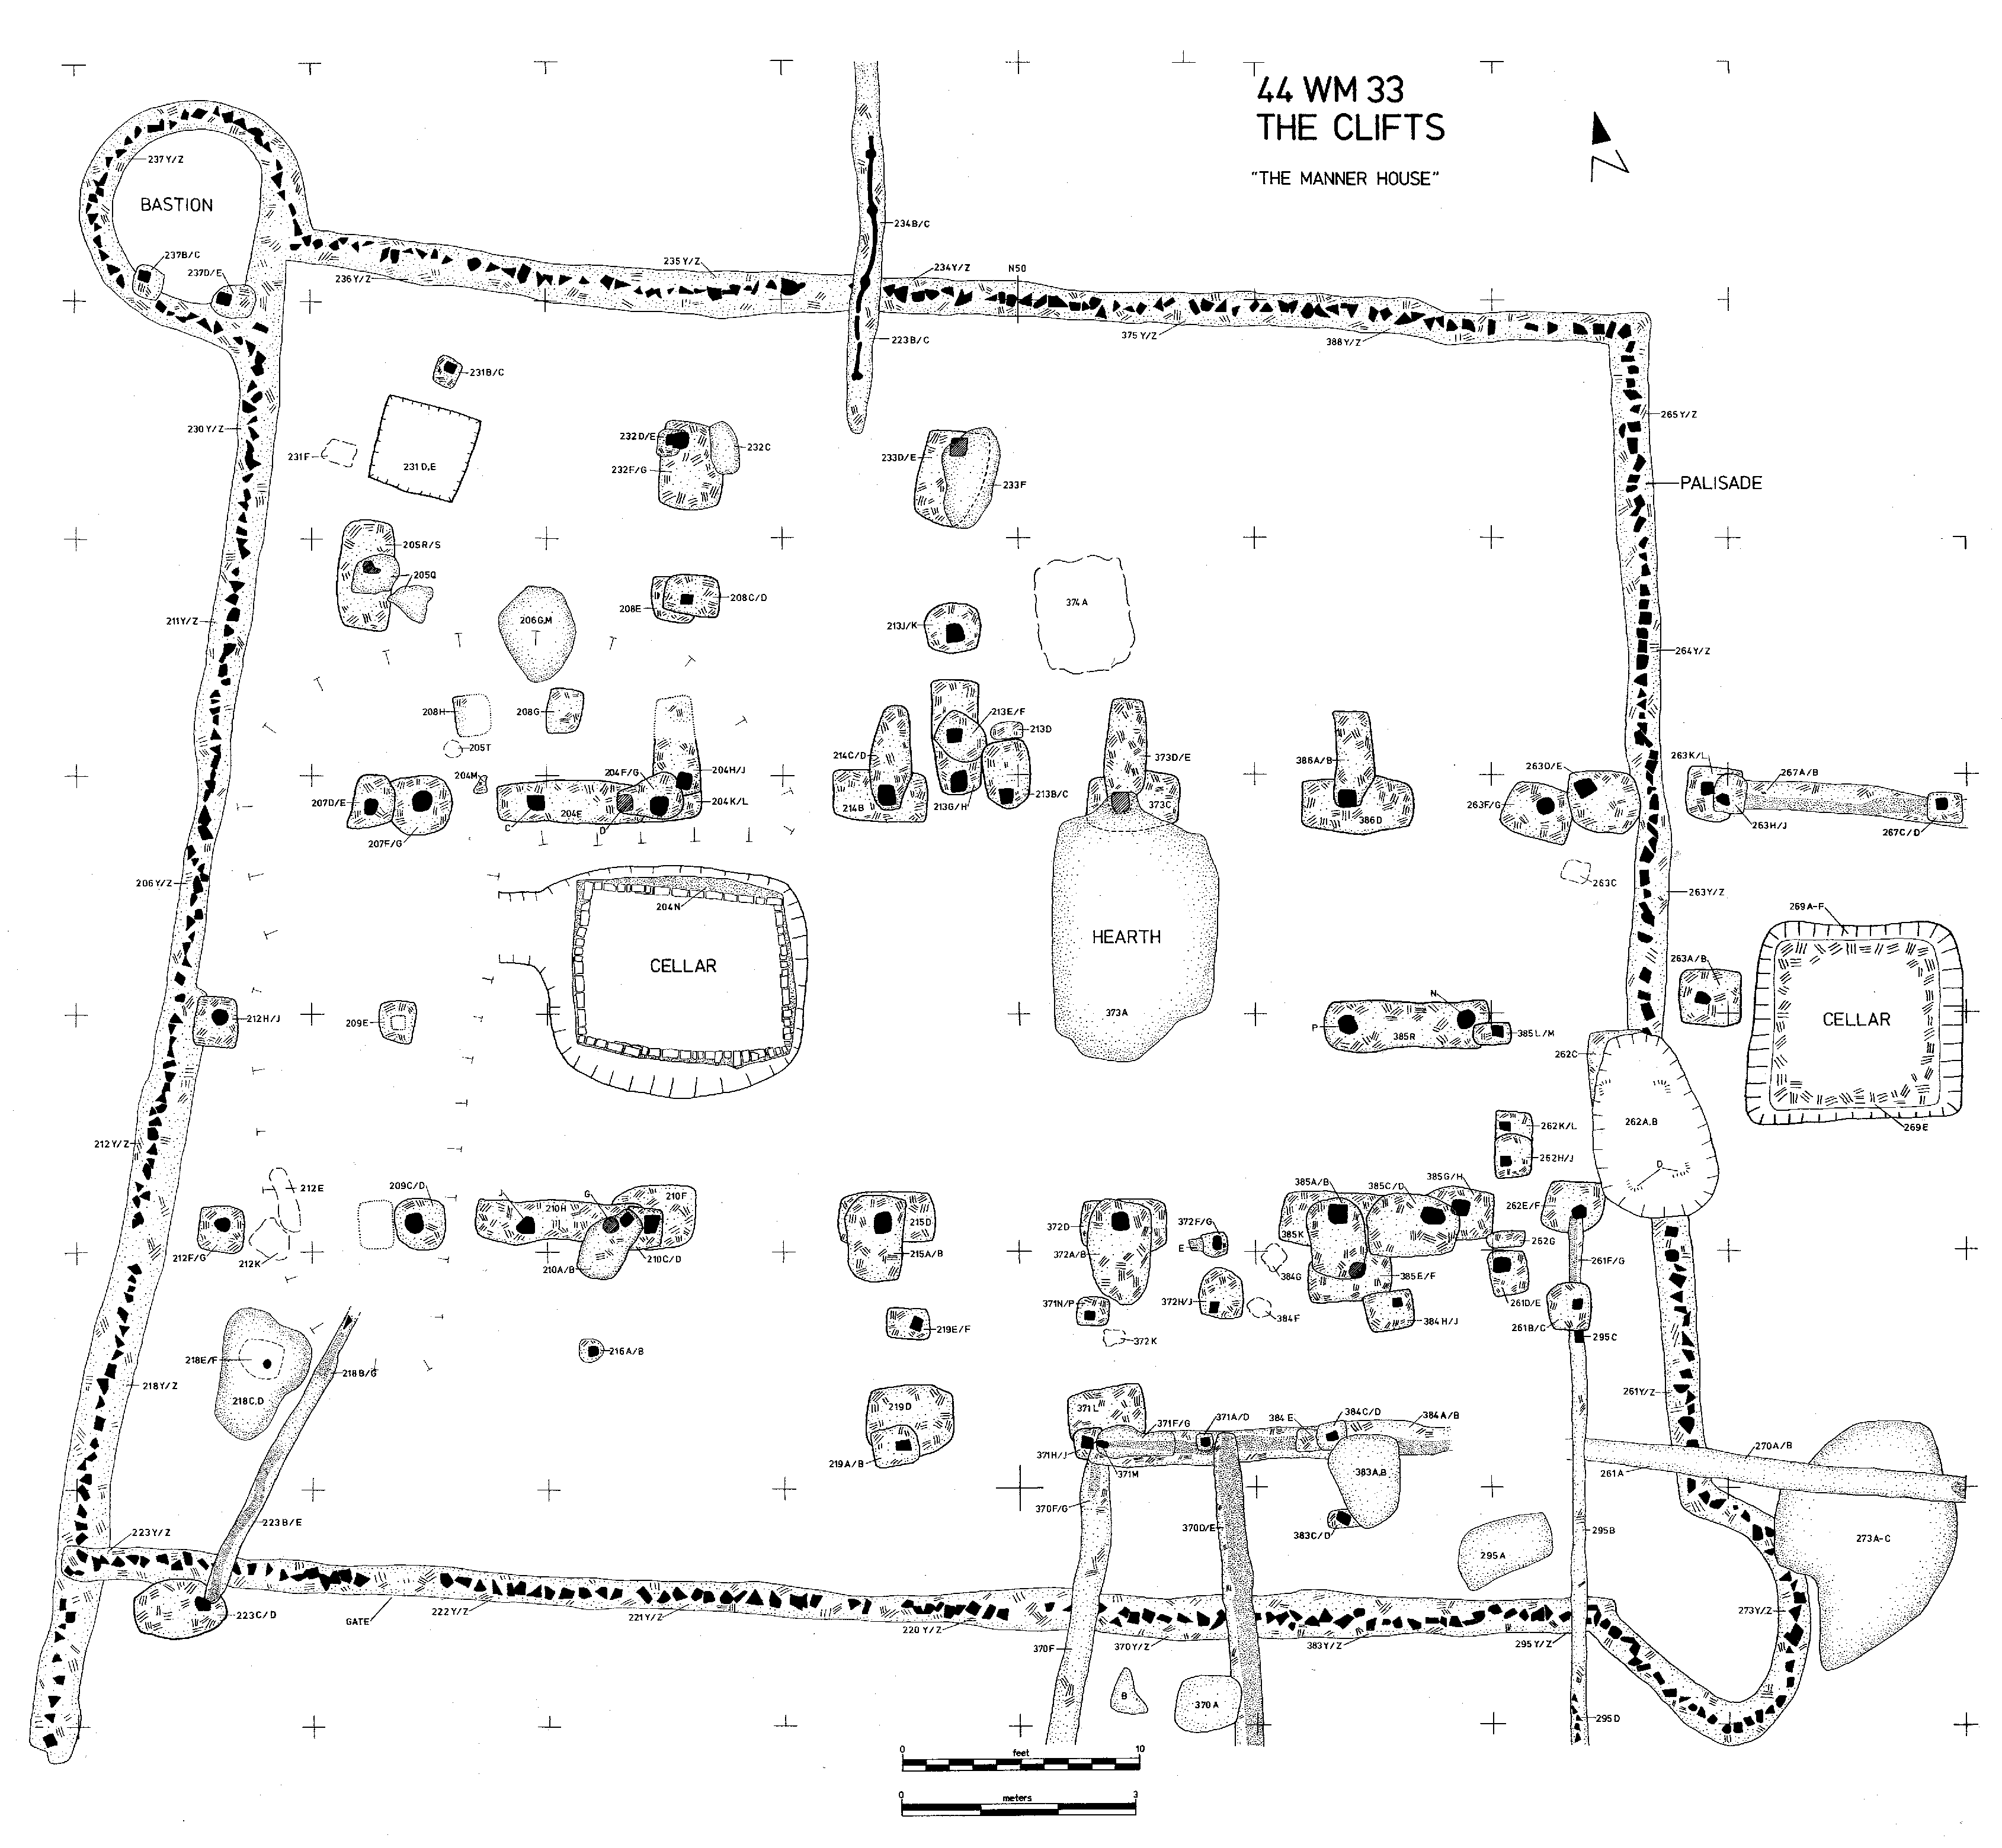

Slide 12
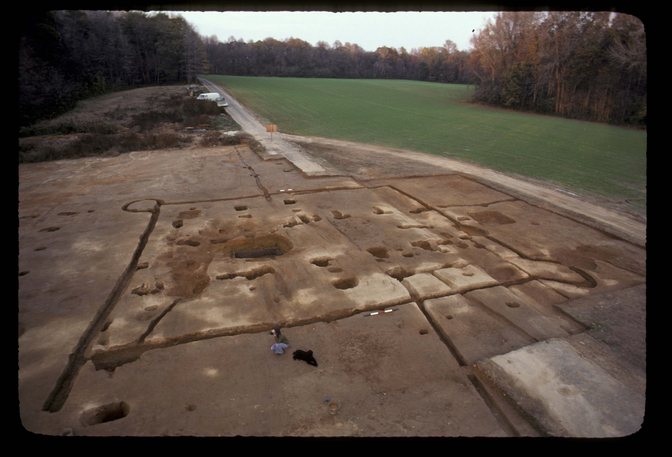

Slide 14
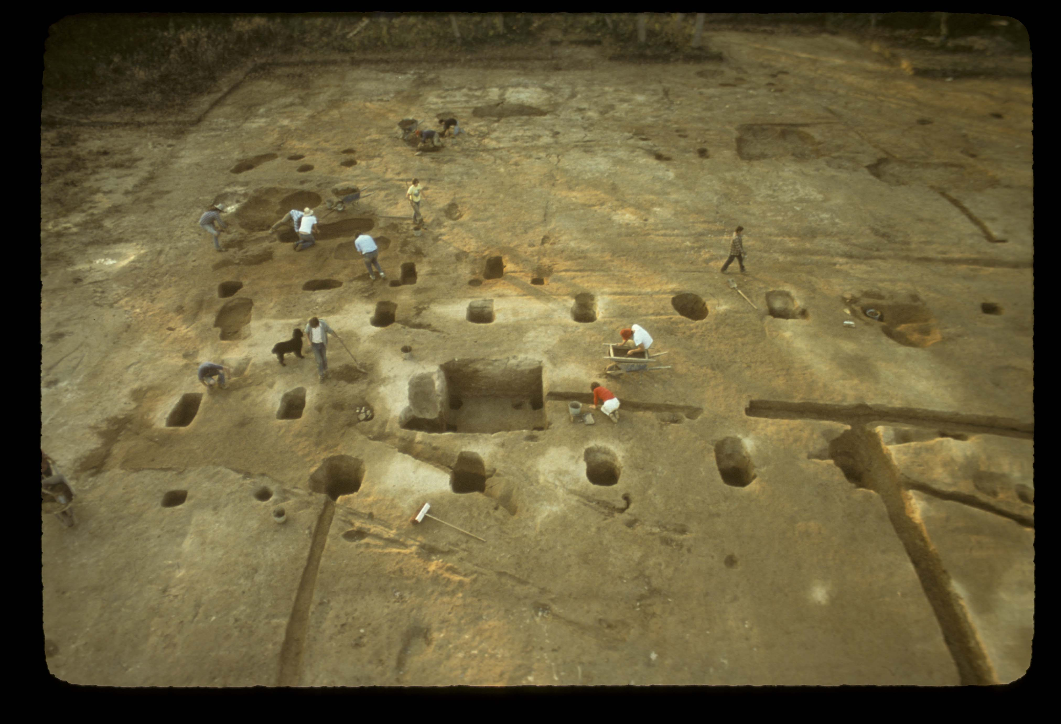

Slide 17
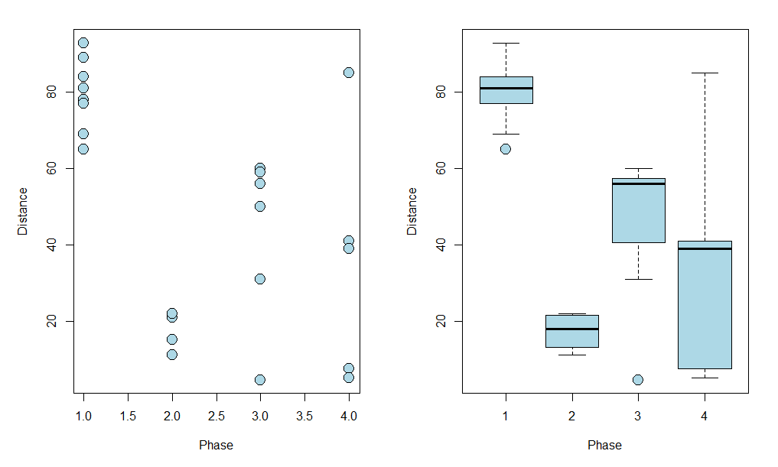
Clifts Plantation
Distances of pits from the main house

Slide 18
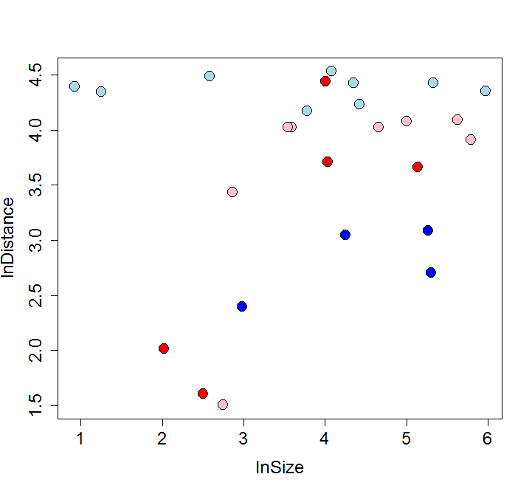
Clifts Plantation
Pit Distances vs. Pit Size (log scale)
1
2
4
3

Slide 20
Systemic context processes
Spatial organization discard
The Pompeii Premise: the false idea that the location of artifact discard is the location of use and breakage.
Primary refuse vs. secondary refuse (Mike Schiffer)
Cleaning up creates some patterns and destroys others
How far broken/failed artifacts are transported effects spatial scale at which spatial patterns can be interpreted.
Secondary refuse nearly always has useful spatial pattern at some informative scale!!
Location of use
(and breakage)
Location of
deposition

Slide 21
Systemic context processes
Spatial Organization of Discard.
The distance that artifacts will be transported from the location of use and breakage is a function of…
Benefits of cleaning up
Scale inversely with interference potential with other activities
Amount of artifacts ~ occupation span, number of occupants
Artifact size: large artifacts are more likely to interfere.
Hazard potential. e.g. glass, poop
Importance of “other activities”
Higher interference potential means refuse is more likely to be moved
farther away.
Costs of cleaning up and moving the refuse
Scale with distance moved
Artifact size: little bits are harder to pick up or sweep than big bits.
Easy cleanup means refuse is more likely to be moved farther away.

Slide 22
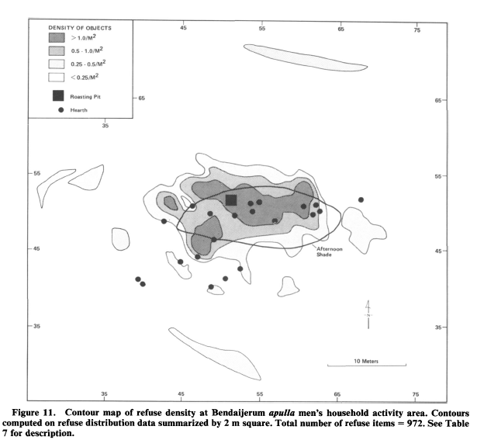
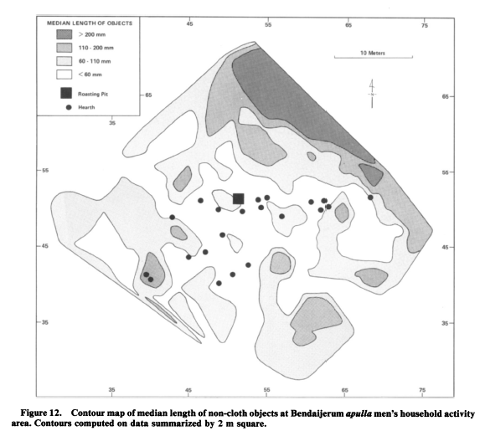
Systemic Context Processes
Spatial organization discard
- How to recognize cleaning up?
- Ethnoarchaeological evidence: Alyawara men’s camp (O’Connell 1987)

Slide 23
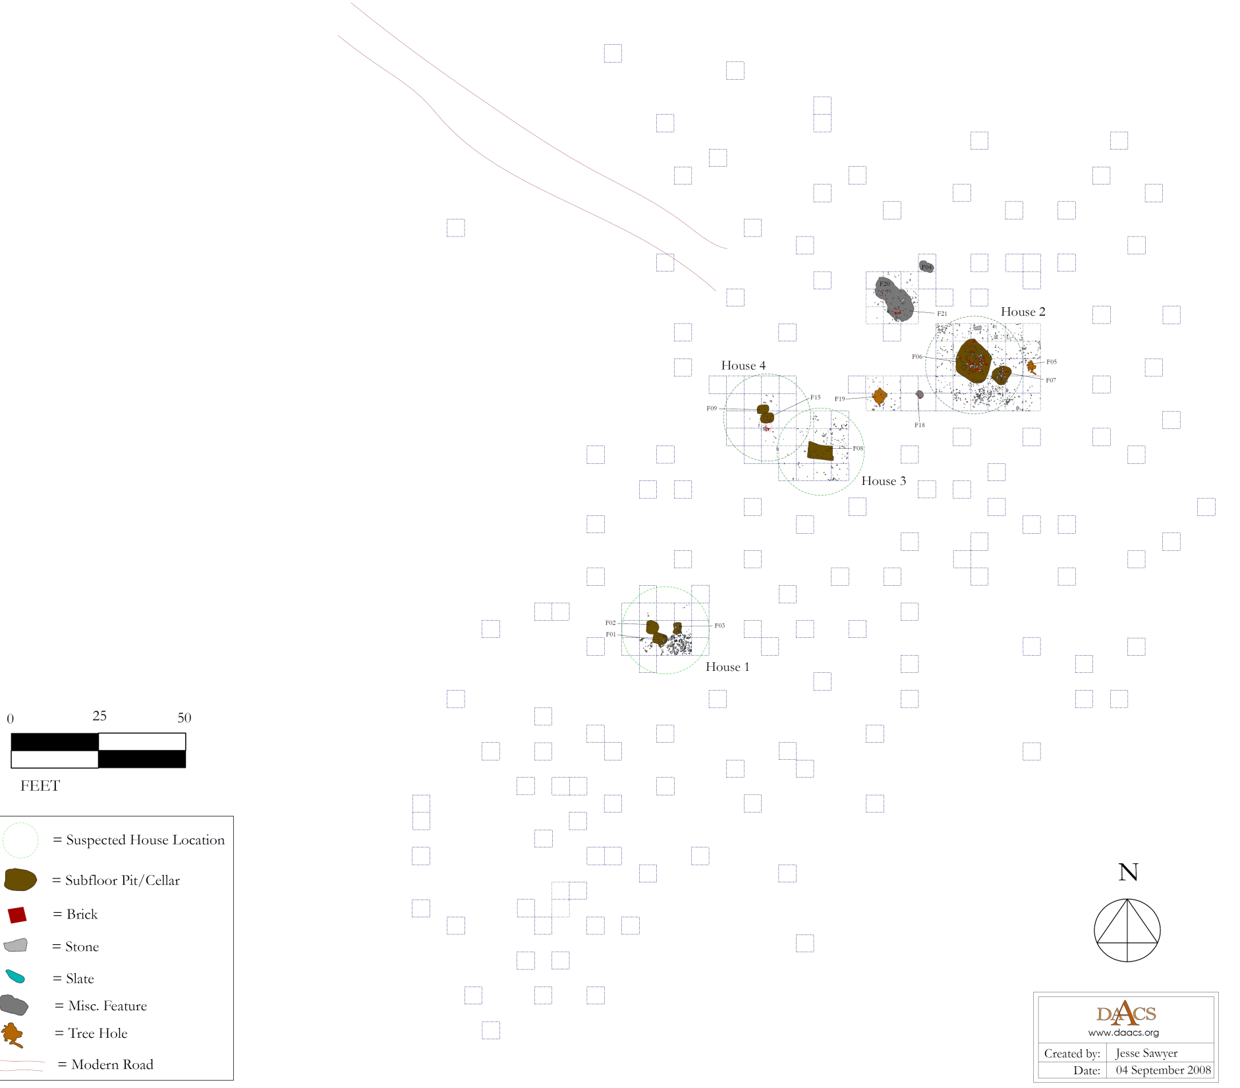
Site 8 Example
-c. 1770-1800
-heavily plowed
-stratified random sample
-266 5-foot quadrats
0 25 50
Feet

Slide 24
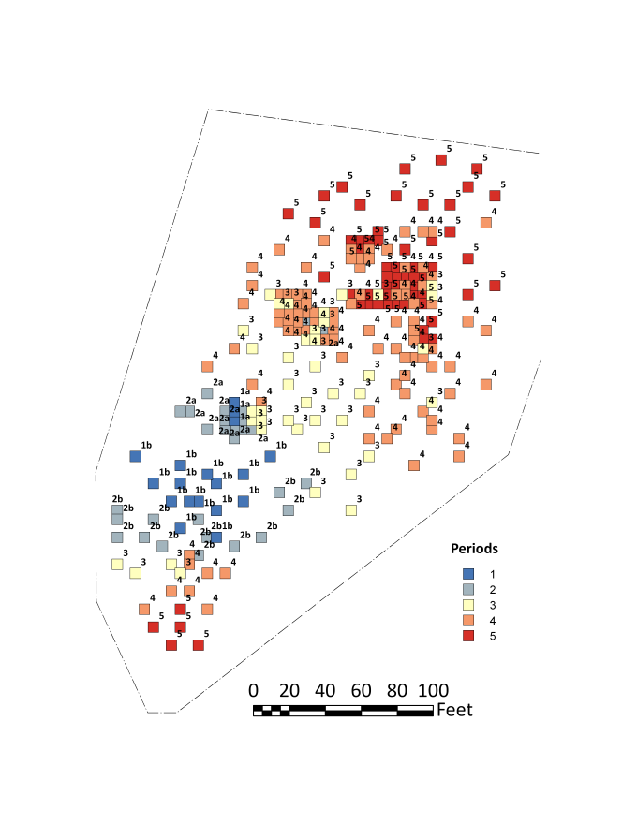
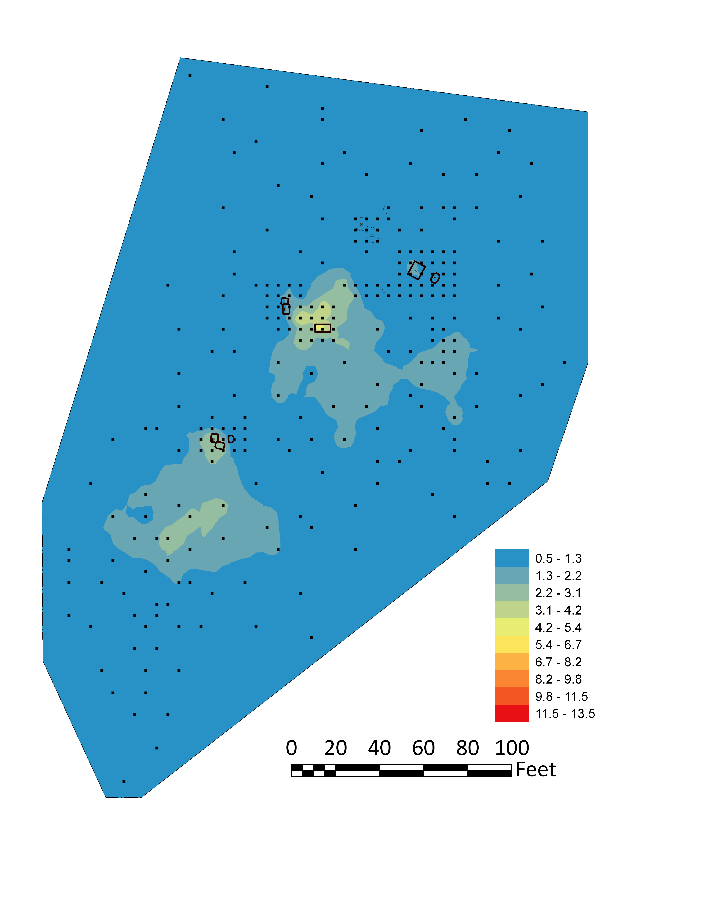
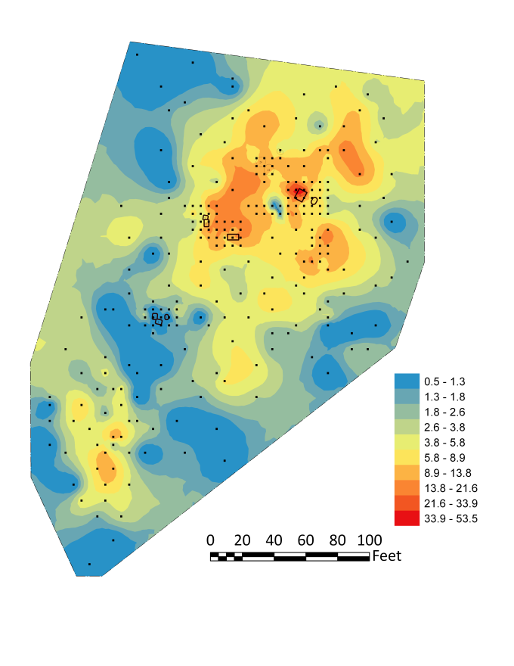
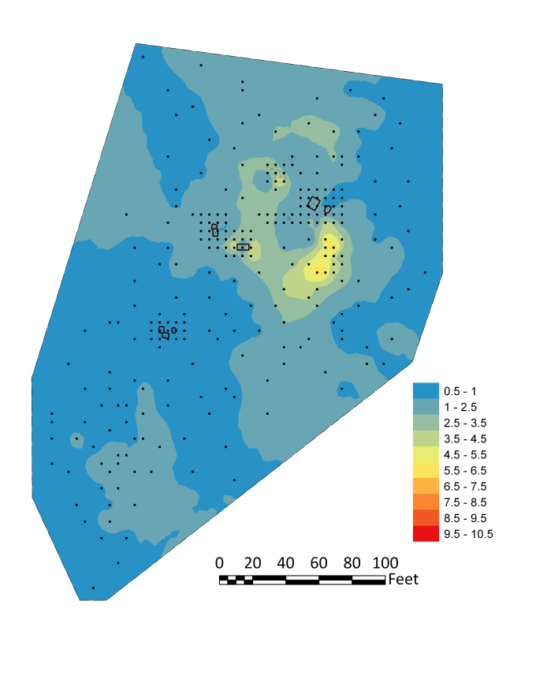
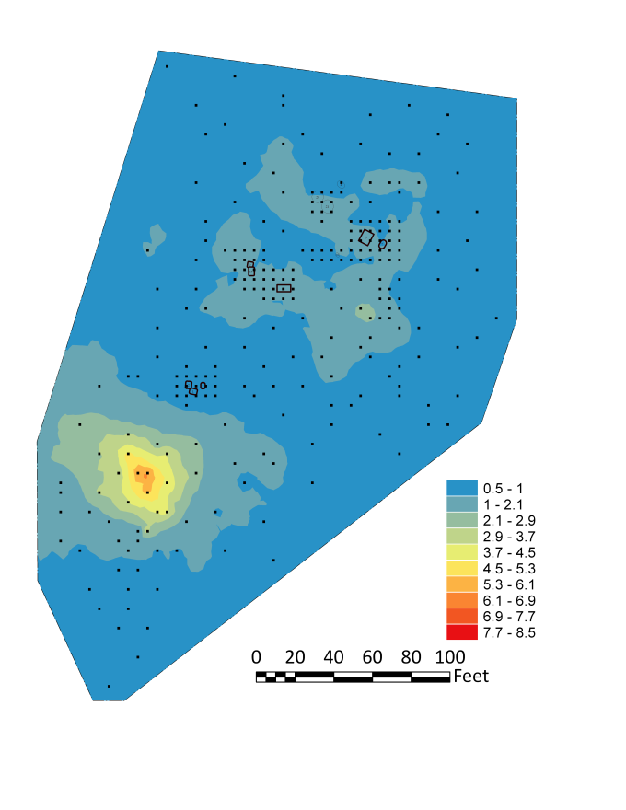
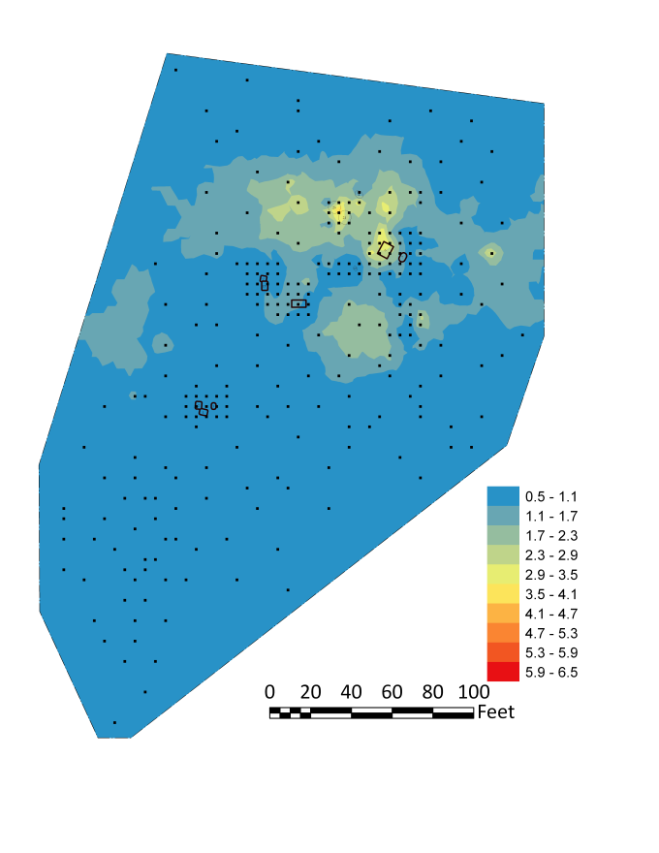
Site 8 (c. 1770-1800)
Pearlware (1775-1830)
Correspondence-Analysis Chronology
Delft (1600-1802)
Creamware (1762-1820)
Artifact density surfaces interpolated from counts in scattered quads, using Kriging.
Redware
Chinese Porcelain

Slide 25
Site 8
Correspondence Analysis Chronology

Slide 26
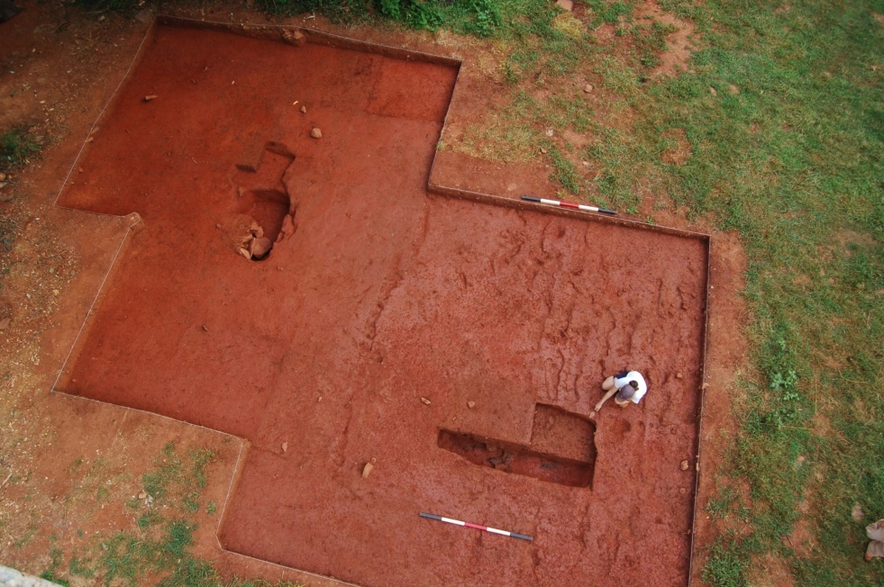
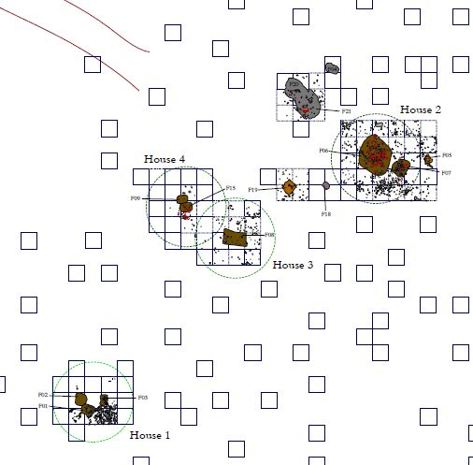
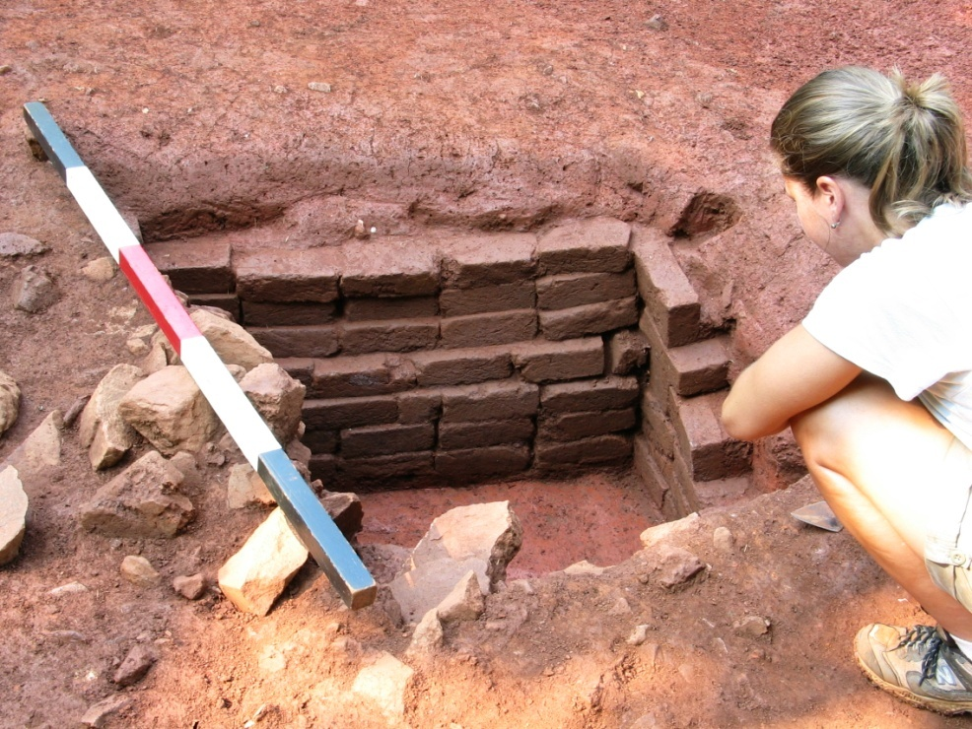
Partially excavated sub-floor pits under Structures 3 and 4
Site 8 (c. 1770-1800)
Subfloor pit evidence
Pits get larger over time: House 1 pits < House 3 and 4 pits < House 2 pits.
House 2 has a brick-lined pit
Partially-excavated , brick-lined sub-floor pit under Structure 2

Slide 27
Systemic Context Processes
Spatial organization of discard
- How to recognize cleaning up?
- Ethnoarchaeological evidence: Alyawara men’s camp (O’Connell 1987)

Slide 28
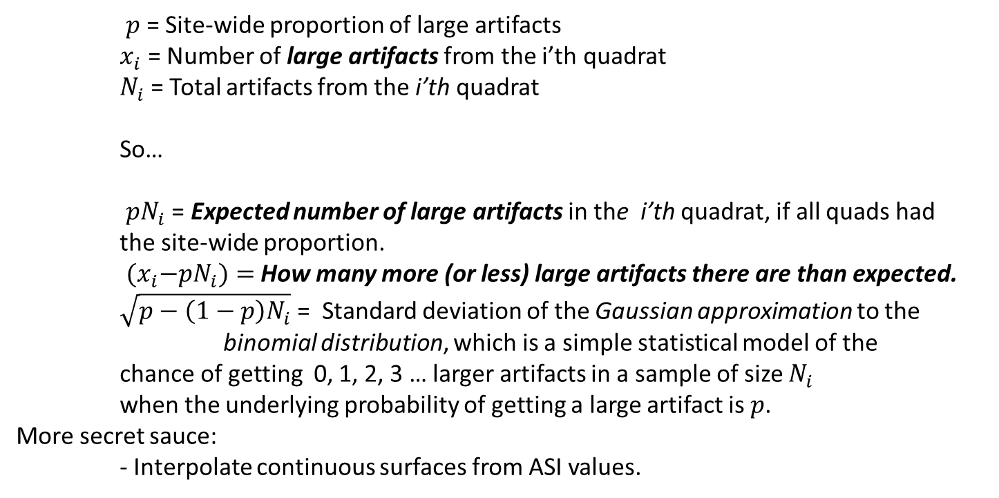
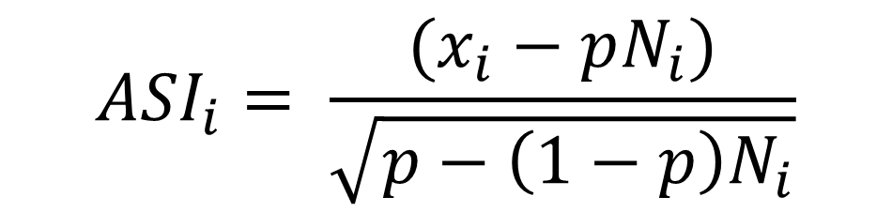
The Artifact Size Index
A statistic to recognize the size sorting that results from cleaning up
$${ASI}_{i}= \frac{(x_{i}−pN_{i})}{\sqrt{p−\left(1−p\right)N_{i}}}$$
Positive ASI: More
large artifacts than
expected
Negative ASI: Fewer
Large artifacts than
expected
$p$= Site-wide proportion of large artifacts
$x_{i}$ = Number of large artifacts from the i’th quadrat
$N_{i}$ = Total artifacts from the i’th quadrat
So…
$pN_{i}$ = Expected number of large artifacts in the i’th quadrat, if all quads had the site-wide proportion.
${(x}_{i}−pN_{i})=$ How many more (or less) large artifacts there are than expected.
$\sqrt{p−\left(1−p\right)N_{i}}$ = Standard deviation of the Gaussian approximation to the
binomial distribution, which is a simple statistical model of the chance of getting 0, 1, 2, 3 … larger artifacts in a sample of size $N_{i}$ when the underlying probability of getting a large artifact is $p$.
More secret sauce:
- Interpolate continuous surfaces from ASI values.

Slide 29
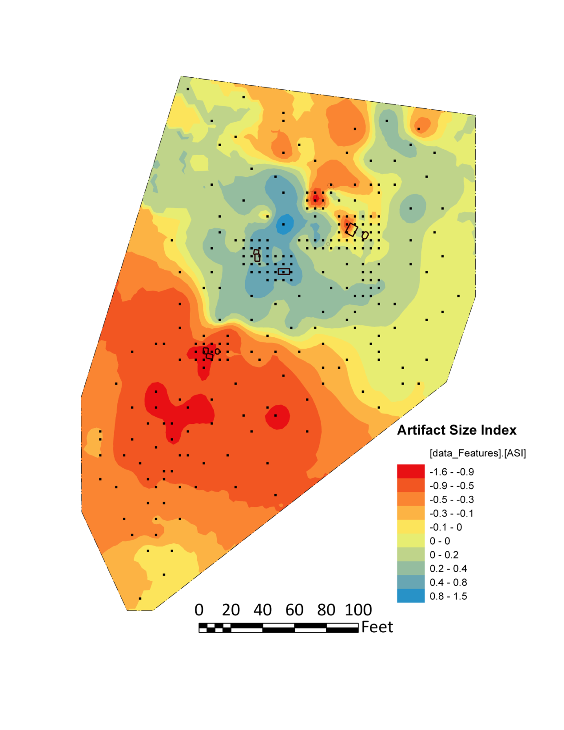
Site 8
Size Sorting: Ceramics
Ceramic Density
Ceramic ASI
-
-
-
-
-

Slide 30
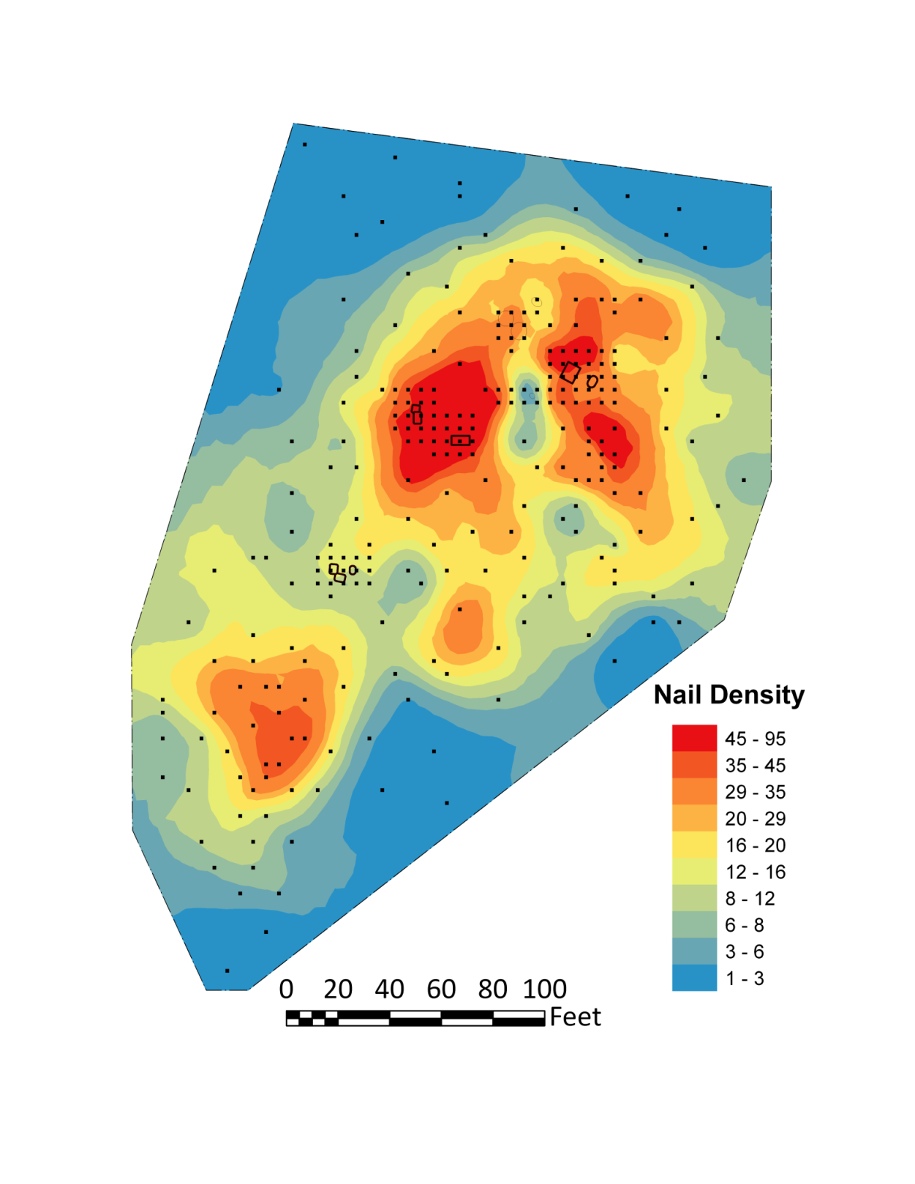
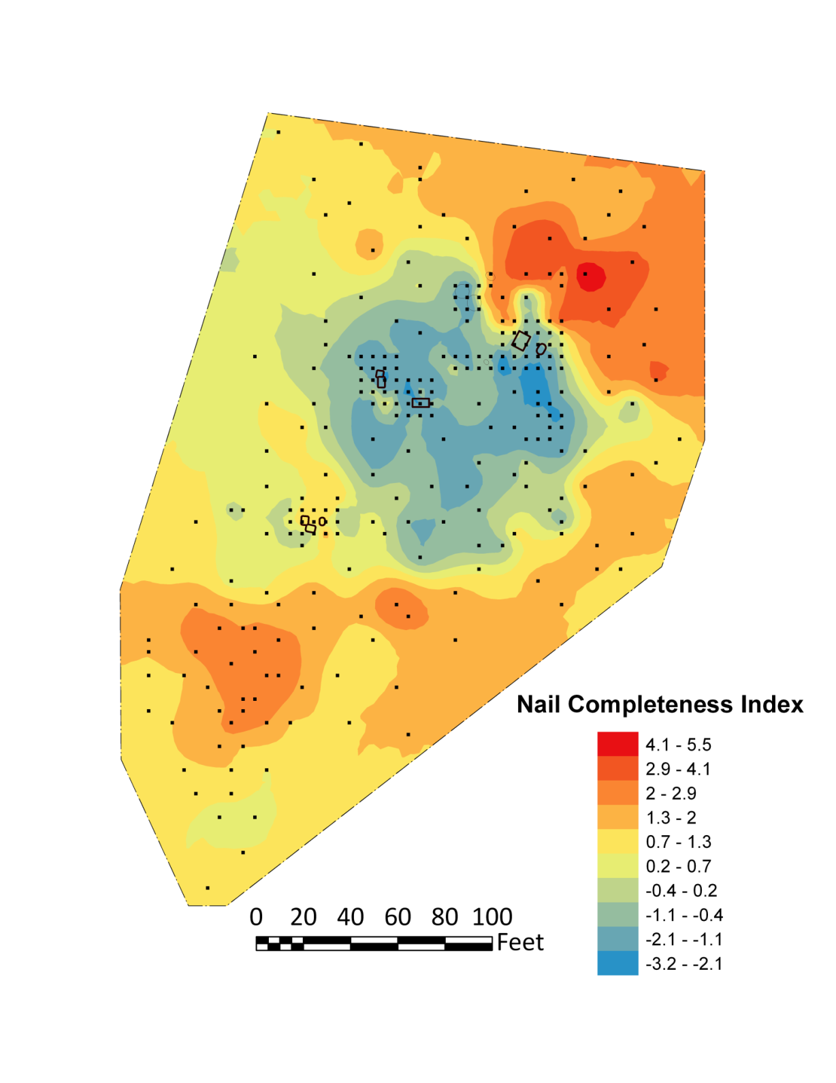
Site 8
Size Sorting: Nails

Slide 31
Archaeological Spatial Structure
Site Structure: how subsurface features are arranged across a site — for instance, the remnants of buildings, fences, pits, and comparable traces.
Intra-Site Artifact Distributions: the way artifacts are spread within a site, represented through artifact density surfaces.
Model of General versus Special Activity Areas
Interference costs offer an incentive to separate special activity areas from general ones.
Cost of repeated traveling between general and special activity areas constrains that movement.
The framework applies to location of features and location of trash disposal (cleaning up)
Case Study 1: Site Structure
How site structure evolved over time: the positioning of borrow pits at the Clifts Plantation Site
Distance of pits from the main house scales with how intensively yard around it is used: number of people, number of outbuilding.
Case Study 2: Intra-site Artifact Distributions
Variation in level of cleaning up among households: size sorting
Establish a site chronology using spatial patterns
Variation in levels of size sorting among households scale with how intensively yards are used.

