Slide 1


High performance computing and additive manufacturing summer camp
Sandra Gesing, Anuj Tiwari, Karan Jogi (DPI)
Jifu Tan, Ryan Mueller (NIU)
sgesing@uillinois.edu

Slide 2
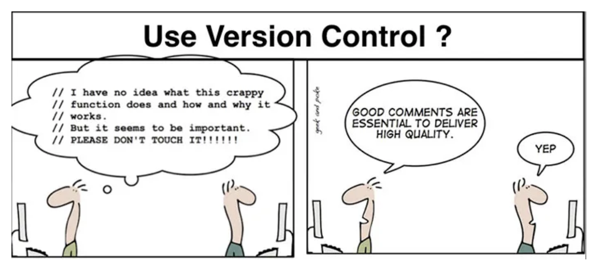
Version Control Systems
Easy Modification
Reverting Errors
Collaboration
Backup
Examples
Git
SVN

Slide 3
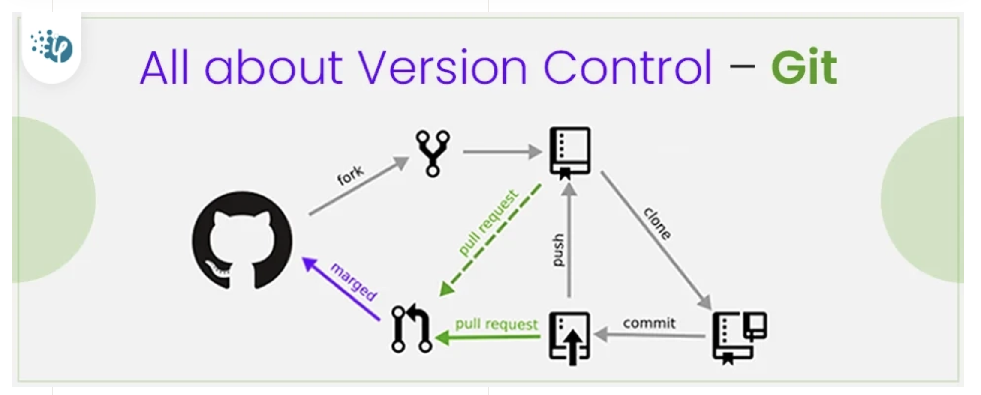
GitHub
Let’s create a user and a first repository!
https://docs.github.com/en/get-started/quickstart/hello-world

