Slide 1
Lecture 1 Introduction to PLD
What does FPGA stand for?
􀂄 Field Programmable Gate Array
Is CPU/DSP a programmable logic device?
NO, here, programmable means hardware can be reconfigured.
Can an FPGA be used as a CPU/DSP?
Yes, FPGA principally can do anything that digital logic circuitry does.
What is the fabric architecture of an FPGA
Basically contains IOB, CLB, and programmable interconnects.
What is a look-up table?
􀂄 A memory block that is used to implement logic functions
What is the design process with FPGA?
􀂄 Specification->HDL input-> Synthesis->Implementation->Configuration
List some major FPGA vendors you known

Slide 2
Lecture 3 Basics of Verilog
Is Verilog HDL a hardware programming language used for hardware design?
What is the use of Verilog HDL?
Can Verilog HDL do both discrete and continuous simulations?
Can HDL be used for both ASICs and PLDs hardware description
What is the value of A, B and C (write each bit)?
B = 13’hxz4
C = 8’o1z2
x_xxxx_zzzz_0100
01_zzz_010

Slide 3
Lecture 4 Combinational Circuit
Given:
A1= 4’b1011; B1 = 4’b11; C1= 4’b101x ;
D1 = 4’b10z0; E1 = 4’b101x ;
What will these expressions evaluate to?
A1 && B1
C1 > D1
A1 < B1
E1 !== C1
A1 & B1
C1 | B1
B1 + A1
^A1
{D1, E1}
{{2{A1}}, C1}
A1 >>> 2
• A1 && B1 // produces 1’b1
• C1 > D1 // produces 1’bx
• A1 < B1 // produces 1’b0
• E1 !== C1 // produces 1’b0
• A1 & B1 // produces 4’b0011
• C1 | B1 // produces 4’b1011
• B1 + A1 // produces 4’b1110
• ^A1 // produces 1’b1
• {D1, E1} // produces 8’b10z0_101x
• {{2{A1}}, C1} // produces 12’b1011_1011_101x
• A1 >>> 2 // produces 4’b1110

Slide 4
Exercise 1 : Give the HDL descriptions of 2-bit comparator using 3 modeling methods

Slide 5
Structural/dataflow modeling
model count2bit(
input a0, a1, b0,b1,
output a_gt_b, a_lt_b, a_eq_b
);
not I0(w6, a1);
not I1(w7, a0);
and I2(w1, w6, b1);
and I3(w2, w6, w7, b0);
and I4(w3, w7, b1, b0);
xor I5(w4, a1, b1);
xor I6(w5, a0, b0);
nor I7(a_gt_b, a_lt_b, a_eq_b);
or I8(a_lt_b, w1, w2, w3);
or I9(a_gt_b, w4, w5);
endmodule
model count2bit(
input a0, a1, b0,b1,
output a_gt_b, a_lt_b, a_eq_b
);
assign w6=~a1;
assign w7=~a0;
assign w1= w6&&b1;
assign w2=w6&&w7&&b0;
assign w3=w7&&b1&& b0;
assign w4=a1^ b1;
assign w5= a0^ b0;
assign a_gt_b=~(a_lt_b||a_eq_b;
assign a_lt_b= w1|| w2|| w3;
assign a_gt_b= w4|| w5;
endmodule

Slide 6
Behavioral modeling
model count2bit(
input a0, a1, b0,b1,
output reg a_gt_b, a_lt_b, a_eq_b
);
always @* begin
if ({a1,a0}>{b1,b0}) begin
a_gt_b=1; a_eq_b=0; a_lt_b=0;
end
else if ({a1,a0}={b1,b0}) begin
a_gt_b=0; a_eq_b=1; a_lt_b=0;
end
else begin
a_gt_b=0; a_eq_b=0; a_lt_b=1;
end
end
endmodule

Slide 7
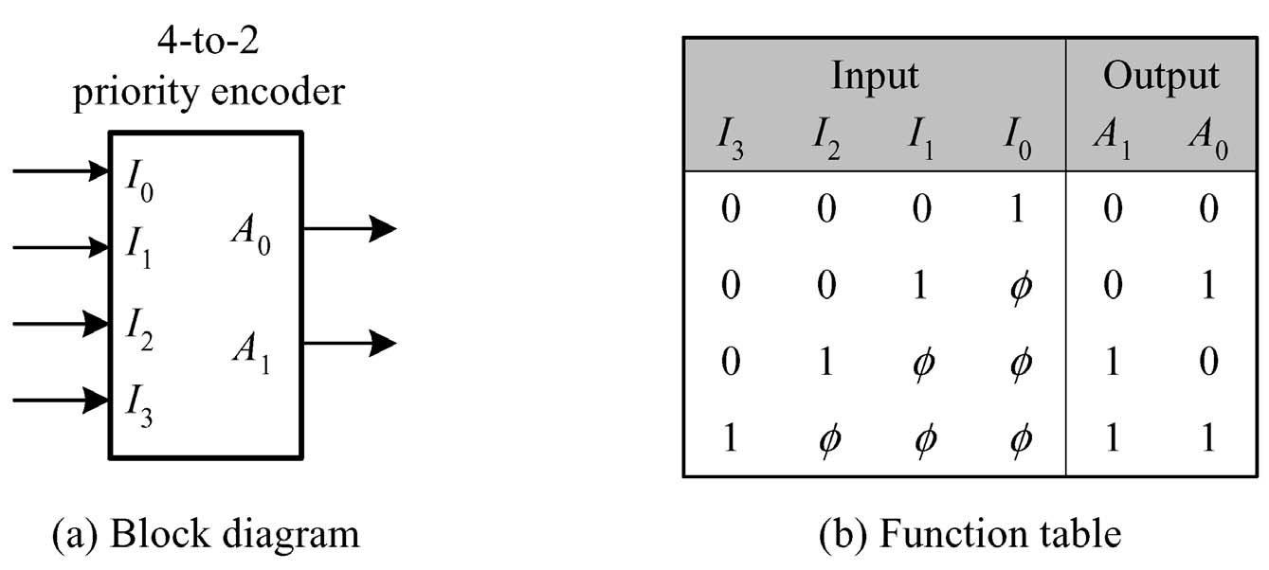
Exercise 2: Behavioral modeling of a 4-to-2 Priority Encoder
high

Slide 8
Behavioral modeling
model encoder4_2(
input I0, I1, I2, I3,
output reg A0, A1
);
always @* begin
if (I3==1) begin
A0=1; A1=1; end
else if(I2==1) ) begin
A0=0; A1=1; end
else if(I1==1) ) begin
A0=1; A1=0; end
else if(I0==1) ) begin
A0=0; A1=0; end
else begin
A0=1’bz; A1=1’bz; end
endmodule

Slide 9
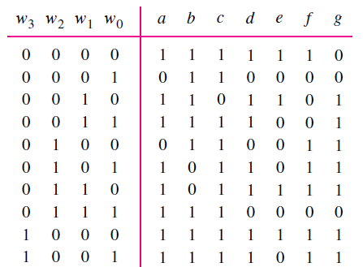
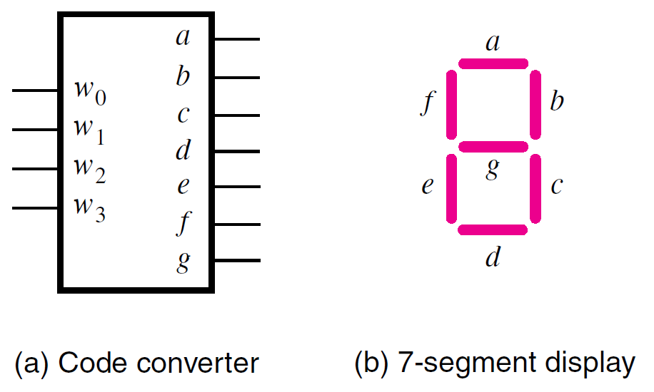
Exercise 3: Modeling of the BCD-to-7-segment Convertor
Ref. to “BCD2_7Segment_convertor.v”

Slide 10
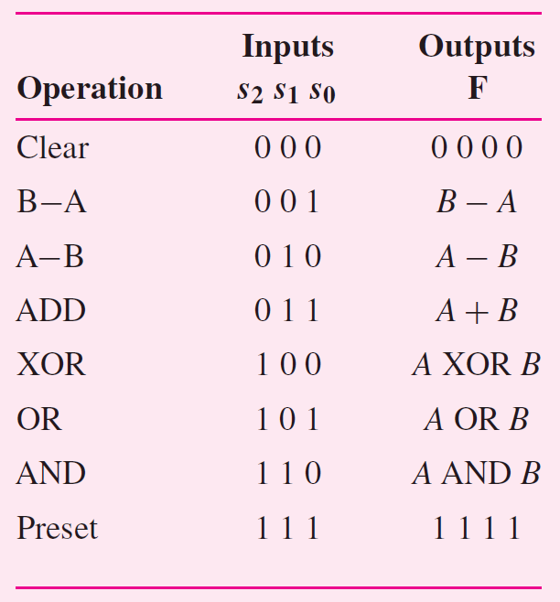
Exercise 4: Code the functionality of the 74381 ALU chip.
Ref.to “ALU_74381.v”

Slide 11
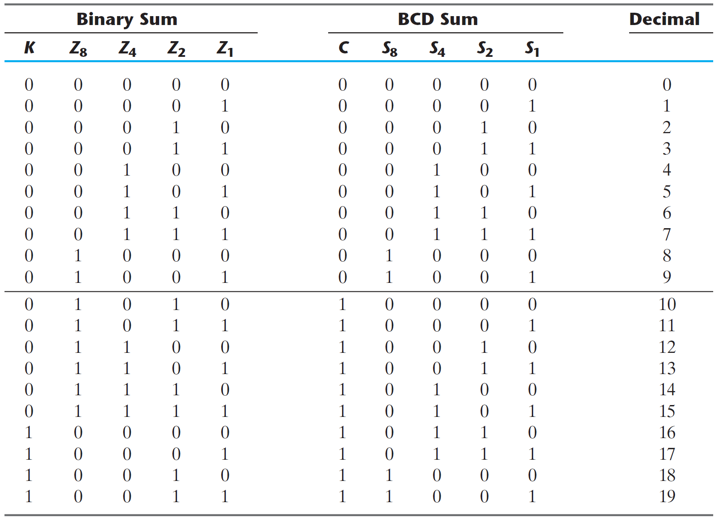
Exercise 5: BCD Adder
A BCD adder adds two BCD digits and produces a sum digit in BCD
大于9时和加6，
超过9时有进位。

Slide 12
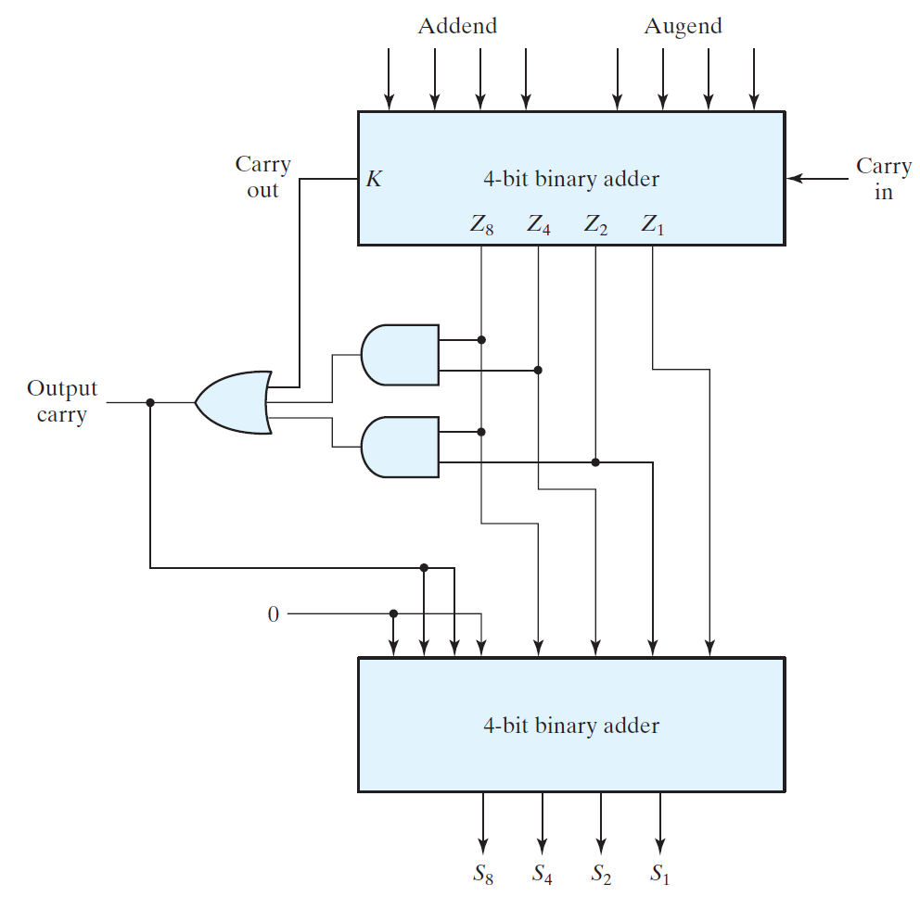
Block diagram of a BCD adder
A decimal parallel adder that adds n decimal digits needs n BCD adder stages.
The output carry from one stage must be connected to the input carry of the next higher order stage.
C = K + Z8Z4 + Z8Z2
When C = 1, it is necessary to add 0110 to the binary sum and provide an output carry for the next stage.

Slide 13
// 4-bit BCD full adder
module BCD_adder_4bit (A, B, C_IN, C_OUT, SUM);
input [3:0] A;B
input C_IN;
output wire [3:0] SUM;
output wire C_OUT
wire [3:0] sum1;
wire cout1, and1_out, and2_out;
wire dummy1;
wire [3:0] dummy2;
wire dummy3;
assign dummy2={0,C_OUT,C_OUT,0};
and and1(and1_out,sum1(3),sum1(2));
and and2(and2_out,sum1(3),sum1(1));
or or1(C_OUT,cout1,and1_out,and2_out);
adder_4bit adder1(.A(A), .B(B), .C_IN(C_IN), .C_OUT(cout1), .SUM(sum1));
adder_4bit adder2(.A(dummy2), .B(sum1), .C_IN(dummy1), .C_OUT(dummy3), .SUM(SUM));
endmodule
// 4-bit binary adder
module adder_4bit (A, B, C_IN, C_OUT, SUM);
input [3:0] A;B
input C_IN;
output reg [3:0] SUM;
output reg C_OUT
always @ *
{C_OUT,SUM} = A+B;
endmodule

Slide 14
Quiz, tell the result and why
module test;
reg[7:0] a, b, c;
reg[7:0] d;
initial begin
a=8; b=9; c=10;
#5 a=11;
#8 b=12;
#5 c=13;
#10 $finish;
end
always @* begin
d=#10 (a+b+c);
$display("a= '%d', b='%d', c='%d', d='%d'", a, b, c, d);
end
endmodule
a= 11 b= 9 c= 10 d= 27
a= 11 b= 12 c= 13 d= 33

Slide 15
delay | time | a | b | c | d | display | time
 | 0 | 8 | 9 | 10 |  | trig 1 sampling and wait 10 step | 0
#5 | 5 | 11
 |  | 11 | 9 | 10 | 27 | display1 and wait change | 10
#8 | 13 |  | 12 |  |  | trig 2 sampling and wait 10 step | 13
#5 | 18 |  |  | 13
 |  | 11 | 12 | 13 | 33 | display2 and wait change | 20
#10 | 28 | finish

Slide 16
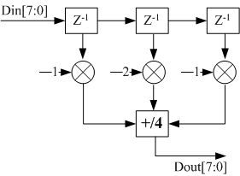
Lecture 5, Exercise I
3-tap FIR filter modeling

Slide 17
module FIR_3_Filter
(
Input[7:0] Din,
Input clk, rst,
output reg[7:0] Dout,
);
reg [7:0] z1, z2, z3;
reg [7:0] z1_next, z2_next, z3_next;
//state register
always@(posedge clk) begin
if(rst) begin
z1<=0; Z2<=0; Z3<=0
end
else begin
z1<=z1_next;
z2<=z2_next;
z3<=z3_next;
end
end
//next state
always@* begin
z1_next=Din;
z2_next=z1;
z3_next=z2;
end
//output
always@*
Dout=(z1+(z2<<1)+z3)>>2;
endmodule

Slide 18
Lecture 5, Exercise II
Generate the following waveform using verilog hdl
A[7:0], B[7:0]
CLK
Cycle=50ns
A
20
255
B
40
240
10

Slide 19
`timescale 1ns/10ps
module wave_generator
(
output reg clk,
output reg[7:0] A,B,
);
initial begin
clk=0;
A=0;
B=0;
#75 A=20;
B=40;
#100 B=240;
#100 A=255;
B=10;
#100 $finish
end
always begin
#25 clk=!clk;
end
endmodule

Slide 20
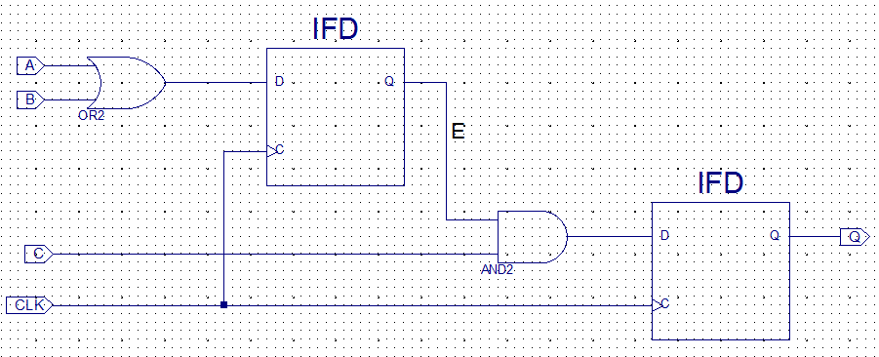
Lecture 5, Exercise III
Draw the logic diagram for the sequential circuit described by the following HDL module:
module Seq_Ckt (
input A, B, C,
output reg Q,
input CLK,
);
//body
reg E;
always @ ( posedge CLK)
begin
E <= A || B;
Q <= E && C;
end
endmodule

Slide 21
Exercise IV
Design a three-decade decimal BCD counter.

Slide 22
// BCD Counter
module BCD_Counter (Q, P_IN,C_OUT);
input P_IN;
output reg [3:0] Q;
output C_OUT;
always@(Q) begin
if (P_IN) begin
if (Q==2’b1001) begin
Q= 2’b0;
C_OUT=1;
end
else begin
Q=Q+1;
C_OUT = 0;
end
end
end
endmodule
// three-decade decimal BCD counter
module d3_Counter (Q, P_IN);
input P_IN;
output wire [11:0] Q;
output wire Cout1, Cout2;
BCD_Counter C1 (.Q(Q[3:0]), .P_IN(P_IN), .C_OUT(Cout1));
BCD_Counter C2 (.Q(Q[7:4]), .P_IN(Cout1), .C_OUT(Cout2));
BCD_Counter C3 (.Q(Q[11:8]), .P_IN(Cout2), .C_OUT( ));
endmodule

Slide 23
Lecture 7, Exercise 1
自动咖啡贩卖机控制器
4种口味可选
1.5元/杯
可接受1元和0.5元硬币
投入硬币总额大于等于1.5元时，4个口味选择按钮灯亮，同时投币口关闭阻止继续投币。
若选择取消按钮，退还所投硬币，并进入等待状态，投币口开启。
选择其中一个口味按钮后，收币，所有口味选择灯灭，出货，找零，进入等待状态，投币口开启。
画出控制模块状态图，并编写其Verilog代码。

Slide 24
状态转移图
ref. to Coffe_Sellor.v

Slide 25
Lecture 6, Exercise II
Ref. comparator_8bit.V
Design a 8-bit comparator using FSM,
Function:比较两个串行输入的8位二进制无符号数a和b的大小，二进制数序列ai和bi从低位到高位按时钟节拍逐位输入。
Input: clk, rst, start, ai, bi;
Output: [1:0]sout; //<,=,>

Slide 26
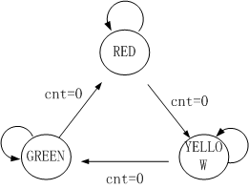
Lecture 6, Exercise III
REF. RYG_light.V
设计一个循环彩灯控制器
要求: 控制红、绿、黄发光管循环发亮
红发光管亮2秒，绿发光管亮3秒，黄发光管亮1秒。
设系统时钟10MHz

Slide 27
Lecture 6, Exercise IV
用FSM设计一个入侵警报系统 Verilog 代码：
红外入侵传感器
启用键，进入防护状态
解除键，从其他状态返回到解除防护状态
测试键，进入测试状态，报警
当传感器输出为“1”持续5秒，警报器报警。

Slide 28
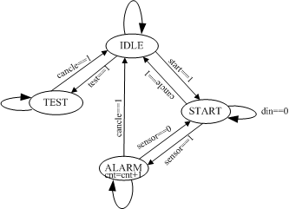
Ref. alarm.v

Slide 29
Exercise V
Design a finite state machine with two binary inputs x and y and a binary output z defined as follows: if the input sequence is (x, y) = 00 01 11 10 00 01 11…then z = 10, and if the input sequence is (x, y) = 00 10 11 01 00 10 11… then z = 11，else z = 00

Slide 30
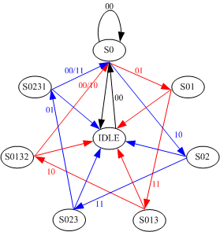
REF. sequence_scan.v
State Diagram

Slide 31
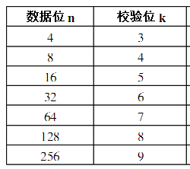
Exercise V
用状态机实现4个信息位的汉明编码
当信息位长度为4时，根据汉明不等式求得：码长为7，监督位长度为3。
若用a6,a5,...a0表示这7个码元。用S1,S2,S3表示三个监督关系式中的校正子，可得：
S1 = a6⊕a5⊕a4⊕a2 (1)
S2 = a6⊕a5⊕a3⊕a1 (2)
S3 = a6⊕a4⊕a3⊕a0 (3)
S1 S2 S3 | 错码位置
0 0 1 | a0
0 1 0 | a1
1 0 0 | a2
0 1 1 | a3
1 0 1 | a4
1 1 0 | a5
1 1 1 | a6
0 0 0 | 无错
在发送信号时，信息位a6,a5,a4,a3的值取决于输入信号，是随机的。监督为a2,a1,a0应该根据信息位的取值按照监督关系决定，即监督位的取值应该使上述(1)(2)(3)式中的S1,S2,S3为0，这表示初始情况下没有错码。即：
a6⊕a5⊕a4⊕a2 = 0
a6⊕a5⊕a3⊕a1 = 0
a6⊕a4⊕a3⊕a0 = 0
即：
a2 = a6⊕a5⊕a4
a1 = a6⊕a5⊕a3
a0 = a6⊕a4⊕a3
参考代码：HammingCoding_4bit.v

Slide 32
a2 = a6⊕a5⊕a4
a1 = a6⊕a5⊕a3
a0 = a6⊕a4⊕a3

Slide 33
Exercise VII
A synchronous Moore FSM has a single input, x_in, and a single output y_out . The machine is to monitor the input and remain in its initial state until a second sample of x_in is detected to be 1. Upon detecting the second assertion of x_in, y_out is to asserted and remain asserted until a fourth assertion of x_in is detected. When the fourth assertion of x_in is detected the machine is to return to its initial state and resume monitoring of x_in .
(a) Draw the state diagram of the machine.
(b) Write and verify a Verilog model of the machine.

Slide 35
Lecture8_FSMD ：Exercise1
Traffic lamps controller
R1=30s
Y1=3s
G1=40s
R2=40s
Y2=3s
G2=30s
Displayer1&2, left time (<10s).
Draw the state diagram.
Give the verilog codes.
1
Main street
2
branch
street
R->Y->G->Y->R

Slide 36
Ref. to Traffic.v
CNT<30
S0(R)
/R1,G2
CNT=30
CNT=3
CNT<3
CNT<3
S1(YA)
/Y1,Y2
S3(YB)
/Y1,Y2
CNT=3
CNT=40
S2(G)
/G1,R2
CNT<40

Slide 37
Exercise
利用FSMD来实现一个整数n的阶乘，画出相应的ASMD流程图并编写其Verilog代码。

Slide 38
refer to. Factorial.v
ASMD chart

Slide 39
Exercise 3：Run-Length Encoder
行程长度编码即根据字符串的连续重复字符进行编码的一种方法，例如： " aaaaaaabbccccccccdefffffffggggggggg "输出结果为："a7b2c8d1e1f7g9 "
常用于有大量重复数据的信号和图像压缩
试设计一个行程长度编码器：
8-bit input stream
16-bit output stream
8 high-order bits : Data value
8 low-order bits : Repeat count of previous data value
Valid bit set when 16-bit output is valid or under-counting
注意计数器溢出的处理措施，譬如重新计数。
Ref. to Run_Length_Encoder.v

Slide 40
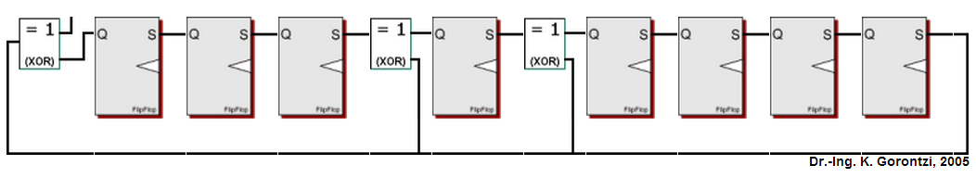
Exercise 4
ref. to CRC8_generator.v
Cyclic Redundancy Check
Design a 8-bit-input CRC generator (CRC8)
Serial input data: 16bits, 1-bit/cycle
Generator polynomial: f=x^8+x^5+x^4+1
The input bits are shifted into the very left XOR gate. The LSB (leftmost bit) of each byte is shifted in first.
Each flip-flop represents a single CRC output bit. The leftmost flip-flop is the MSB of the CRC. This implementation doesn't need to augment the serial input message with zeros.
Note that in our case the flip-flops are cleared to zeros at the beginning of each CRC calculation.
Din

Slide 42
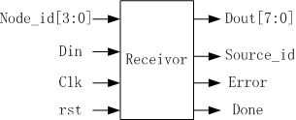
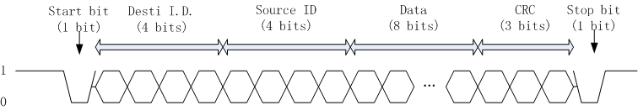
Exercise 5
Design a receiving controller to receive serial data from a data bus.
Baud rate of the bus is set to 115200 bps
system clock is 10MHz
If Desti ID equals to node ID, retrieve the 8-bit data from the frame, generate and check CRC code with CRC field in the frame

Slide 43
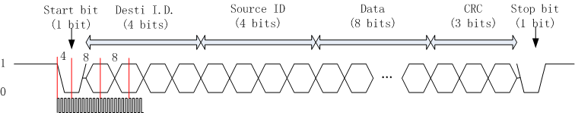
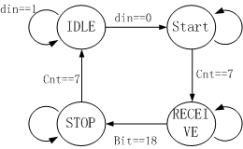
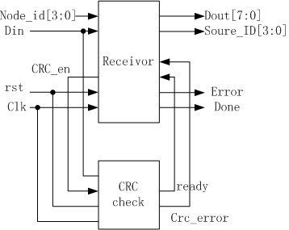
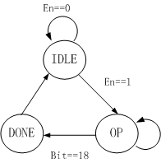
refer to. receiver.v
crc4_check.v
每比特占用8个时钟周期，分频倍数：10MHz/115200/8=10.8,取11
receiver
CRC
check

Slide 44
Quiz
Give the synthesizable Verilog code for modular 100 arithmetic of an integer n.
( ie., R = n % 100)
refer to. mod_100.v for regular one,
mod_100_fast_x5.v for fast one.
speed or area?

Slide 45
利用3X3方形窗口的中值滤波器对2D灰度图像进行实时处理，消除图像中的椒盐噪声。
Exercise II
中值滤波原理：对图像中每个像素点的3X3=9个邻域的灰度值进行排序，取其中间值作为该像素点的灰度值。
传统的通过排序求中值的算法，每个像素点需要执行n(n-1)/2次比较运算，运算量大。考虑采用流水线方式，并选择快速算法。
一种快速算法步骤为：先将模板中的每一列排序，然后将每一行排序，然后将对角线排序，其中间值即为所求。

Slide 46
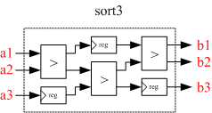
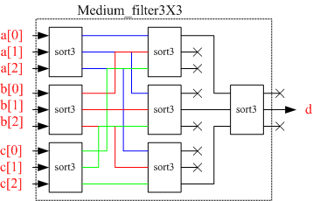
refer to. medium_filter3X3.v

