Slide 1
CATS
Classification Assessment of Tumor Subtypes
Three-state molecular subtype classiﬁcation
of breast tumors using biomarkers extracted
from high-resolution array-CGH CNV data
Authors: MJ Best, TJ Clement, BM Kiedik, N Rufﬁno and B Wölﬂ
Department of Computer Science, Vrije Universiteit Amsterdam

Slide 2
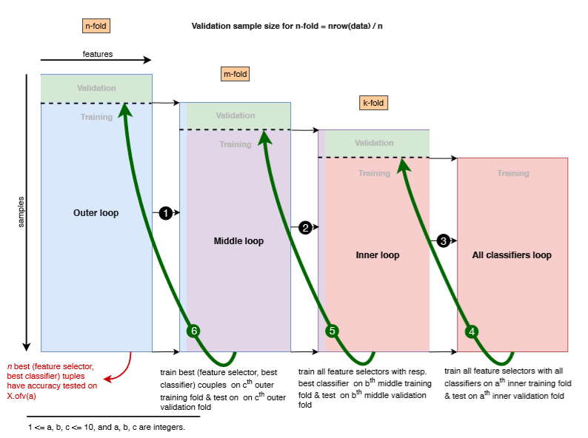
Cross validation scheme

Slide 3
Accuracies estimated in the best performing methods

Slide 4
Methods employed for feature selection and classification
Feature selection methods: All Features Selector Random Selector Gene Based Selection Selector Kruskall-Wallis H Test Selector Mann-Whitney U Test Selector Modiﬁed Recursive Feature Elimination (RFE) Selector Permutation Test Selector | Classifiers: Deep Neural Network Classiﬁer Nearest Mean Classiﬁer k-Nearest Neighbors (kNN) Classiﬁer Naive Bayes Classiﬁer Decision Tree Classiﬁer Random Forest Classiﬁer Variation of SVM classifiers Multinomial Logistic Regression Classiﬁer

Slide 5
4. rationale why you think the submitted method performed best

