Slide 1
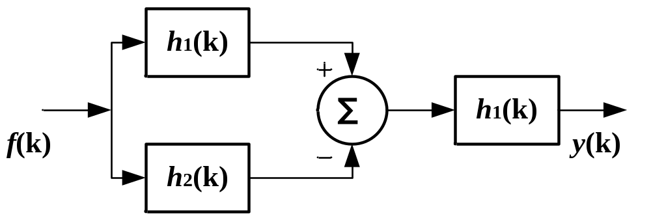
性质求卷积和例
例1 复合系统中
h₁(k) = ε(k)， h₂(k) = ε(k – 5)，求复合系统的单位序列响应h (k) 。
解 根据h(k)的定义，有
h(k)= [δ(k)* h₁(k) –δ(k)* h₂(k) ]* h₁(k)
= [h₁(k) – h₂(k) ]* h₁(k)
= h₁(k) * h₁(k) –h₂(k) * h₁(k)
= ε(k)* ε(k) – ε(k – 5) *ε(k)
= (k+1)ε(k) – (k+1 – 5)ε(k – 5)
= (k+1)ε(k) – (k– 4)ε(k – 5)

