Slide 1
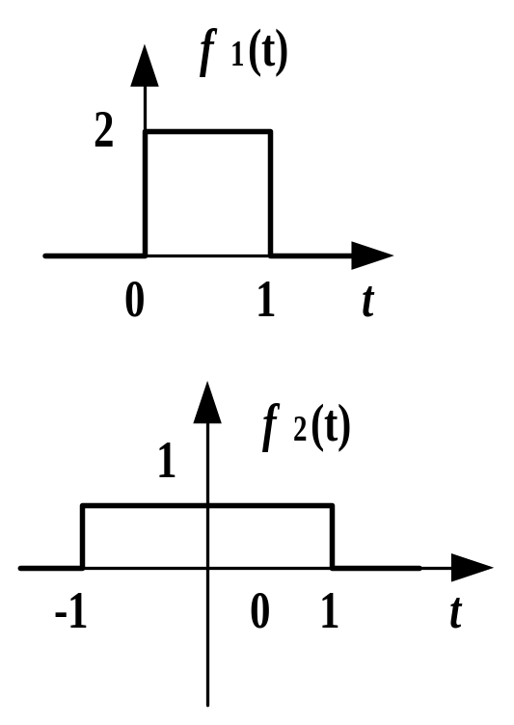

卷积性质例3
例：f₁(t), f₂(t)如图，求f₁(t)* f₂(t)
解： f₁(t) = 2ε (t) –2ε (t –1)
f₂(t) = ε (t+1) –ε (t –1)
f₁(t)* f₂(t)
= 2 ε (t)* ε (t+1) –2 ε (t)* ε (t –1)
–2ε (t –1)* ε (t+1) +2ε (t –1)* ε (t –1)
由于ε (t)* ε (t) = tε (t)
据时移特性，有
f₁(t)* f₂(t) = 2 (t+1) ε (t+1) - 2 (t –1) ε (t –1)
–2 tε (t) +2 (t –2) ε (t –2)

