Slide 1
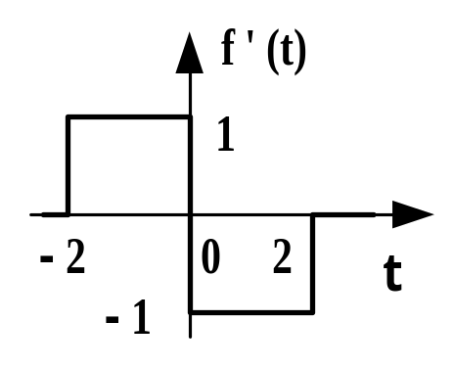
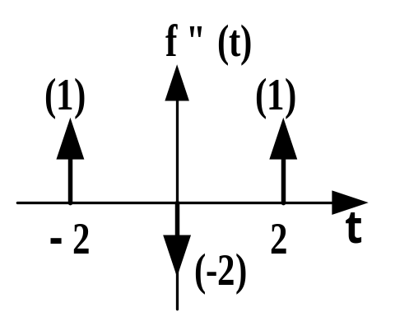
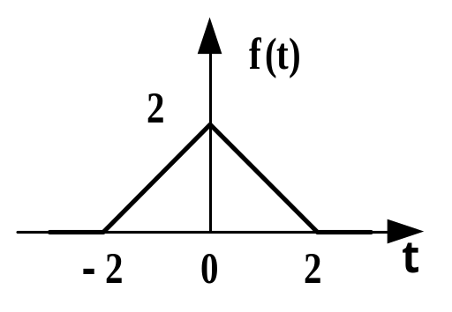
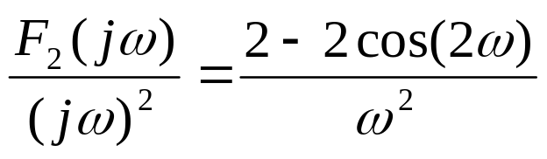
时域微分积分特性例2
For example 2
Determine f (t)←→ F (jω)
Ans:
f ”(t) = δ(t+2) – 2 δ(t) + δ(t –2)
F₂(jω)= F [f ”(t)] = e ^{j2ω}– 2 + e – ^{j2ω}= 2cos(2ω) – 2
F (jω) =
Notice:
ε(t) ←×→ 1/(jω)
dε(t)/dt = δ(t) ←→ 1

Slide 2
Summary:
If f ^{(n)}(t)←→ F_{n}(jω)，and
f(-∞)+ f(∞) = 0
then
f (t)←→ F (jω) = F_{n}(jω)/ (jω)^{n}

