Slide 1
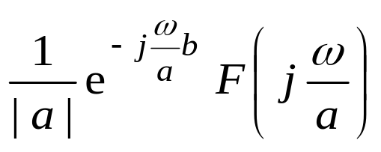
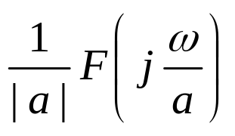
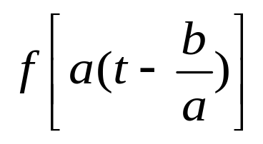
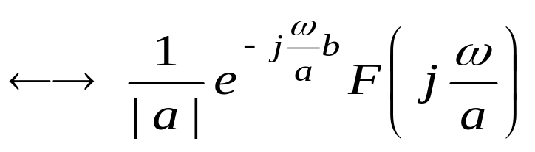
时移尺度举例
For example 2
Given that f (t)←→F( jω), find f (at – b) ←→ ?
Ans: f (t – b)←→
e ^{-jωb} F( jω)
f (at – b) ←→
or
f (at) ←→
f (at – b) =

