Slide 1
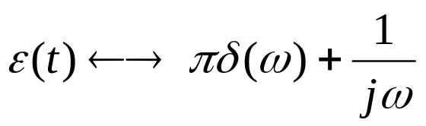
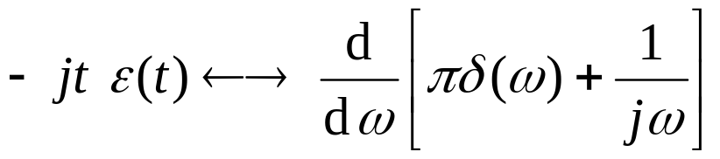
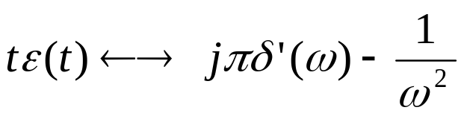
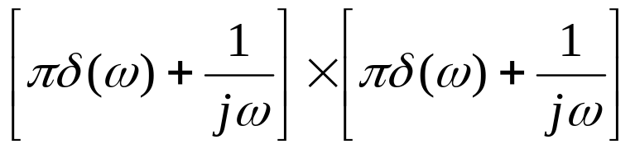
频域微分积分特性例1
For example 1
Determine f (t) = tε(t) ←→ F (jω)=?
Ans:
Notice: tε(t) =ε(t) * ε(t) ←→
It’s wrong.
Because δ(ω)δ(ω) and (1/jω)δ(ω) is not defined.

