Slide 1
Capstone Project for Building Life cycle Models
Tapajyoti Ghosh, Bhavik Bakshi

Slide 2
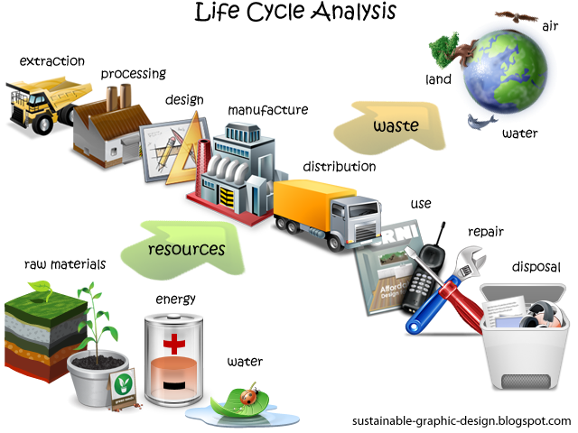
What is a life cycle model?
Life cycle models are used for environmental analysis of a product manufacture or other activity.
Life cycle model enable us to have a holistic view of the system rather than a small incomplete picture.

Slide 3
Remember the Car example!
Suppose you are driving a car for one mile.
How much environmental impact due you cause? (maybe emissions of carbon dioxide)
Is it only the tailpipe emissions?
Life cycle model enables use to include emissions in the upstream life cycle along with the tail pipe emissions.
For example – Emissions while manufacturing the car, emissions while building roads, emissions while producing gasoline and transporting gasoline, electricity required for all activities, coal mining of electricity and so on and on.

Slide 4
Algorithm for Building Models
Building Life cycle models are difficult due to their infinitely large sizes.
The algorithm developed through this research guides users for building life cycle models.
The algorithm is manually implemented.
The goal of the capstone project is to automatize this algorithm.

Slide 5
Algorithm Steps
Step 1 : Enter process information through entry interface.
Step 2 : Price information entered.
Step 3 : Mapping information entered for database crosswalks and links.
Step 4 : Input Output model information entered all loaded from default database.
Step 5 : Disaggregation and rebuilding of model calculations performed before SPA. Environmental information entered.

Slide 6
Algorithm Steps:
Step 6 : Perform SPA analysis based on MATLAB code or other new rewritten code. Code sent in zip file.
Step 7 : SPA results obtained and stored in memory for use.
Step 8 : Initial simple model built. The user is notified of this and may be asked to press something like Next or Continue to move through these steps.
Step 9 : Uncertainty information asked from user. If unavailable default available information is used.

Slide 7
Algorithm Steps
Step 10 : Calculations performed on model and parameters for evaluation obtained, passed through checks and decision obtained for either STOP or CONTINUE.
Step 11 : STOP – Algorithm finishes. Current model is exported as final output.
Step 12 : CONTINUE – The algorithm iterates to build a new model.
Step 13 : At this moment, a large amount of variables will affect the next step of the algorithm. The algorithm procession will depend upon a huge amount data availability (Process, price, environmental , database crosswalk, uncertainty) and parameter constraints.
Step 14 : Also, this step requires data from SPA results.

Slide 8
Algorithm Steps
Step 15 : The previous step also requires search of life cycle inventory databases which will probably be the hardest part to automatize. More needs to be discussed on it later.
Step 16 : With new data, calculations are redone and command moves back to Step 10.
Step 17 : Calculations are done using matlab codes which may/may not be rewritten.
Additional Info: The description above is very broad. There will be more details to each of the steps and I will try my best to help you through the calculations. Also regarding interface design and data entry, we will need to discuss more on flow of data input. Some visual graphs for the SPA results will also be good. I have added a pdf file for SPA if you want to readup

Slide 9
