Slide 1
Example For Toy Problem
Disaggregation and Derivation of A matrix

Slide 2
Toy Example Problem
Process Name – Toy
NAICS Code – A03
Process Output – 25 kg
Process Output Price – 1.5$/kg
Process Inputs – 2
Input1 – 10.074kg Price – 3$
Input2 – 8.0592 kg Price – 2.5$
NAICS Codes : Input1 – A01, Input2 – A02
Environmental Impact information (Process) – 7.5kg co2

Slide 3
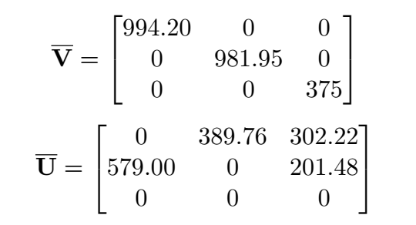

Economy Scale data Entry
Matrices :
NAICS CODE LIST FOR ECONOMY SCALE ORDERED ACCORDING TO SECTORS IN MATRICES-
A01, A02 and A03

Slide 4
Search
Search for the process NAICS code in the Economy NAICS code list. If obtained, disaggregate.
If not, skip to rebuilding directly.

Slide 5
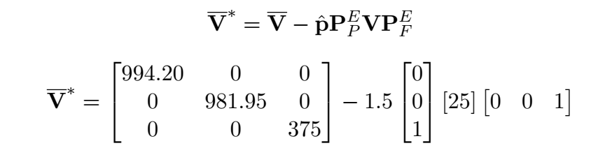
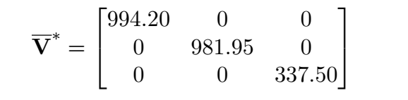

Disaggregation
Number of sectors derived from the matrices – 3
$\begin{matrix}1 \\ 2 \\ 3\end{matrix}\left[\begin{matrix}0 \\ 0 \\ 1\end{matrix}\right]$
Toy

Slide 6
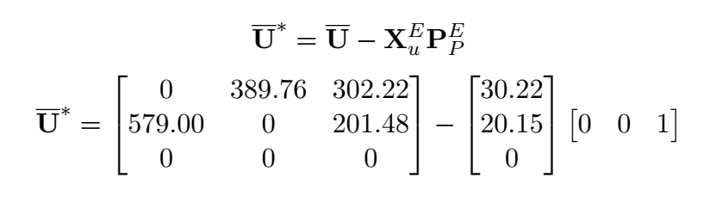
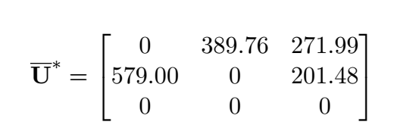
Disaggregation of U matrix
Toy

Slide 7
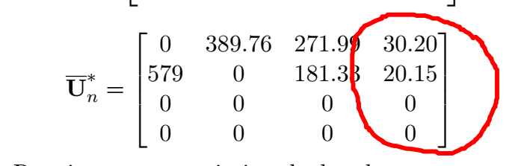
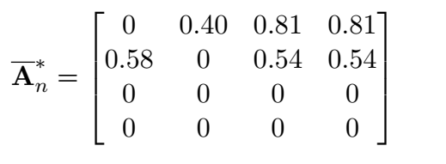
Rebuilding U and V and B matrix
(M+1)th Column and (M+1)th row gets filled up with the output*price information V matrix
U matrix Fill up the (M+1)th column be matching the NAICS codes.

Slide 8

A = U*inv(transpose(V))
F = [0;0;0;1] If the user enters activity 4 as the activity to perform SPA on.
F = zeros(4)
F(4,1) = 1;
Emission = B*inv(I-A)*F I = identity matrix (same size as A)
Runprog(4, emission, B, A, 4)

