Slide 1

A Generalized Language Model in Tensor Space
Tianjin University
Lipeng Zhang, Peng Zhang, Xindian Ma, Shuqin Gu, Zhan Su, Dawei Song
AAAI 2019

Slide 2
Outline
Motivation
Background
TSLM basic representation
Generalization
Recursive Language Modeling
Experiment

Slide 3
Motivation
In the literature, a dense tensor is often used to represent a sentence or document. (A vector is defined as a 1-order tensor; a matrix is defined as a 2-order tensor.)
Some previous work:
VSM(Vector Space Model)
LSI(Latent Semantic Index)
N-Gram(Bi-gram, Tri-gram)
Neural Network Based Language Model
…

Slide 4







Motivation
Hypotheses: A sentence has $n$ words. Each word has $m$ semantic meanings.
$$w_{1}$$
$$w_{2}$$
$$w_{n}$$
$$e_{1}$$
$$e_{2}$$
…
.
.
.
.
.
.
.
.
.
.
.
.
$$e_{m}$$
The sentence still has $m$ semantic meanings.

Slide 5










Motivation
We can present such combination method as from vector to vector.
$$\vec{w_{1}}$$
$$+$$
$$\vec{w_{2}}$$
$$+$$
…
$$+$$
$$\vec{w_{n}}$$
$$\vec{s}$$
$$+$$
$$+$$
…
$$+$$
The sentence is still in vector space.

Slide 6
Motivation
The existing methods usually adopt relatively low-order tensors, which have limited expressive power in modeling language.
We propose a language model based on relatively high-order tensor representation——Tensor Space Language Model (TSLM).

Slide 7

Motivation
Hypotheses: A sentence has $n$ words. Each word has $m$ semantic meanings.
$$w_{1}$$
$$w_{2}$$
$$w_{n}$$
…
$$e_{1}$$
$$e_{2}$$
…
.
.
.
.
.
.
.
.
.
.
.
.
$$e_{m}$$
…
According to the fully arranged combination, we will get $m^{n}$ semantic combinations.

Slide 8









Motivation
We can present such combination method as from vector to tensor using tensor product.
$$\vec{w_{1}}$$
$$⊗$$
$$\vec{w_{2}}$$
$$⊗$$
…
$$⊗$$
$$\vec{w_{n}}$$
$$⊗$$
$$⊗$$
…
$$⊗$$
However, it is difficult to represent a high-order tensor. (A cube can only represent a 3-order tensor)

Slide 9
Challenges
1.To construct a high-order tensor representation;
2.To derive an effective solution for such representation;
3.To demonstrate such a solution is a general approach for language modeling;
4.To solve that such a high-order tensor contains exponential magnitude of parameters;
…

Slide 10
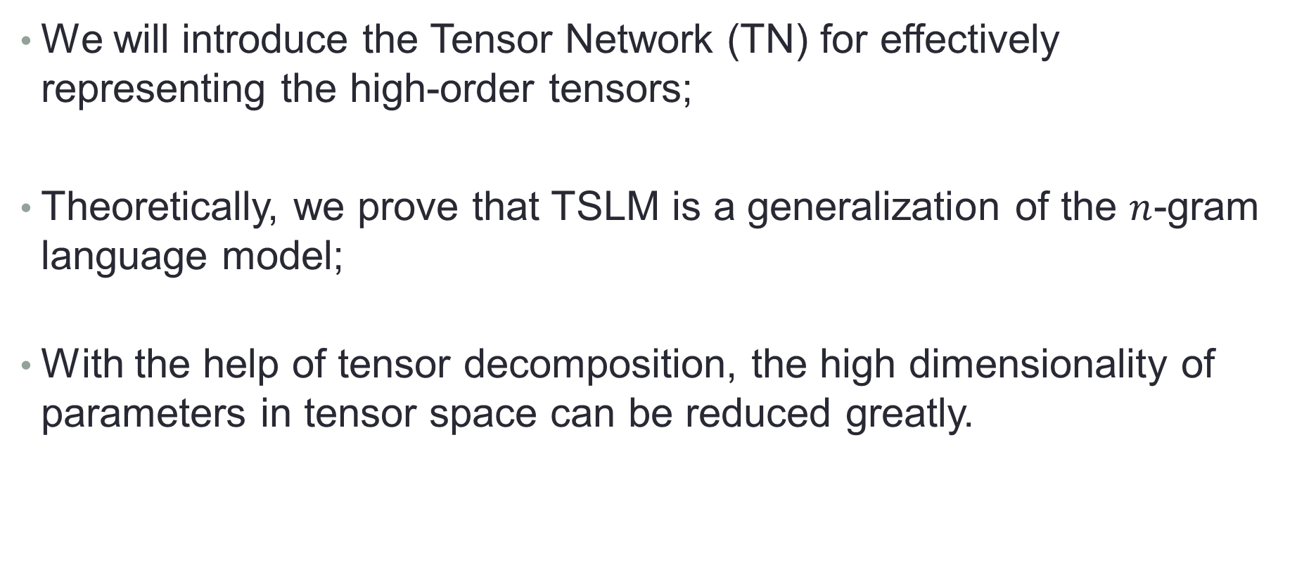
Challenges
We will introduce the Tensor Network (TN) for effectively representing the high-order tensors;
Theoretically, we prove that TSLM is a generalization of the $n$-gram language model;
With the help of tensor decomposition, the high dimensionality of parameters in tensor space can be reduced greatly.

Slide 11
Outline
Motivation
Background
TSLM basic representation
Generalization
Recursive Language Modeling
Experiment

Slide 12


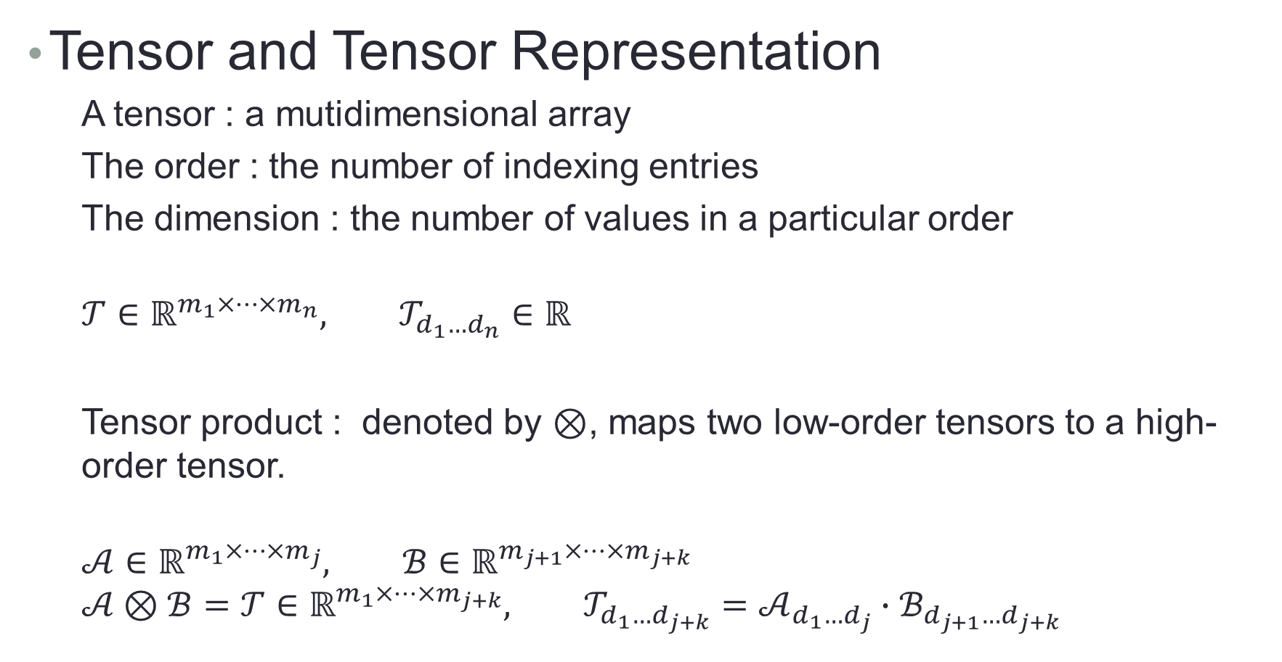



Background
Tensor and Tensor Representation
A tensor : a mutidimensional array
The order : the number of indexing entries
The dimension : the number of values in a particular order
$$𝒯∈ℝ^{m_{1}×⋯×m_{n}}, 𝒯_{d_{1}…d_{n}}∈ℝ$$
Tensor product : denoted by $⊗$, maps two low-order tensors to a high-order tensor.
$$𝒜∈ℝ^{m_{1}×⋯×m_{j}}, ℬ∈ℝ^{m_{j+1}×⋯×m_{j+k}}$$
$$𝒜⊗ℬ=𝒯∈ℝ^{m_{1}×⋯×m_{j+k}}, 𝒯_{d_{1}…d_{j+k}}=𝒜_{d_{1}…d_{j}}∙ℬ_{d_{j+1}…d_{j+k}}$$
$$𝓣$$
…
…
$$d_{n}$$
$$d_{3}$$
$$d_{2}$$
$$d_{1}$$

Slide 13

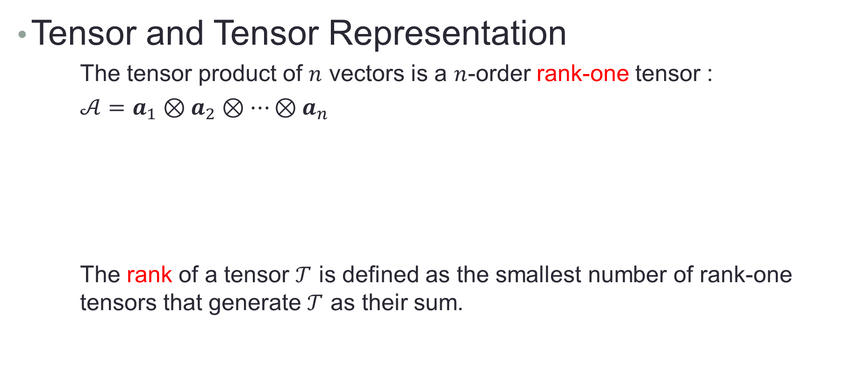








Background
Tensor and Tensor Representation
The tensor product of $n$ vectors is a $n$-order rank-one tensor :
$𝒜=$ $a_{1}⊗a_{2}⊗⋯⊗a_{n}$
The rank of a tensor $𝒯$ is defined as the smallest number of rank-one tensors that generate $𝒯$ as their sum.
$$a_{1}$$
$$a_{2}$$
$$a_{3}$$
…
$$a_{n}$$
$$\text{𝓐}$$
…
…
$$d_{n}$$
$$d_{3}$$
$$d_{2}$$
$$d_{1}$$

Slide 14
Background
Tensor and Tensor Networks
Tensor Network is formally represented an undirected and weight graph;
Tensor operations (e.g., multiplication, inner product, decomposition) can be represented intuitively in tensor networks.

Slide 15

























































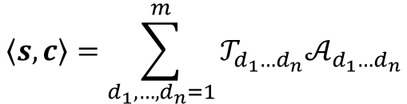


1)
Vector $v:$
2)
Matrix $A:$
3)
3-order $δ$ tensor$:$
4)
$n$-order tensor $𝓣$:
5)
$n$-order rank-one tensor 𝓐:
$$\text{𝓐}$$
$$i∈[m]$$
$$d_{1}∈[m_{1}]$$
…
$$d_{1}$$
$$d_{3}$$
$$𝓣$$
…
$$d_{n}$$
$$d_{3}$$
$$d_{2}$$
$$δ$$
$$d_{1}$$
$$v$$
$$A$$
…
…
$$d_{n}$$
$$d_{3}$$
$$d_{2}$$
$$d_{2}$$
$$d_{1}$$
$$α_{1}$$
$$α_{2}$$
$$α_{3}$$
…
$$α_{n}$$
$$d_{2}∈[m_{2}]$$
(a)
$$i∈[m]$$
$$j$$
$$k$$
$$A$$
=
$$i∈[m]$$
$$𝓣$$
$$A$$
=
…
$$u$$
$$j∈[n]$$
$$j$$
$$i$$
$$i$$
$$k$$
$$\left\langle s,c\right\rangle$$
=
$$d_{1}$$
$$d_{2}$$
$$d_{3}$$
$$d_{n}$$
$$v$$
$$U$$
$$δ$$
$$V$$
…
$$α_{1}$$
$$α_{2}$$
$$α_{3}$$
$$α_{n}$$
$$i$$
$$u=Av$$
$$λ$$
$$u_{i}=\sum_{j=1}^{n}{A_{ij}v_{j}}$$
$$A=\sum_{i=1}^{r}{λ_{i}u_{i}⨂v_{i}}$$
$$\left\langle s,c\right\rangle =\sum_{d_{1},…,d_{n}=1}^{m}{𝒯_{d_{1}…d_{n}}𝒜_{d_{1}…d_{n}}}$$
(b)
(c)
(d)

Slide 16
Outline
Motivation
Background
TSLM basic representation
Generalization
Recursive Language Modeling
Experiment

Slide 17
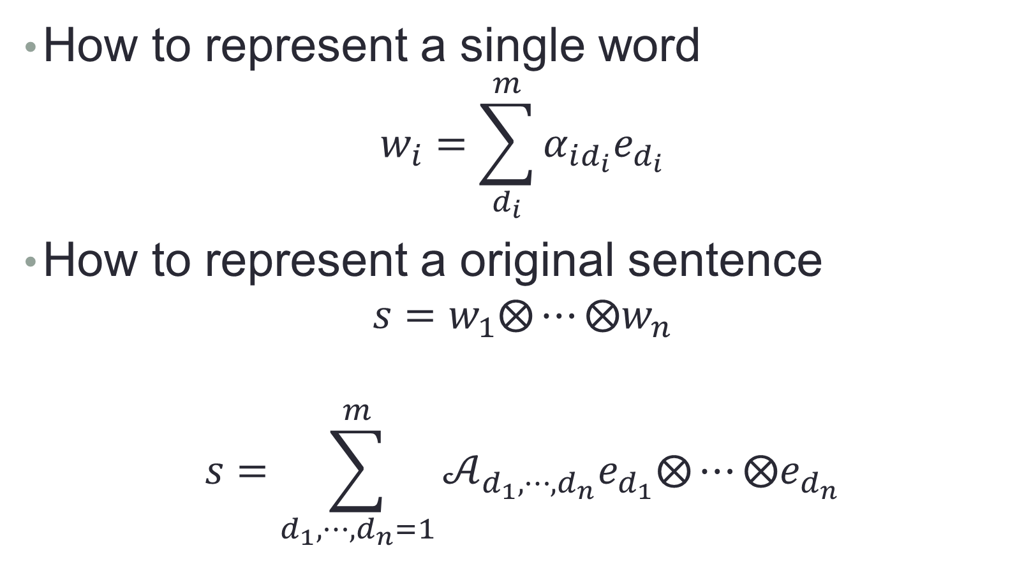

TSLM basic representation
How to represent a single word
$$w_{i}=\sum_{d_{i}}^{m}{α_{id_{i}}e_{d_{i}}}$$
How to represent a original sentence
$$s=w_{1}⨂⋯⨂w_{n}$$
$$s=\sum_{d_{1},⋯,d_{n}=1}^{m}{𝒜_{d_{1},⋯,d_{n}}e_{d_{1}}⨂⋯⨂e_{d_{n}}}$$
Rank One
$$𝒜_{d_{1},⋯,d_{n}}=\prod_{i=1}^{n}{α_{id_{i}}}$$

Slide 18
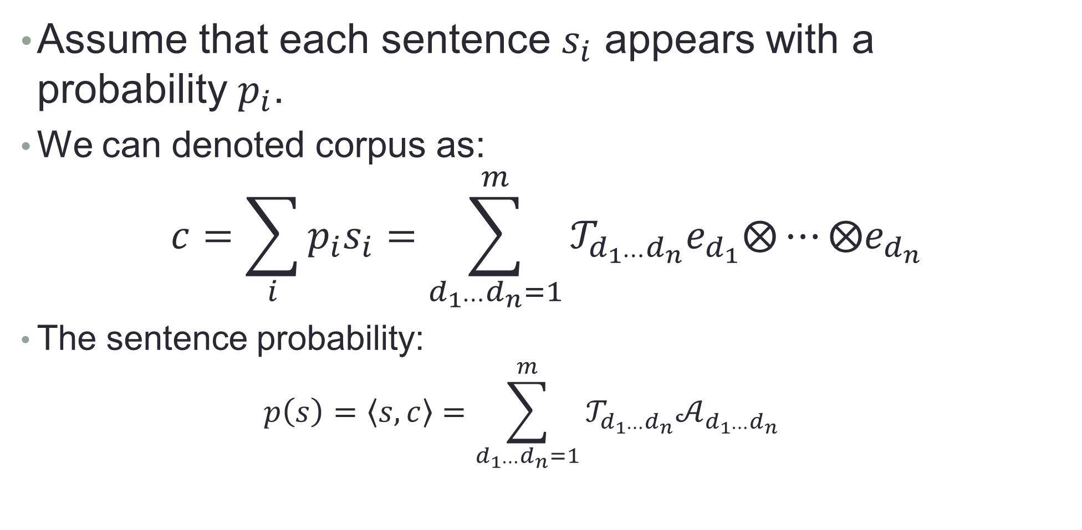
TSLM basic representation
Assume that each sentence $s_{i}$ appears with a probability $p_{i}$.
We can denoted corpus as:
$$c=\sum_{i}{p_{i}s_{i}=\sum_{d_{1⋯}d_{n}=1}^{m}{𝒯_{d_{1⋯}d_{n}}e_{d_{1}}⨂⋯⨂e_{d_{n}}}}$$
The sentence probability:
$$p\left(s\right)=\left\langle s,c\right\rangle =\sum_{d_{1⋯}d_{n}=1}^{m}{𝒯_{d_{1⋯}d_{n}}𝒜_{d_{1⋯}d_{n}}}$$

Slide 19
Outline
Motivation
Background
TSLM basic representation
Generalization
Recursive Language Modeling
Experiment

Slide 20
A Generation of N-Gram Language Mode
N-gram Language Model
N-gram language model: estimate the probability distribution of sentences
Compute a sentence’s joint probability
Compute the current word’s conditional probability

Slide 21
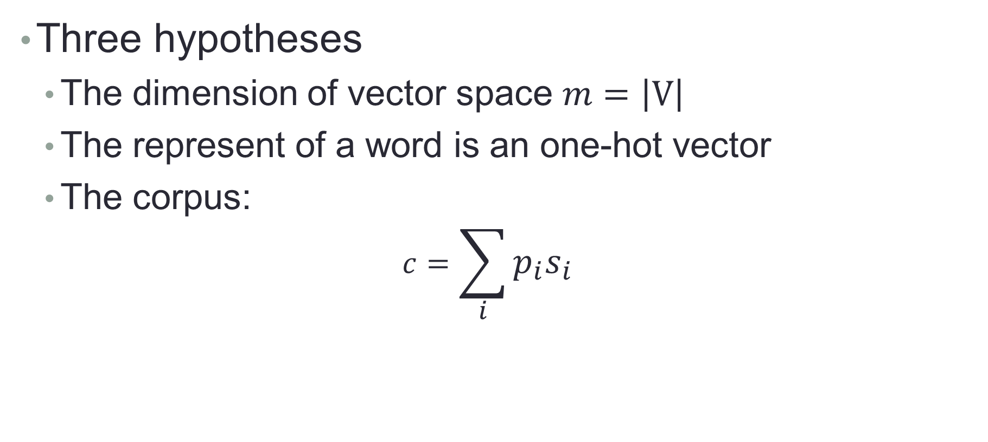
How to Prove TSLM as a Generalization of N-Gram
Three hypotheses
The dimension of vector space $m=\left|V\right|$
The represent of a word is an one-hot vector
The corpus:
$$c=\sum_{i}{p_{i}s_{i}}$$

Slide 22
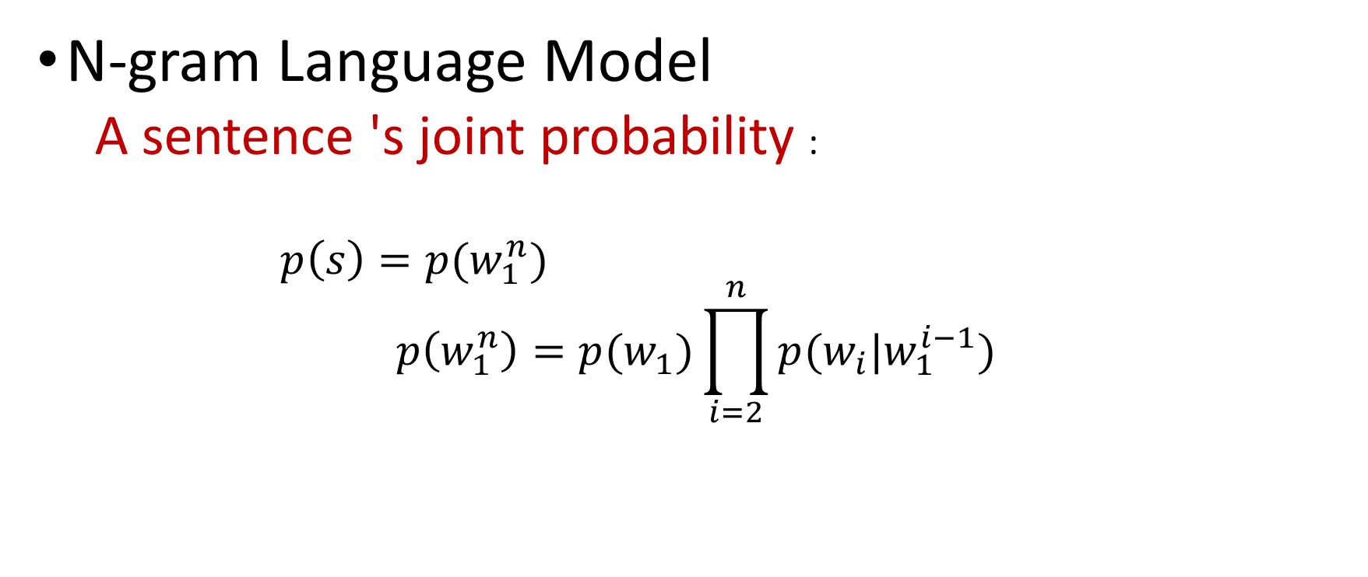
Compute the joint probability
N-gram language model
A sentence’s joint probability
①

Slide 23
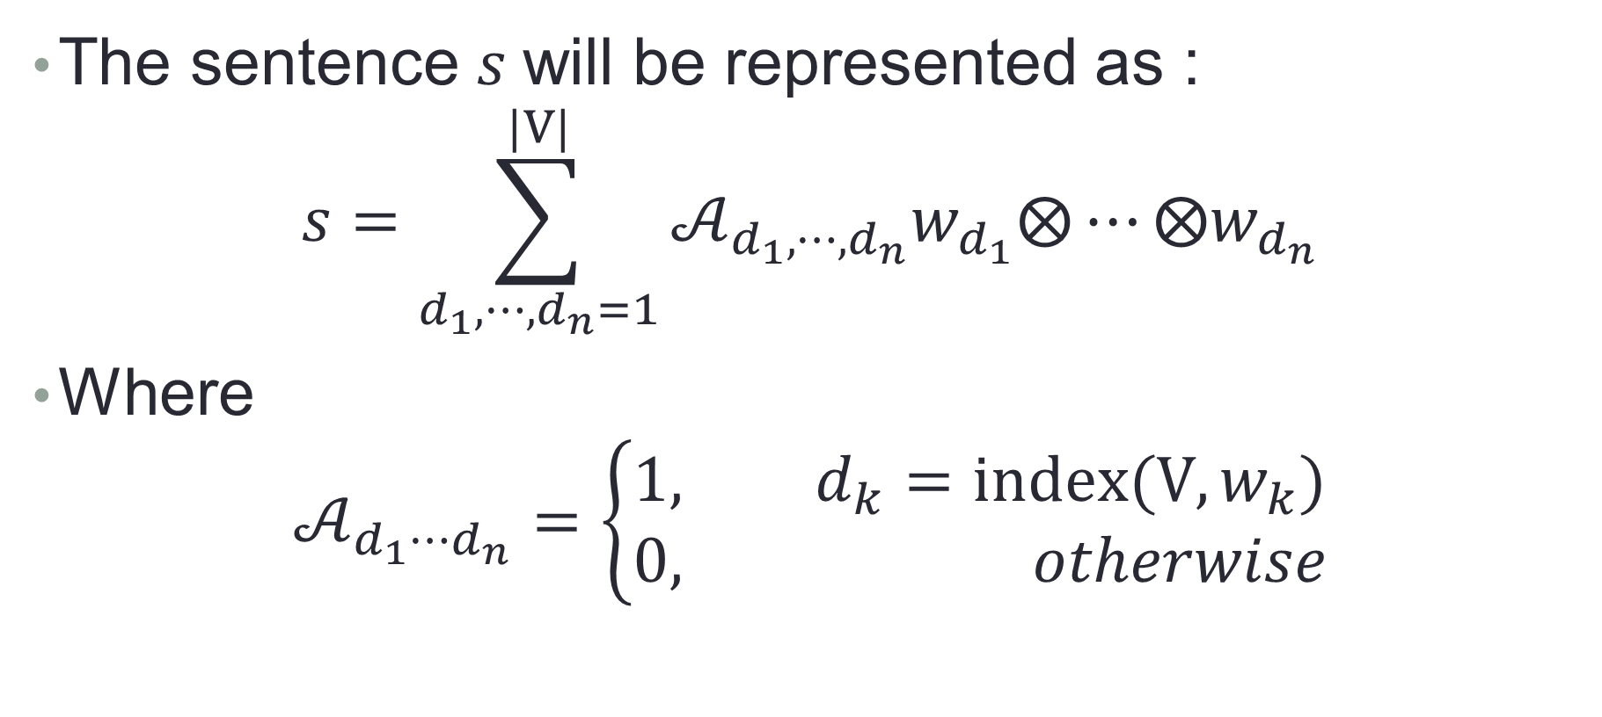
Compute the joint probability
The sentence $s$will be represented as :
$$s=\sum_{d_{1},⋯,d_{n}=1}^{|V|}{𝒜_{d_{1},⋯,d_{n}}w_{d_{1}}⨂⋯⨂w_{d_{n}}}$$
Where
$$𝒜_{d_{1}⋯d_{n}}=\left\{\begin{aligned}1, d_{k}=index(V,w_{k}) \\ 0, otherwise\end{aligned}\right.$$

Slide 24
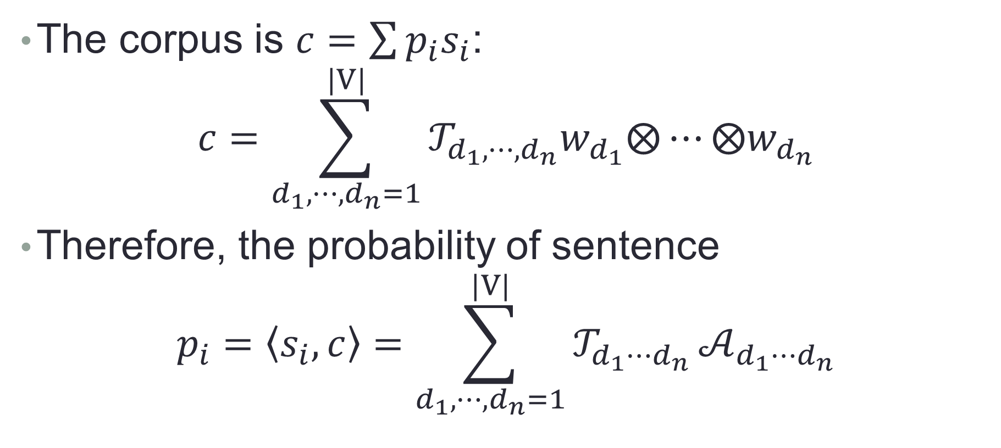
Compute the joint probability
The corpus is $c=\sum{p_{i}s_{i}}$:
$$c=\sum_{d_{1},⋯,d_{n}=1}^{|V|}{𝒯_{d_{1},⋯,d_{n}}w_{d_{1}}⨂⋯⨂w_{d_{n}}}$$
Therefore, the probability of sentence
$$p_{i}=\left\langle s_{i},c\right\rangle =\sum_{d_{1},⋯,d_{n}=1}^{|V|}{𝒯_{d_{1}⋯d_{n}}}𝒜_{d_{1}⋯d_{n}}$$

Slide 25
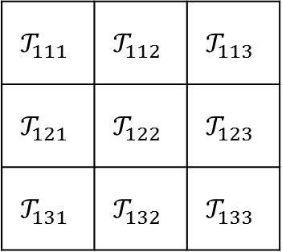
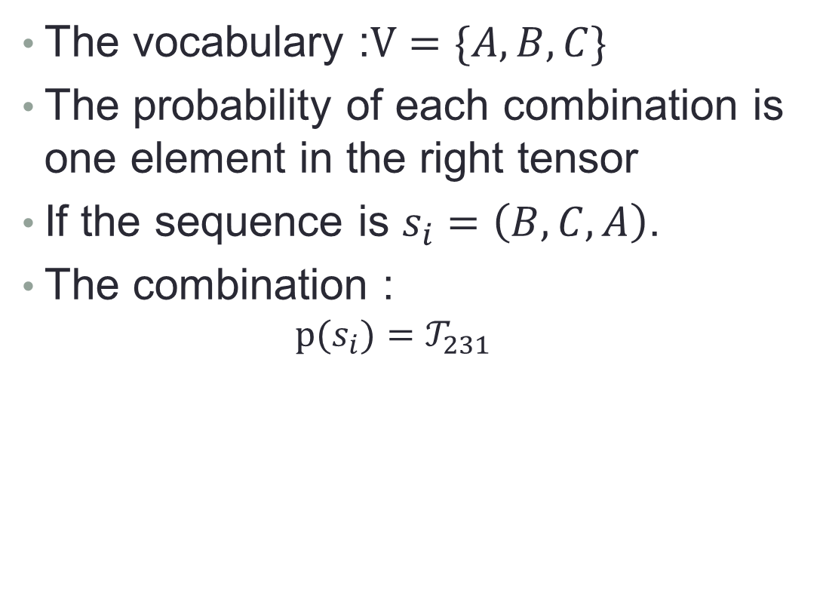
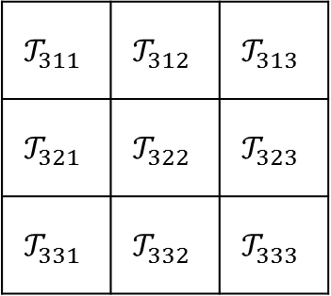
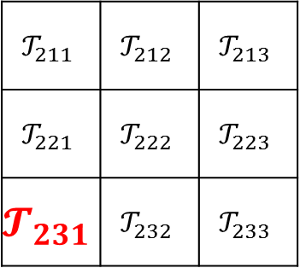
An example
The vocabulary :$V=\{A,B,C\}$
The probability of each combination is one element in the right tensor
If the sequence is $s_{i}=\left(B,C,A\right)$.
The combination :
$$p(s_{i})=𝒯_{231}$$

Slide 26
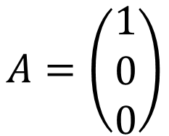
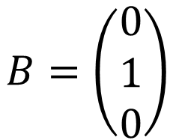
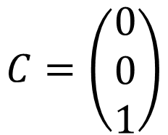

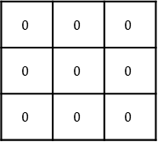

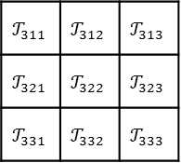

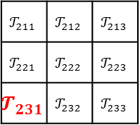
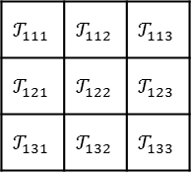
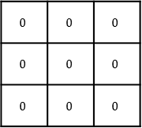
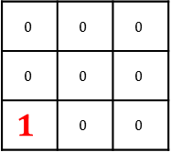

An example
$$s_{i}=B⨂C⨂A$$
$$𝒯$$
$$𝒜$$

Slide 27
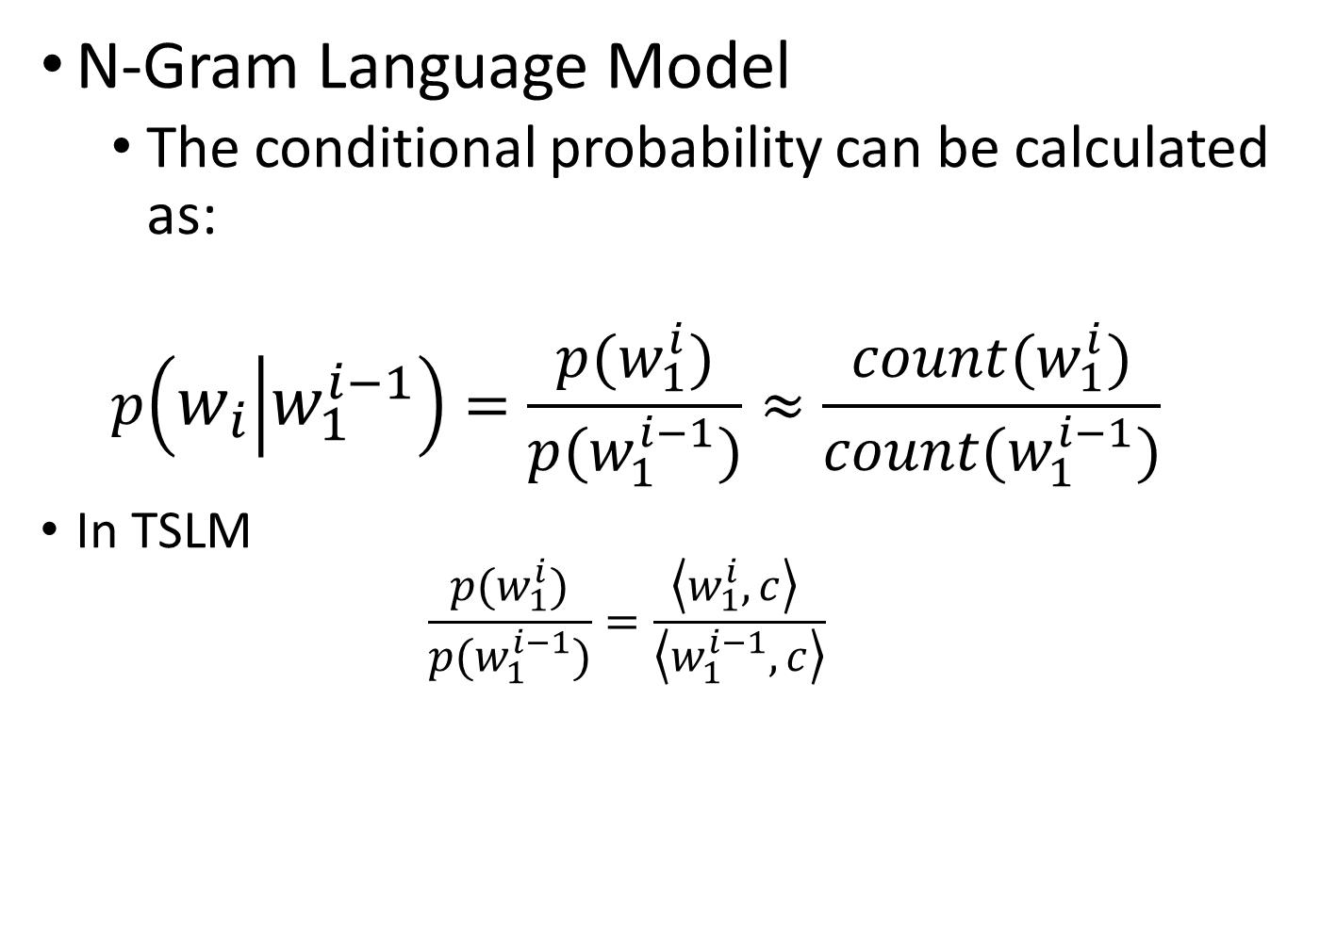
Compute the conditional probability
②

Slide 28

Compute the conditional probability
In TSLM, we define marginal distribution as:
$$p\left(w_{i}\right)=\sum_{w_{j}∈V}{p\left(w_{i},w_{j}\right)}$$
$$p\left(w_{1},…,w_{n−1}\right)=\sum_{w_{n}∈V}{p\left(w_{1},…,w_{n−1},w_{n}\right)}$$
$$p\left(w_{1}^{i}\right)=p\left(w_{1},⋯,w_{i}\right)$$
$$=\sum_{w_{i+1,…,w_{n}}∈V}{p\left(w_{1},…,w_{i},w_{i+1},…w_{n}\right)}$$
$$=\sum_{d_{i+1},⋯,d_{n}=1}^{|V|}{𝒯_{d_{1}⋯d_{n}}}$$

Slide 29
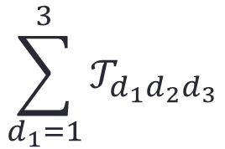
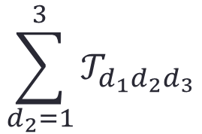
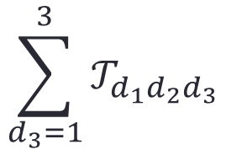

The conditional probability in Tensor
$$\sum_{d_{3}=1}^{3}{𝒯_{d_{1}d_{2}d_{3}}}$$
$$\sum_{d_{1}=1}^{3}{𝒯_{d_{1}d_{2}d_{3}}}$$
$$𝒯$$
$$\sum_{d_{2}=1}^{3}{𝒯_{d_{1}d_{2}d_{3}}}$$

Slide 30
Outline
Motivation
Background
TSLM basic representation
Generalization
Recursive Language Modeling
Experiment

Slide 31
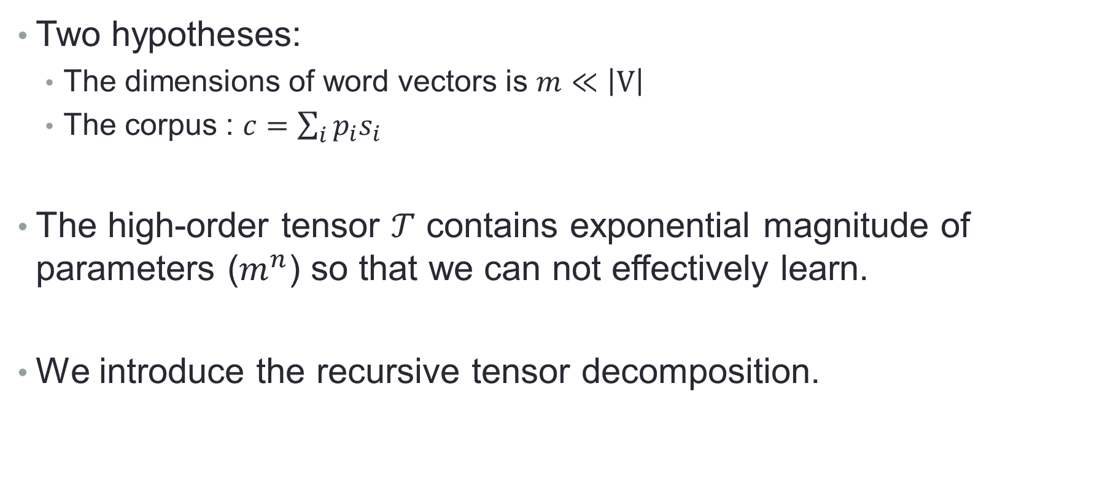
Recursive Language Modeling
Two hypotheses:
The dimensions of word vectors is $m≪\left|V\right|$
The corpus : $c=\sum_{i}{p_{i}s_{i}}$
The high-order tensor $𝒯$ contains exponential magnitude of parameters ($m^{n}$) so that we can not effectively learn.
We introduce the recursive tensor decomposition.

Slide 32




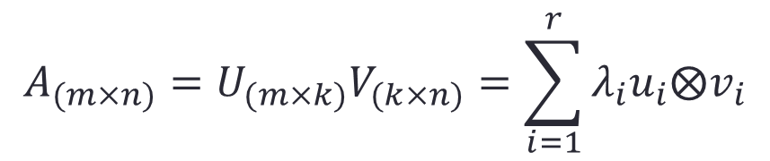



SVD(Single Value Decomposition)
$$k×n$$
$$m×n$$
$$=$$
$$m×k$$
$$j$$
$$k$$
$$A$$
=
$$j$$
$$i$$
$$i$$
$$k$$
$$U$$
$$δ$$
$$V$$
$$i$$
$$m×n$$
$$=$$
$$+$$
$$+…+$$
$$λ$$
$$A=\sum_{i=1}^{r}{λ_{i}u_{i}⨂v_{i}}$$

Slide 33
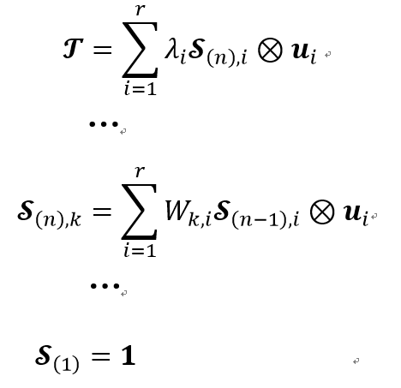



















Recursive tensor decomposition
$$𝓣$$
$$1$$
$$δ$$
$$W$$
$$δ$$
…
$$δ$$
$$λ$$
…
$$U$$
$$U$$
$$U$$
$$𝒮_{(n)}$$
$$𝒮_{(n−1)}$$
$$δ$$
$$W$$
$$λ$$
$$δ$$
$$λ$$
$$δ$$
…
…
$$U$$
$$U$$
$$U$$

Slide 34


Recursive Language Modeling
(a)
$$V$$
$$V$$
$$V$$
$$y_{1}$$
$$y_{2}$$
$$𝓣$$
$$h_{0}$$
$$W$$
$$δ$$
$$W$$
$$δ$$
$$δ$$
$$λ$$
…
$$V$$
$$V$$
$$U$$
$$U$$
$$U$$
$$𝓐$$
$$α_{1}$$
$$α_{2}$$
…
$$h_{0}$$
$$h_{1}$$
$$h_{2}$$
…
$$α_{n}$$
$$W$$
$$W$$
$$g(∙,∙)$$
$$g(∙,∙)$$
$$V$$
$$h_{t−1}$$
$$W$$
$$δ$$
$$=$$
$$h_{t}$$
$$U$$
$$U$$
$$𝒮_{(t−1)}$$
$$δ$$
$$=$$
$$𝒯_{(t)}$$
$$U$$
…
$$x_{1}$$
$$x_{2}$$
$$U$$
$$α_{t}$$
(b)
(c)
(d)

Slide 35
Outline
Motivation
Background
TSLM basic representation
Generalization
Recursive Language Modeling
Experiment

Slide 36
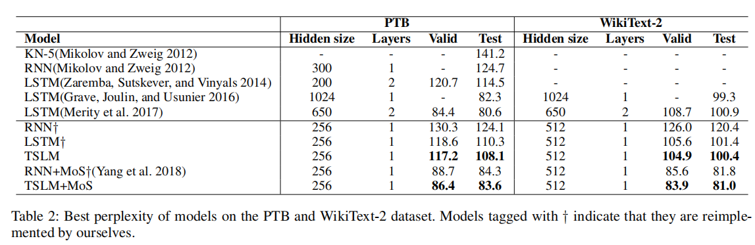
Experimental Result

Slide 37
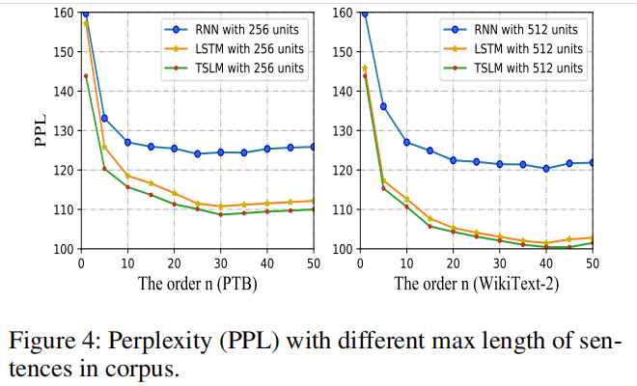
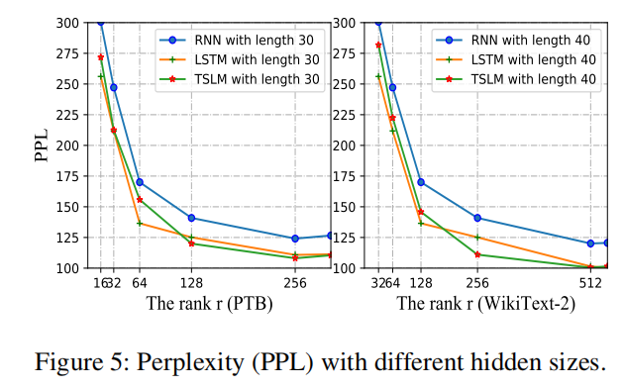
Experience

Slide 38
Future Work
Achieve text generation by using TSLM
Further interpreted in the neural network by tensor network
Further explore the potential of tensor network for language model

