Slide 1
RNN
Recurrent Neural Network
循环神经网络

Slide 2
1.Model of RNN
Model and Characters
2.Learning Algorithm of RNN
Backpropagation Through Time Algorithm
3.Vanishing Gradient & Gradient Explosion Problems
Solutions
4.General RNN and Application
Bidirectional RNN
Deep Bidirectional RNN
LSTM
5.RNN Language Model

Slide 3
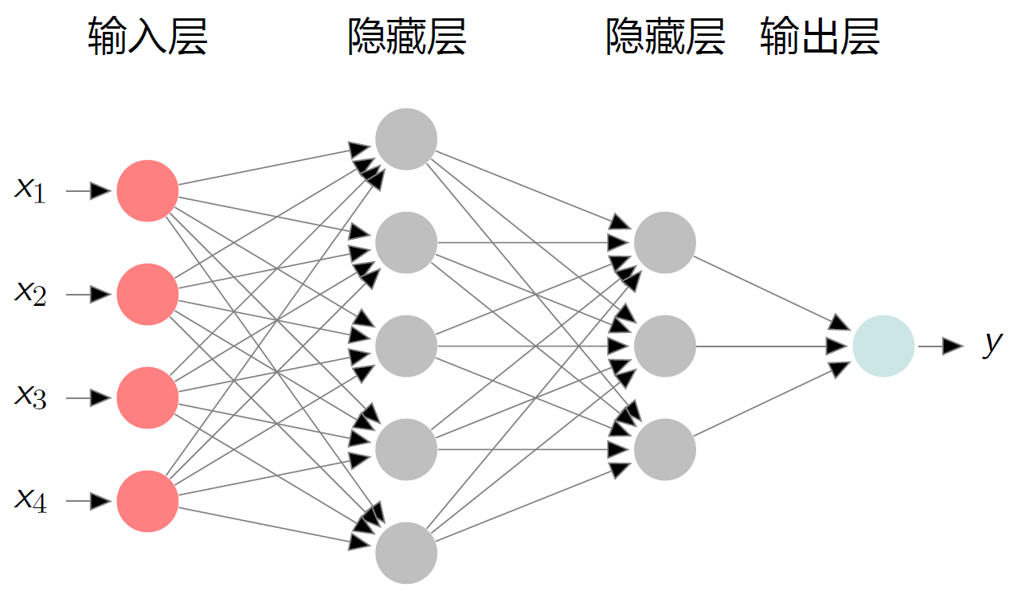
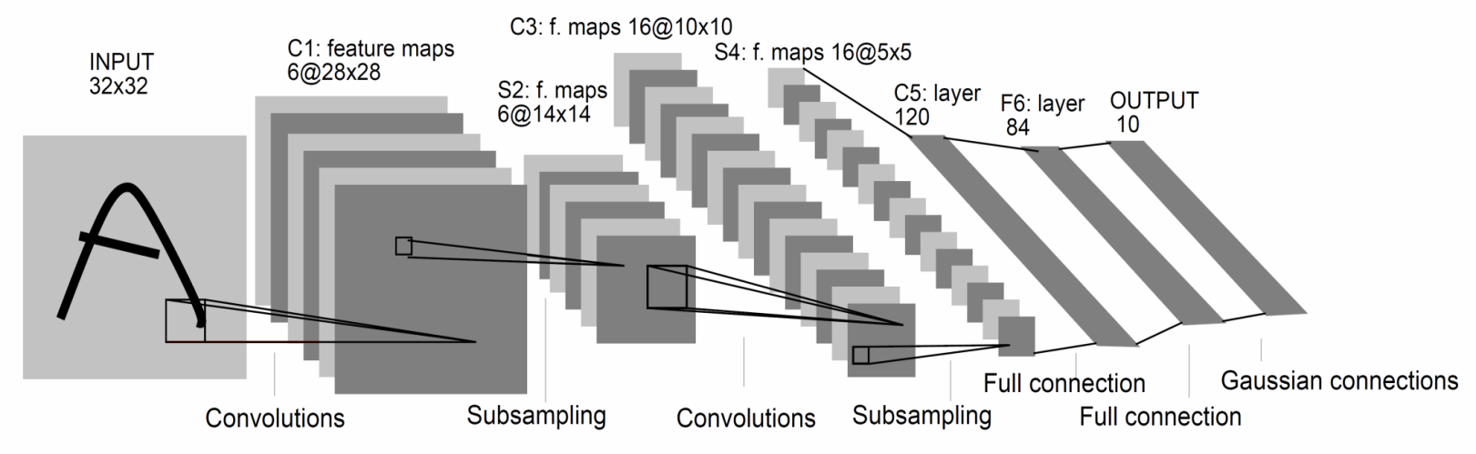
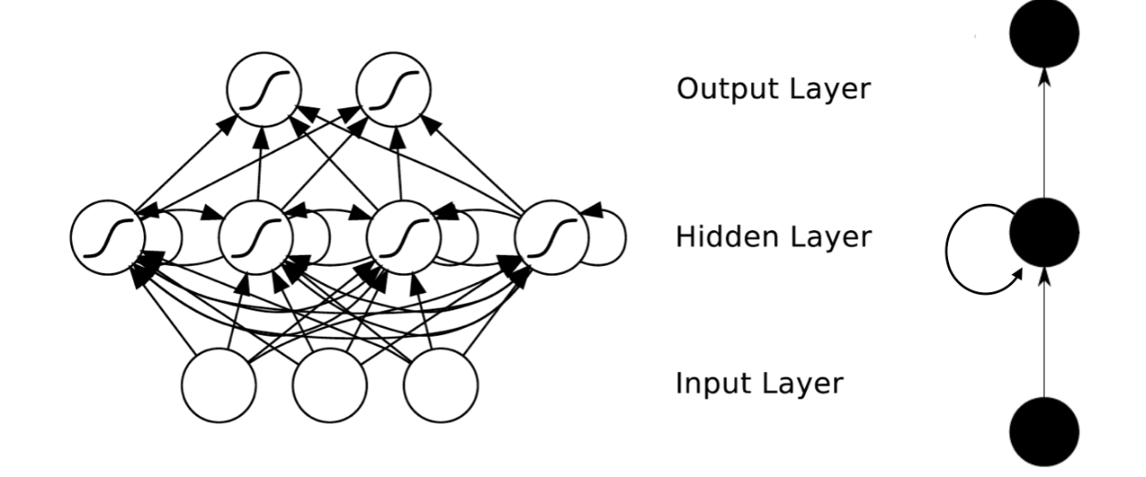
CNN
NN
Differences:
1.There are connections between nodes in the hidden layer of RNN.
2.The inputs of NN and CNN are finite.
3.RNN can make use of sequential information and inputs can be arbitrarily long sequences.
4.RNN shares the same parameters(weights and bias) across all steps.
RNN

Slide 4
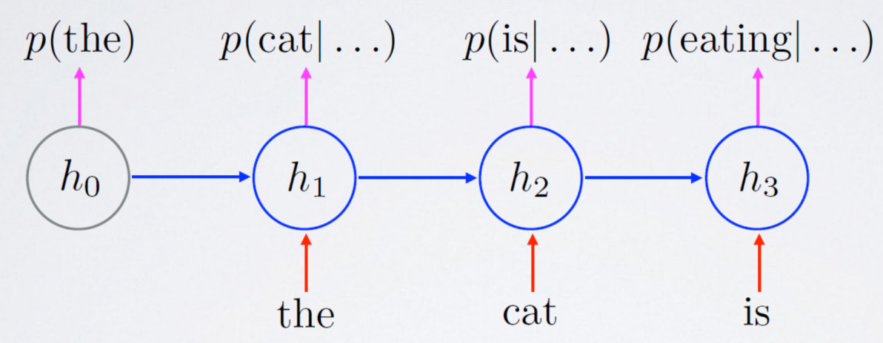
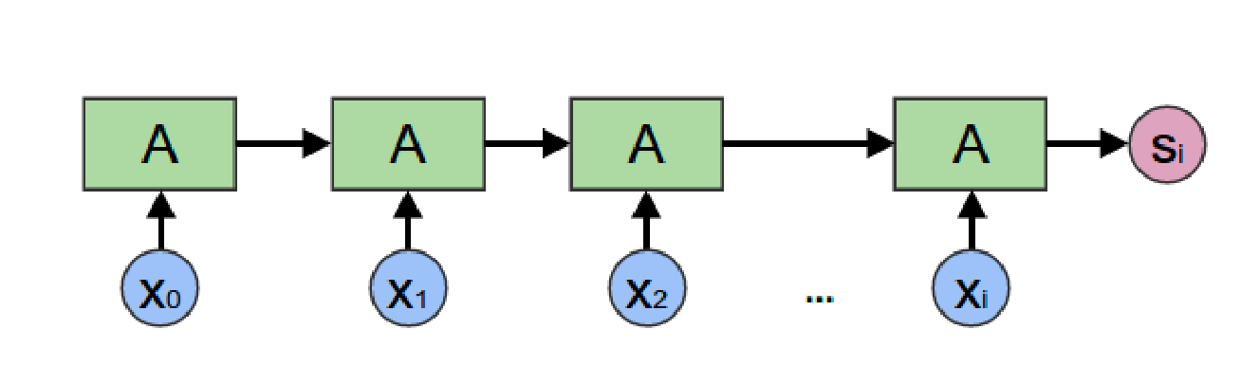
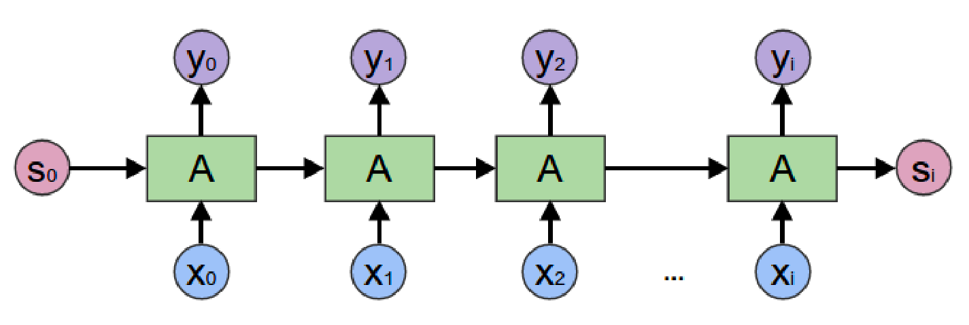
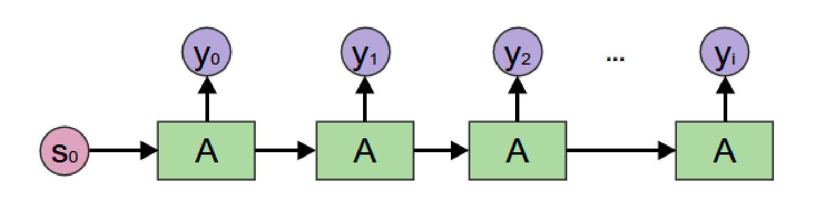
RNN for sequential information
RNN Language Model
Encoding RNN
Generating RNN
General RNN

Slide 5
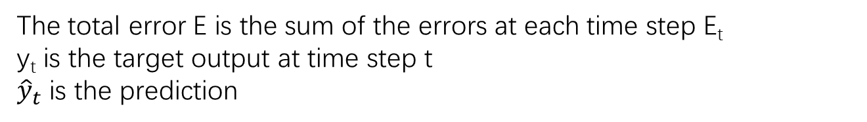
Loss Function
Cross entropy loss:
The total error E is the sum of the errors at each time step E_{t}
y_{t} is the target output at time step t
${\hat{y}}_{t}$ is the prediction

Slide 6
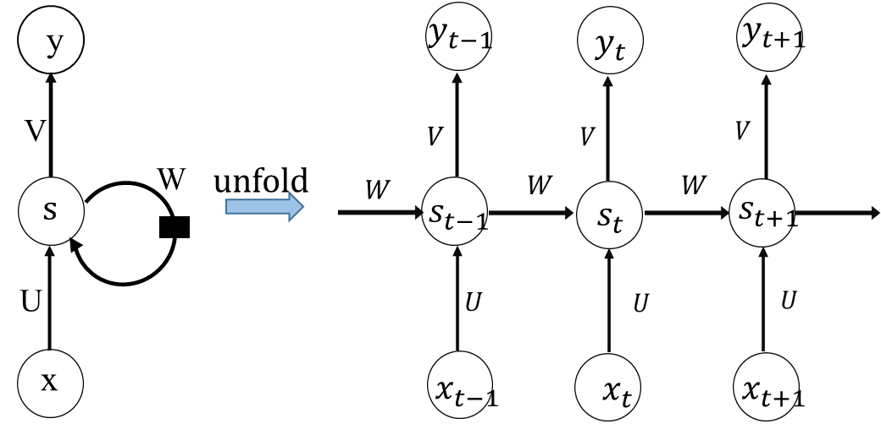
Backpropagation Through Time Algorithm

Slide 7
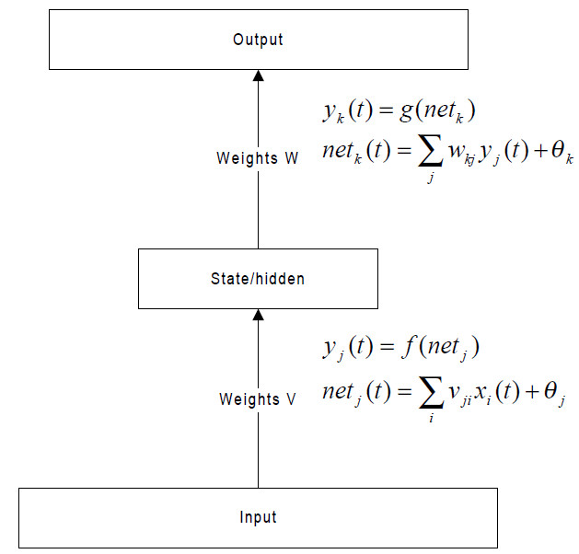
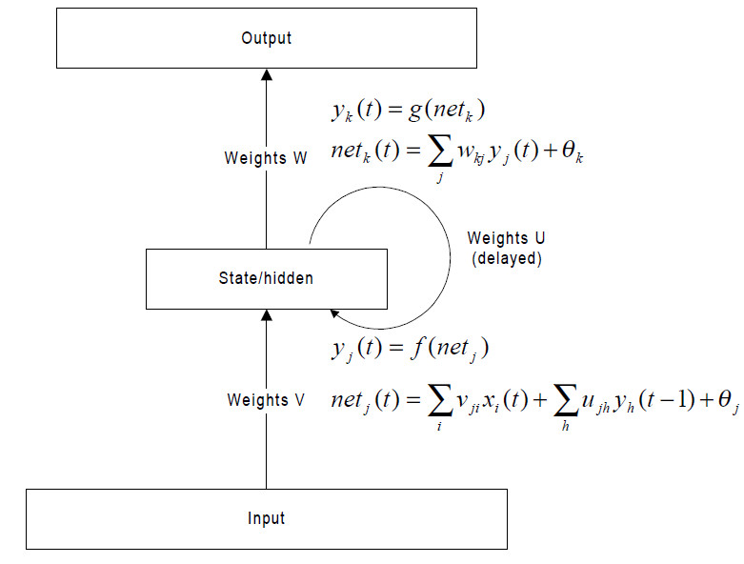
NN and RNN forward pass:

Slide 8
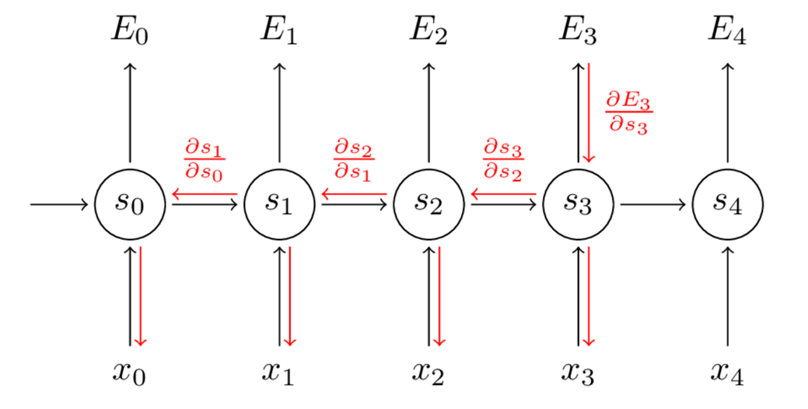




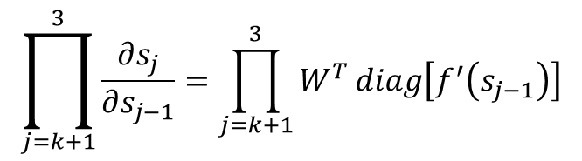
$$\prod_{j=k+1}^{3}{\frac{∂s_{j}}{∂s_{j−1}}}=\prod_{j=k+1}^{3}{W^{T}\operatorname{diag}\left[f^{′}\left(s_{j−1}\right)\right]}$$

Slide 9


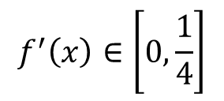



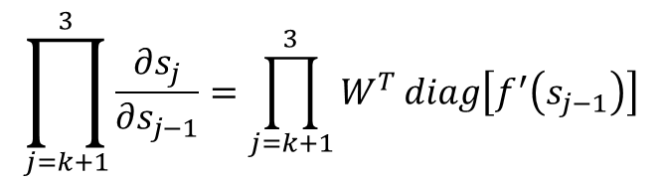

Vanishing Gradient & Gradient Explosion Problems
$$\prod_{j=k+1}^{3}{\frac{∂s_{j}}{∂s_{j−1}}}=\prod_{j=k+1}^{3}{W^{T}\operatorname{diag}\left[f^{′}\left(s_{j−1}\right)\right]}$$
$$γ=\left\|W^{T}\operatorname{diag}\left[f^{′}\left(s_{j−1}\right)\right]\right\|$$
Example:
Sentence1:
“Jane walked into the room. John walked in too. Jane said hi to___”
Sentence2:
“Jane walked into the room. John walked in too. It was late in the day, and everyone was walking home after a long day at work. Jane said hi to___”
when
$$γ>1,t−k→∞$$
$$γ^{t−k}→∞$$
Gradient Explosion
when
$$γ<1,t−k→∞$$
$$γ^{t−k}→0$$
Vanishing Gradient
$$f^{′}\left(x\right)∈\left[0,\frac{1}{4}\right]$$
Logisitc’s derivative:
Tanh’s derivative:
$$g^{′}\left(x\right)∈\left[0,1\right]$$

Slide 10
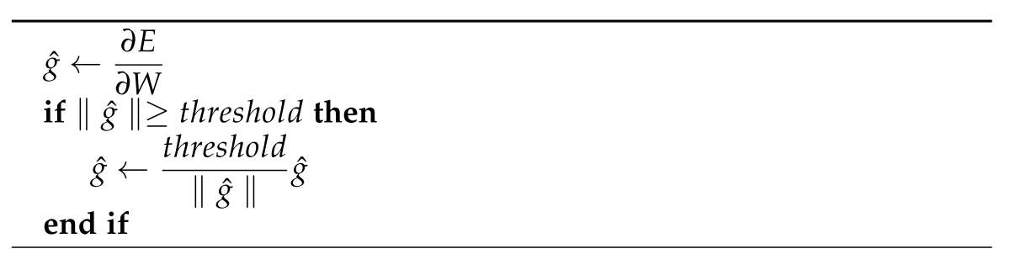
Solutions
Tricks for exploding gradient : clipping trick
Thomas Mikolov first introduced a solution that clips gradients to a small number whenever they explode. Whenever they reach a certain threshold, they are set back to a small number close to the original gradient landscape.
Tricks for vanishing gradients:
Initialize W to identity matrix.
Use the ReLU instead of the sigmoid function.
GRU and LSTM

Slide 11
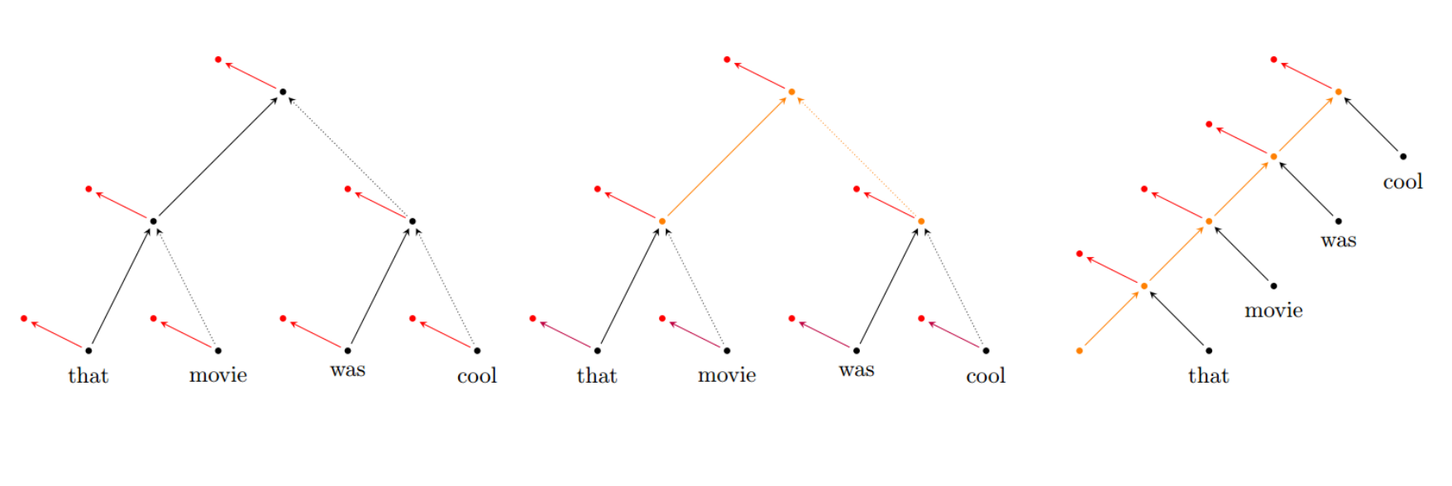
Recursive(递归) Neural Network & Recurrent(循环) Neural Network
Recursive Neural Network:
Focus on compositional representation
Learning of hierarchical structures, features and predictions
Applications:
Paraphrase detection
Relation classification
Sentiment analysis

Slide 12
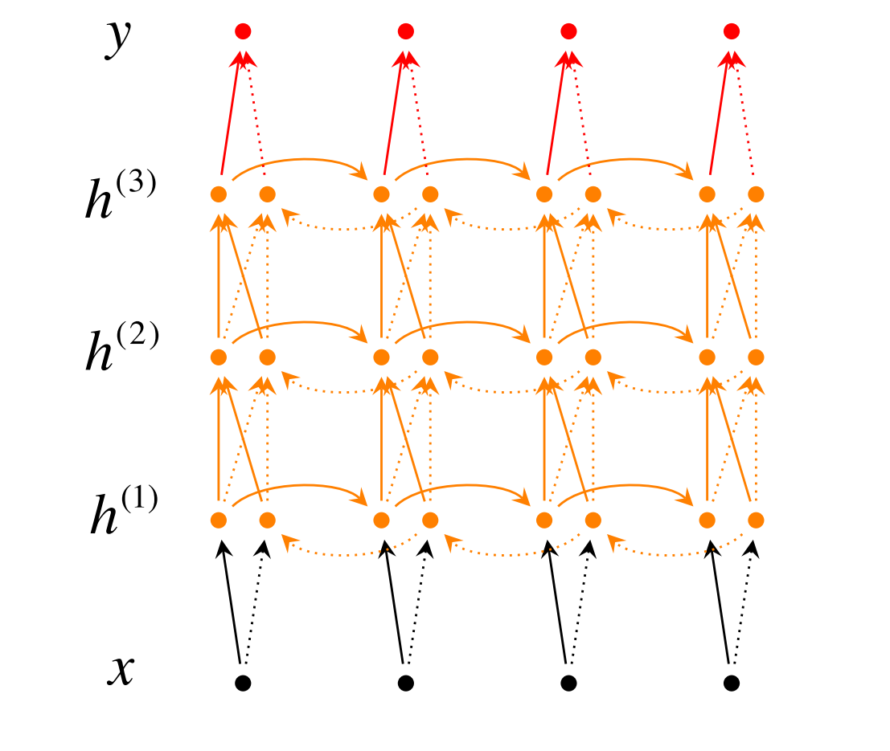
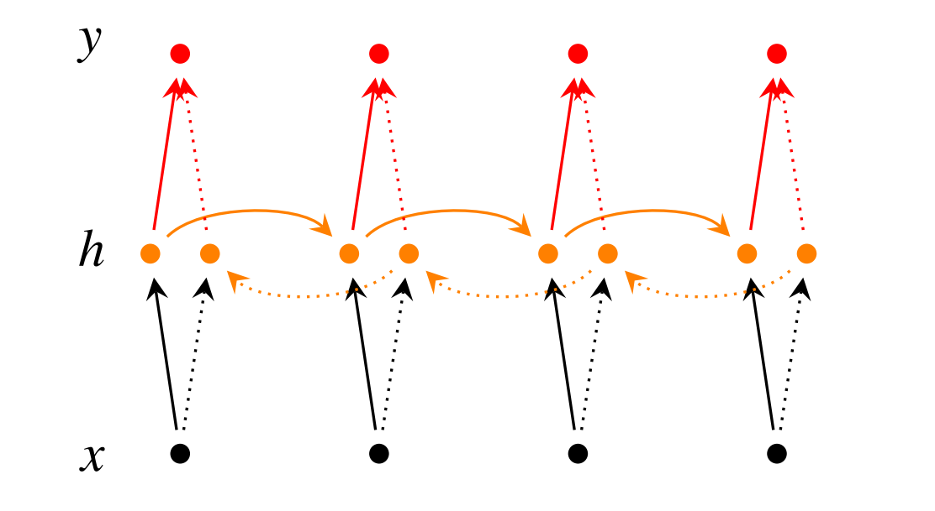
Bidirectional RNN
Incorporate information from words both preceding and following
Deep Bidirectional RNN
Inputs and outputs are arbitrary sequences
More hidden layer states

Slide 13
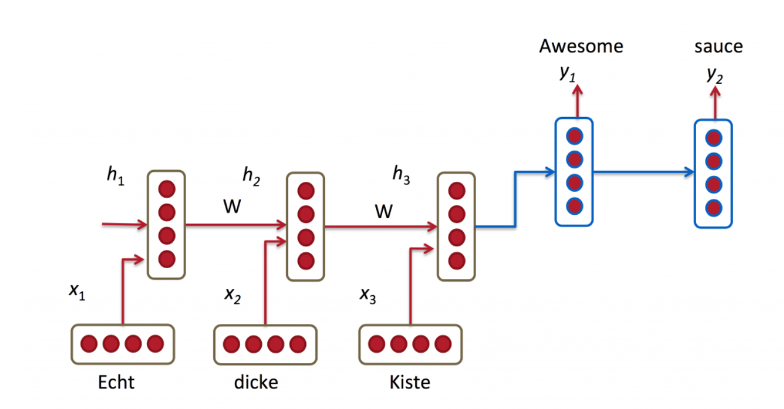
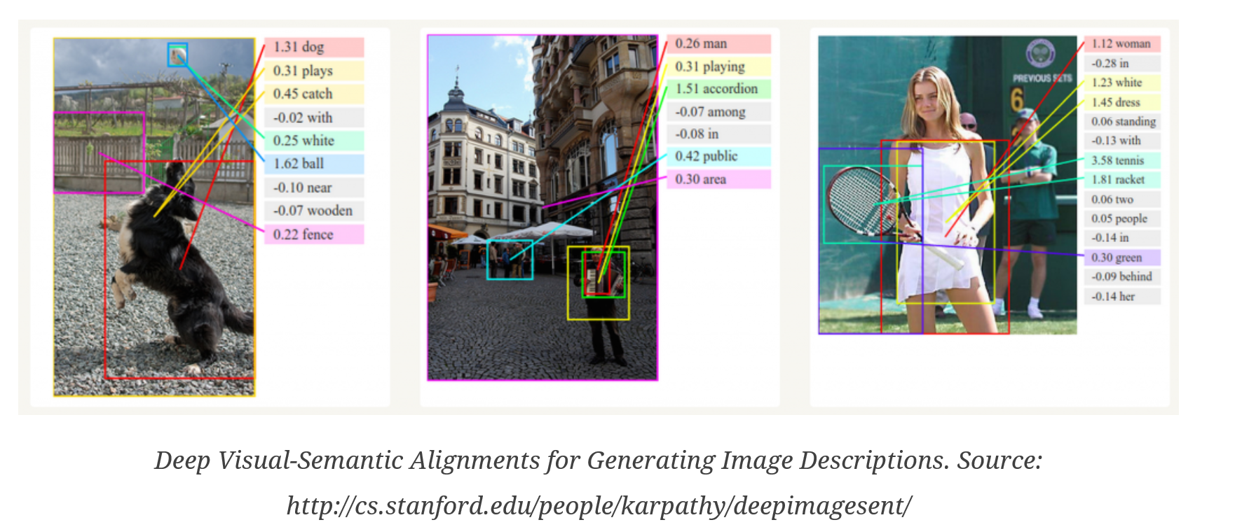
Applications
Machine Translation:
Generate Image Descriptions:

Slide 14
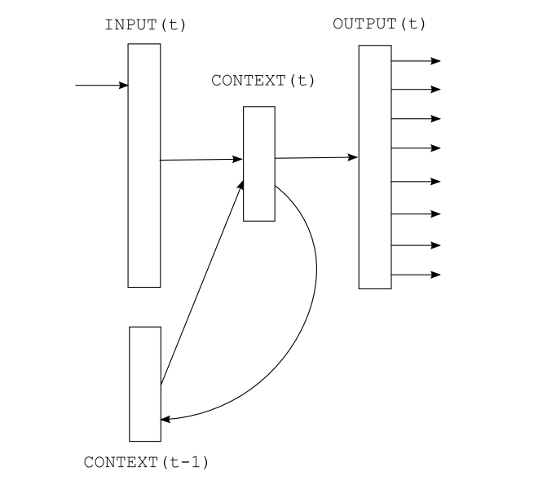

RNN Language Model
$$x\left(t\right)=w\left(t\right)+s\left(t−1\right)$$
$$s_{j}\left(t\right)=f\left(\sum_{i}{x_{i}\left(t\right)u_{ji}}\right)$$
$$y_{k}\left(t\right)=g\left(\sum_{j}{s_{j}\left(t\right)v_{kj}}\right)$$
$$f\left(z\right)=\frac{1}{1+ⅇ^{−z}}$$
$$g\left(z_{m}\right)=\frac{e^{z_{m}}}{Σ_{k}e^{z_{k}}}$$
$$ⅇrror\left(t\right)=dⅇsirⅇⅆ\left(t\right)−y\left(t\right)$$
Tomas Mikolov. et.al.Recurrent neural network based language model

Slide 15
Thanks

