Slide 1

A Generalized Language Model in Tensor Space
Tianjin University
Lipeng Zhang, Peng Zhang, Xindian Ma, Shuqin Gu, Zhan Su, Dawei Song
AAAI 2019

Slide 2
Outline
Motivation
Background
TSLM basic representation
Generalization
Recursive Language Modeling
Experiment

Slide 3
Motivation
To construct a high-order based language model
(not limited to two/three consecutive words in 2/3-order tensor)
To derive an effective solution and demonstrate such a solution is a general approach for language modeling
(a high-order tensor contains exponential magnitude of parameters)

Slide 4
Motivation
Represent the documents as the two order tensors:
For 10000-dimensional vector can be converted into 100×100
Cai, D.; He, X.; and Han, J. 2006. Tensor space model for document analysis. The 29th SIGIR conference on Research and development in information retrieval, 625–626

Slide 5
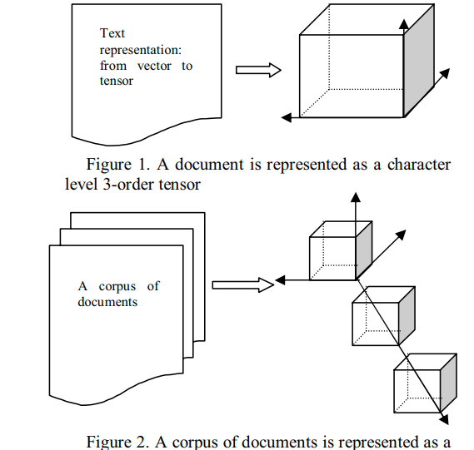
Motivation
Represent the text as a 3-order tensor
Liu, N.; Zhang, B.; Yan, J.; and Chen, Z. 2005. Text representation: from vector to tensor. In IEEE International Conference on Data Mining, 725–728

Slide 6
The problem of exponential magnitude of parameters
Tensor
Network
Tensor decomposition

Slide 7
High-order tensor based language model
Consider all the combinatorial relations among words through the interaction among all the dimensions of word vectors.
Demonstrate that tensor representation is a generalization of the n-gram language model
Derive a recursive calculation of conditional probability for
language modeling via tensor decomposition in TSLM

Slide 8
Outline
Motivation
Background
TSLM basic representation
Generalization
Recursive Language Modeling
Experiment

Slide 9



















Background
Tensor and Tensor Networks
A tensor : a mutidimensional array
The order : the number of indexing entries
Tensor product : a fundamental operator
1)
2)
3)
4)
…
…

Slide 10



























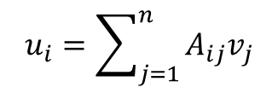
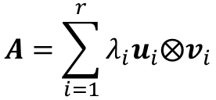
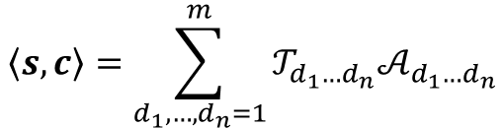
Tensor and Tensor Networks
Tensor Network is formally represented an undirected and weight graph
=
=
…
=

Slide 11
Outline
Motivation
Background
TSLM basic representation
Generalization
Recursive Language Modeling
Experiment

Slide 12

Language Modeling by Tensor Space
How to represent a single word
$$w_{i}=\sum_{d_{i}}^{m}{α_{id_{i}}e_{d_{i}}}$$
How to represent a original sentence
$$s=w_{1}⨂⋯⨂w_{n}$$
$$s=\sum_{d_{1},⋯,d_{n}=1}^{m}{𝒜_{d_{1},⋯,d_{n}}e_{d_{1}}}⨂⋯⨂e_{d_{n}}$$

Slide 13
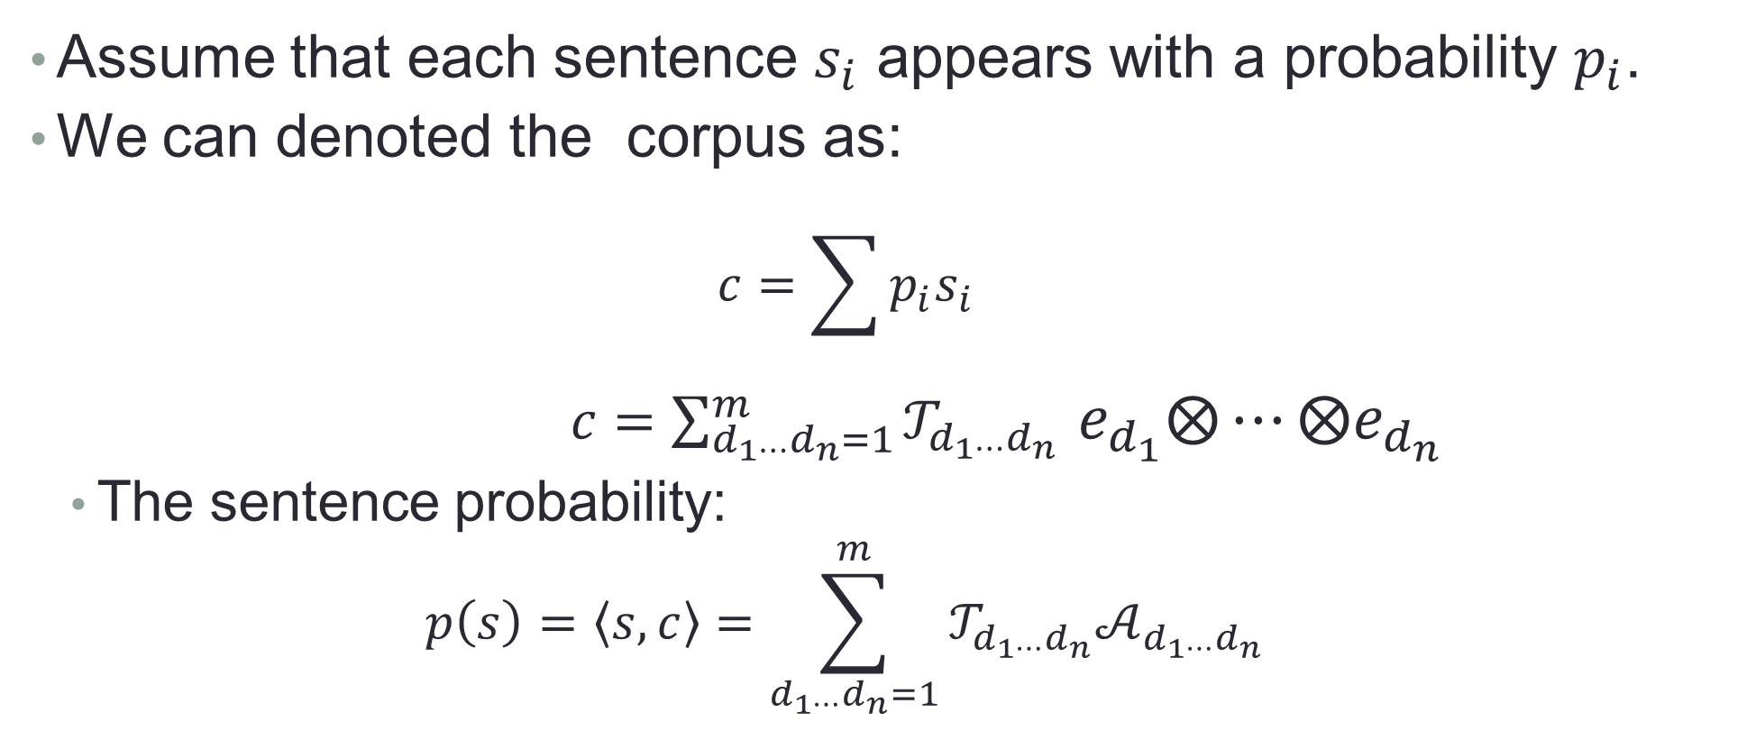
Language Modeling by Tensor Space
Assume that each sentence $s_{i}$ appears with a probability $p_{i}$.
We can denoted the corpus as:
$$c=\sum{p_{i}s_{i}}$$
$c=\sum_{d_{1⋯}d_{n}=1}^{m}{𝒯_{d_{1⋯}d_{n}}}$ $e_{d_{1}}⨂⋯⨂e_{d_{n}}$
The sentence probability:
$$p\left(s\right)=\left\langle s,c\right\rangle =\sum_{d_{1⋯}d_{n}=1}^{m}{𝒯_{d_{1⋯}d_{n}}𝒜_{d_{1⋯}d_{n}}}$$

Slide 14
Outline
Motivation
Background
TSLM basic representation
Generalization
Recursive Language Modeling
Experiment

Slide 15
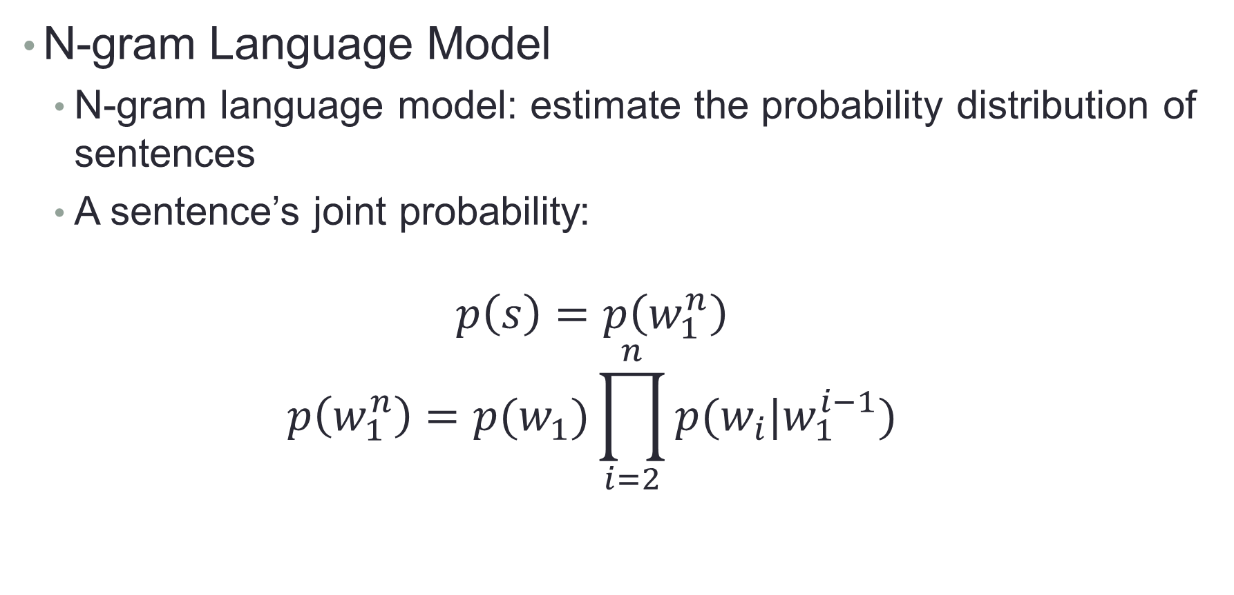
A Generation of N-Gram Language Mode
N-gram Language Model
N-gram language model: estimate the probability distribution of sentences
A sentence’s joint probability:
$$p\left(s\right)=p\left(w_{1}^{n}\right)$$
$$p\left(w_{1}^{n}\right)=p(w_{1})\prod_{i=2}^{n}{p(w_{i}|w_{1}^{i−1})}$$

Slide 16
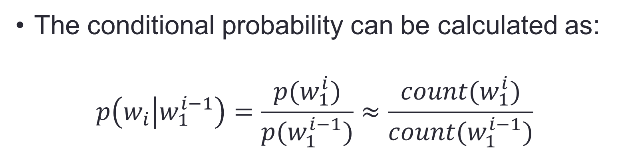
N-Gram Language Model
The conditional probability can be calculated as:
$$p\left(w_{i} | w_{1}^{i−1}\right)=\frac{p(w_{1}^{i})}{p(w_{1}^{i−1})}≈\frac{count(w_{1}^{i})}{count(w_{1}^{i−1})}$$
Where the count denotes the frequency statistics in corpus.

Slide 17
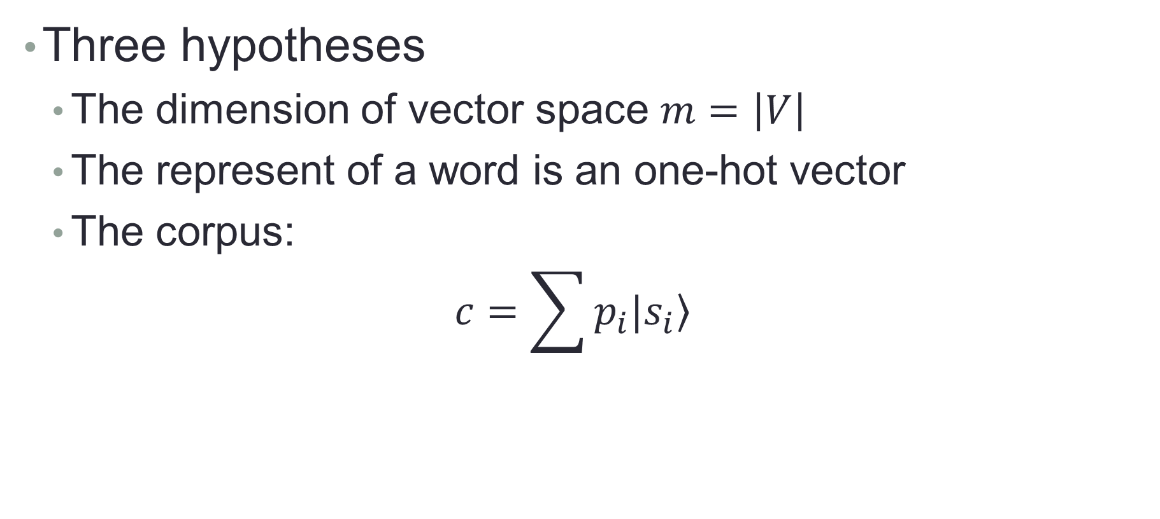
How to Prove TSLM as a Generalization of N-Gram
Three hypotheses
The dimension of vector space $m=\left|V\right|$
The represent of a word is an one-hot vector
The corpus:
$$c=\sum{p_{i}|\left.s_{i}\right\rangle }$$

Slide 18
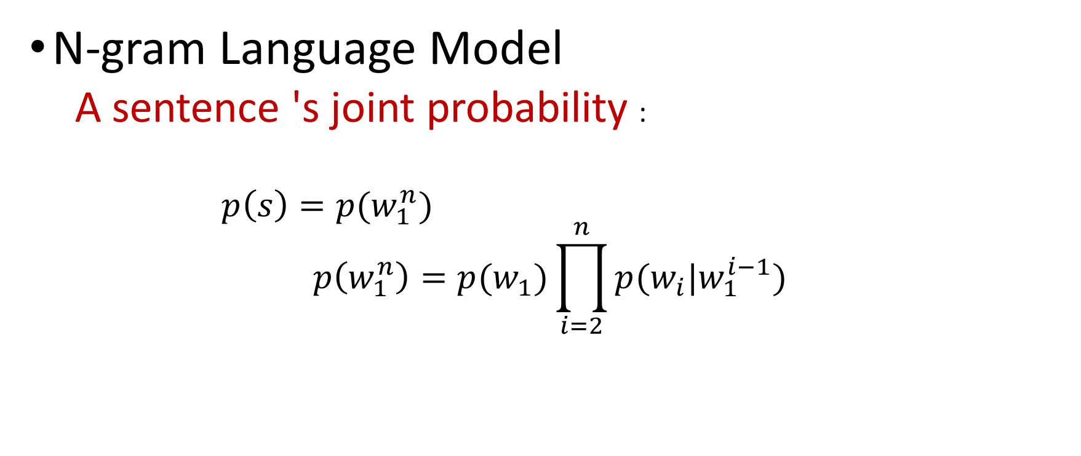
Compute the joint probability
①

Slide 19

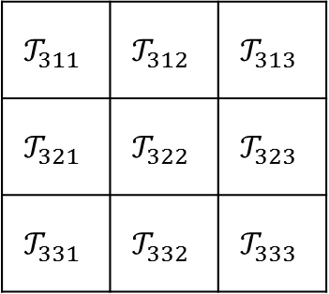
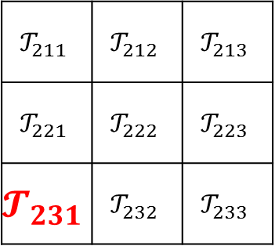
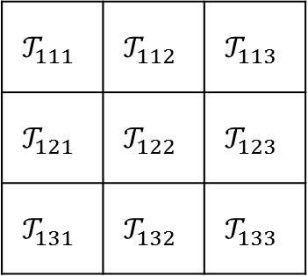
An example
V={A,B,C}
The probability of each combination is one element in the tensor
S_{i}=(B,C,A)
p(S_{i}) =

Slide 20
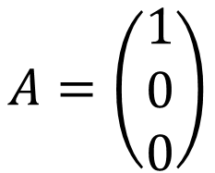
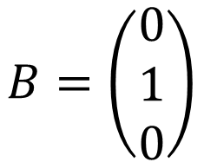
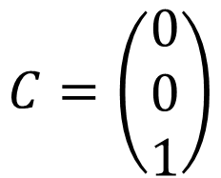




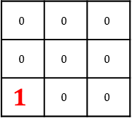
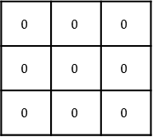
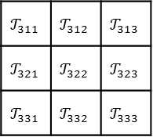
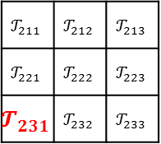
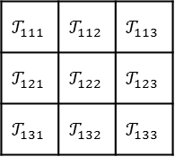
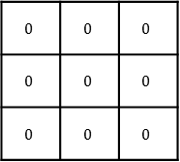
Vocablary V={A,B,C}，

Slide 21
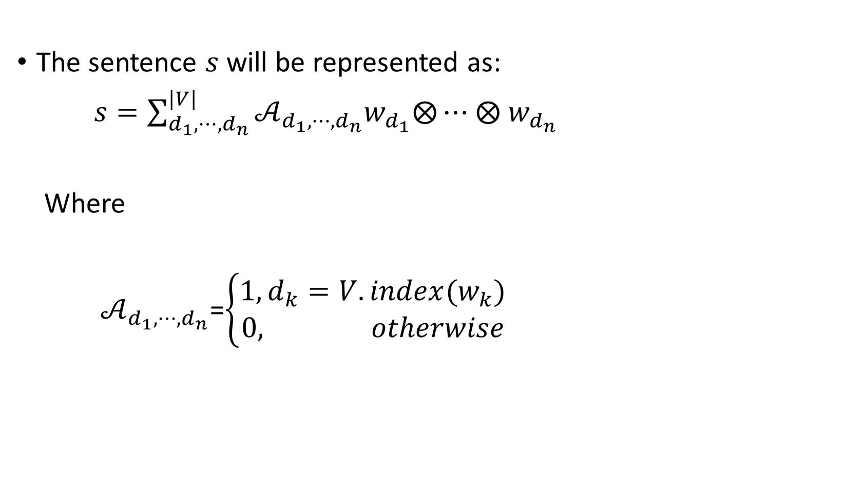
Compute the joint probability

Slide 22
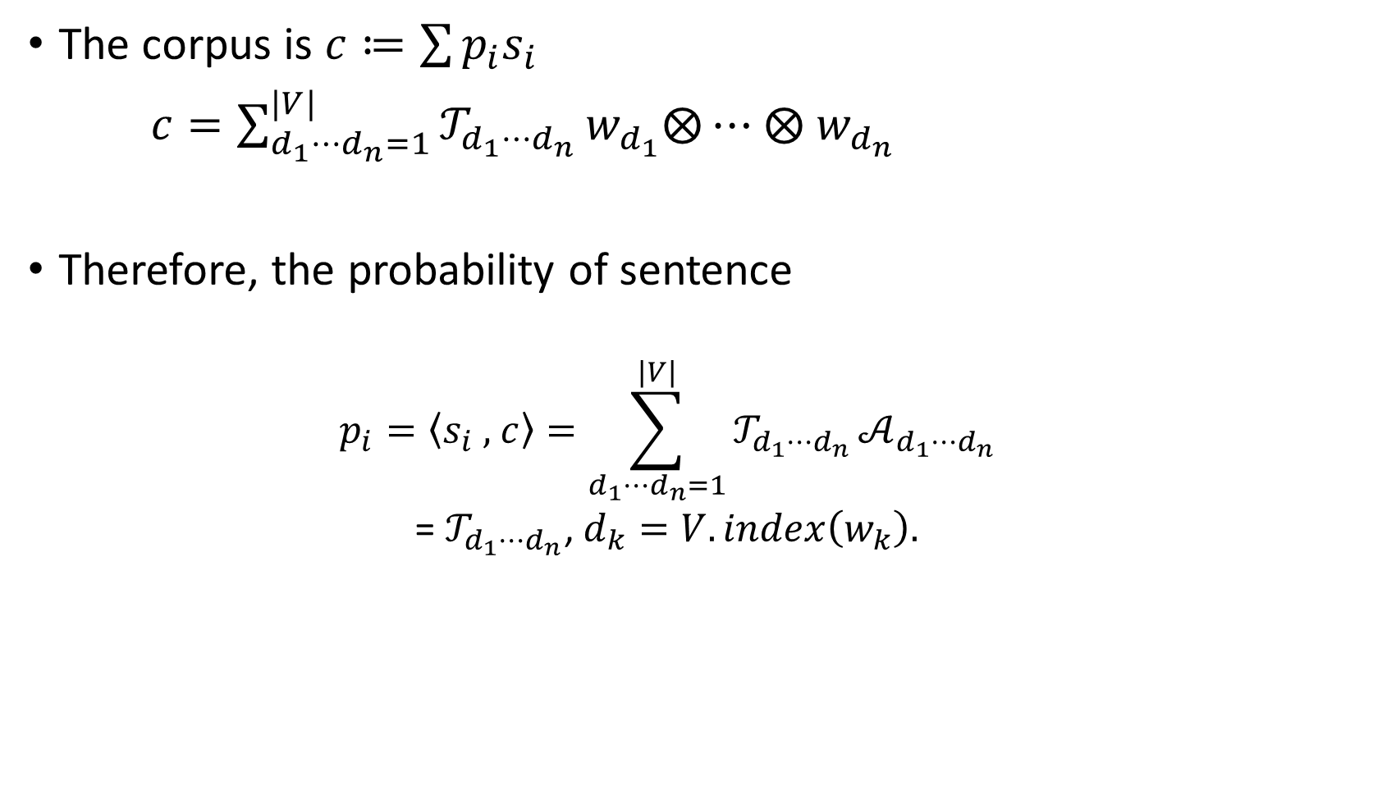

Slide 23
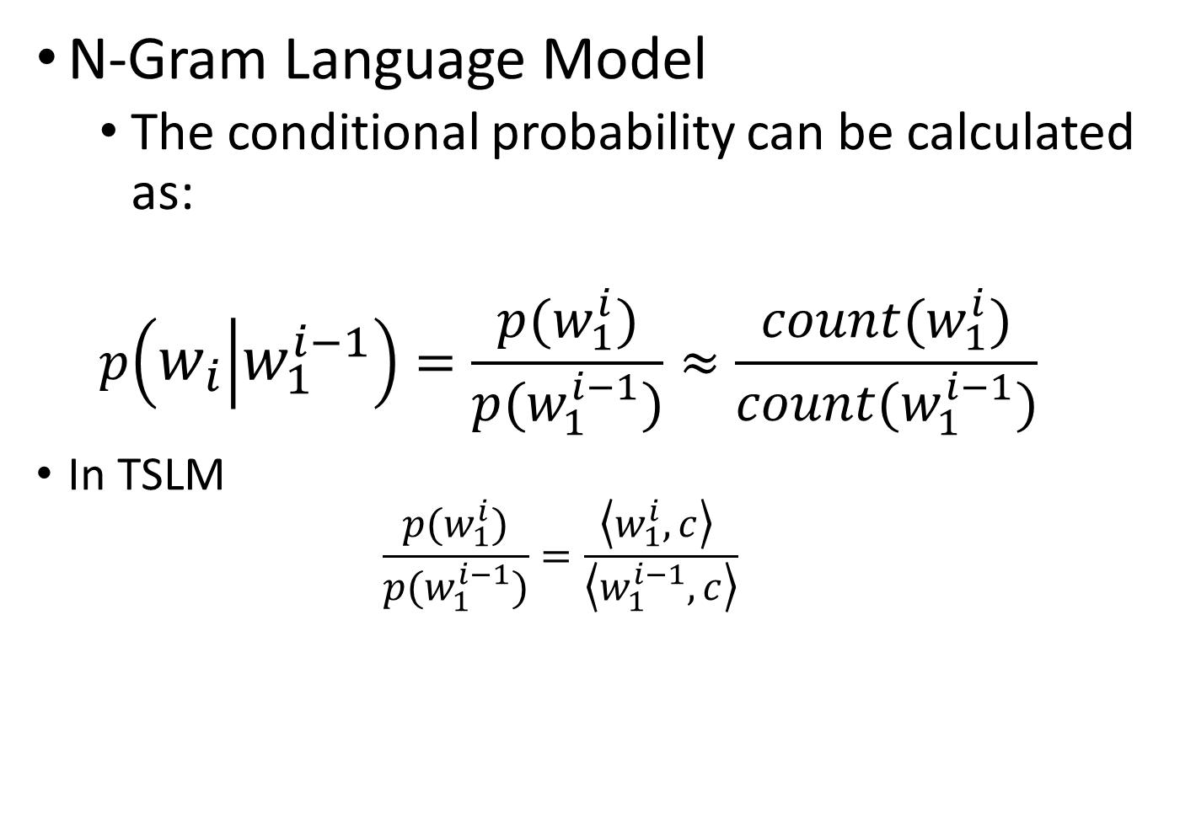
Compute the conditional probability
②

Slide 24
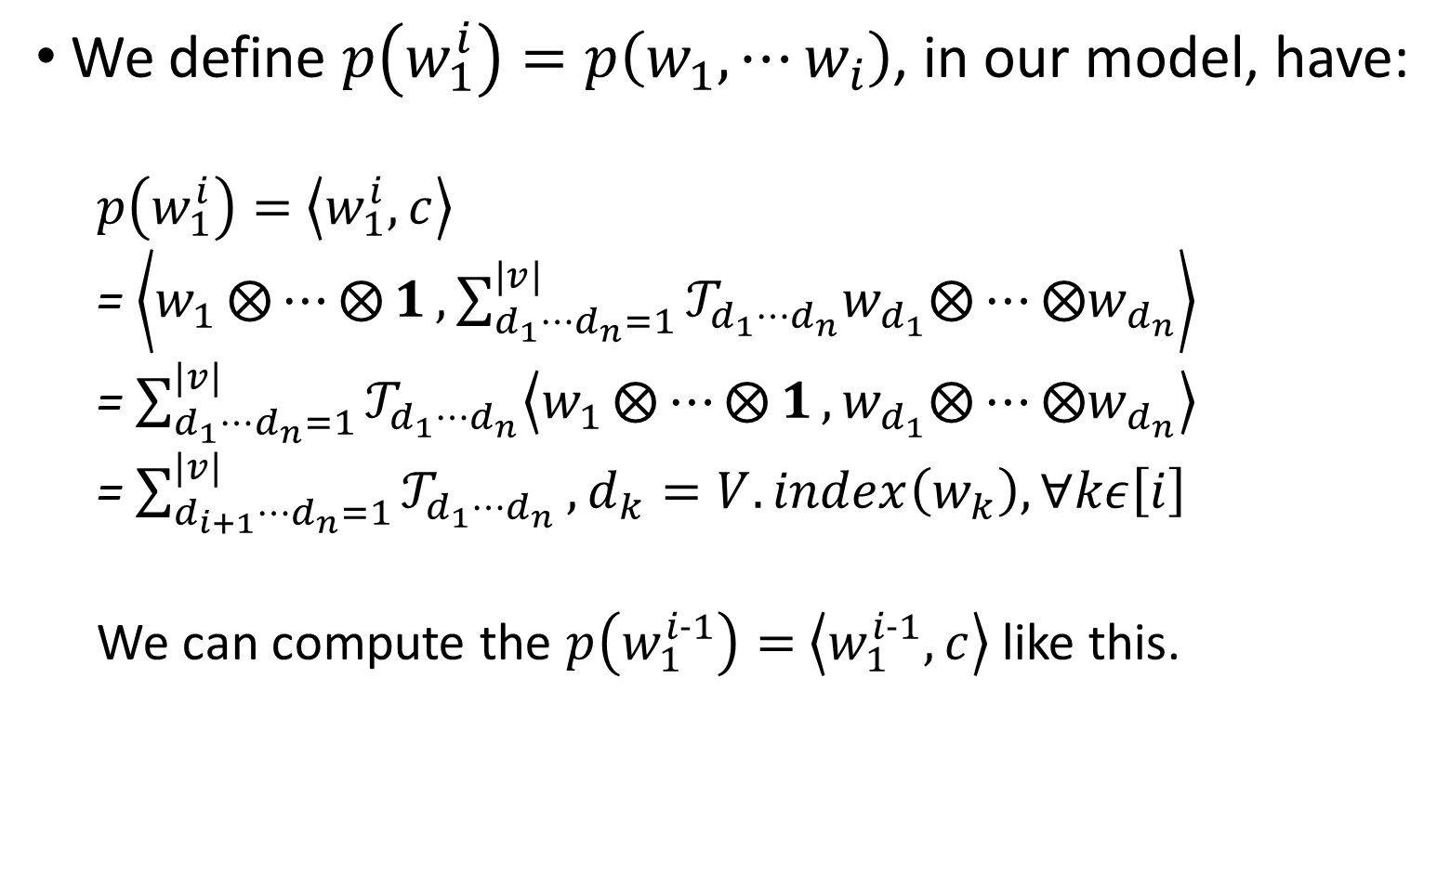

Slide 25
Outline
Motivation
Background
TSLM basic representation
Generalization
Recursive Language Modeling
Experiment

Slide 26
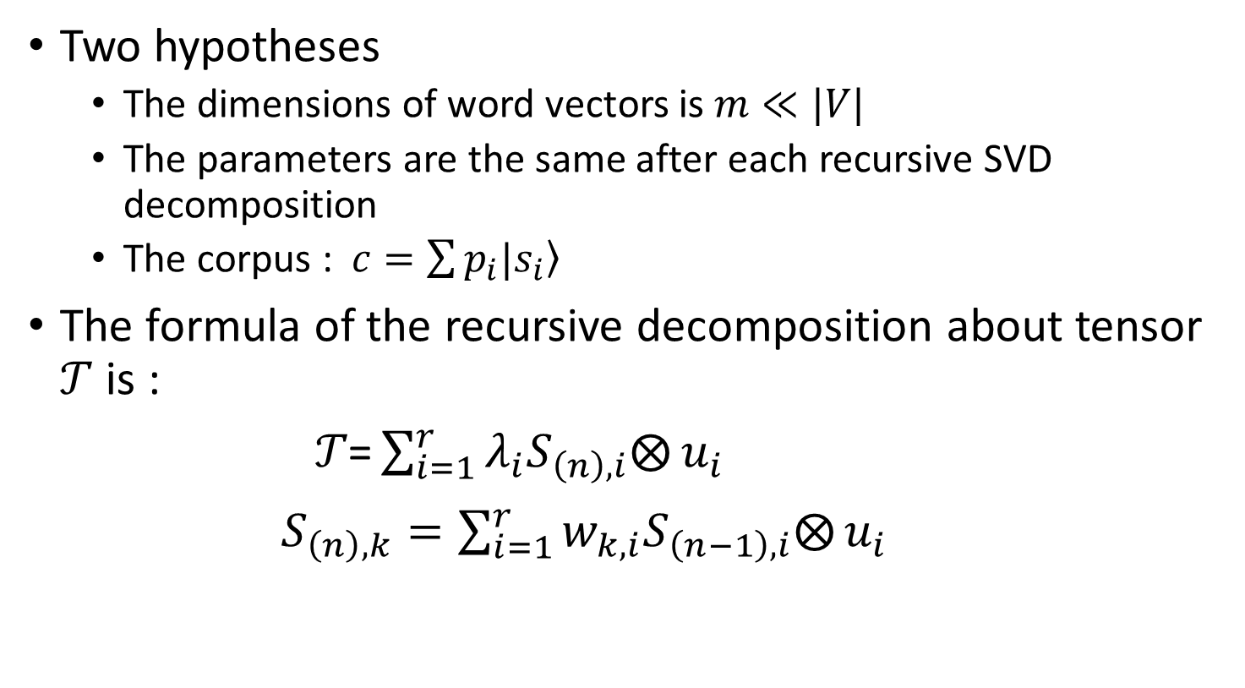
Recursive Language Modeling

Slide 27





















Tensor recursive decomposition
…
…
…
…

Slide 28













































Recursive Language Modeling
(a)
…
…
…
…
(b)
(c)
(d)

Slide 29
Outline
Motivation
Background
TSLM basic representation
Generalization
Recursive Language Modeling
Experiment

Slide 30
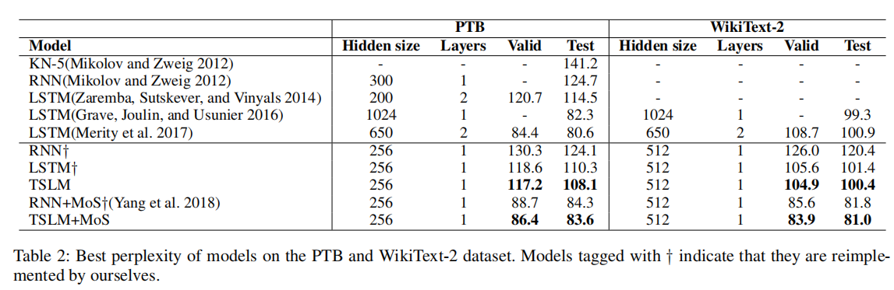
Experimental Result

Slide 31
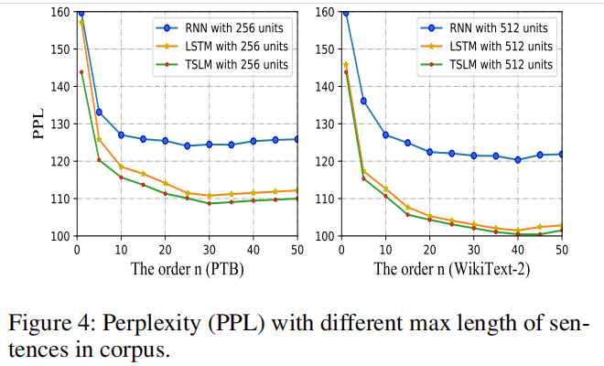
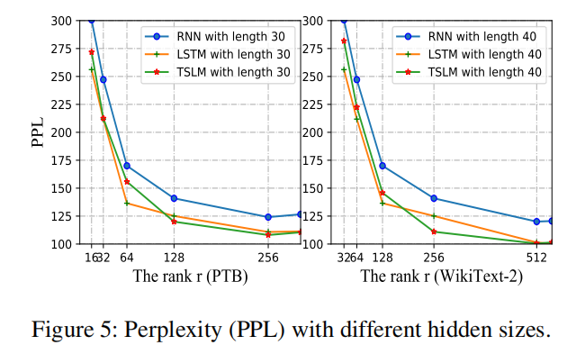
Experience

Slide 32
Future Work
Achieve text generation by using TSLM
Further interpreted in the neural network by tensor network
Further explore the potential of tensor network for language model

