Slide 2
F R O H
—The first session of conference
on paper reading
CIS Lab, Shenzhen graduate school of PKU, Shenzhen
Oct, 11th, 2019

Slide 3
Agenda
Deep Residual Learning for Image Recognition. —Ben
How to Understand RNN? —Xiaoyaozi
Report: On the Importance of Initialization and Momentum. —Forrest
Banquet: 22:00 pm Running.

Slide 4
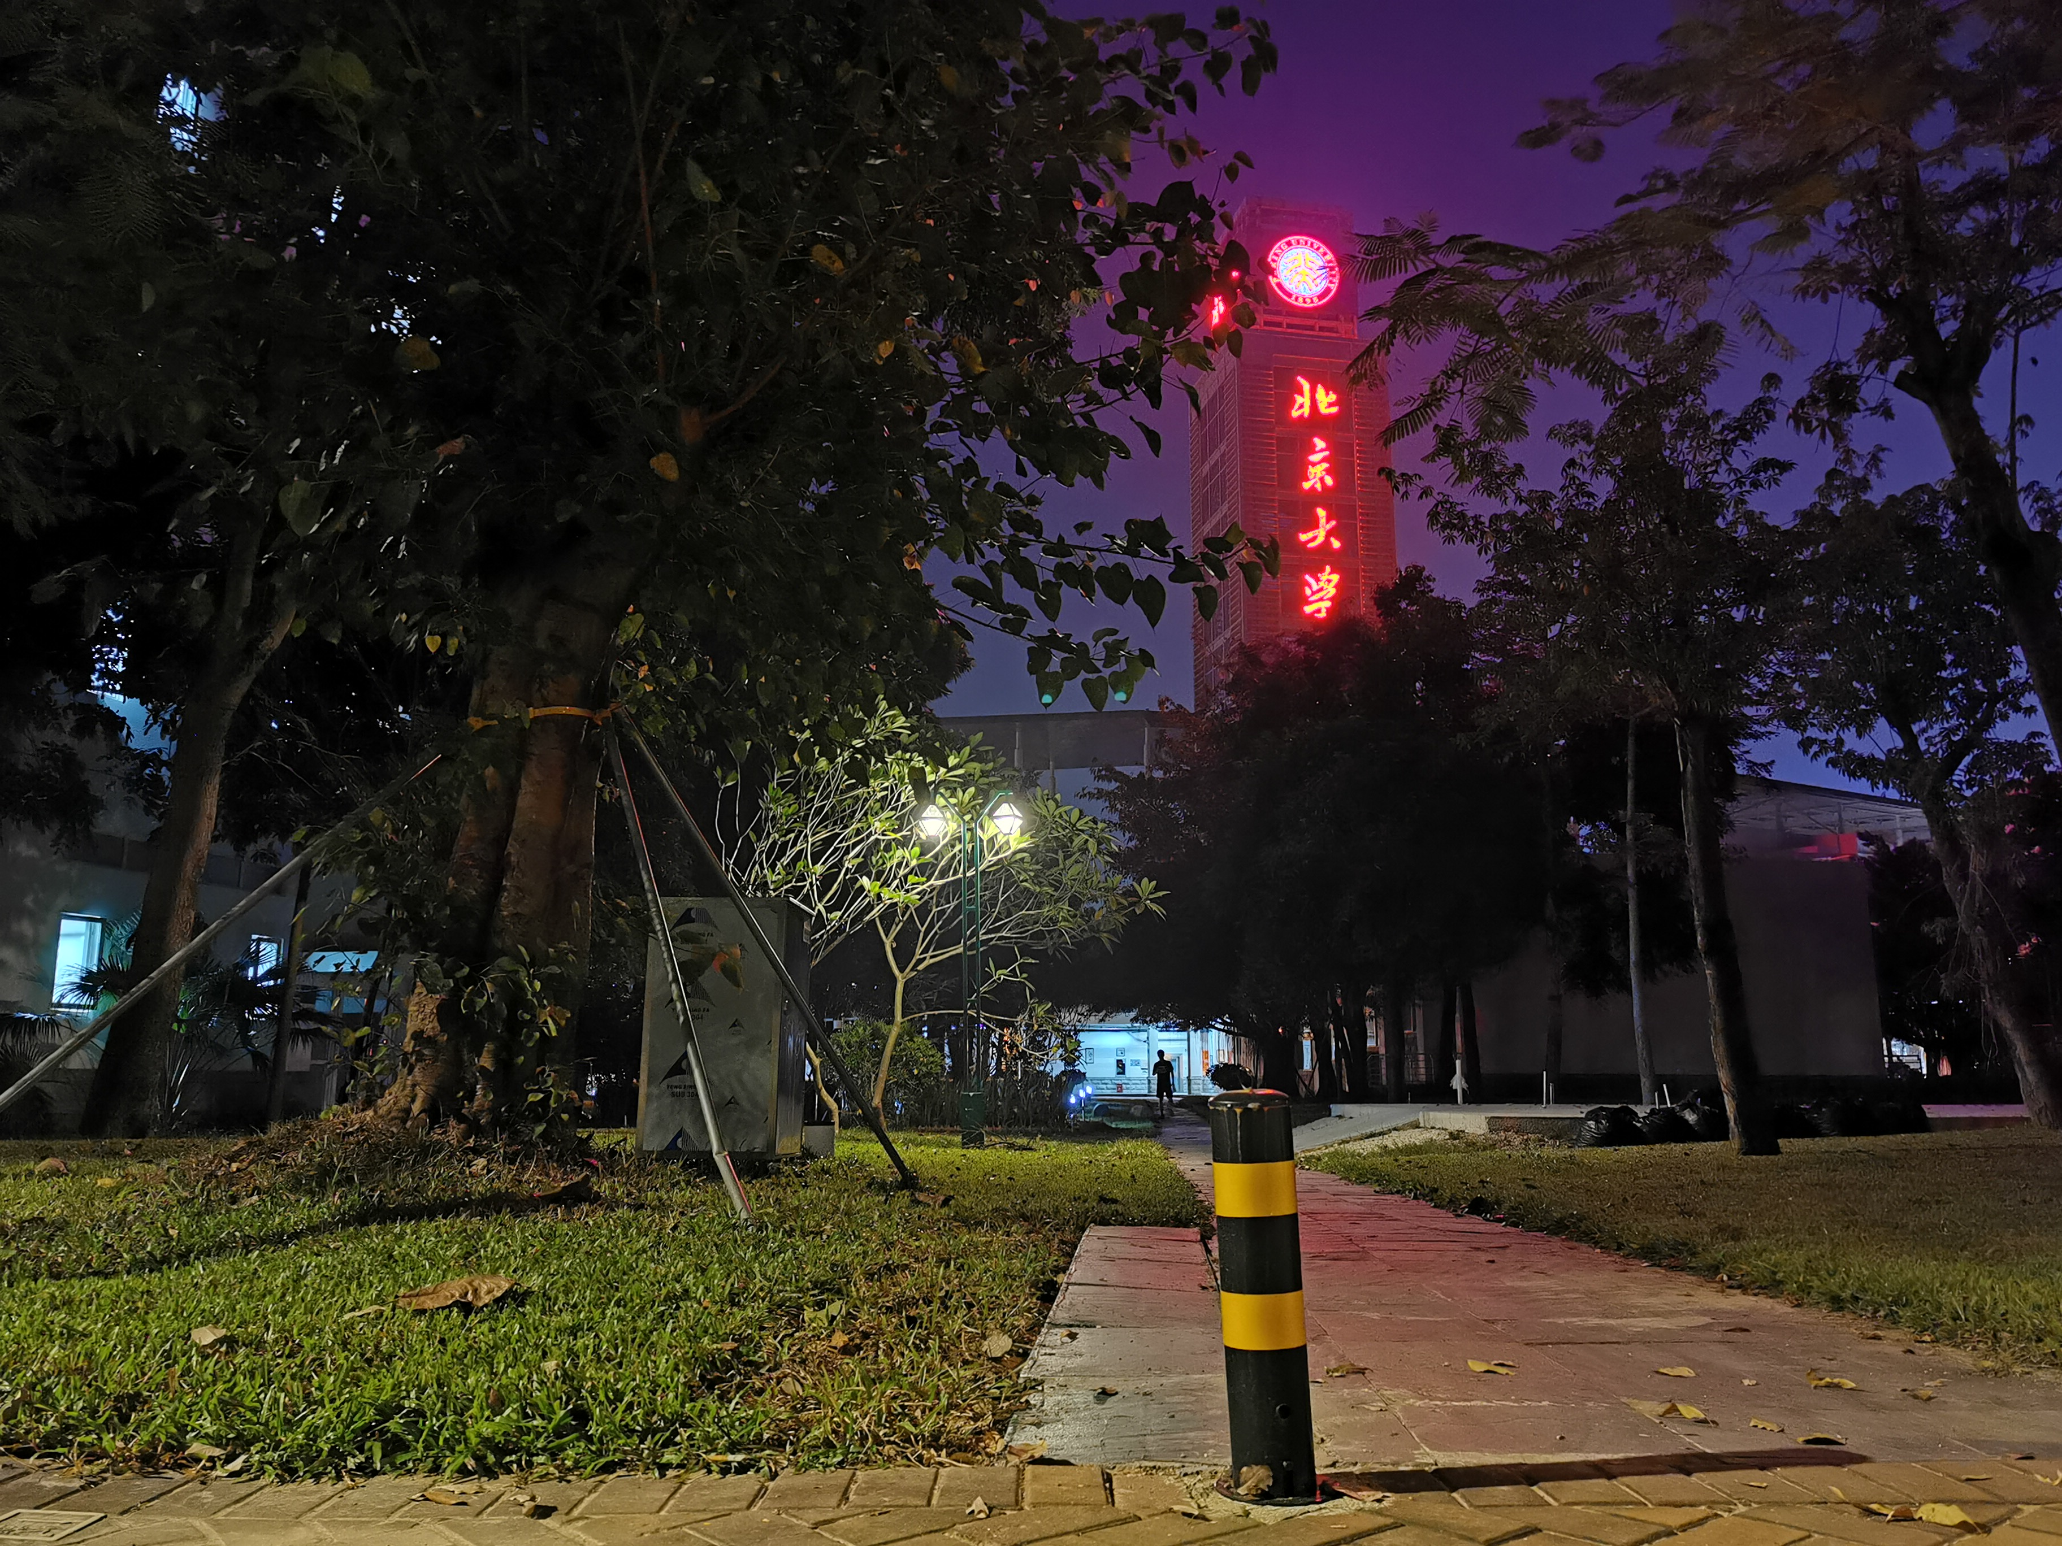
Thanks

Slide 5
Thanks

