Slide 1

Kernel Trick
Reproducing Kernel Hilbert Space
Faker
2019.11.01

Slide 2


矩阵回顾
Eigen Decomposition
For a real symmetric matrix A , there exists real number λ and vector x so that
Ax=λx
Then λ is an eigenvalue of A and x is the corresponding eigenvector. If A has two different eigenvalues λ1​ and λ2​ , λ1​unequal to λ2​ , with corresponding eigenvectors x1​ x2​ respectively
Since 2λ1​≠λ2​ , we have

Slide 3

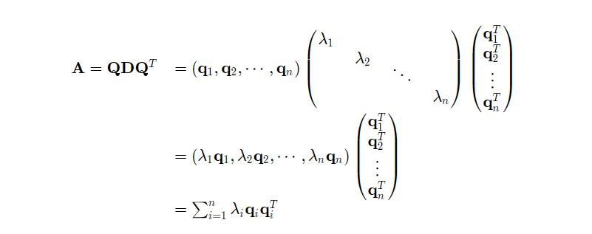

矩阵回顾
For A∈Rn×n , we can find n eigenvalues a long with n orthogonal eigenvectors. As a result, A can be decomposited as
Note：

Slide 4
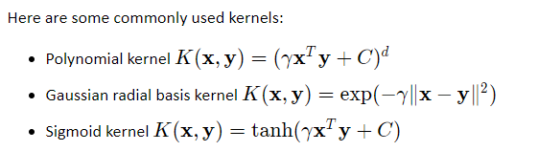
Kernel Function
A function f(x) can be viewed as an infinite vector, then for a function with two independent variables K(x,y) , we can view it as an infinite matrix. Among them, if K(x,y)=K(y,x) and
∫∫f(x)K(x,y)f(y)dxdy≥0
for any function f 就是上面的f(x)和f(y)
then K(x,y) is symmetric and positive definite, in which case K(x,y) is a kernel function.

Slide 5
Kernel Function
Similar to matrix eigenvalue and eigenvector
there exists eigenvalue λ and eigenfunction ψ(x) so that
∫K(x,y)ψ(x)dx=λψ(y)
根据前面提到下面的式子，证明一下不同特征值对应特征函数也是互相垂直？

Slide 6
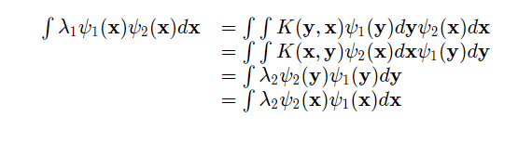

Kernel Function
answer
Therefore <ψ1​,ψ2​>=∫ψ1​(x)ψ2​(x)dx=0
Similar to matrix case

Slide 7




Reproducing Kernel Hilbert Space
Treat as a set of orthogonal basis and construct a Hilbert space H . Any function or vector in the space can be represented as the linear combination of the basis. Suppose
​
既然是向量，当然可以写成向量形式。。。。。
在假设有另外一个向量g，两个向量的内积就是：

Slide 8


Gradient exploding & vanish
we fix one parameter of the kernel function to be x then we can regard it
as a function with one parameter or as an infinite vector. Then
向量形式
This is the reproducing property, thus H is called reproducing kernel Hilbert space (RKHS)

Slide 9


空间映射
我们将x的映射表示为
就有如下关系
As a result, we do not need to actually know what is the mapping, where is the feature space, or what is the basis of the feature space. For a symmetric positive-definite function KK , there must exist at least one mapping Φ and one feature space H so that
<Φ(x),Φ(y)>=K(x,y)

Slide 10
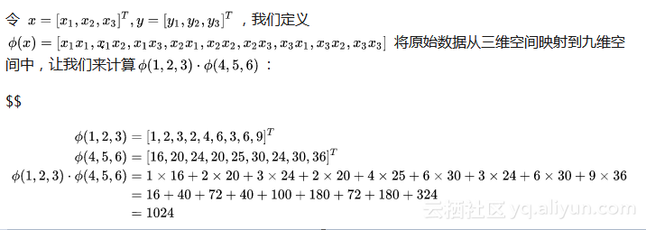
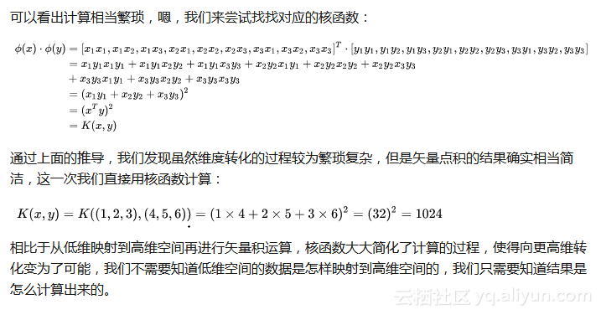
example

Slide 11
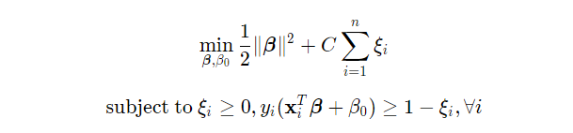
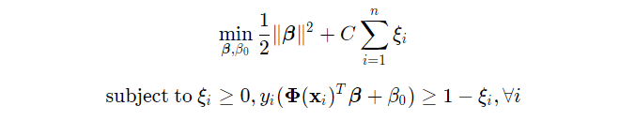
Apply in Svm
映射前
映射后

Slide 12
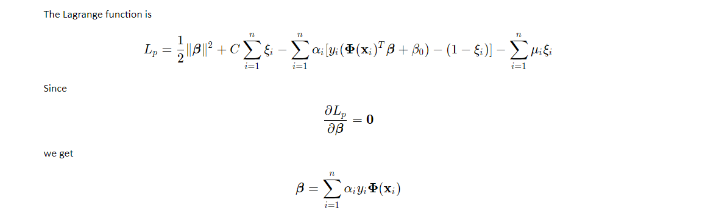
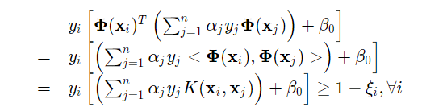
Apply in Svm
The constraints changes to:

Slide 13
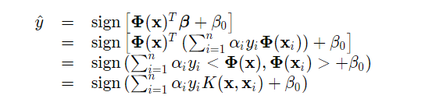
Apply in Svm
What we need to do is determining a kernel function and solve for α,β0​,ξi​ . We do not need to actually construct the feature space.

Slide 14
Thanks For listening

Slide 15
discuss

Slide 16


