Slide 1
CODEATHON 2018

Slide 2
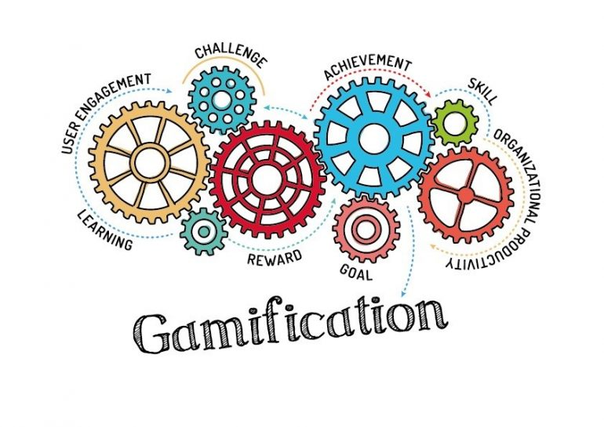
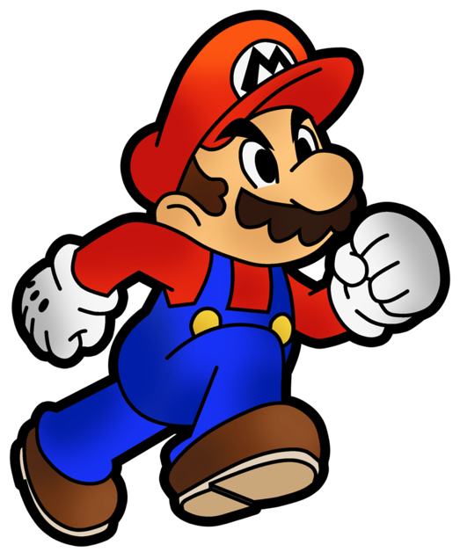

THE CHALLENGE!

Slide 3
The Tech Challenge – GAMIFICATION!
The challenge is Gamification!
In 5 hours, you will need to take the online starter app and create a “gamified" experience for users filling out the application and it will need to meet the following criteria:
Must leverage some type of “gamification” that incentivizes users to fully complete the application
Must leverage elements from the HIG UX KIT (For example: for form fields, UX KIT styling must be used)
Must take the user from beginning to end of the application to be considered complete
There are no requirements for repositories, so we encourage teams to collaborate in the way most comfortable to them.
Leverage the starter package that has a base online application consisting of 3 basic sections (this way you can focus on building the “gamification” piece)
Expand on the starter package
Add new sections, fields
Add images, styles
Make it your own
Leverage Game Mechanics to create your “gamified” experience
At the end of the 5 hours, please visit the codeathon sharepoint site and go to Upload Zip. Upload a zipped version of your final project into your Team’s folder
Some “DONT’S”:
Can NOT have any PII (use dummy data at all times, not even team member data)
Can NOT connect to any Hartford APIs or Web services that return any real life data
Can NOT connect to any APIs or Web services that are paid services that only certain people can access

Slide 4
What is Gamification?
gam·i·fi·ca·tion
ɡāmifəˈkāSHən/
noun
the application of typical elements of game playing (e.g., point scoring, competition with others, rules of play) to other areas of activity, typically as an online marketing technique to encourage engagement with a product or service. "gamification is exciting because it promises to make the hard stuff in life fun”
“Gamification involves the use of game techniques and elements to influence the behaviors of individuals. The use cases are many and diverse, but most involve prizes and points, competition and/or teamwork and scorekeeping to motivate people to meet specific goals.”
“Within insurance, gamification offers the greatest potential value in the realm of consumer engagement. Among early adopters, it has emerged as a useful practice and effective means to:
Transform ordinary tasks into interesting and fun experiences that keep users coming back
Strengthen brand awareness, affinity and penetration
Educate customers about product suitability and guide them to purchase
Motivate people to act in areas such as health and wellness, safe driving, financial planning and sustainability”
Source: https://www.insurancejournal.com/magazines/mag-features/2016/09/19/426309.htm

Slide 5
Game Mechanics – Rewarding the User (“Player”)
Consider the user of an online application a “player”
You want to design the application with a gamification layer that could reward the “player” as they go through the application
Examples of Game Mechanics:
Fast Feedback: Immediate feedback or response to actions
“Encourage users to continue or adjust their activities with onscreen notifications, text messages or emails. Congratulate a user for reaching a goal, encourage the next step to a milestone or promote a new reward.”
Goals: Short- and long-term goals to achieve
“Missions or challenges give users a purpose for interaction, and educate users about what is valued and possible within the experience.”
Badges: Evidence of accomplishments
“An indicator of accomplishment or mastery of a skill is especially meaningful within a community that understands its value. Often used to identify skills and expertise within a group.”
Competition: How I’m doing compared to others
“Raise the stakes for accomplishing a goal by showing users how they compare to others, as individuals or in teams. Encourage competition with time-based, team and individualized leaderboards. Where do I rank? How can I overtake my closest competitor?”
Points: Tangible, measurable evidence of my accomplishments
“Used to keep score and establish status or accumulated to purchase virtual or real goods. Earn points through activities, sharing, contributing, or by creating something useful to others.”
Source: https://www.bunchball.com/gamification/game-mechanics

Slide 6
GOOD LUCK!!! GO 4TH, AND CODE!

