Slide 1


Pigeon Calendar
MEAN Stack APP
Online task planner
Tianju Zhou
Yujun Xie
Rui Yang
Yuanxin Zhang

Slide 2

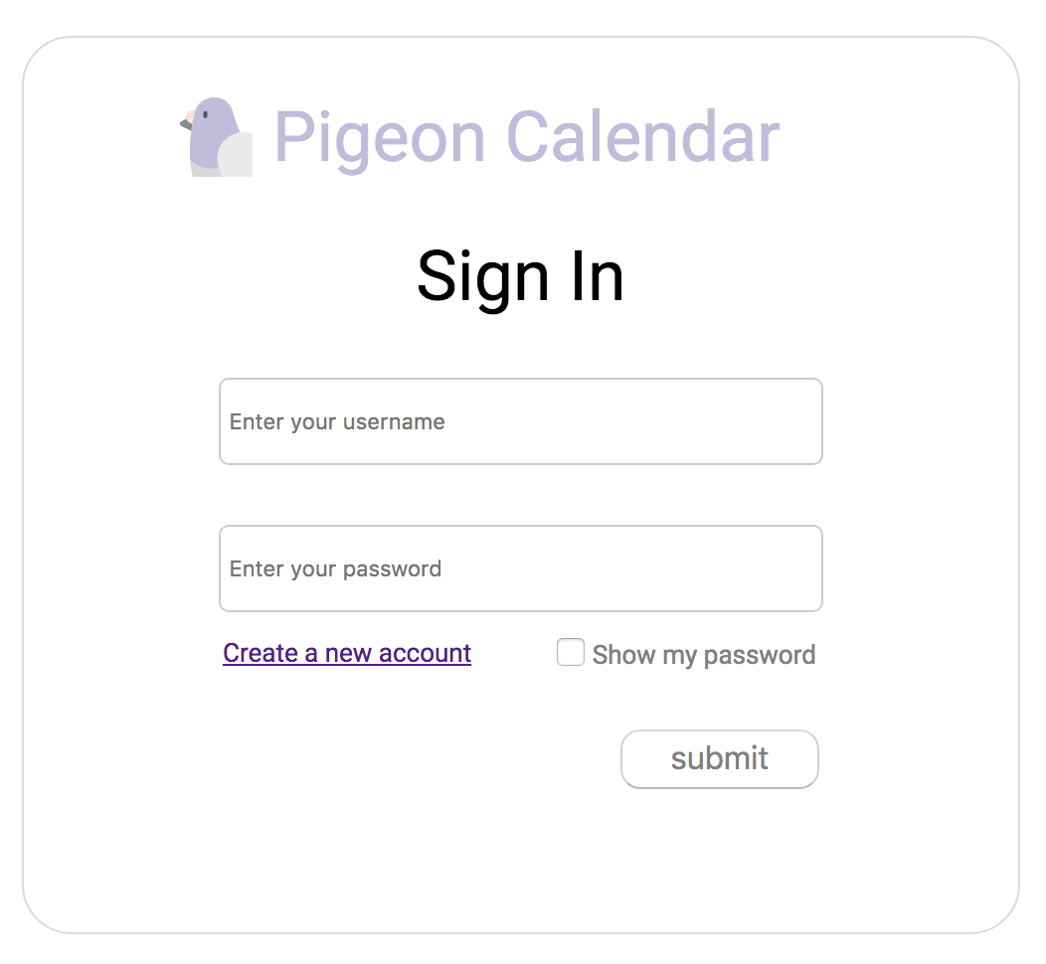
Sign in

Slide 3
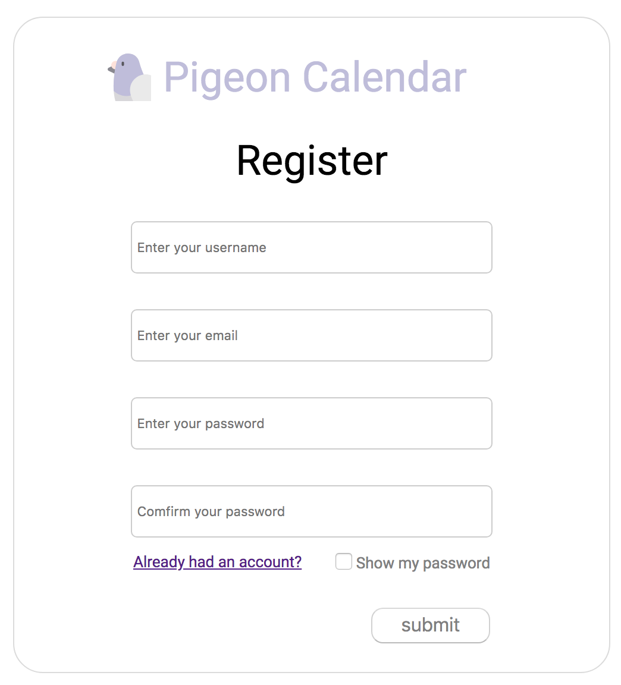
Register
Verify:
Password → 6~30 characters
Email format
Confirm
Password
Already had an account
→ Sign in

Slide 4
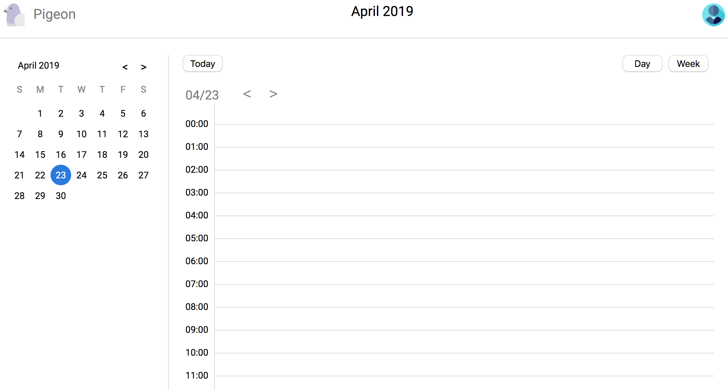
nav part
Main page → Day calendar

Slide 5
Change the month
Change the day
Click one grid → Add event

Slide 6
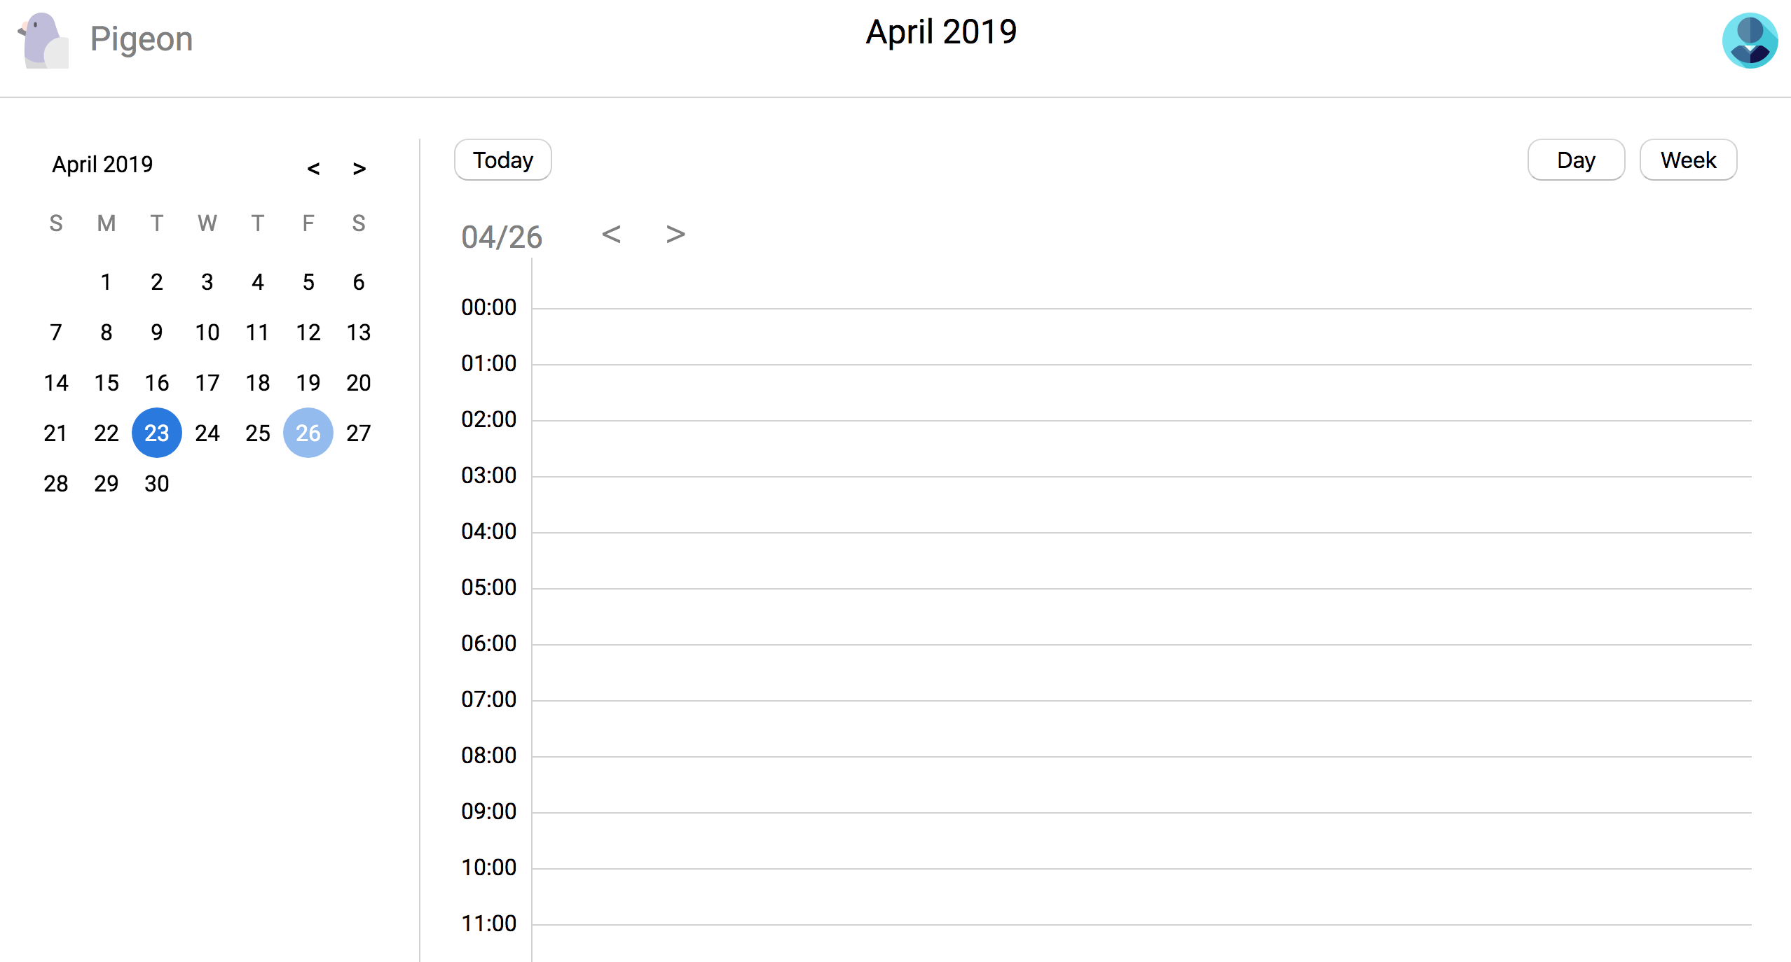
Click the Day,
the corresponding
calendar will be shown here →

Slide 7
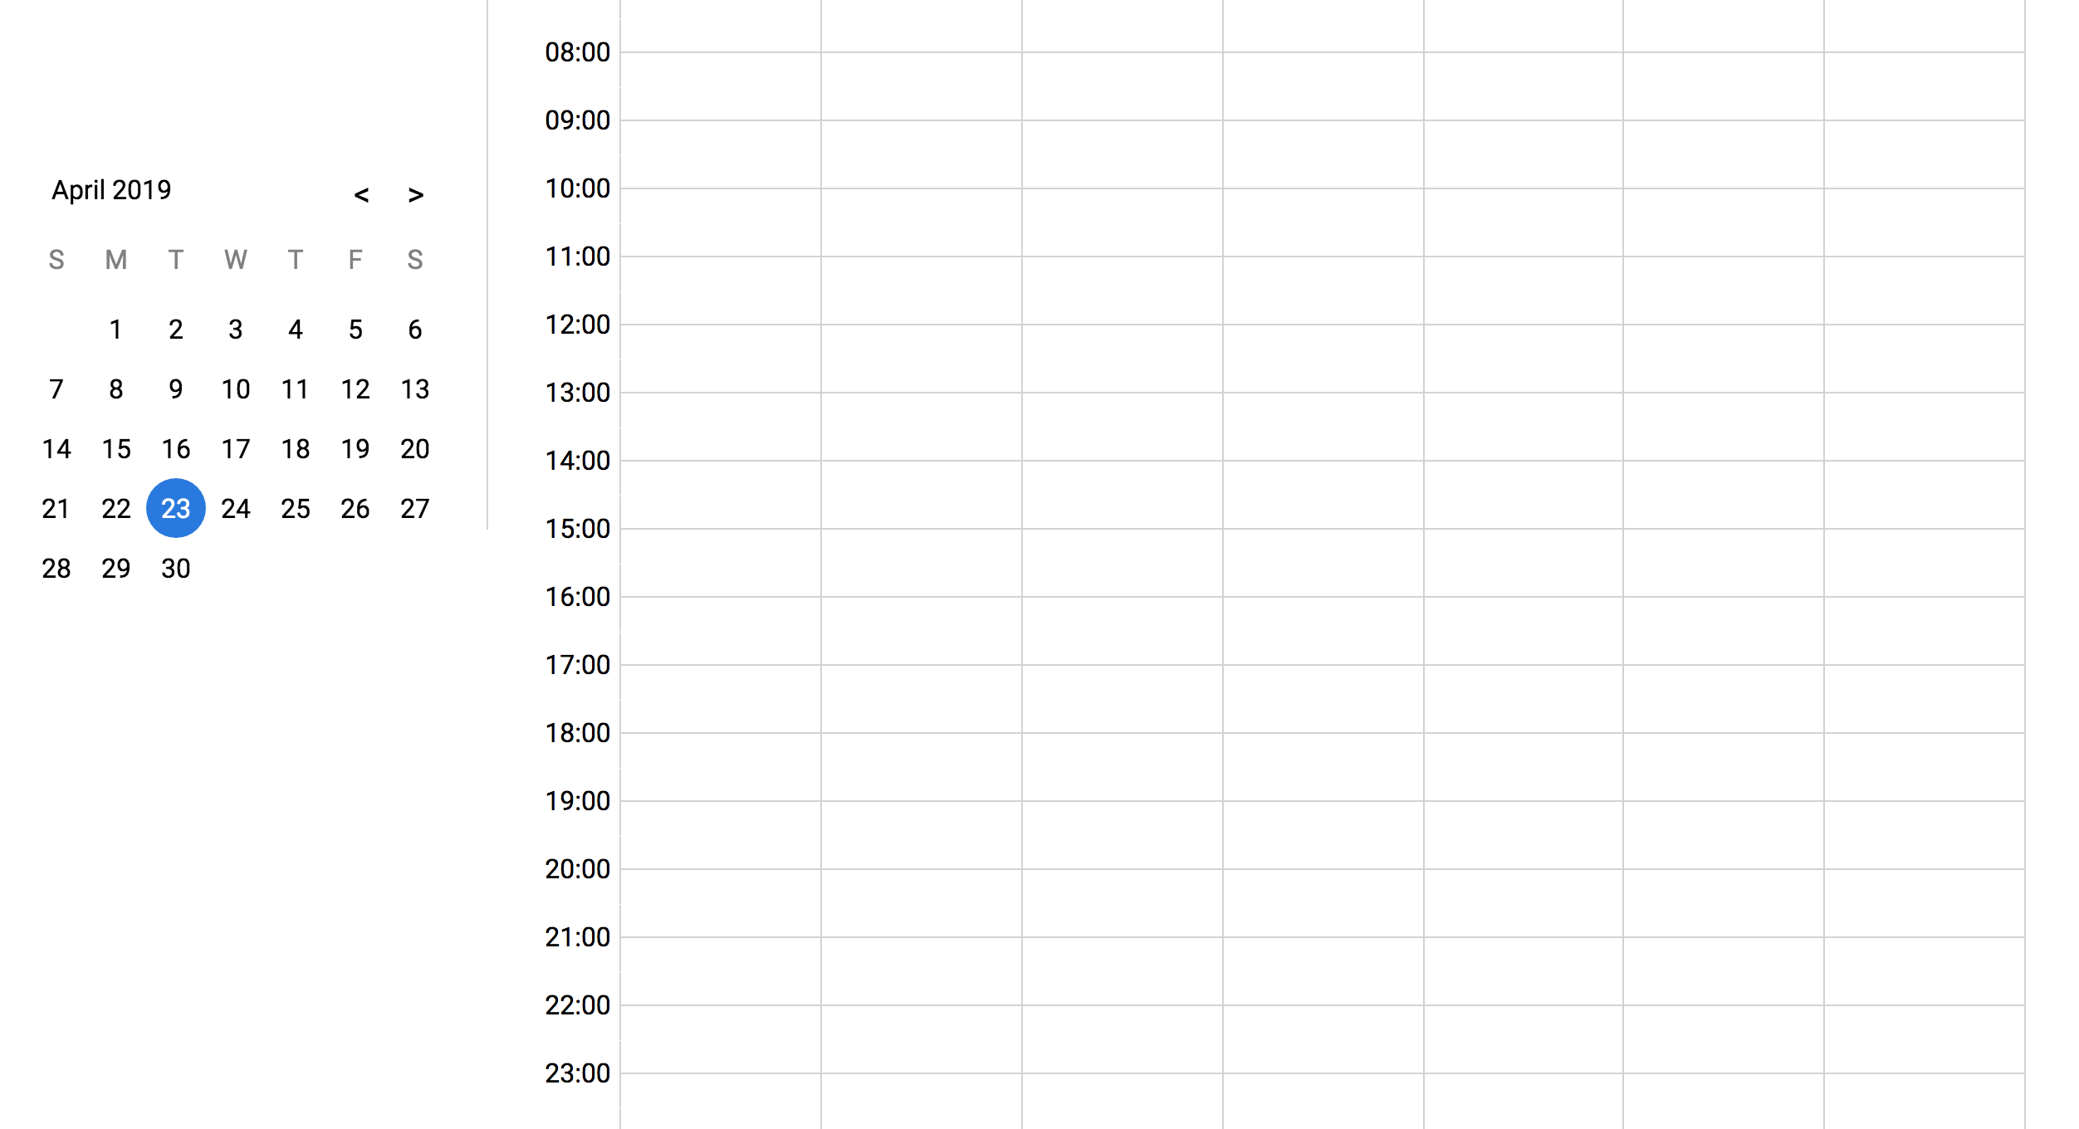
Scroll down,
It will show all the time periods of one certain day
Fixed

Slide 8
Personal info
Switch Day or Week here

Slide 9
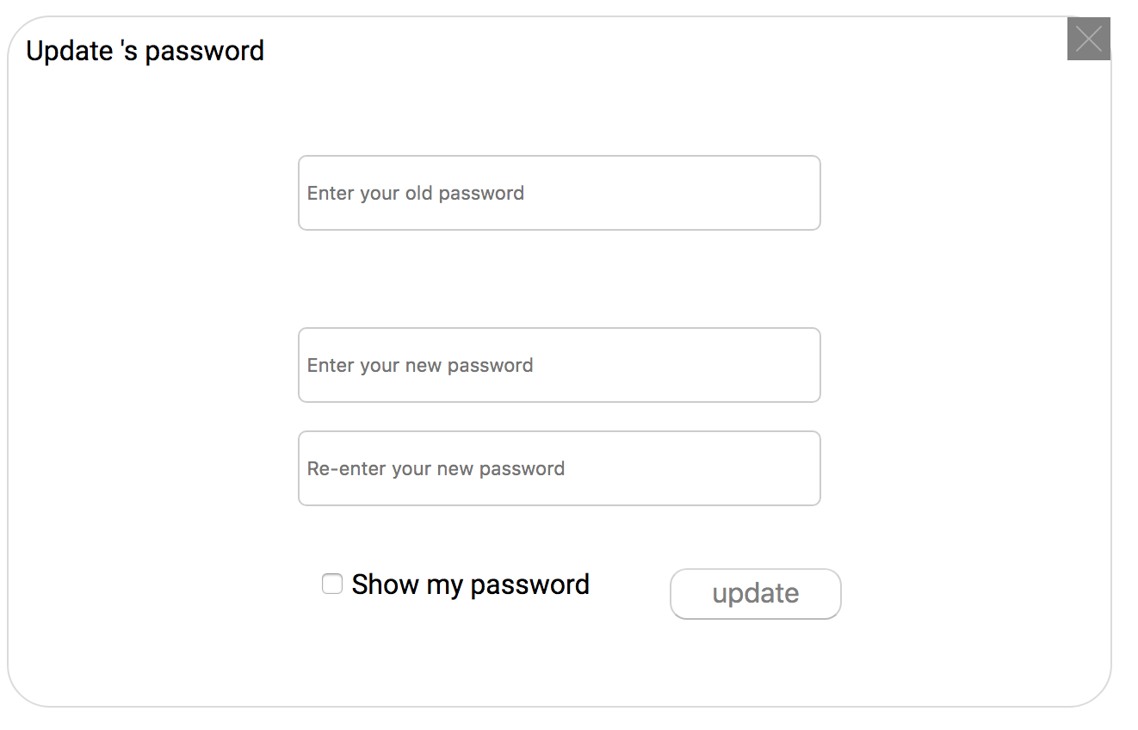
In personal info part:
Change the password
Update the email address

Slide 10
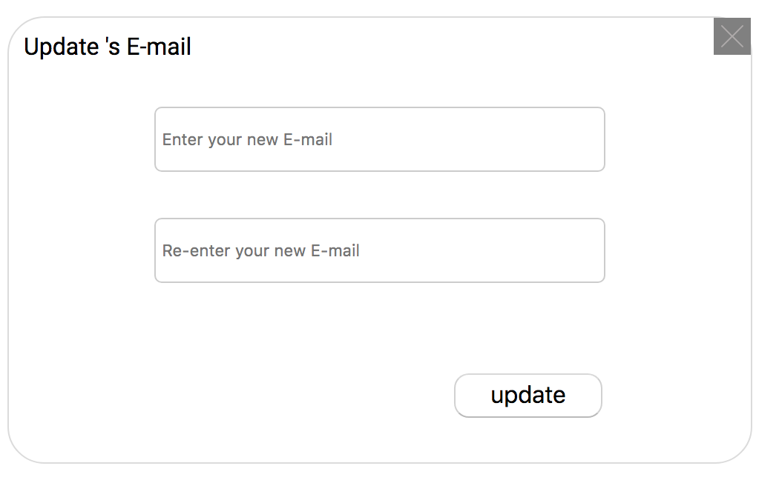
In personal info part:
Change the password
Update the email address

Slide 11
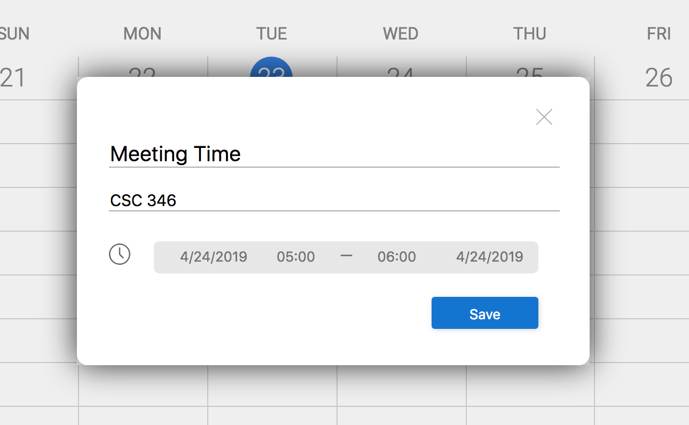
Click one certain grid:
Add event in this MatDialog
The info includes Title, Address, and the time period.

Slide 12
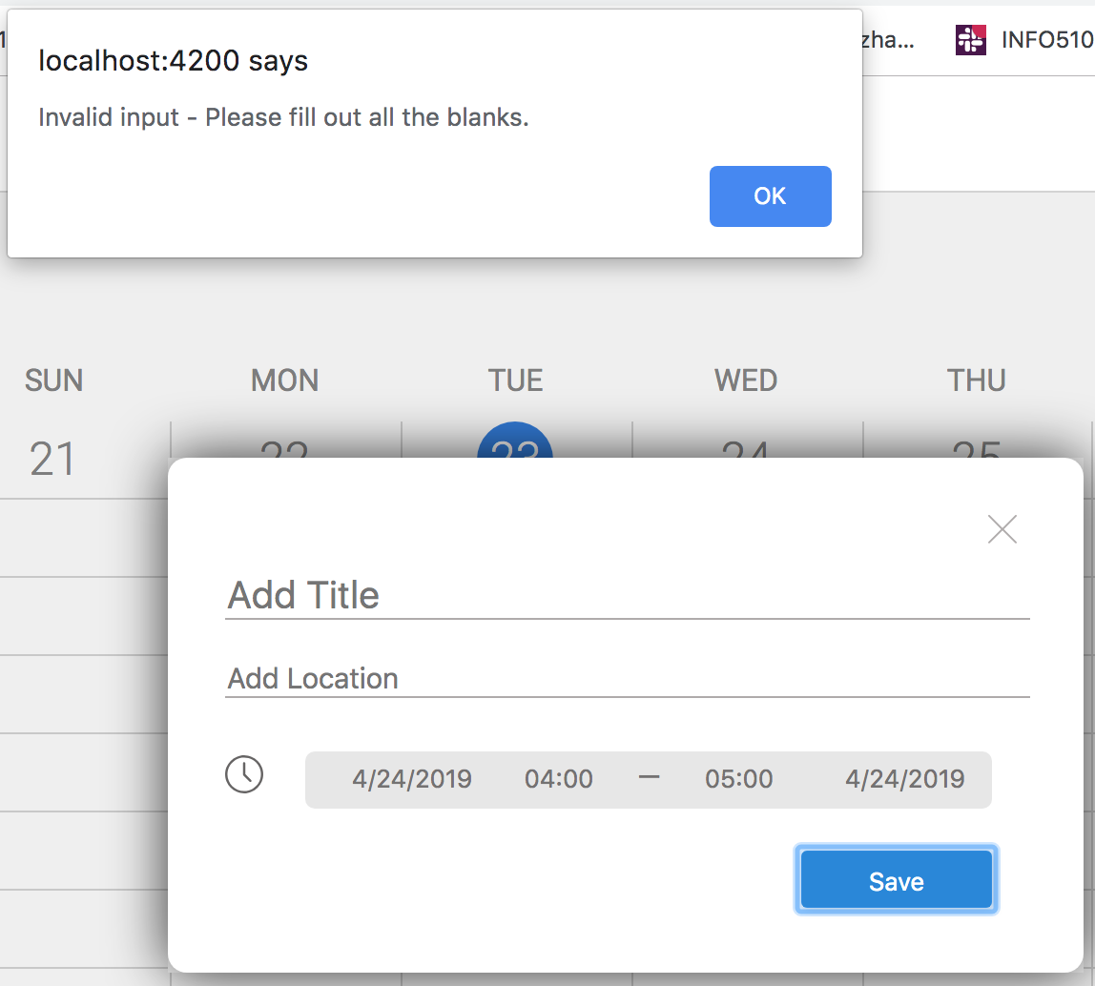
If it exists any of blank:
Show the alert.

