Slide 1
GROUP 3 · SELLER PERFORMANCE
Understanding Olist’s Seller Performance
3,095
total sellers
Revenue contributions, top-performing sellers and states, and opportunities to improve marketplace performance.
R$13.59M
in item revenue
99,441
Methodology · SQL for extraction and analysis; Python for processing; Plotly and Streamlit for interactive visualisation.
orders
GROUP 3 – TEAM MEMBERS · Jack Nengi Prince · Olubakin Olusade Titilayo · Ayebainemi Emmanuel Obediah · Ternenge Ibu · Adekunle Toluwanimi Jezer · Nuhu Ibrahim · Ogunnaike Oluwatimilehin Elizabeth
Notes:
This analysis examines 3,095 sellers across 99,441 orders and R$13.59 million in item revenue. The focus is where revenue is concentrated, which seller groups matter most, and where Olist can improve marketplace performance.

Slide 2
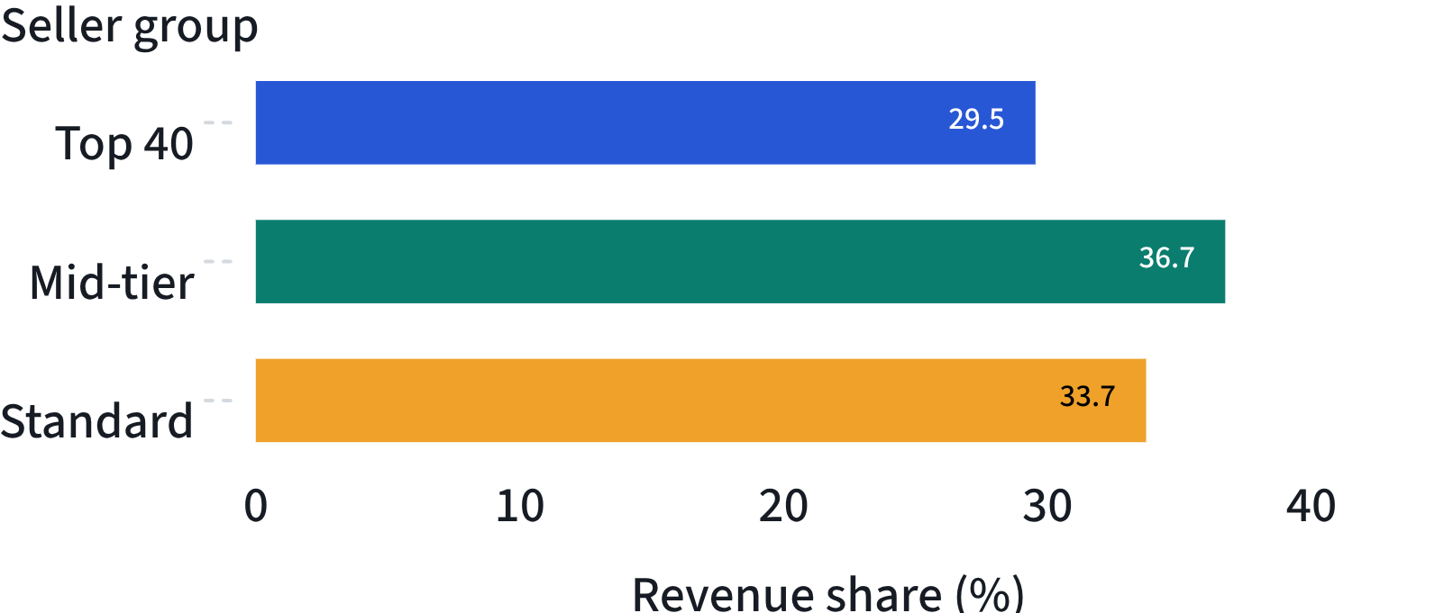
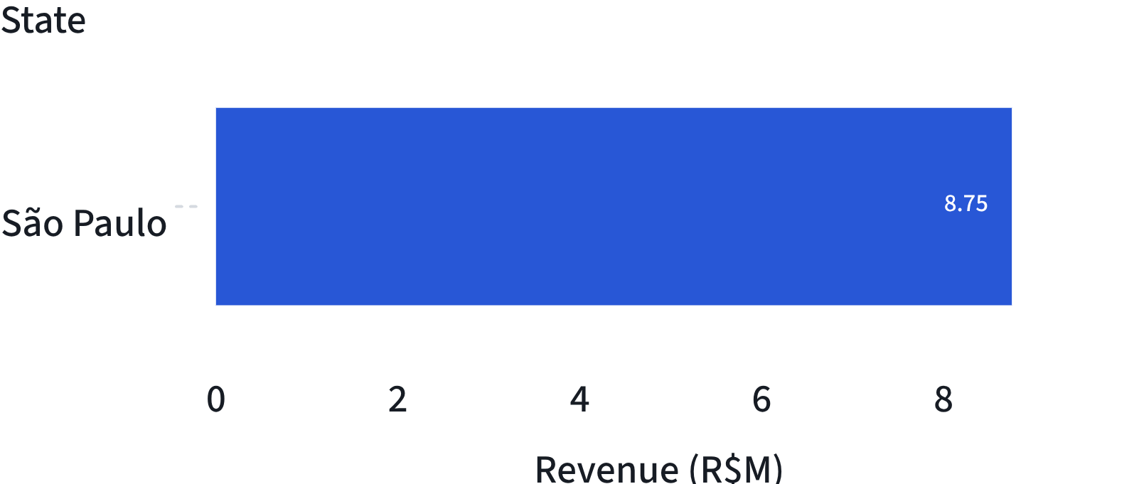
02
FINDINGS · EXHIBIT 01
What Did We Discover?
Revenue is concentrated by seller tier and geography, but the largest opportunity sits beyond the top performers.
Revenue share by seller tier
Revenue by state
Top 40: 1.29% of sellers generate 29.54% of revenue. The highest-performing seller generated R$229,472.63. Mid-tier sellers contribute 36.73%.
São Paulo leads with R$8.75 million, 64.41% of total revenue, from 1,849 sellers. Paraná, Minas Gerais and Rio de Janeiro are other notable contributors.
252
2,803
90.57%
Key message: A large seller population does not automatically translate into a larger share of revenue.
Mid-tier sellers
Standard sellers
of sellers are Standard
Notes:
Revenue is concentrated, but not exclusively in the top 40. Mid-tier sellers contribute the largest share at 36.73%, while Standard sellers make up 90.57% of sellers and contribute 33.73% of revenue. São Paulo is the clear geographic leader.

Slide 3



03
IMPLICATIONS
What Do These Findings Mean for Olist?
Seller performance is uneven.
A small percentage of sellers generates a significant share of revenue, showing Olist’s dependence on its strongest performers.
EXHIBIT 02
Data limitations
Mid-tier sellers offer growth opportunities.
2016 and 2018 contain incomplete periods.
Revenue covers item prices, excluding freight and operating costs.
Seller tiers are based on revenue, not delivery performance or customer ratings.
They already contribute the highest revenue share; helping them improve could increase overall marketplace revenue.
There is room to improve seller productivity.
Most sellers belong to the Standard tier, yet their individual revenue contribution is relatively low.
Notes:
The findings point to a two-part opportunity: protect the contribution of the strongest sellers while helping the much larger Standard and Mid-tier populations become more productive. The limitations matter when interpreting the results.

Slide 4
04
ACTION
PART 4 · RECOMMEND
Recommendations & Conclusion
Olist’s marketplace revenue is driven by a relatively small group of sellers, while the majority remain in the Standard tier.
01
Develop Mid-tier sellers
Targeted support, training and growth opportunities.
02
Support top-performing sellers
Strengthen relationships to maintain their contribution.
03
Improve Standard seller performance
Identify low-performing sellers and provide guidance to improve sales.
04
Expand beyond São Paulo
The biggest opportunity is not just acquiring more sellers, but helping existing sellers become more productive.
Encourage seller growth in other states to reduce geographical revenue concentration.
Notes:
The recommendations follow directly from the findings: develop the Mid-tier, protect top performers, improve Standard seller productivity, and reduce dependence on São Paulo. The central conclusion is that productivity among existing sellers is the largest opportunity.

