Slide 1
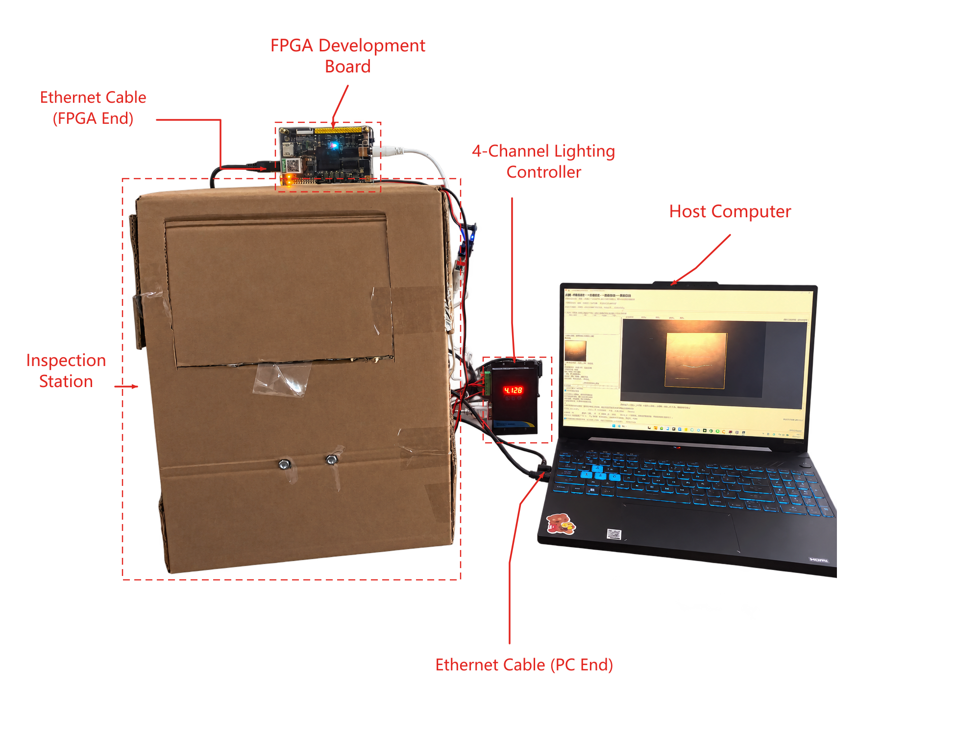
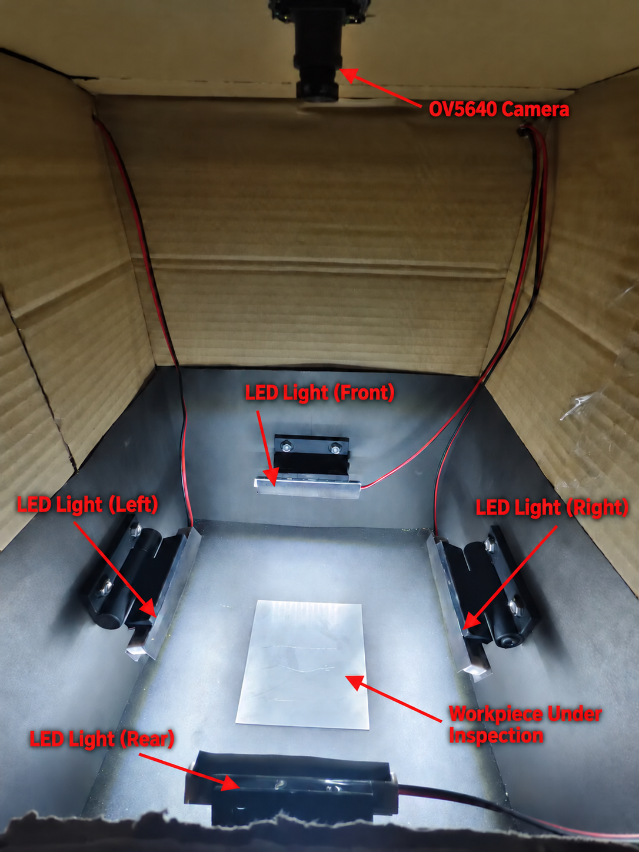


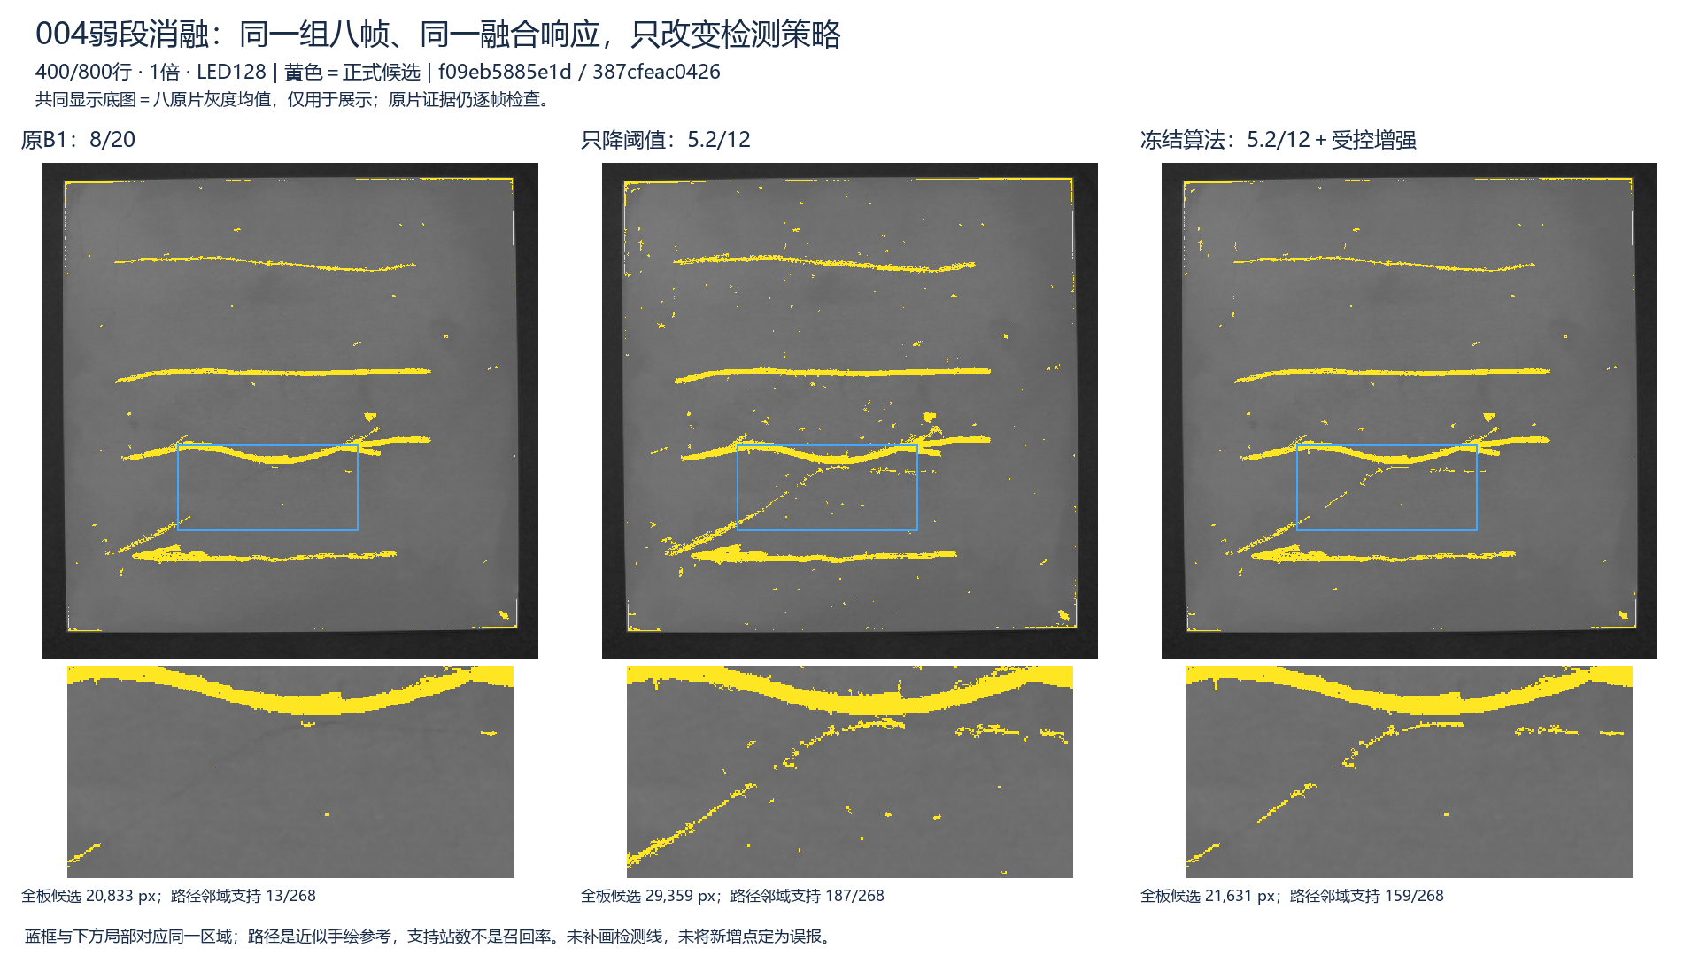
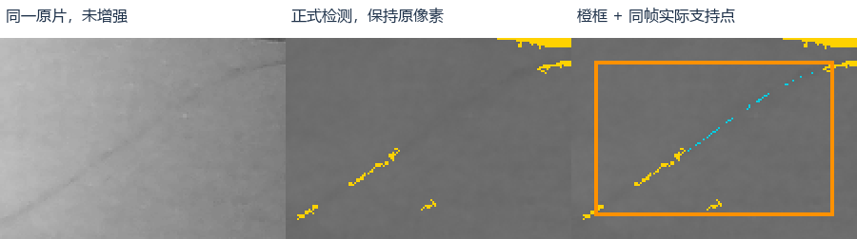
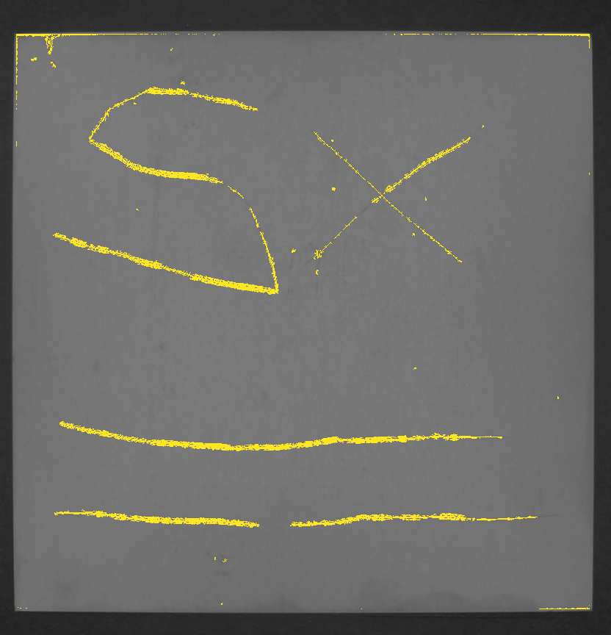
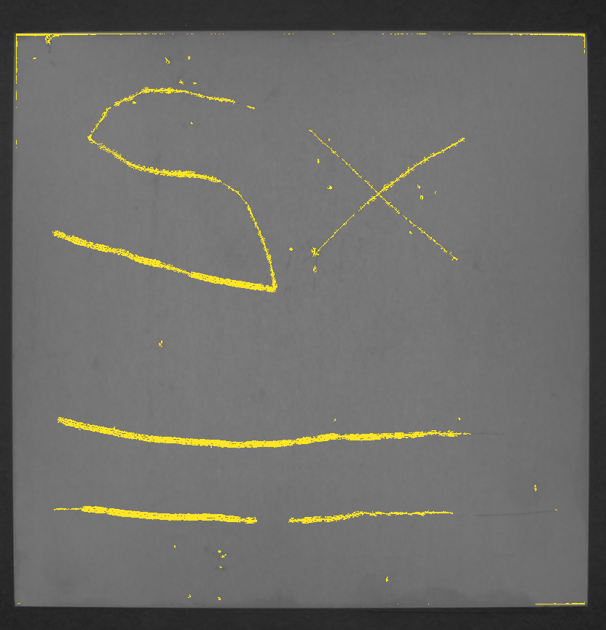
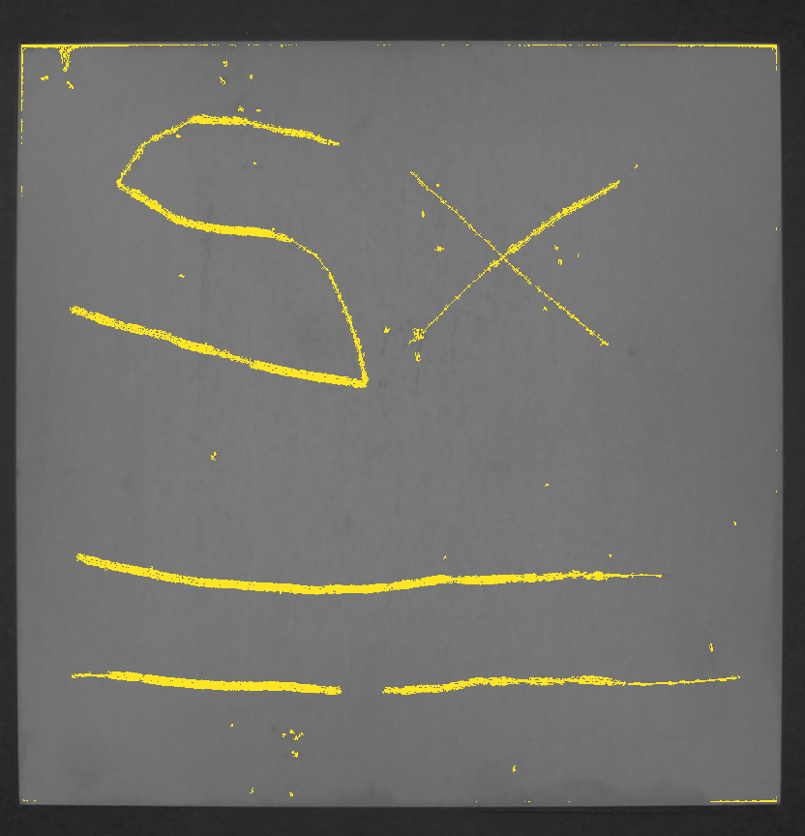
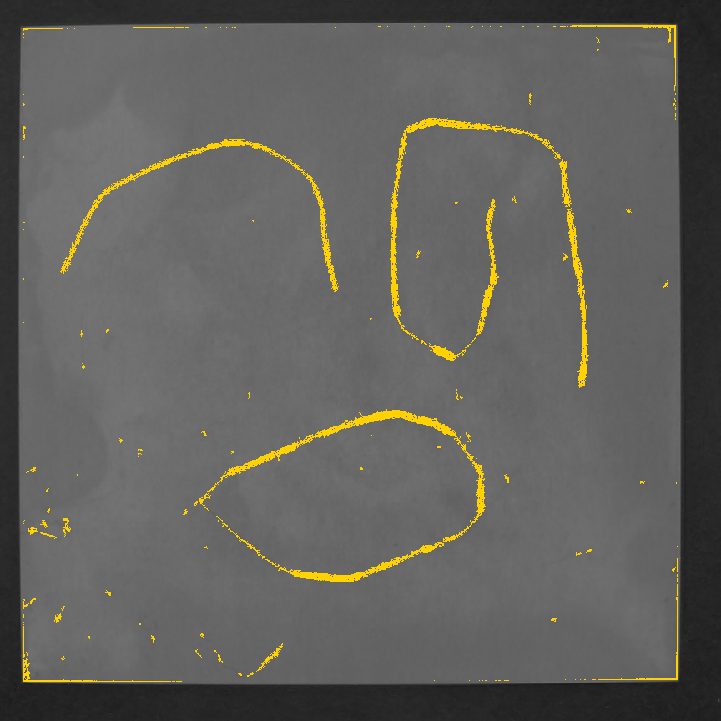
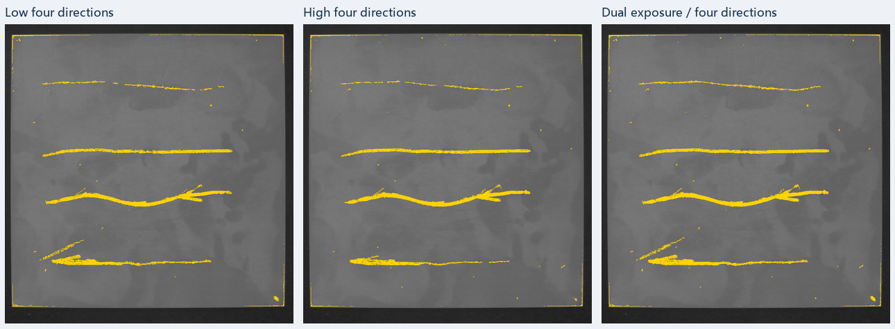
INTRODUCTION
Selfree: FPGA-Based
Metal Scratch Inspection
University of Electronic Science
and Technology of China
Yue Mingwei, Tu Jin, Xie Donglin
Multi-Directional Illumination and Dual-Exposure Fusion
System architecture
OV5640 + four-direction lighting
Platform: BX72
AMD Artix-7 XC7A100T
Selfree inspects reflective metal surfaces using four lighting directions and two exposures. The FPGA controls capture, computes integer background residuals and incrementally fuses eight observations. The PC evaluates image quality, enhances weak scratch segments under structural constraints, and highlights suspected gaps for human review.
Image /
control
ROI / exposure
Artix-7 FPGA
External PC
Controlled weak-scratch enhancement
C
Baseline 8/20
Lower 5.2/12
Frozen algorithm
Capture + ROI crop
Integer grayscale
9×9 residual
ROI / mask + quality
PC reference audit
Frame identity checks
R
R
Frames + IDs
E
E
8 observations
CH1
CH2
CH3
CH4
A
S
400
1
3
5
7
T
U
More weak-segment support with less uncontrolled growth
4 directions × 2 exposures
Residuals
Quality
table
Audit arrays
I
L
800
2
4
6
8
V
T
Sample004, same eight frames. Yellow: scratch candidates.
Example ROI: 864 × 864
Exposure (sensor lines)
Valid MaxAbs fusion
Sign + source retained
Incremental commit
Global connection
Controlled weak
segment enhancement
E
S
Suspected gaps highlighted for human review
Default: 400/800 sensor lines
32-bit records
Exposure can be adjusted manually between groups.
D
Source frame
Formal result
Local review
Exposure complementarity
E
Low: 400 lines
4 directions
High: 800 lines
4 directions
Dual: 400 + 800
4 directions
State
S
External DDR
32 MiB reserved
Review cues + score
Source archive
I
G
Separate Sample004 capture. Orange: review region
N
High priority. Evidence index: 45/100
Data
Configuration / quality
Memory
Metric | Result
BRAM36 equivalent | 81.5/135 (60.37%)
UDP payload¹ | 54.51% lower
Host processing² | 15.35–17.05% lower
Reference check³ | 0 differences / 10 masks
Complementary observations
Signed MaxAbs retains source across eight views.
Shared hardware and layered memory
Reuse compute with line buffers and DDR. BRAM stays at 81.5 blocks.
Cyan: low preserves detail
Magenta: high fills gap
Controlled weak segments and local review
¹ Matched ROI, RGB+gray+SAT to gray+SAT.
² Host stage only, 3 groups and 18 runs. Excludes
capture, PL service and result transfer.
³ Reference agreement, not detection accuracy.
Sample006. Matched local crops, fixed B1 detector (8/20).
Protect main structures and flag gaps using source evidence.
For stationary, approximately planar metal parts.
Notes:
Selfree poster. Source evidence and scope
Exposure comparison: Sample006 group sample006_g1793522156640254500. ROI [576,128,832,864]. CH1–CH4, 400/800 sensor lines, gain16=16, LED128. All three use the original fixed B1 8/20 detector. Same eight-frame grayscale mean is display background only. Cyan A shows more low-exposure support. Magenta B shows more high-exposure support. Boxes are editable annotations and do not change detection pixels.
Exposure source: E:/GuangjianData/VerifiedCombined0109/356b7c5cd01439cb56c7b7f720154703a4e401bda5b8d80fb920add477b7118d/native.npz. Provenance bound to E:/GuangjianData/UnifiedInspectionSpeed0109/20261101_163623_83499265. Cyan row has native crop [600,668,108,64] and inner box [620,688,48,26], with 168/4/184 candidate pixels in low/high/fused masks. Magenta row has native crop [466,254,108,64] and box [486,277,48,28], with 3/43/47 pixels. Candidate pixels measure local response support, not physical scratch counts or dataset accuracy. The full eight-frame B1 mask was checked against the saved frozen-run original array.
Weak-scratch ablation: group sample004_A_v1_20261028_220937_87f02b. Same eight frames and same fused response. Left baseline 8/20. Middle threshold-only 5.2/12. Right frozen controlled enhancement f09eb5885e1d / 387cfeac0426. No altered candidate pixels. Source: Selfree/YMW/handoffs/tj_final_writing_package_20261101/video/detailed/02_weak_segment_ablation_1920x1080.png. Three source rectangles [76,752,504,240], [708,752,504,240], [1340,752,504,240]. More support and less growth are qualitative same-input observations, not recall/false-positive claims.
Local review: separate Sample004 capture sample004_g1793416865712919600. ROI [608,96,832,864], 400/800, gain16=16, LED128. R1 high priority, evidence score 45/100. The score is a development evidence index, not calibrated probability. Orange region and cyan source support points prompt human review and do not fill the formal detector mask. Source: E:/GuangjianData/UnifiedInspection/20261031_112124_c88b9eac/final/sample004_g1793416865712919600/R1_comparison.png, copied in the writing handoff.
BRAM: 81.5/135 equivalent BRAM36 blocks, 60.37%. Incremental fusion versus preprocessing baseline keeps BRAM constant, but logic, register and DSP use increase. Line buffers handle neighborhoods and external DDR stores frame/fusion state.
UDP payload reduction 54.51%: 25,005,698 to 11,373,958 application bytes, matched ROI, two first-configuration groups. RGB565+GRAY8+SAT1 versus GRAY8+SAT1. Excludes Ethernet/IP/UDP headers.
Host handoff-to-export reduction 15.35–17.05%: 3 same-input datasets, 18 runs. Excludes acquisition, PL service and fusion-result transfer. This is host workflow improvement, not a proven full-system speedup. Ten output masks agree with PC reference. Numerical agreement is not detection accuracy.
PL: capture and lighting control, ROI crop, integer grayscale, 9×9 integer residual, valid MaxAbs incremental fusion, external DDR. PC: quality table generation and upload, global connectivity, controlled weak-segment enhancement, review scoring, visualization and audit/archive. A 32-bit fusion record packs signed16 residual, source and flags. It is not a signed32 residual.
Fixed source repository: https://github.com/TJin-667/Selfree/tree/2115d6e/YMW. Reporting evidence: YMW/handoffs/tj_final_writing_package_20261101 and YMW/handoffs/tj_writing_update_20261031.
The user confirmed that official poster rules permit names and university emblem. Member attribution, university, emblem and existing physical-photo proportions/placement are retained. Whole-system hardware image provenance is an AI-assisted cutout with annotations. Algorithm result images retain real archived pixel evidence.

