Slide 1
Machine Learning and Pattern Classification
Labeling Functions & Audio Features: Team Observe
Johannes Grafinger, Jonas Gantar, Leonhard Markus Spanring, Reinhard Josef Pötscher

Slide 2
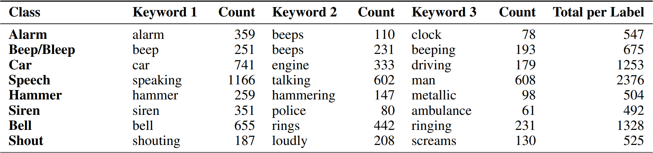
Labeling Function
Assess how accurately the applied labeling functions capture the intended classes.
-> Class labels seem to match the textual annotations quite well
For our further analysis we used single frames of the spectrogram + 2 frame context window on both sides. We focus on a subset of 7 randomly chosen classes.

Slide 3
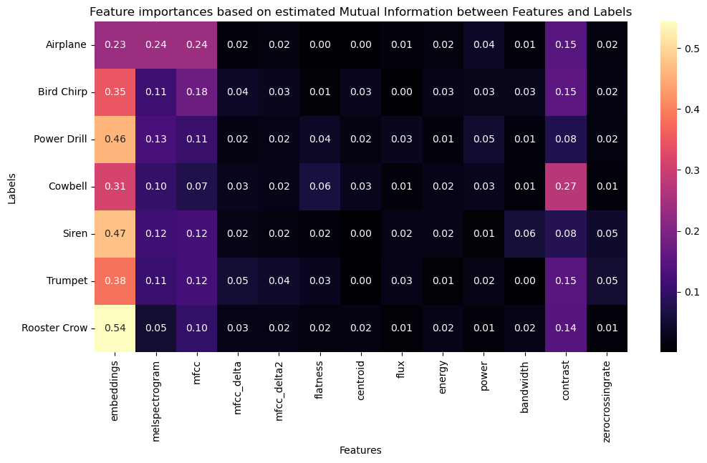
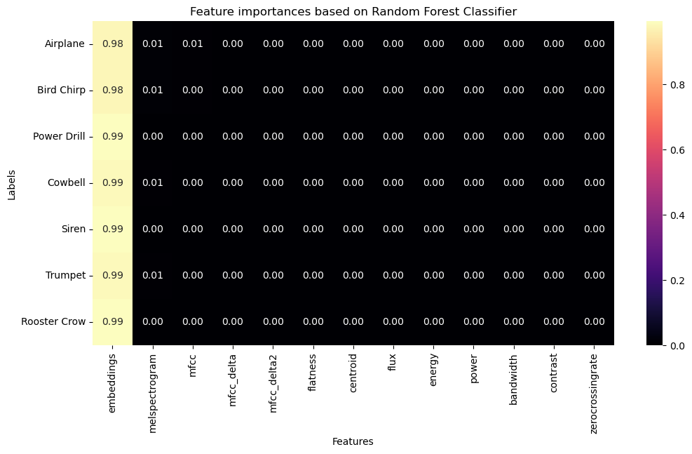
Which audio features appear most useful for distinguishing between the classes of interest?
Mutual Information:
RF Feature importances
Nonlinear relationships, no combinatorial effects
Nonlinear relationships + combinatorial effects
Trust the results?
Seemingly useful features: embeddings, melspectrogram, mfcc, contrast
Seemingly useful features: embeddings

Slide 4
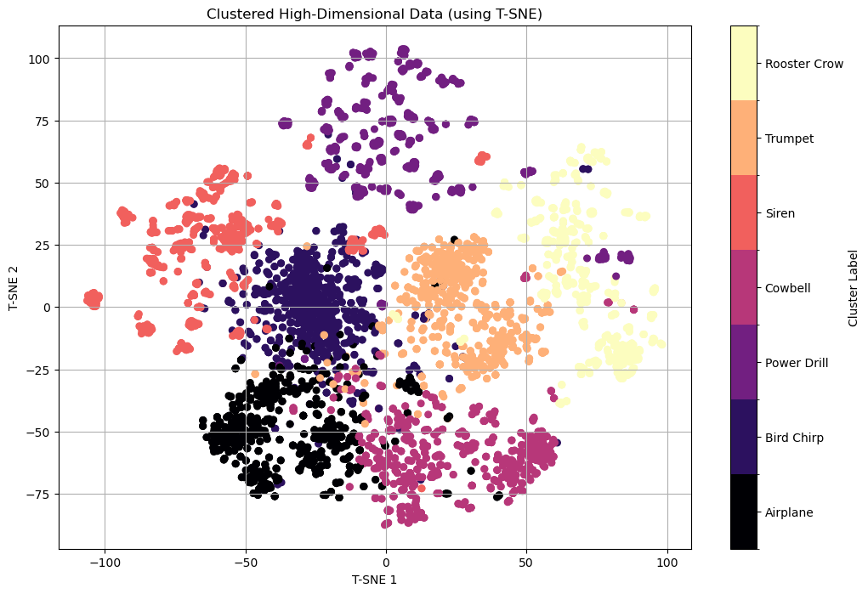
How well do the chosen audio features group according to the discretized class labels? Do samples of the same class form tight clusters?
Dimensionality reduction (T-SNE), then colored according to class-label.
Clusters clearly discernible, some overlap is to be expected.

Slide 5
Audio Features
Which subset of audio features did you select for your final classifier? Describe the selection process and the criteria you used to make your choice
Decided to play it safe and use all four features: ‘embeddings’, ‘melspectrogram’, ‘mfcc’ and ‘contrast’.
Unsure whether to trust the Random Forest, small-scale tests showed similar/slightly higher performance using all four.
No context frames, too computationally complex.
Did you apply any preprocessing to the audio features? If so, explain which techniques you used and why they were necessary.
We settled for framewise mean/std normalization, also tested global mean/std normalization using training set statistics.
Ensures consistency in the scale of data -> helps performance and convergence. Predictions should not depend on e.g. volume.

