Slide 1
Machine Learning and Pattern Classification
Challenge: Team Observe
Johannes Grafinger, Jonas Gantar, Leonhard Markus Spanring, Reinhard Josef Pötscher

Slide 2
Evaluation setup
Dataset split:
8230 files total; 60% train; 20% val; 20% test
Baseline classifier:
Average cost: 108.8553

Slide 3
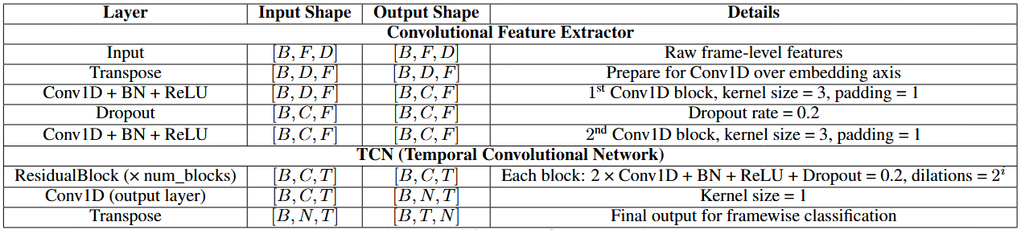
Model Architecture
Model Class: TCN (Temporal Convolutional Network)
More efficient than RNN for long-term dependencies.
Doesn’t rely on sequential processing (Faster training and easier to parallelize).
Less likely to overfit.
Loss Function: Weighted BCE-Loss

Slide 4
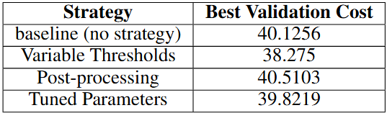

Strategies to improve performance: Variable Thresholds
Globally constant threshold ignores class imbalances.
Threshold search space consists of values from 0 to 1.
Thresholds are tuned after each validation epoch.
Utility function: $U=TP −{cost}_{FP}FP −{cost}_{FN}FN$

Slide 5
Strategies to improve performance: Post Processing
Spurious positive class predictions lasting only a few frames could have a big effect on overall performance.
Amplified by weighted loss function: Model more pushed toward predicting positive.
Post-processing strategy:
Predictions lasting only a few frames get discarded.
Best result for rejecting positive predictions lasting less than 3 frames.

Slide 6
Strategies to improve performance: Hyperparameter Tuning
Tested hyperparameters:
Optimizers: Adam, AdamW
Batch sizes: 32, 64, 128, 256
Learning rate: 1e-3, 1e-4, 1e-5
Best hyperparameter combination: AdamW, 64, 1e-4

Slide 7
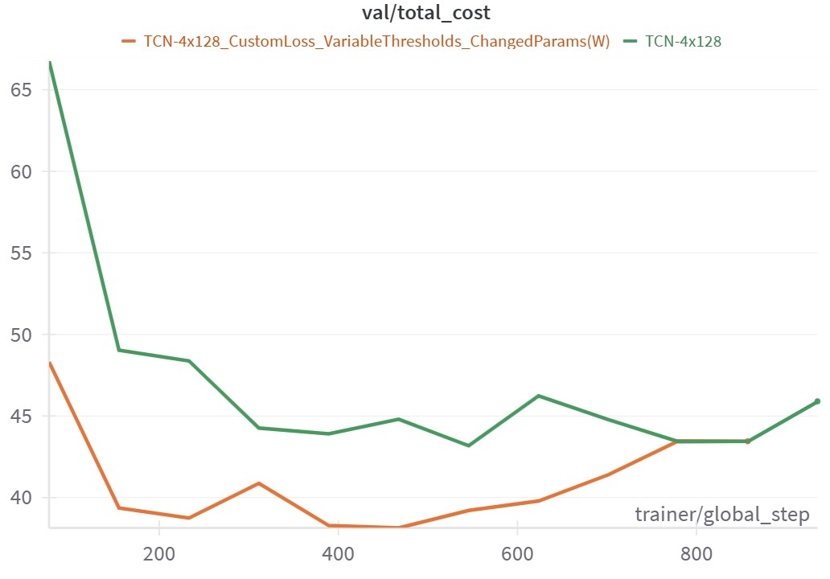
Strategies to improve performance: Improvement on cost
A combination of the strategies was used

