Slide 1
Machine Learning and Pattern Classification
Labeling Functions & Audio Features: Team Observe
Johannes Grafinger, Jonas Gantar, Leonhard Markusn Spanring, Reinhard Josef Pötscher

Slide 2
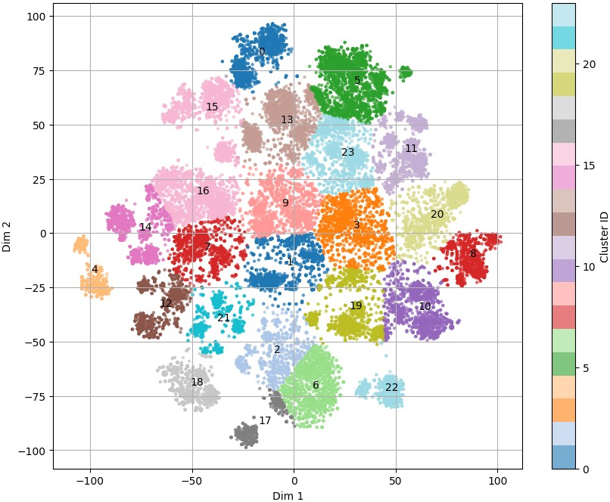
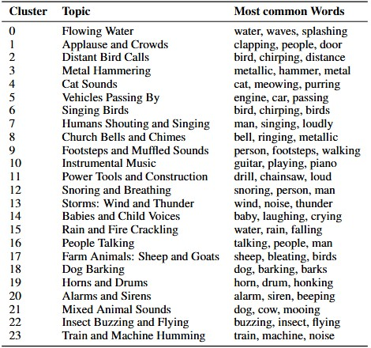
Cluster the text features.
Can you find meaningful clusters?
Clear cluster separation in the text feature space after applying t-SNE for dimensionality reduction, followed by k-Means clustering
Most common words per cluster, showing a clear semantic separation between the text-based clusters

Slide 3
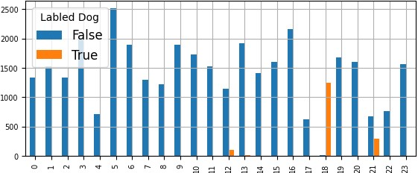
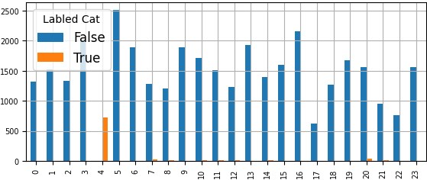
Design a labeling function for classes dog and cat. Do the annotations labeled as dog or cat sounds form tight clusters in the text and audio feature space?
Labeling function dog:
Labeling function cat:
Keywords used for labeling function:
"dog", "bark", "puppy", “growling”
Keywords used for labeling function:
"cat", "citten", "meow", "purr"
Distribution of samples labeled “Dog” across all text clusters in orange
Distribution of samples labeled “Cat” across all text clusters in orange

Slide 4
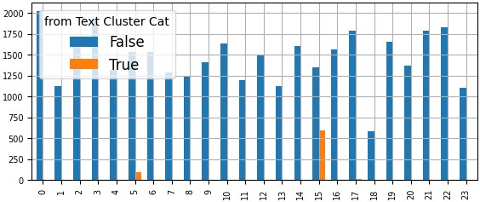
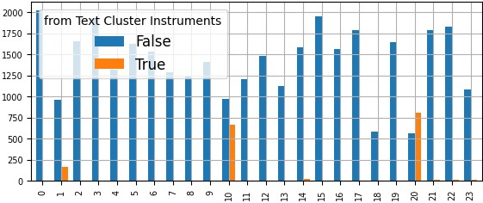
How well do the audio feature clusters align with text clusters?
Text cluster “Cats” vs audio feature clusters:
Text cluster “Instruments” vs audio feature clusters:
The text cluster for “Cats” was laid over all audio feature clusters to identify any patterns in its distribution
The text cluster for “Instruments” was laid over all audio feature clusters to identify any patterns in its distribution
Text cluster for “Cats“ laid over all audio feature clusters, showing a tight clustering in cluster 15
Text cluster for “Instruments” laid over all audio feature clusters, showing a spread primarily across clusters 1, 10 and 20

Slide 5
Text Feature Conclusion
The text feature space was highly clusterable, resulting in multiple meaningful clusters.
The labeling functions for “Cat” and “Dog” formed tight, well defined clusters, in the audio space and especially in the text space.
The majority of text clusters aligned with one or more audio clusters, indicating a strong relationship between semantic meaning and sound similarity.

