Slide 1
Who is trust worthy?
Thomas Jones, Ltd
Capstone 3

Slide 2
Who is trustworthy?
Thomas Jones, Ltd
Capstone 3

Slide 3


ABOUT THE PROJECT
Thomas Jones, Ltd
What factors affect the credibility of a customer?
A bank loan is a type of loan that is offered by a bank and can be used for a variety of reasons including financial emergencies, major expenses, and as a way to build up your credit history. Every financial institution is interested to know who qualifies for a loan and has minimal probability for default.

Slide 4

Visualization & Data
Thomas Jones, Ltd
Data Overview

Slide 5

PROBLEM
Thomas Jones, Ltd
Reviewing the relation of demographics per customer and their ability to pay off a loan.
Every financial institution is interested to know who qualifies for a loan and has minimal probability for default.
Our goal is to identify the demographics that can be collected for every applicant or previous customer, that are highly correlated with Loan Defaults.
Past studies conclude that the significant factors which drive loan defaults are marital status, education, monthly income, diversion of funds and monitoring. There was no evidence of significant relationship between age, sex, household size and loan default.

Slide 6
Presentation Step by Step
Thomas Jones, Ltd
Data Wrangling, Data Preprocessing, Exploratory Data Analysis, Methodologies, Modeling, Outcomes and Conclusion
1
2
3
Data
EDA
Modeling
5000 customers with personal information and demographics about their financial history and status of 26 different variables. No Nan in the set.
Graphical presentation of the relations of different variables and interactions.
Also visuals on the way that each of the variables affected the default probability and rate of each customer.
We started with a Logistic Regression and followed with a Random Forest classifier.

Slide 7
Visualization & Data
Thomas Jones, Ltd
Data Overview

Slide 8
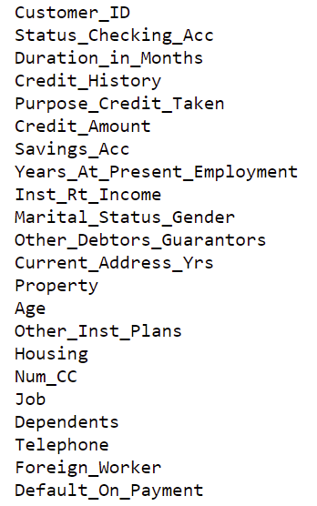
Data Overview
Thomas Jones, Ltd
Source, description, issues, wrangling, preprocessing
The source of my data was https://www.kaggle.com/rikdifos/credit-card-approval-prediction It was not missing any data and had 24 variables, that identified demographics of 5000 customers.
The presentation of those variables is more convenient for human reading and manipulation. The values of the variables are described on the attached file. We will be changing the values to the actual description factors. Out of the 24 variables, 10 of those are numerical, while the other 14 are qualitative, most of them are ordinal, and this creates some issues with the dummies variables that we have to add, but we have no missing values and the entire dataset of 5000 observations will be used.

Slide 9
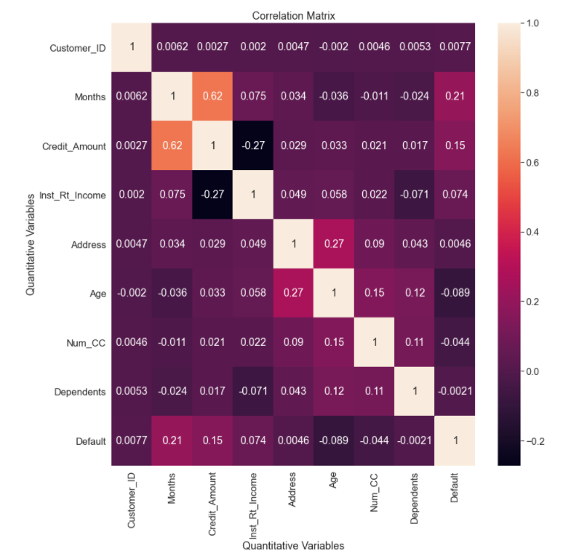
Exploratory Analysis
Thomas Jones, Ltd
Relationships, dissection and correlation
A total of 5000 observations, 24 total variables that are both demographics and information regarding Credit current and History of the customers. Out of the 24 variables we have 10 numerical and 14 categorical. Except of the Credit Amount, Current Address number of years, Credit amount originally lend, Number of Credit Accounts, Number of dependents, and Age, all the other variables are ordinal that describe ranges of the variable. The reason for the use of the ordinal measurement level is due to legal requirements to protect the privacy of the customers data.
By reviewing the descriptive statistics of the data, we can observe that the loans given to customers have an average value of $3200, with average duration of 21 months. The customers are younger with an average age of 35 years old, 1 dependent and an average number of credit account 1.45, while they reside in their current residency the last 3 years. Of all the customers, we have an average 30 percent defaulted loans.
Overall, 75 percent of the customers is younger than 42 years old and have received a loan of less than $4000

Slide 10
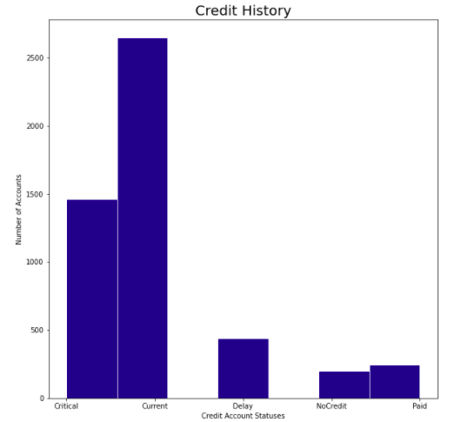
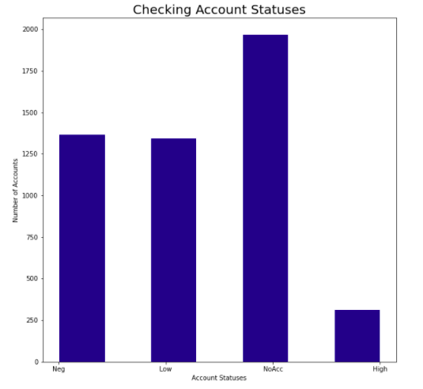
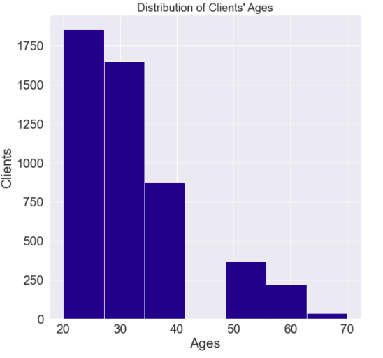
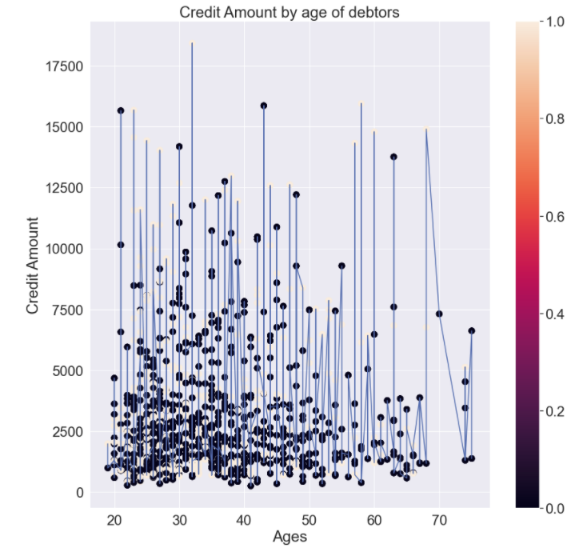
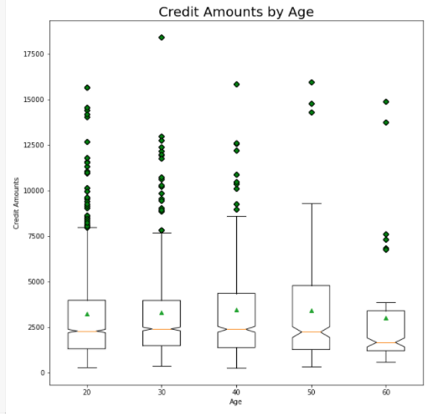
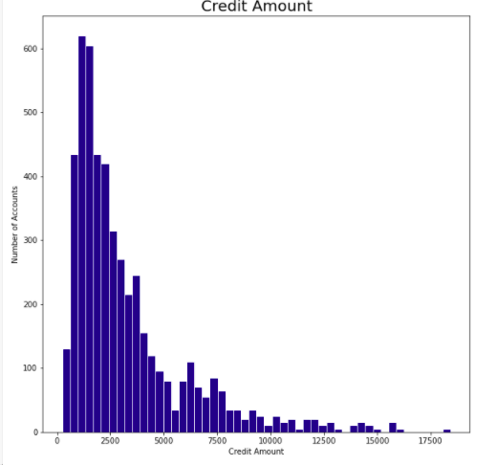
Exploratory Analysis

Slide 11
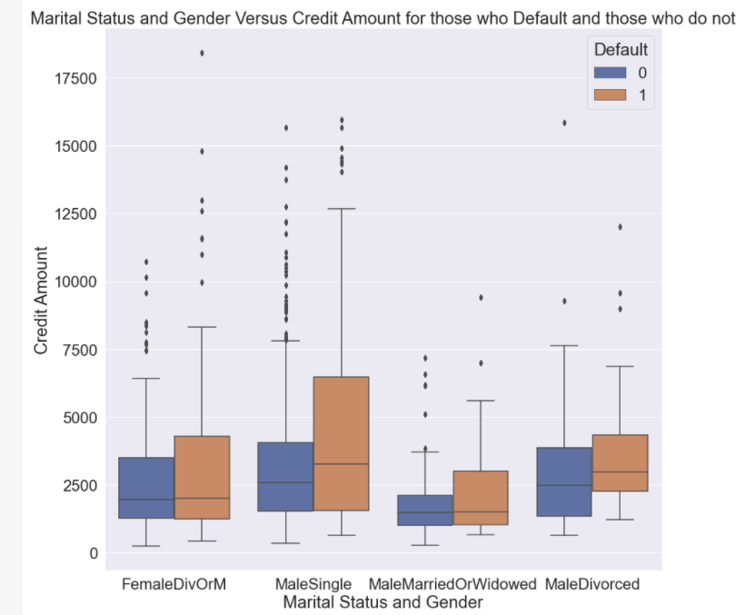
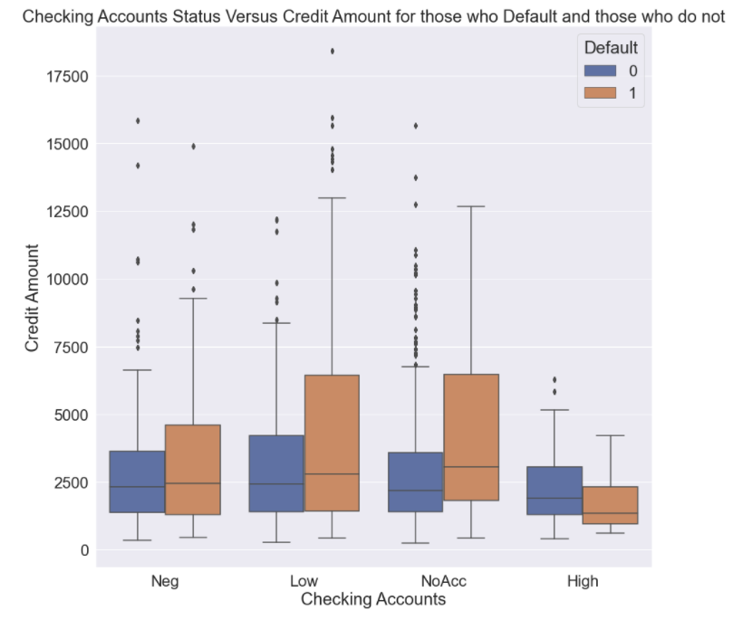
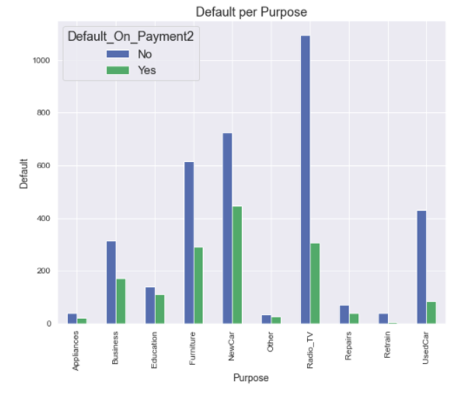
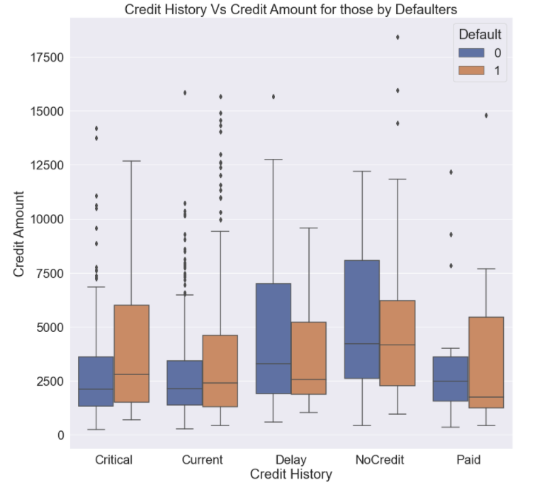
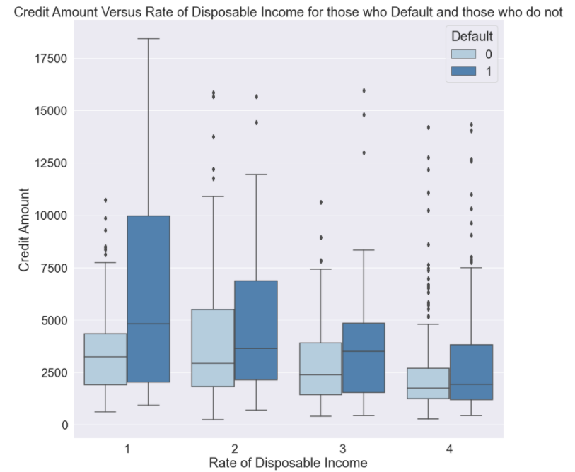
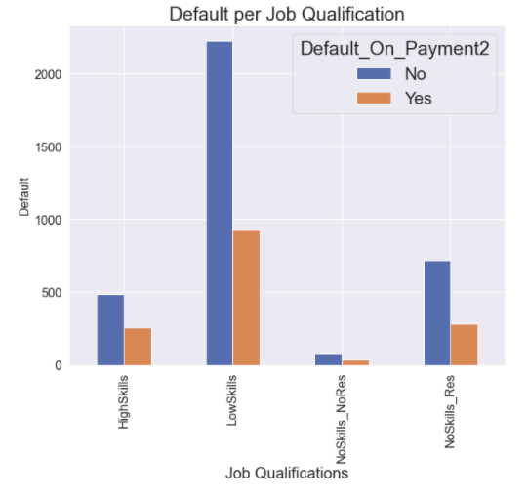
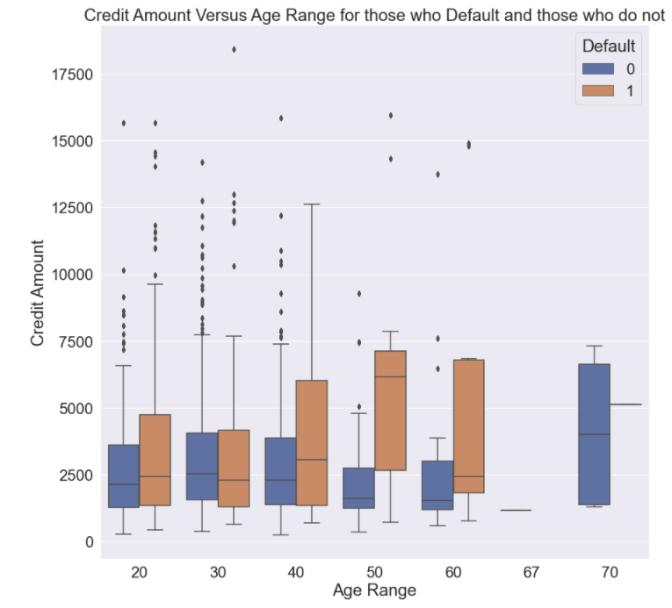
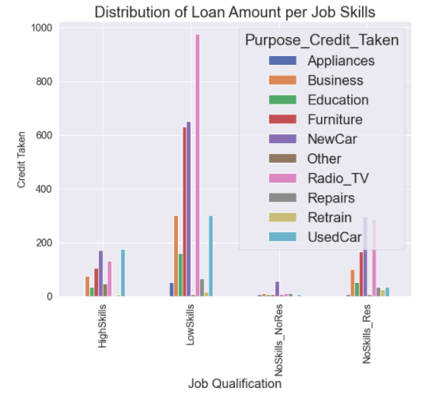
Exploratory Analysis

Slide 12
Approach & Methodologies
Thomas Jones, Ltd
Modeling

Slide 13
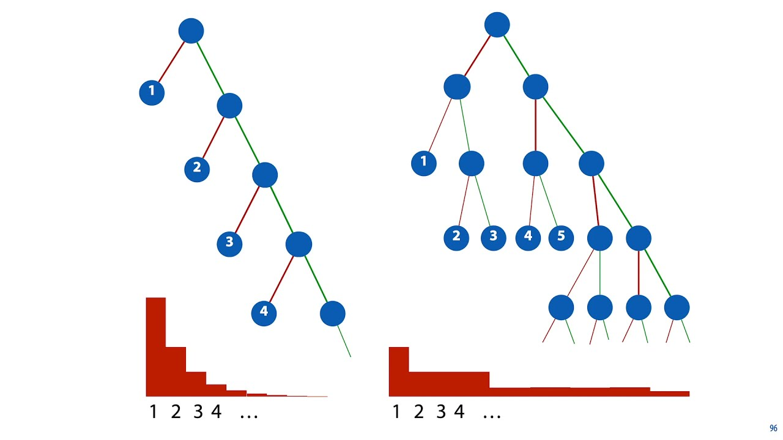
Methodologies
Thomas Jones, Ltd
Explanation of Methods and Models preferred
We are working with our dataset and run a classic Logistic Regression, starting with all the data and variables in our model. As expected the result is not robust. Nevertheless that initial results identify the same variables that our final model identifies as predictors of the customers that are prone to default their payments. The most important predictors are the Credit History, Status of Checking account, the Proportion of Debt over their income, their Age and the Credit Amount and the Duration of the loan.
We also perform a Random forest Classifier to verify the predictors. With trial and error we identified the best test size to 0.28 and random state = 2, for running our Random Forest Classifier with 300 estimators.

Slide 14
Modeling
Thomas Jones, Ltd
Logistic Regression and
Random Forests

Slide 15
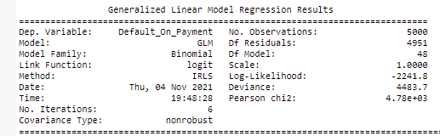

Model 1
Thomas Jones, Ltd
Logistic Regression

Slide 16

Random Forest
Thomas Jones, Ltd
With trial and error we identified the best test size to 0.28 and random state = 2, for running our Random Forest Classifier with 300 estimators.
We ran the Random Forest on the two possible values of our categorical response variable, YES for those who will default and NO for those who will not default. We have great accuracy as a model as the Confusion Matrix reveals below.
Based on the result below we can see that our model is a quite accurate one with a positive probability rate 0.58 and ROC - AUC rate at 0.78
Source, description, issues, wrangling, preprocessing

Slide 17
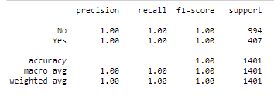
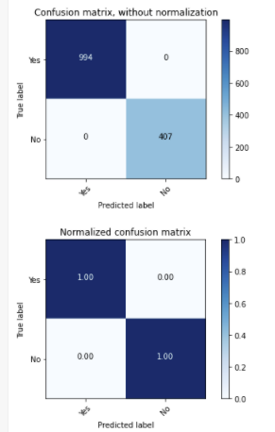

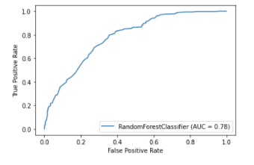
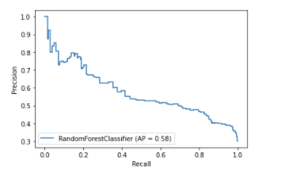
Random Forest

Slide 18
Outcomes & Conclusion
Thomas Jones, Ltd
Solutions

Slide 19
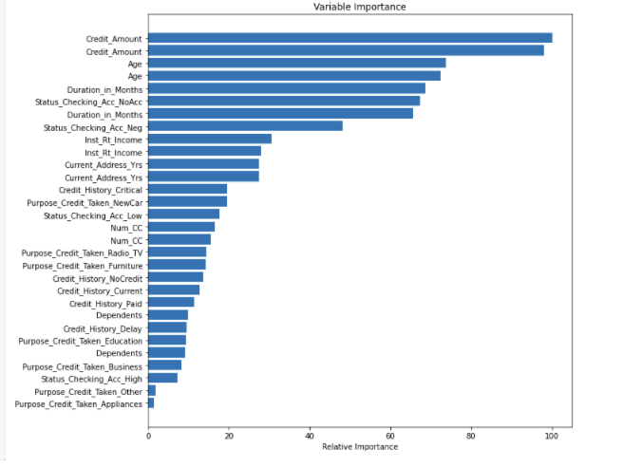
Outcomes & Metrics
Thomas Jones, Ltd
ROC, AUC and Predictors
Our model gave us:
No Skill ROC AUC 0.780 Logistic ROC AUC 0.795
Reviewing the information predicted by our model, we can identify that the most important predictors are the Credit Amount and the Duration of the Loan in conjunction with the Age of the recipient and the cash flow in his checking account and the ratio of the loan to his income.

Slide 20
Applications and Future Work
Thomas Jones, Ltd
The use of the model

Slide 21

Applications
Thomas Jones, Ltd
Applications of the model
It is true that the use of a program or predictive model that allows for accurate identification of the factors that affect repayment ability, will be useful for any financial institution but not only.
Institutions, department stores and commercial companies that offer customer credit accounts, mortgage providers, credit card providers, etc that provide loans would like access to a predictive model for defaulting customers.

