Slide 1
Bitcon and the SP&500 Relationship
A relationship between Bitcoin (BTC) price and the S&P500 market indexes in a 5 year span.
Presented by: Travis

Slide 2
What is the role of Bitcoin in our economy?
If Bitcoin has been playing a safe-heaven role in the investment world, we should expect to see a negative relationship between stock and Bitcoin prices.
Below are three potential roles:
is Bitcoin following a trend different than financial markets.
if stock prices are rallying, is this positivism contagious, and therefore, also visible in Bitcoin prices
A third potential outcome from our analysis may be that Bitcoin prices do not show a relationship with the stock market at all.

Slide 3
Data
Lets use data over a 5 year span
We rely on Federal Reserve Economic Data for the S&P500, and will pull from a reliable source
Using the Financial Modeling Prep API , this provides data for bitcoin prices that meets our needs for 10 years

Slide 4
Data Cleanup & Exploration
We will want to ‘connect’ both types of data together, thru the date as the index
cleaning will require removing nulls from the S&P, as trading is only done on weekdays, while bitcoin ‘never sleeps’
Displaying output along the data organization journey, will give us a visual if we are on the right path
Our output was in a (json)dictionary panda dataframes
There was a need to organize both S&P500 and bitcoin pricing, into one dataframe
Correlations could then be seen

Slide 5
Data Analysis
use pandas dataframe.corr() we looked to find the correlation of our Pandas DataFrame columns: S&P500 closing price and Bitcon (closing/eod) price

Slide 6
Results How to interpret the correlation between BTC and S&P 500 prices? The values from a correlation matrix range from -1 to 1. Closer to +1 means that both variables move closely together and in the same direction. A value of 0 meaning that there is no relationship between the variables. A negative correlation indicates that the variables move in different directions. The closer to -1 the stronger the inverse relationship.
At the end, we found: S&P500 and Bitcoin prices related to each other
Entity | BTC | S&P500
BTC | 1.000000 | 0.843103
SP500 | 0.843103 | 1.000000

Slide 7
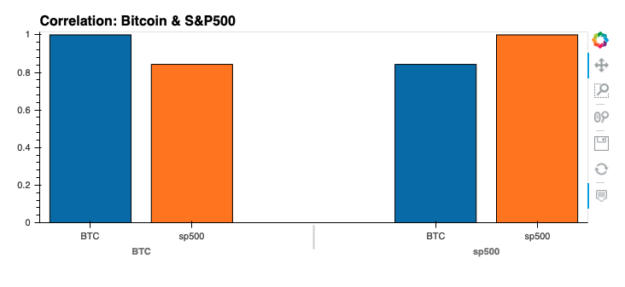
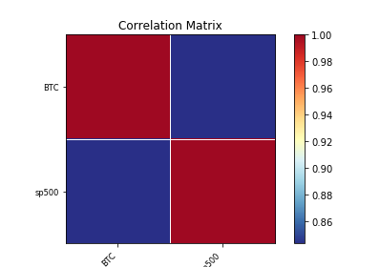
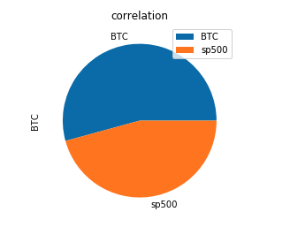
Visual correlations
The red color of the graph means that the relationship is strong and positive.

Slide 8
Wrapping up
Using Python and Pandas, we have done analysis on the relationship between stock market and Bitcoin prices. As per our analysis results, we can say that BTC and S&P500 prices move pretty much in the same direction.

