Slide 1
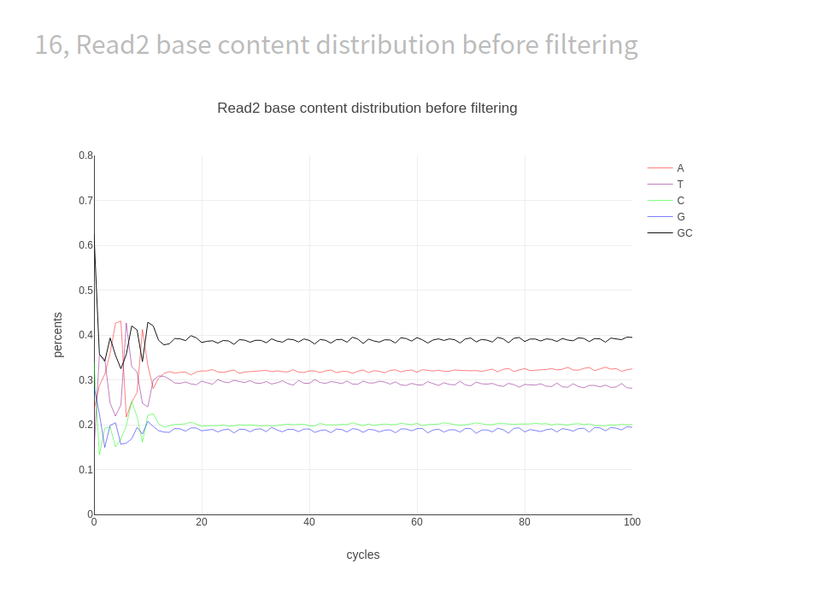
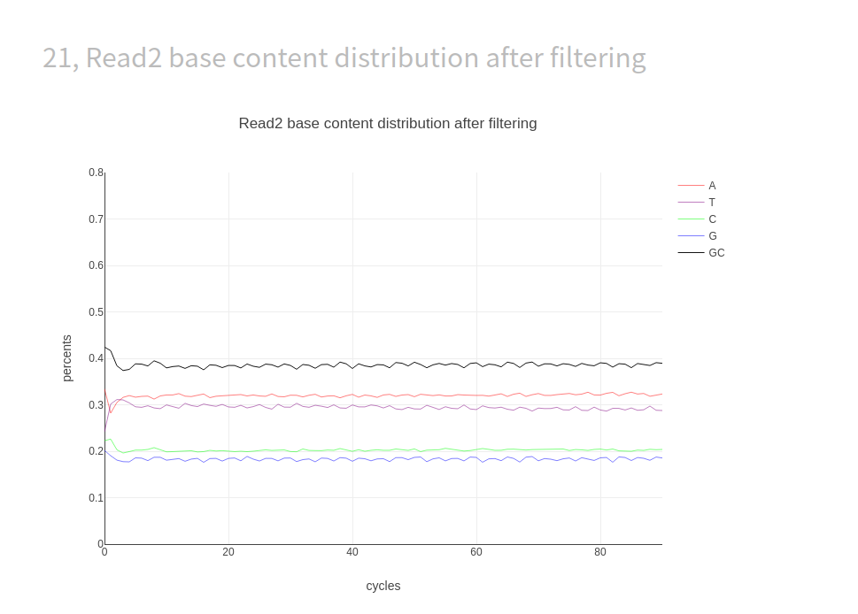

Slide 2
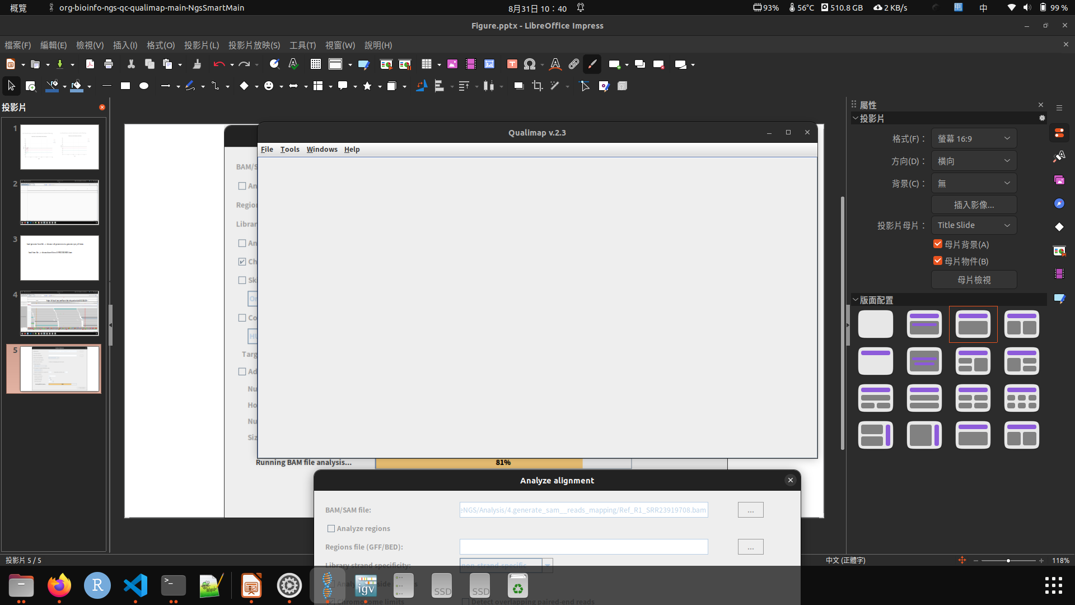

Slide 3
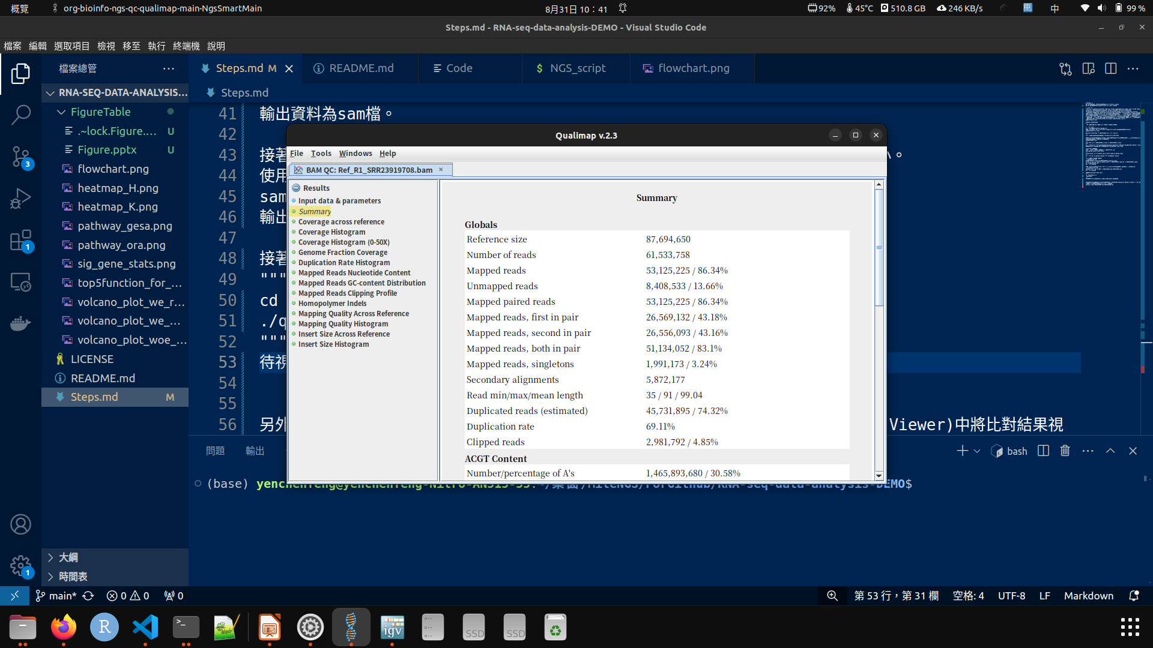

Slide 4
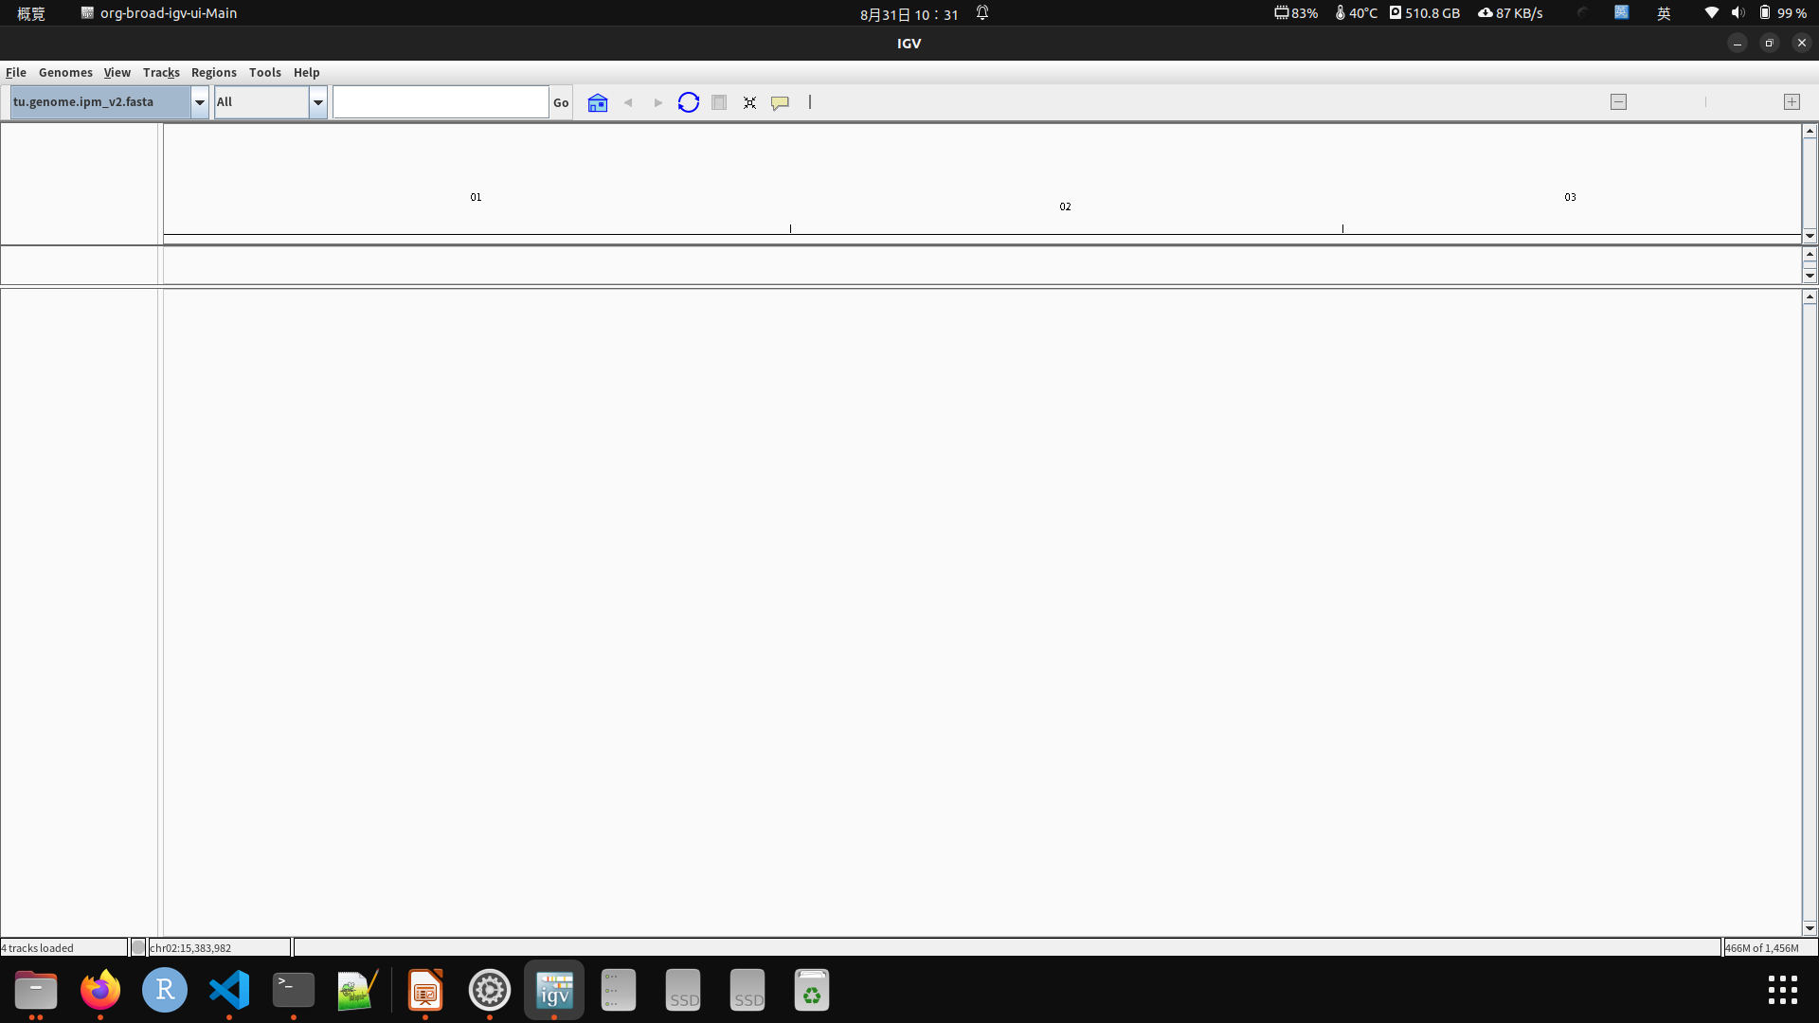

Slide 5
load genome from file --> choose ref genome ex tu.genome.ipm_v2.fasta
load from file --> choose bam file ex SRR23919699.bam

Slide 6
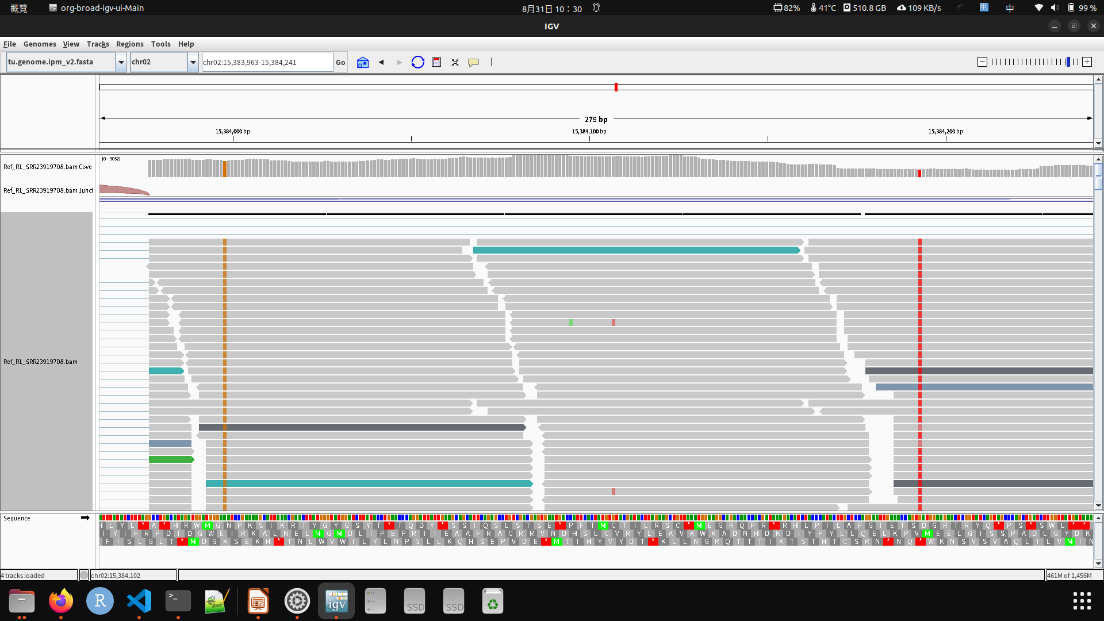
https://cloud.tencent.com/developer/article/1624543

Slide 7
