Slide 1
Power Play Danger Index
Tim Keller – University of Basel, 10.07.2022

Slide 2
Table of Contents
Structure index
xG model
Danger index
Big Data Cup / Olympic Data
NWHL Data
Outlook: Space, Structure, Danger and Tracking

Slide 3
Power Play Structure Index
Hockey-Graphs article by Matt Cane:
“Measuring Measuring the Importance of Structure on the Power Play” from February 2017
Measuring distance from average shot location by shot
Player Structure = (Σ distance of shot to player’s average shot location) / (# of shots for player)
Team Structure Index = (Σ # of shots for player * Player Structure ) / (Σ # of shots for each player)

Slide 4
Shortcomings Structure Index
Shots taken from dangerous spots?
→ Expected Goals (xG)
How much space when taking the shot?
→ Tracking Data

Slide 5
Expected Goals Model
Feature set:
Shot type
Coordinates x and y, distance to goal
Angle to the goal
Shot type, x and y previous two events
Time, angle and distance to goal differences between last two events
Strength state
XG Boost classifier with grid search
K-fold split training

Slide 6
xG Index
Intermediate step to Danger Index
Player xG Index = Σ(xG – average xG) / (# of shots for player)
Team xG Index = Σ(Σ # of shots for player * Player xG Index ) / (Σ # of shots for each player)

Slide 7
Power Play Danger Index
Combination of xG index and structure index divided through 100
Weighting of 100:1 decided through predictability of final value
Player Danger Index = Player xG Index – (Player Structure Index \ 100)
Team Danger Index = (Σ (Σ shots * Player xG Index) \ Σ shots) – (Σ(Σ shots * Player Structure Index) \ Σ shots * 100)

Slide 8

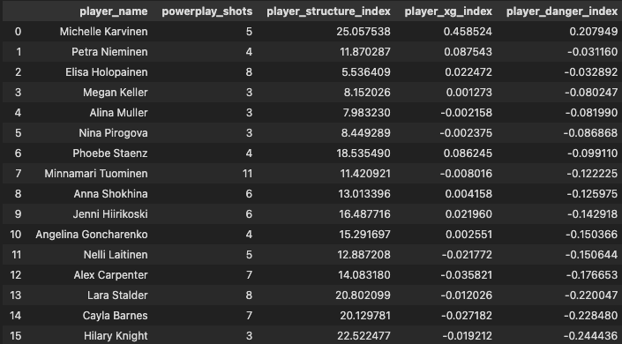
Results Olympics

Slide 9
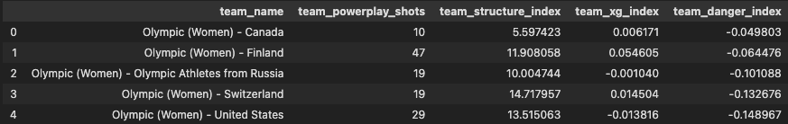
Results Olympics

Slide 10
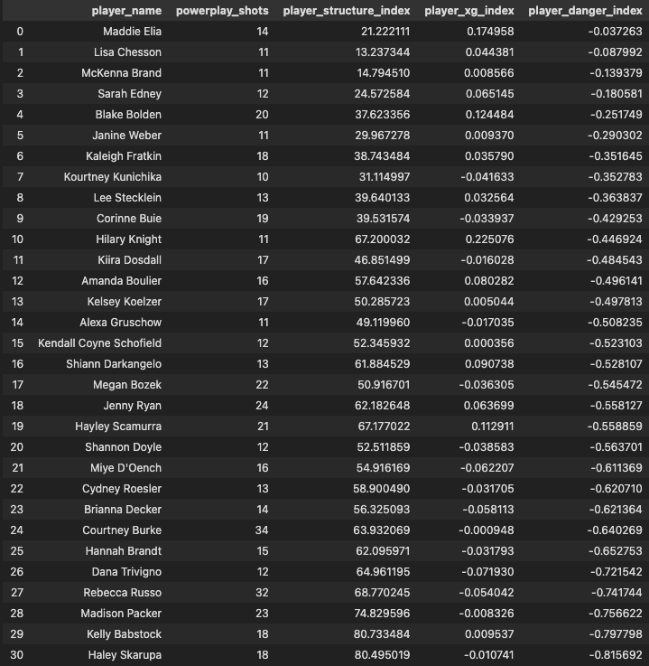
Results NWHL

Slide 11
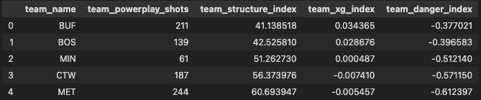
Results NWHL

Slide 12
Evaluation Danger Index
Nothing “beats” xG
Puts some context into Cane’s structure index but makes it more complicated
Kept things similar but maybe not optimal
Difficult to draw meaningful conclusions from very limited data (a general whky problem)

Slide 13
Tracking Data: Creating Space
Started using the BDC tracking data to find out who is good with creating space
Calculated nearest defender for events and the difference between events
Very favourable of backwards passes to the blue line (defeats purpose)
xG weighting helped a little bit
Still needs refinements

Slide 14
Tracking Data: Keeping Structure
Trying to get back to topic of PP structure
Calculated differences to AVG position
Like difference to AVG shot in Cane’s structure index
Extremes caused by small samples for most players

Slide 15
Conclusion
Able to add a bit more context to powerplay structure index
Able to see who is just structured and who is structured in dangerous positions
Should the approach be changed from an index to more of a model?
Tracking data helps to add more context but “can’t live on its own”

Slide 16
Thank You!
To Alyssa, Carlie and Mike for organizing the conference and letting me present
To Meghan Chayka, Shirley Mills, Alison Lukan, Michael Schuckers and everyone else involved for putting on the Big Data Cup
To Mr. Bucket for the Data cleaning for BDC and ultimately this project
Everyone in the Net Growth Pod Discord for putting up with my questions and keep the motivation high

Slide 17
JSM2022
I’m going over the pond to D.C. to attend JSM this summer
My main goal is to network with people I only know via the internet so anyone who wants to meetup please DM on Twitter @imkeller_5

