Slide 1
Where did they get out? Evaluating zone exits using expected threat in hockey
Tim Keller, Student Computer Science, University of Basel, Switzerland
Twitter: @imkeller_5, Website https://tk5.futbol

Slide 2
Agenda.
1 | Introduction
2 | Expected Threat
3 | Exit Sequences & Lanes
4 | Results
5 | Discussion

Slide 3
Introduction
Zone exits:
start offensive sequences
decrease opponent danger
controlled zone exit → successful defensive sequence
Are all zone exits the same?
Impact of exit location on opponent danger?
Thesis: exits over the sides more effective and danger-reducing

Slide 4
Agenda.
1 | Introduction
2 | Expected Threat
3 | Exit Sequences & Lanes
4 | Results
5 | Discussion

Slide 5
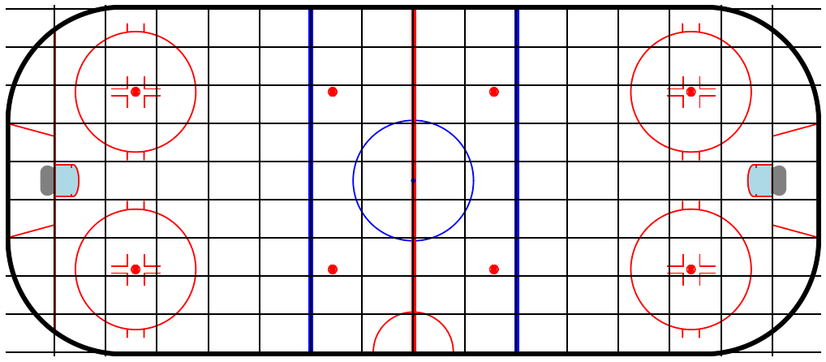
Expected Threat (xT)
Concept developed for soccer with Markov Chains by Sarah Rudd
Further developed in the most widely used form by Karun Singh
Every section of the field value of scoring in a given amount of moves
Difference between sections used to evaluate actions
Translation into ice-hockey: divide the ice surface into a 16 x 9 matrix

Slide 6
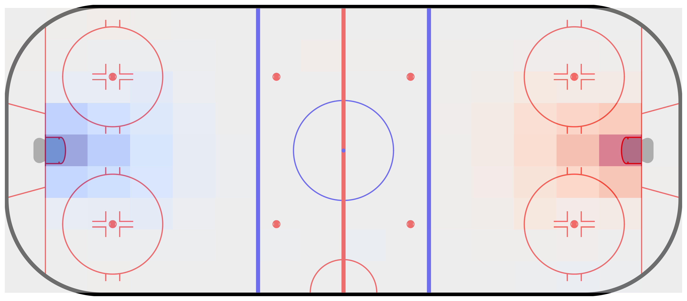
Expected Threat (xT)
Evaluating passes and carries as move actions
Use Markov chains to calculate transition matrices after 8 moves → xT for offense
Defensive xT: flipped values xT offense
Net xT: offensive xT + defensive xT

Slide 7
Agenda.
1 | Introduction
2 | Expected Threat
3 | Exit Sequences & Lanes
4 | Results
5 | Discussion

Slide 8
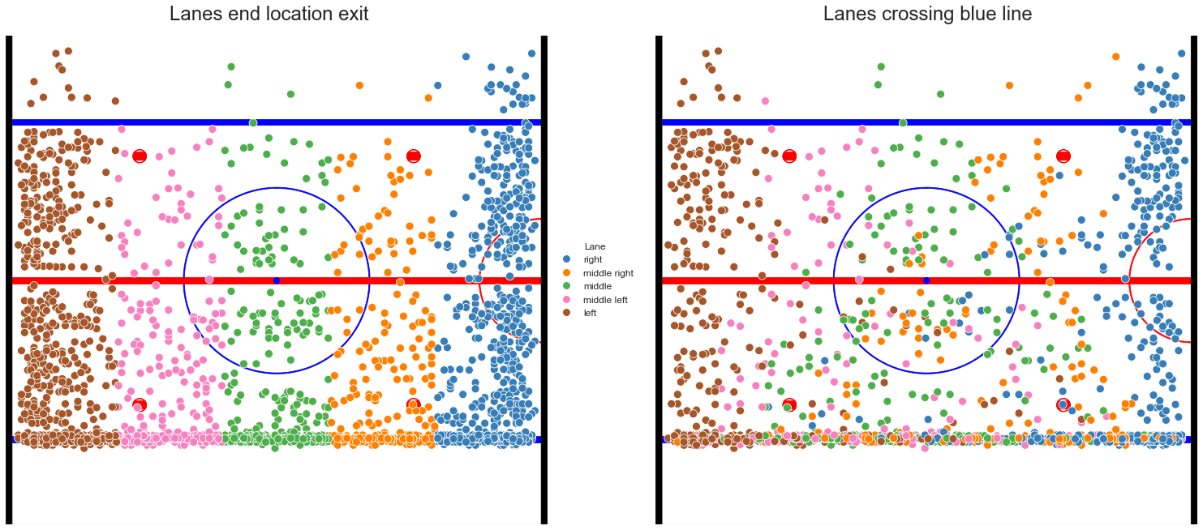
Exit Sequences & Lanes
Breaking down the event data into sequences leading to zone exits → exit sequences
Exit lanes similar to zone entry work by Daniel Weinberger and Nick Czuzoj-Shulman
Two ways to define exit lanes:
Location of the zone exit
Location of the puck (approx.) crossing the blue line

Slide 9
Agenda.
1 | Introduction
2 | Expected Threat
3 | Exit Sequences & Lanes
4 | Results
5 | Discussion

Slide 10
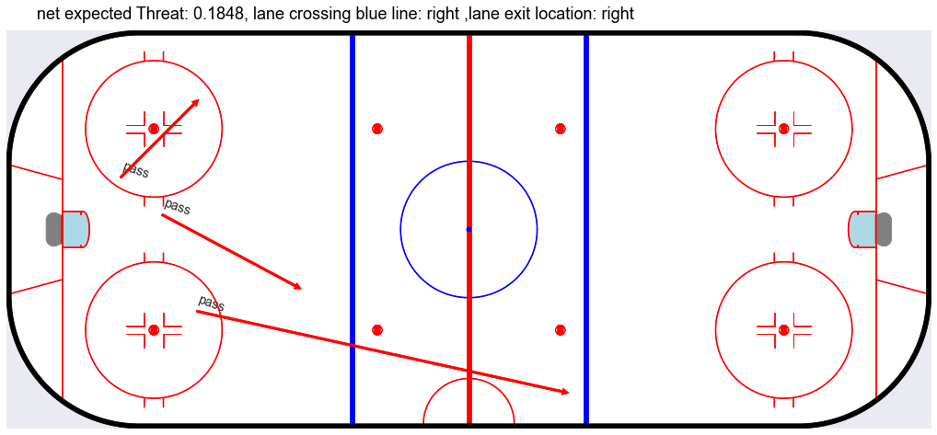
Results

Slide 11
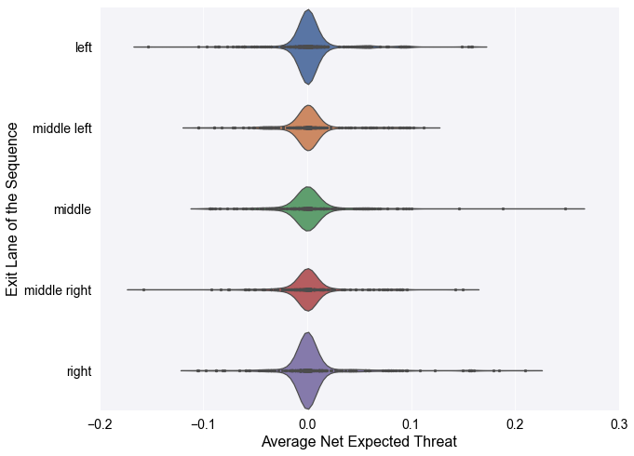
Results
Left and right lanes:
have the most exit events
most extreme results both directions
good plays through the middle get rewarded
xT values not conclusive enough to show outside lanes better for preventing or creating danger

Slide 12
Agenda.
1 | Introduction
2 | Expected Threat
3 | Exit Sequences & Lanes
4 | Results
5 | Discussion

Slide 13
Discussion
What happens after exits?
How are different pass and carry types affecting the exits?

Slide 14
References
Daniel Weinberger, Lateral Puck Movement in the neutral zone, Article, https://hockey-graphs.com/2019/10/24/lateral-puck-movement-in-the-nz/,
Nick Czuzoj-Shulman, SEAHAC 2022 - OZ Entry Lanes, Presentation, https://www.flipsnack.com/75B8FBBBDC9/seahac-2022-oz-entry-lanes.html
Alex Novet, Why Possession is the Key to Zone Exits, Article, https://hockey-graphs.com/2019/07/30/why-possession-is-the-key-to-zone-exits/
Jen LC, Clearing the Defensive Zone: The Dangers of Dumping the Puck Out, Article, https://jenlc13.wordpress.com/2015/05/19/clearing-the-defensive-zone-the-dangers-of-dumping-the-puck-out/
Sarah Rudd, A Framework for Tactical Analysis and Individual Offensive Production Assessment in Soccer Using Markov Chains, Presentation, https://docplayer.net/27070167-A-framework-for-tactical-analysis-and-individual-offensive-production-assessment-in-soccer-using-markov-chains.html,
Karun Singh, Introducing Expected Threat (xT), Website, https://karun.in/blog/expected-threat.html,
Hugo Fabregues, A new Expected Threat (xT) Model, not publicly availabe (2023)
David Sumpter and Aleksander Andrzejewski, Calculating xT (position-based), Website, https://soccermatics.readthedocs.io/en/latest/gallery/lesson4/plot ExpectedThreat.html
David Sumpter and Aleksander Andrzejewski, Possesion Chains, Website, https://soccermatics.readthedocs.io/en/latest/gallery/lesson4/plot PossesionChain.html,
Daniel Weinberger, Passing clusters: A Framework to Evaluate a Team’s Break-out, Article, https://hockey-graphs.com/2019/10/22/passing-clusters-a-framework-to-evaluate-a-teams-breakout/

Slide 15
Thank You for your attention!

