Slide 1
Repeated Measures Multivariate Models Advanced Statistics Missing Data

Slide 2
Overview
Missing data
Occurrence, typology, determinants
Mechanisms: randomness
Treatment
Imputation
Maximum likelihood based procedures

Slide 3
Literature
Chapter 4 of Tabachnick & Fidell. In particular section 4.1.3:
Nice for a quick, general overview
Very limited theoretical background
Paper by Baraldi & Enders (2010)
Neatly explained theoretical background
With nice empirical illustration

Slide 4
What is missing data?
What is missing data?
Lack of response
Subjects refuse to participate or do not show up
Subjects drop out of a study
Subjects cannot or refuse to answer specific questions
Written answer is unreadable
…
Important question for statistics: Does an underlying true value exist?
Only if yes, a missing score is a missing datum

Slide 5
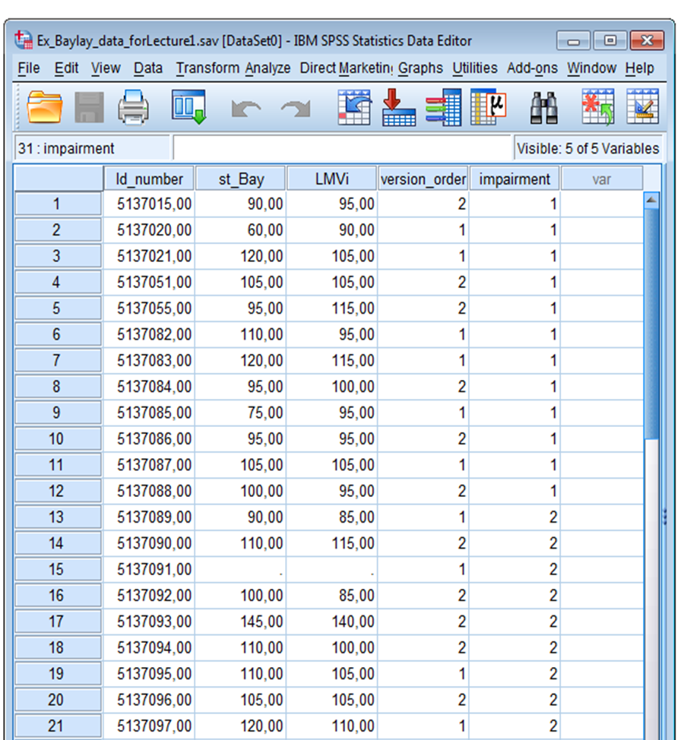

Slide 6
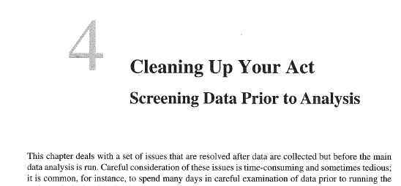
Tabachnick & Fidell

Slide 7
Take home messages for empirical research
Before starting your research think about Missing data
Prevention is better than cure
Take measures to avoid/reduce the missing data
Plan a Cure:
Plan the administration of the cause of each missing datum
In intervention studies: Drop-out of intervention does not necessarily imply drop-out of your study!

Slide 8
Why paying attention to missing data? (1)
Most data analysis procedures and software are not designed to handle missing data

Slide 9
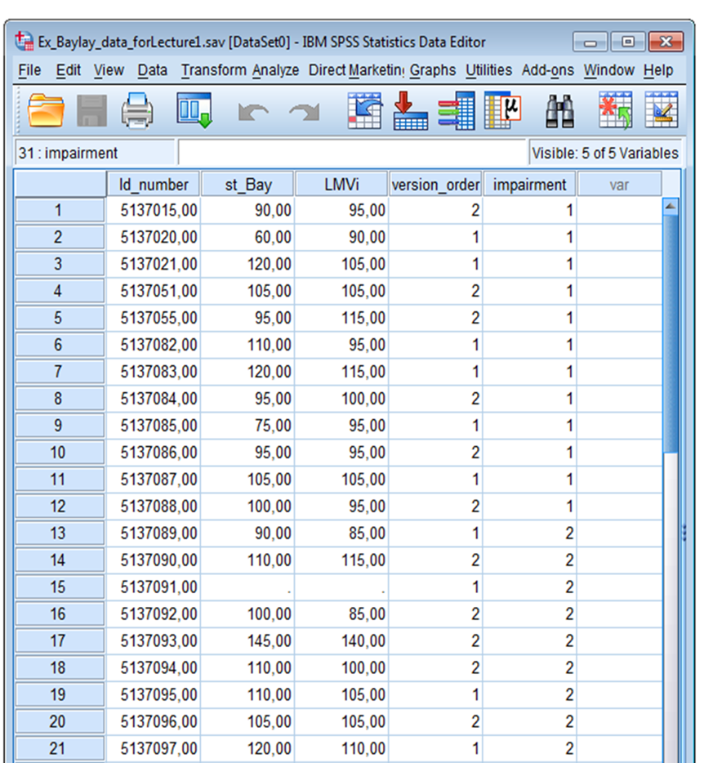
Example – default in SPSS
ANOVA
DV: LMVi
Factors: version_order, impairment
What happens with case 15?

Slide 10
Why paying attention to missing data? (2)
Ignoring missing data or ad hoc editing lends an appearance of completeness, but may lead to serious problems
Inefficiency (loss of information and size) ⇒ loss of power
Biased results, depending on
systematic differences between responders and non-responders (depending on nature of missingness)
proportion of missing data
Note (comparing two treatments): If the bias is the same in both treatments, there is no bias in the comparison
Incorrect inferential information (i.e., standard errors, statistical tests)

Slide 11
A typology of missing data
Data are completely missing
Unit non-response:
A sampled unit is not observed, the entire data collection fails

Slide 12
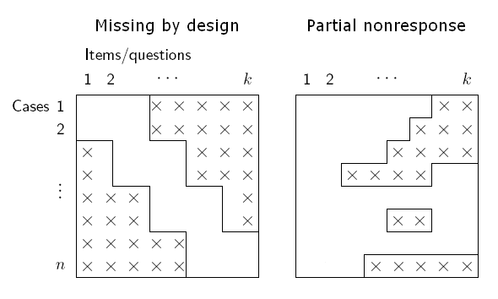
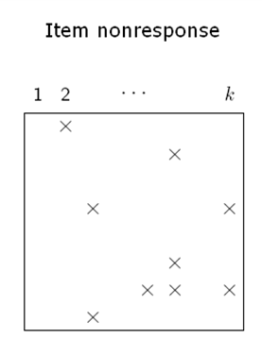
A typology of missing data
Data are partially missing
Missing by design:
not-applicable items, incomplete designs
Partial nonresponse (time dependency):
attrition, missing baseline, break-off during interview, drop-out
Item non-response:
skipped items, inadequate responses, information lost

Slide 13
Empirical example – Bayley test (1)
Bayley-III: test for developmental assessment of very young children (3 – 36 months)
Cognition scale consists of 91 items
increasing developmental level,
consecutively administered
Only subset of items administered
first item to administer selected on the basis of calender age – ‘entry level’
last item depending on performance: after 3 false items, test stops – ‘exit level’

Slide 14
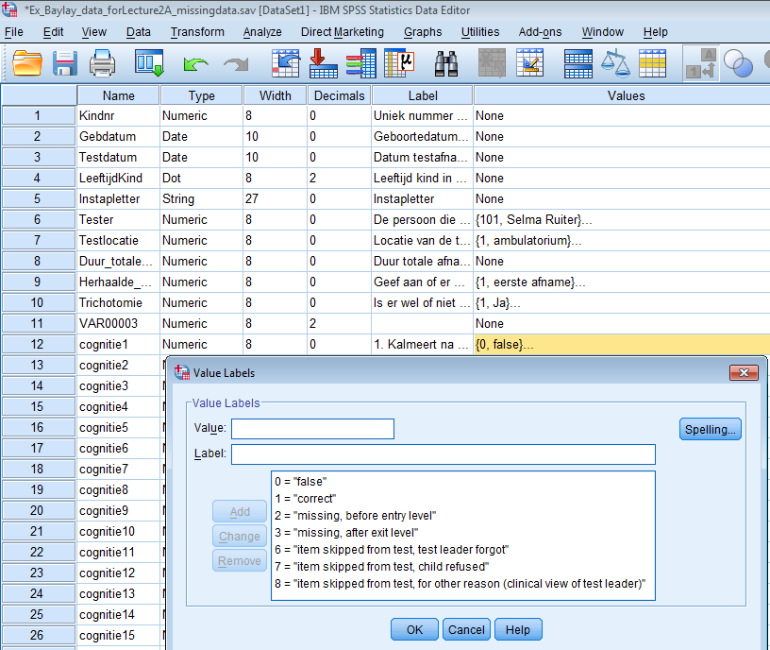
Missing by design
Partial or item-
non response

Slide 15
Determinants of missing data
Unit nonresponse: Design (study, sampling), data collection process
Item nonresponse: Question-answer process
Potential sources of nonresponse (survey errors)
Mode of data collection: interviewer/experimenter, telephone, mail, computer-assisted, internet
Questionnaire: layout, number of questions, question wording, format, instructions, sensitive questions, ‘hard’ questions
Respondent: accidental skipping, refusal, motivation, not able to provide answer
Interviewer: guidance, probing, recording answer, skipping items
Data processing: coding, editing data, computer-assisted

Slide 16
Missing data processes
Types, patterns, and determinants are important for prevention and treatment
Important: the distribution of the missingness
Indicator variables (matrix) R indicate whether an element of the data matrix is observed (R = 1) or missing (R = 0)
The distribution of R is called the missing data mechanism - a mathematical device (Little & Rubin, 2002)
To describe rates and patterns of missing values
To capture roughly possible relations between missingness and the (unobserved) values of the missing items
BUT it does not capture causal relationships

Slide 17
Missing data processes
Typology of missingness mechanisms
Missing completely at random (MCAR)
Missing at random (MAR)
Missing not at random (MNAR)
At Random implies a probabilistic process
MCAR implies
Missingness is not related to the observed (Y_{obs}) and missing data (Y_{mis}): P(R) does not depend on Y_{obs} and Y_{mis}
No bias due to (systematic) differences
Responders are representative (sub)sample of the population:
only loss of power
Ignorable
Non-informative
Non-ignorable

Slide 18
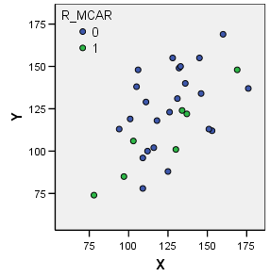
Example – MCAR
Simulated missing data: MCAR
Variable: systolic blood pressure
Two measurements (n = 30): January: Mean(X_{com}) = 125.7, SD(X_{com}) = 23.0 February: Mean(Y_{com}) = 121.9, SD(Y_{com}) = 24.7 correlation 0.60
7 responders (i.e., only 23% data in Y observed!): Mean(Y_{obs}) = 108.6, SD(Y_{obs}) = 25.1
Representative sample

Slide 19
Missing data processes
Missing at random (MAR): ignorable
MAR implies
Missingness may be related to the observed data (Y_{obs}) but not to the missing data (Y_{mis}): P(R) may depend on Y_{obs} but not on Y_{mis}
No bias due to (systematic) differences given observed data
Subgroups of responders are representative subsamples of the population
Put differently: Nonresponse can be predicted by observed data
In longitudinal studies:
missingness may depend on previous measurements, but not on actual (and future) measurements

Slide 20
Example – MAR
Simulated missing data: MAR
Selection based on observed data: blood pressure in January (X) larger than 140 (X > 140)
The missing data in February were ‘caused’ by the observed blood pressure in January
Therefore there is a selection (bias) of only patients who are hypertensive in January
Because missingness depends on observed values it is predictable (by modeling the missing values)

Slide 21
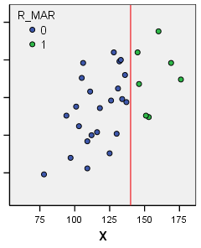
Example – MAR
Simulated missing data: MAR
7 responders (i.e., only 23% data in Y observed), with X > 140
Mean(Y_{obs}) = 138.6, SD(Y_{obs}) = 21.1
Mean(Y_{com}) = 121.9, SD(Y_{com}) = 24.7
Representative subsample, given X NOTE: Biased (= not representative) sample with only Y present

Slide 22
Missing data processes
Missing not at random (MNAR): non-ignorable
Also called informative nonresponse
MNAR implies
Missingness are related to the missing data (Y_{mis}) (and maybe the observed data Y_{obs}): P(R) depends on Y_{mis}
Systematic bias due to (systematic) differences
Put differently: It is unknown what we do not measure
In longitudinal studies:
missingness is related to the actual measurements and maybe future measurements
MNAR requires advanced modeling (of missing and observed data)

Slide 23
Example – MNAR
Schafer & Graham: Repeated measures design
Simulated missing data: MNAR
Selection based on the value of the variable under consideration: blood pressure in February (Y) larger than 140
The missing data in February were ‘caused’ by the observed blood pressure in February
⇒ Dependent on the unknown value of the missing data
Therefore there is a selection (bias) of only patients who are hypertensive in February
Because missingness depends on unobserved values it is problematic to treat

Slide 24
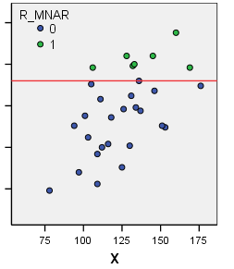
Example – MNAR
Simulated missing data: MNAR
7 responders (i.e., only 23% data in Y observed), with Y > 140
Mean(Y_{obs}) = 153.4, SD(Y_{obs}) = 7.5
Mean(Y_{com}) = 121.9, SD(Y_{com}) = 24.7
Not a representative sample, not a representative subsample
⇒ Biased sample

Slide 25
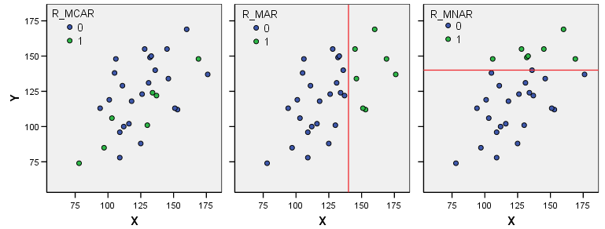
Example – Schafer & Graham
The means and SD’s differ: increasing means, decreasing SD’s
In real data we usually do not know the missingness process, and we need to make
assumptions (usually MAR)
Try to check the assumptions by comparing responders and non-responders on
observed scores

Slide 26
Assuming MAR
MAR is plausible in certain settings
Missing by design (planned missingness): mechanism is controlled by experimenter
Latent variables: missing with probability 1
The researcher does not (cannot) control missingness: the mechanism is unknown and MAR is only an assumption
Find causes and correlates that confirm this assumption:
Descriptive techniques to investigate patterns of missingness
Testing MCAR vs. MAR (testing MAR vs. MNAR not possible)
Follow-up of nonrespondents
Erroneous assumption of MAR often has minor impact

Slide 27
Empirical example – Bayley test (2)
Value | Label | MCAR/MAR/NMAR plausible?
2 | Missing, before entry level | MAR, given calender age
3 | Missing, after exit level | MAR, given calender age
6 | Item skipped, test leader forgot | MCAR
7 | Item skipped, child refused | Depending on cause: MCAR (‘just missed’), NMAR (e.g., because appeared too difficult for child)
8 | Item skipped, for other reason, ‘clinical view test leader’ | Depending on specific reason

Slide 28
Strategies to handle MD
Always try to avoid or prevent missing data
Work hard on follow-up or tracing missing participants
Collect data on reasons for missing
Obtain information about the missing data mechanism
Use descriptive techniques and test MCAR vs. MAR
Where possible do a MAR-approach
Direct modeling of observed and missing data (multilevel)
Multiple imputation of missing data: predicting missing scores
(Possible other missing data treatments)
Non-ignorable mechanisms (MNAR) require advanced modeling

Slide 29
MD treatments
1. Deletion methods
Listwise deletion = complete case analysis = casewise deletion: delete subjects for which at least 1 score missing
Pairwise deletion = available case analysis: delete subjects that miss at least 1 score necessary for the analysis at hand
Only unbiased estimates if missing data is MCAR
2. Procedures based on imputation
Single imputation
Multiple imputation
3. Maximum Likelihood-based procedures

Slide 30
2. Imputation
Substitute plausible values for the missing scores
Advantages:
More efficient than analyzing complete cases
Opportunity to use information about missing scores
Completed data can be analyzed with standard procedures and software
Results in completed data set that is the same for all following analyses
Disadvantages
Sometimes hard to implement (especially multivariate cases)
Some (ad hoc) imputations severely bias distributions and relations

Slide 31
Single imputation
From least to most preferred
unconditional means: filling in means
conditional means: filling in model predictions (e.g., regression imputation)
conditional distributions: filling in draws from the distributions of Y_{mis}, given Y_{obs} (e.g., filling in predictions plus random error)

Slide 32
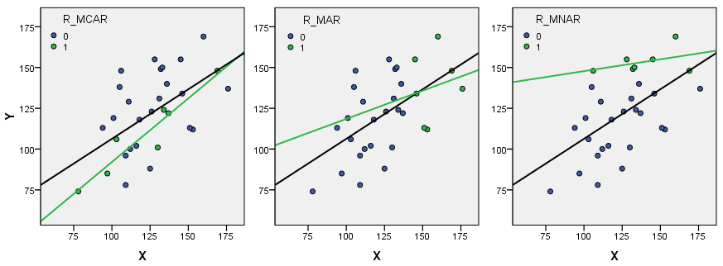
Example – Complete case analysis
 | Mean(Y) | SD(Y) | b₁ | SE(b₁)
Completely observed MCAR MAR MNAR | 121.9 108.6 138.3 153.4 | 24.7 25.1 21.1 7.5 | 0.61 0.78 0.35 0.15 | 0.17 0.12 0.79 0.15

Slide 33
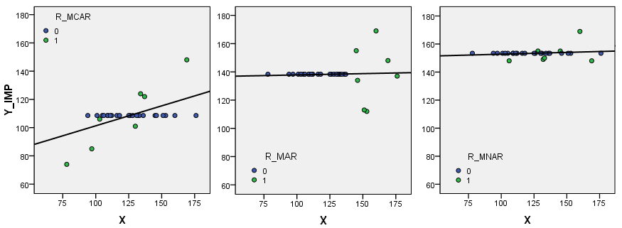
Example – Impute means
Unconditional means: 108.6 (MCAR), 138.3 (MAR), 153.4 (MNAR)
Biased estimates of variances and covariances

Slide 34
Single imputation
Unconditional means: biased variances and covariances
Conditional means
MCAR: Y_{mis} = 14.03 + 0.78 X
MAR: Y_{mis} = 83.87 + 0.35 X
Conditional distributions
MCAR: Y_{mis} = 14.03 + 0.78 X + 8.96 Z
MAR: Y_{mis} = 83.87 + 0.35 X + 22.66 Z
with Z ~ N(0,1)
biased covariances
unbiased under MAR

Slide 35
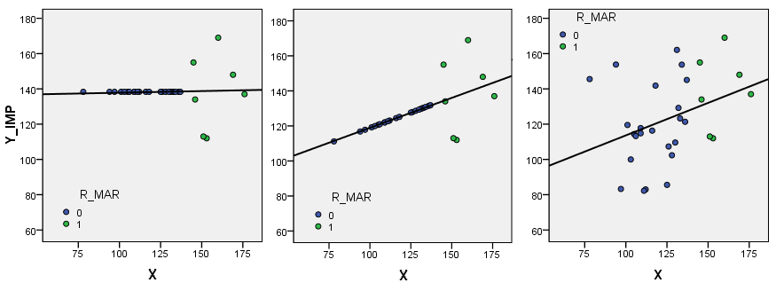
Example –regression under MAR
MAR: 1) unconditional means, 2) conditional means, 3) conditional distributions

Slide 36
Single imputation
Shortcomings:
Biased estimations: means and/or variances and/or covariances
The joint distribution of the variables is disrupted
SEs, p values, and other uncertainty measures are misleading because they do not take into account the extra uncertainty caused by missing values
Moreover, imputations are treated as observations
Sample size is not equal to n
Solution: Multiple imputation

Slide 37
Multiple imputation
Repeat the imputation process:
Parameter estimates vary due to the random character of the imputation procedure and this variation can be used to correct the variances and SEs
Procedure (Rubin, 1987) :
Repeat imputation process m times: m imputed data sets
Analyze the m data sets separately using standard techniques
Summarize the results, taking into account differences within datasets (uncertainty in data) and between datasets (uncertainty due to missing data and imputation)

Slide 38
3. Maximum Likelihood-based procedures
Some background: maximum likelihood estimate of a parameter is the value of the parameter that is most likely to have resulted in the observed data.
Analyze the full, incomplete data set using maximum likelihood estimation
With missing data: Likelihoods computed for cases with
complete data on some variables
complete data on all variables.
two likelihoods are maximized together

Slide 39
3. Maximum Likelihood-based procedures
ML based procedures give unbiased parameter estimates and standard errors.
Only available for linear models (e.g., regression)
Advantages over Multiple Imputation
it does not require the careful selection of variables used to impute values

Slide 40
MD treatment in practice
Avoid MD as much as possible
If MD occurs, administer reason for MD for each case
Data analysis
- Very few MD? Single imputation using plausible model
More than very few: Consider mechanism(s) underlying MD
M(C)AR: Likelihood-based procedure or Multiple imputation
NMAR: Specific likelihood-based methods (pattern mixture, use of auxiliary variables)

