Slide 1


NEXT GEN EMPLOYABILITY PROGRAM
CREATING A FUTURE-READY WORKFORCE
Student Name :
AKSHAY KHANNA T K
Student ID :
College Name :
STU64cb65384788f1691051320
SRM Institute Of Science and Technology

Slide 2
CAPSTONE PROJECT SHOWCASE
Project Title
E-commerce platform with MERN techonology
Abstract | Problem Statement | Project Overview | Proposed Solution | Technology Used | Modelling & Results | Conclusion | Q&A

Slide 3
Abstract
1
Personalized Online Shopping Experience
2
Scalable E-Commerce for Small Businesses
3
Real-Time E-Commerce Marketplace
4
Progressive Web App for E-Commerce

Slide 4


Problem Statement
Centralized Online Shopping System Small and medium-sized businesses lack a centralized online platform to sell their products, making it difficult to reach a broader audience and compete with established marketplaces.
Real-Time User Interaction Most E-commerce platforms lack real-time features like live chat support, instant notifications, or dynamic pricing updates, which can improve user engagement and decision-making.
Insecure Payment Processing Ensuring secure payment processing and protecting sensitive user information from cyber threats is a persistent issue for E-commerce platforms.
Customer Retention and Loyalty Retaining customers in a competitive market is difficult without features like loyalty programs, personalized promotions, and efficient after-sales support.

Slide 5

Project Overview
React-Based Architecture: A modular, component-driven approach ensures scalability and maintainability.
Dynamic Routing:
Homepage (/) showcasing the main shopping interface.
Category-specific pages for Men, Women, and Kids (/mens, /womens, /kids) with unique banners.
Product Details Page (/product/:productId) for viewing detailed information about individual products.
Cart Page (/cart) for managing shopping carts.
Login/Signup Page (/login) for user authentication.
Reusable Components: Includes a Navbar for navigation, Footer for additional information, and dynamic ShopCategory pages.
Dynamic Banners: Displays category-specific banners using static assets (men_banner, women_banner, kid_banner).
Centralized Styling: A single CSS file (App.css) ensures consistent design across the application.
Nested Routes: Supports deeper navigation within the Product page (e.g., /product/123)

Slide 6
Routing Library: React Router
Styling: Centralized CSS file
Frontend Framework: React.js
Asset Management: Organized folder structure for components and static assets.
Folder Structure:
Components: Houses reusable elements like Navbar and Footer.
Pages: Contains individual pages like Shop, ShopCategory, Product, Cart, and LoginSignup.
Assets: Stores static images and other resources

Slide 7
Proposed Solution
Organize Directory Structure
Maintain a clean and organized file structure to ensure scalability and ease of understanding. Separate components, pages, assets, and styles into distinct folders.
Dynamic Product Page
Ensure the product details page dynamically fetches and displays information based on the product ID from the URL. Use the productId parameter to retrieve specific product data.
Reusable and Validated Components
Components like ShopCategory should validate their props to avoid errors. Ensure banners and categories passed to them are properly handled and displayed.
Consistent Styling
Use a global CSS file or CSS modules to apply consistent styles across the application, including for the navbar, footer, and banners. Reuse styles for common layout patterns.
Authentication Pages
Provide a toggle functionality in the login/signup page to switch between login and signup forms. Implement basic form validation and error handling for user inputs.
404 Error Handling
Add a user-friendly 404 page for unmatched routes to handle navigation errors and improve the overall user experience.
Code Optimization
Implement lazy loading for components to improve performance by reducing the initial load time. Use a fallback loader during the component loading process.

Slide 8
Technology used
MongoDB (Database - NoSQL)
Express.js (Backend Framework)
React.js (Frontend Library)
Node.js (Runtime Environment)
Supporting Tools (Commonly Used):
Redux (State Management)
Mongoose (ODM for MongoDB)
Axios/Fetch API (HTTP Requests)
JWT/Passport.js (Authentication)
Webpack/Babel (Build Tools)
CSS Frameworks (Bootstrap/Tailwind)

Slide 9
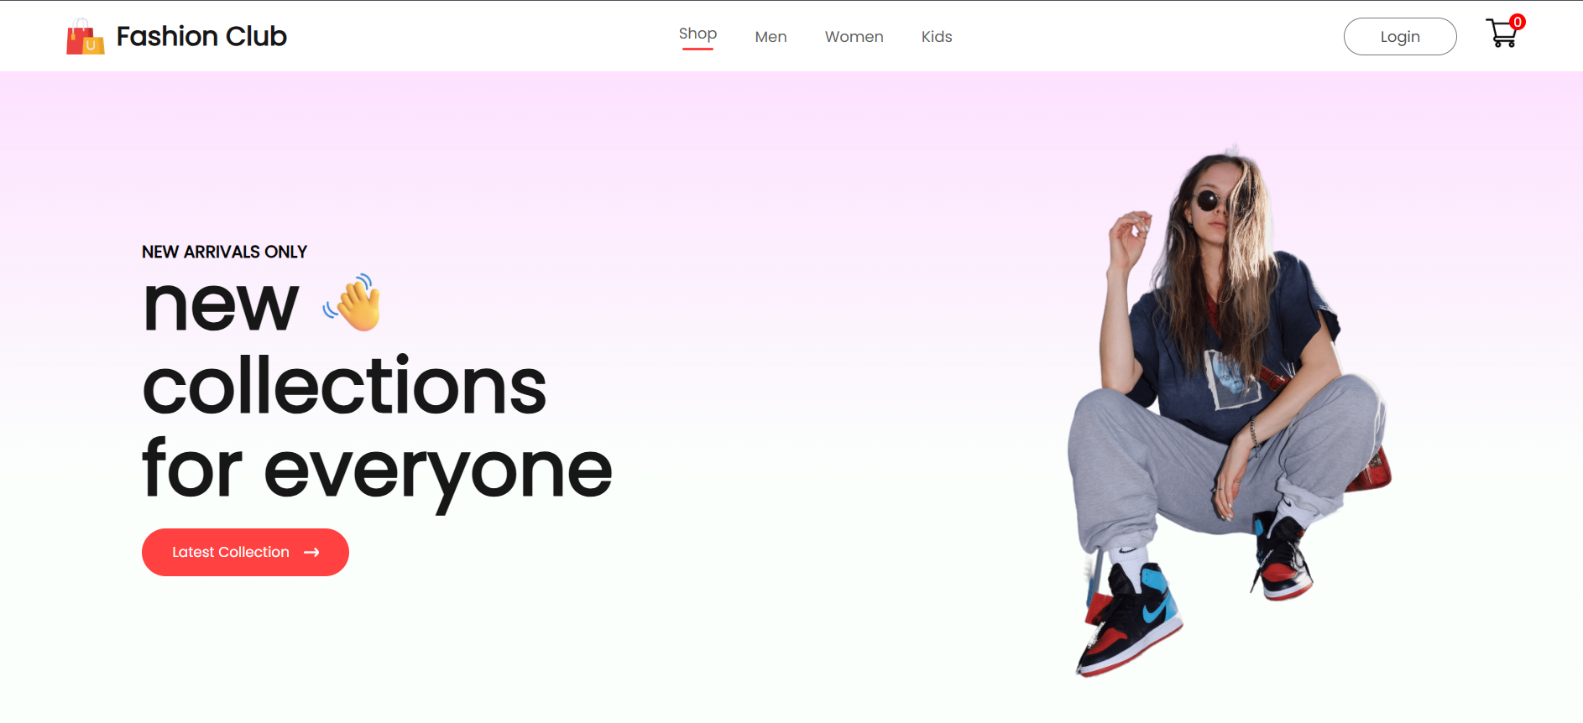
Modelling & Result

Slide 10
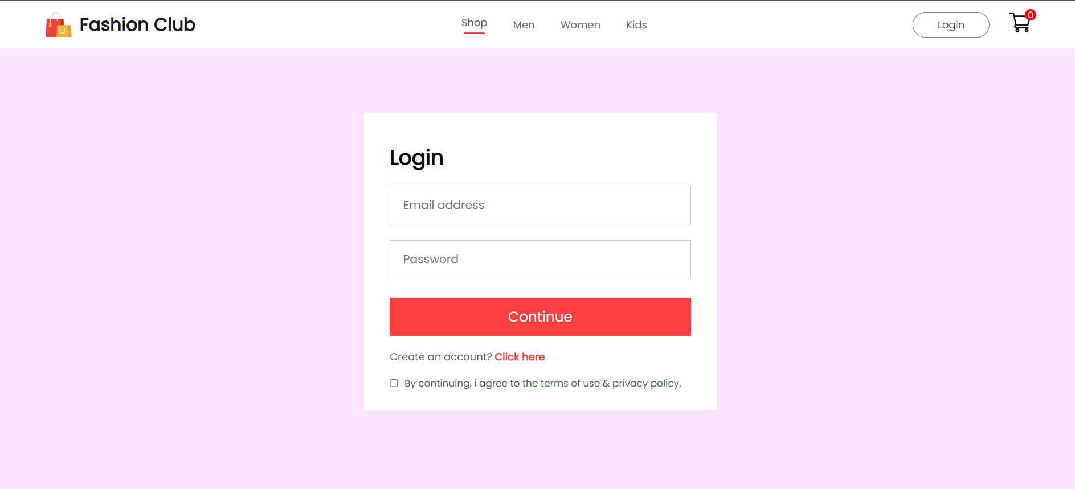
Modelling & Result

Slide 11
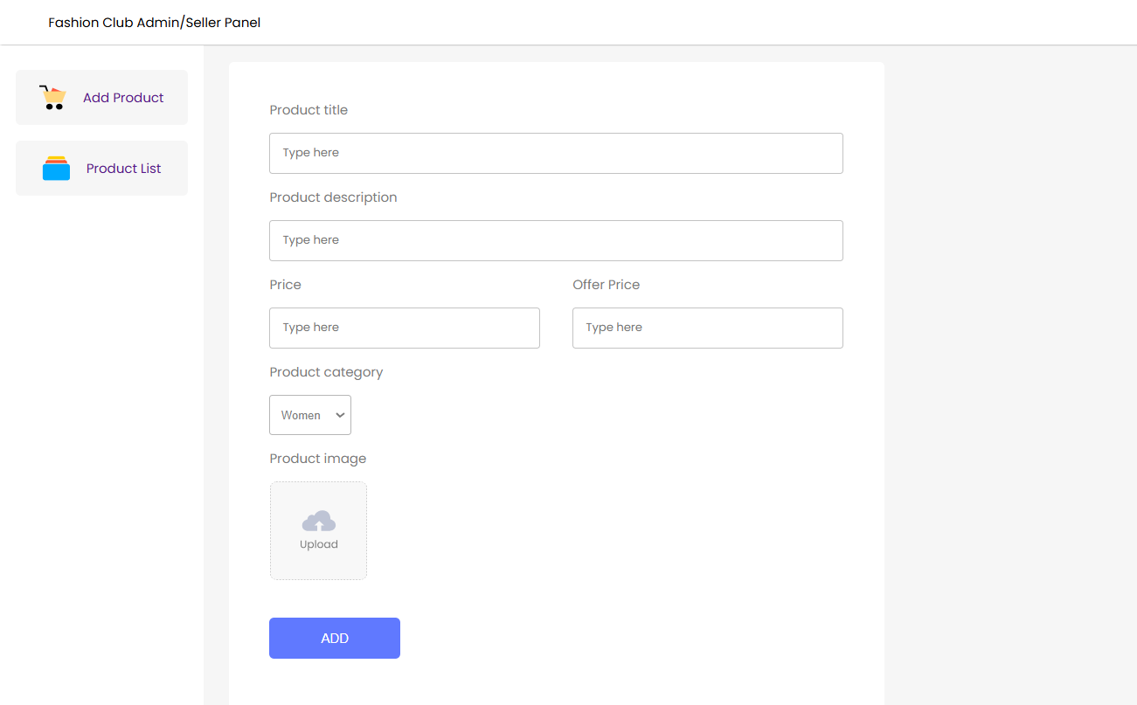
Modelling & Result

Slide 12

Conclusion
End-to-End Solutions Full-stack development allows developers to manage both the frontend and backend, providing a complete solution for building and maintaining applications.
Cost-Effectiveness By employing full-stack developers skilled in multiple technologies, companies can reduce the need for separate specialists, lowering development costs.
Faster Development With knowledge across the stack, developers can seamlessly integrate frontend and backend, reducing communication gaps and speeding up the development cycle.
Flexibility Full-stack developers can switch between frontend and backend tasks as needed, making it easier to adapt to changing project requirements.
Comprehensive Understanding Full-stack developers have a holistic view of the application, enabling them to identify and resolve issues efficiently across both ends.
Scalability Full-stack expertise ensures the application is designed and developed with scalability in mind, making it easier to accommodate future growth.

Slide 13


Notes:
Thank You !!

