Slide 1
Final Project Proposal
Lab Members : 梁智堯、杜泓毅、曹宗叡

Slide 2
Optimization For FIR Workload Outline
Modify FIR to improve overall latency (13T).
Four schemes:
Use only SDRAM to transfer data (scheme 1)
Use DMA + User BRAM to transfer data (scheme 2)
Use DMA + SDRAM to transfer data (scheme 3)
Use FIFO for FIR and prefetch buffer for User BRAM (scheme 4)
Performance comparisons
Discussions

Slide 3
Block diagram (scheme 1)
Caravel
SoC PS
AXI lite
FIR
SDRAM Device(16KB*4)
configurations
Bank 0
Bank 1
Instr Bank
ss
sm
Wishbone
bus signals
Bank 2
Bank 3
Data Bank
Wishbone interface
AXI stream
Tap
BRAM
Data
BRAM
I-Cache
SDRAM Conttroller
D-Cache

Slide 4
SDRAM
Support write back scheme for data cache
When cache hit, it only have 1T latency.
SDRAM
SDRAM_controller
Sdram_dqo
sdram_a
sdram_ba
Bank 0
user_addr
data_in
rw
busy
out_valid
data_out
Cache Comparator
SDRAM FSM
Bank 1
Sdram_we
sdram_cs
sdram_cas
sdram_ras
Controller
cache selector
Bank 2
I-Cache
Out_logic
sdram_dqi
Bank 3
D-Cache
Cache size = 16

Slide 5
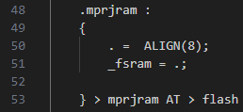
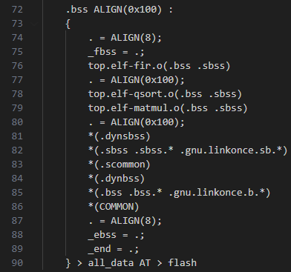
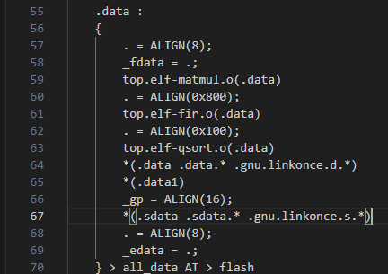
Linker and Address mapping
Data 38001000~38001FFF
0x38001000 0x3800107C
0x38001800 0x380018fc
0x38001900 0x38001924
0x38001a00 0x38001afc
0x38001b00 0x38001b3c
Bank2
A、B
(matmul)
Instruction 38000000~38000FFF
0x380000 0x380001f0
0x380001f4 0x380006e8
0x380006ec 0x380007FC
0x38000800 0x38000db8
Inputdata
(Fir)
matmul
Bank0
QS(qsort)
Fir
Bank3
Ans
(Fir)
result
(matmul)
qsort
Bank1

Slide 6
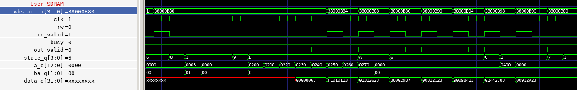
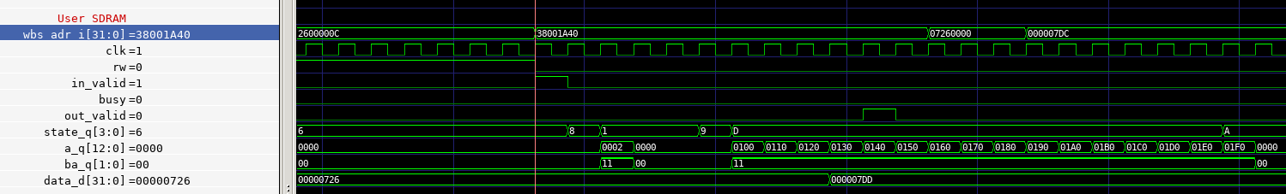
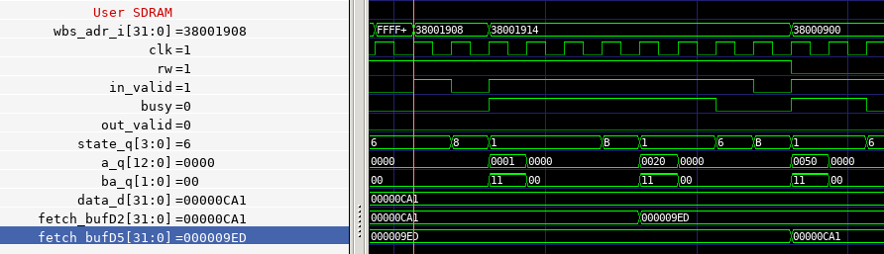
Waveform

Slide 7
Block diagram (scheme 2)
AXI lite
AXI stream
ss
sm
Caravel
SoC PS
FIR
DMA
Configurations
(0x31xxxxxxx)
r_addr
w_addr
data_len
dma_en
R buffer
W buffer
DMA status
BRAM interface
Wishbone
bus signals
Wishbone interface
Arbitrator
Tap
BRAM
Data
BRAM
User BRAM

Slide 8
DMA + User BRAM
Move data from user-bram to fir accelerator.
Store answers from dma write buffer to user-bram.
DMA
User BRAM
r_addr
w_addr
data_len
dma_en
dma_busy
Address Generator
A
Controller
(counter, flag)
R or W Arbitrator
WE
R buffer
W buffer
Di
ss_tdata
sm_tdata
Do

Slide 9
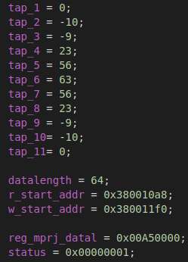
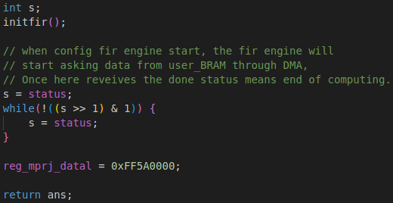
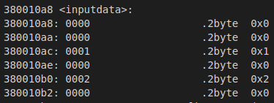
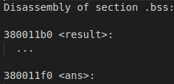
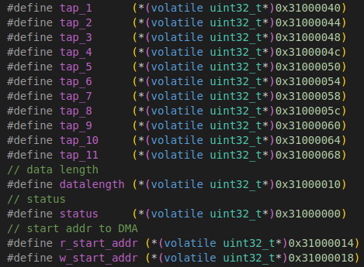
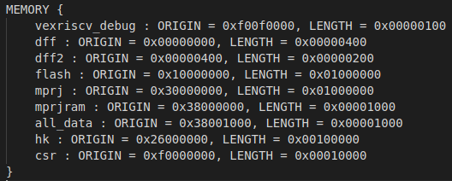
Firmware code and linker

Slide 10
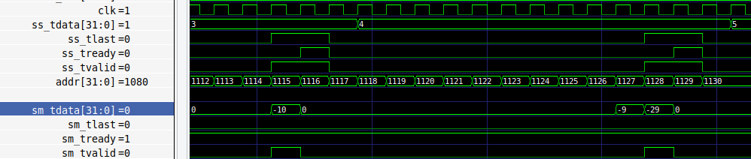
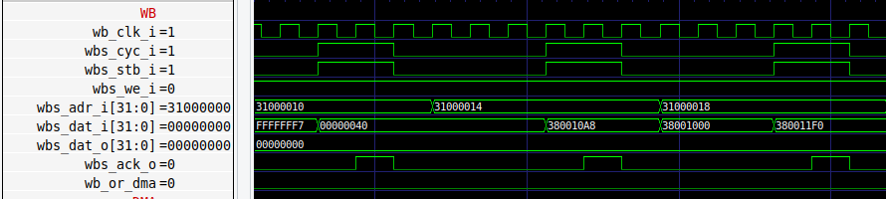
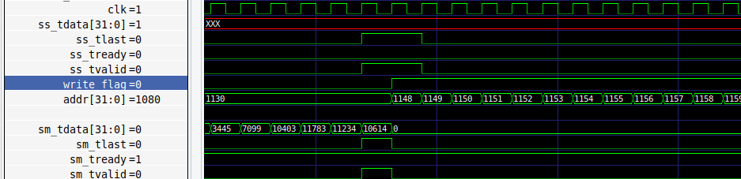
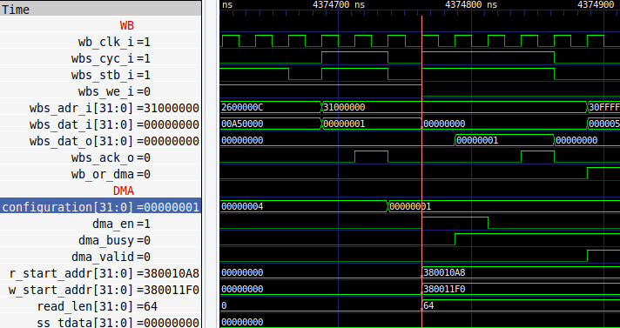
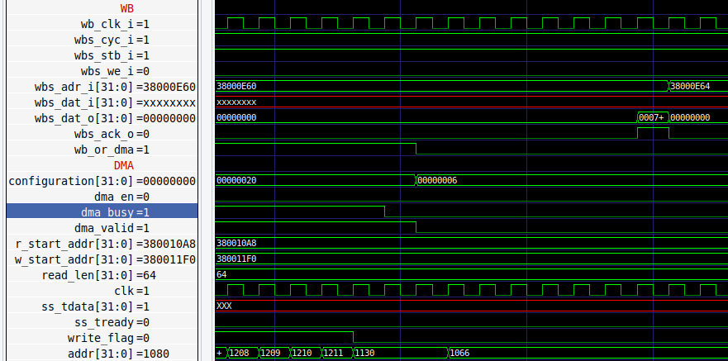
Waveform

Slide 11
Block diagram (scheme 3)
AXI lite
AXI stream
ss
sm
Caravel
SoC PS
FIR
DMA
configurations
r_addr
w_addr
data_len
dma_en
R buffer
W buffer
DMA status
SDRAM interface
Wishbone
bus signals
Wishbone interface
Arbitrator
Tap
BRAM
Data
BRAM
SDRAM

Slide 12
DMA + SDRAM
Move data from SDRAM to fir accelerator.
Store answers from dma write buffer to SDRAM.
DMA
SDRAM
r_addr
w_addr
data_len
dma_en
dma_busy
Address Generator
addr
Controller
(FSM, cnt)
R or W Arbitrator
rw
R buffer
W buffer
data_in
sdr_busy
In_valid
out_valid
ss_tdata
sm_tdata
data_out

Slide 13
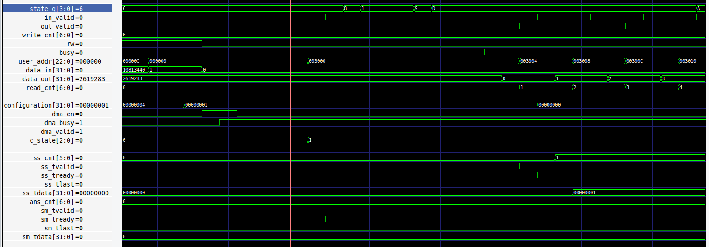
Waveform

Slide 14
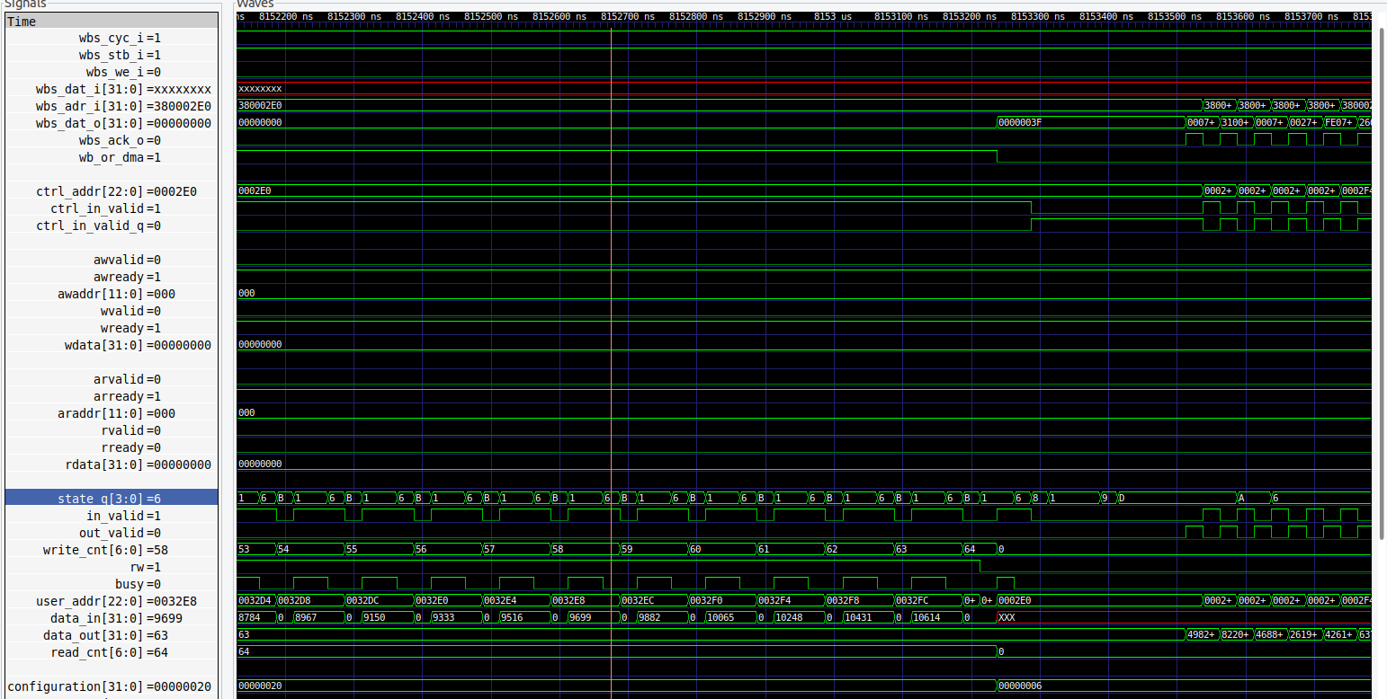
Waveform

Slide 15
Block diagram(scheme 4)
Caravel
SoC PS
AXI lite
FIFO equipped FIR
configurations
ss
sm
Wishbone
bus signals
AXI stream
Wishbone interface
Tap
BRAM
Data
BRAM
Prefetch
buffer
User BRAM

Slide 16
FIFO equipped FIR
FIFO FIR
FIR
Empty
AXI-stream(ss)
(~Full as ready)
Read
AXI-lite
Full
AXI-stream(sm)
(~Empty as valid)
Write

Slide 17
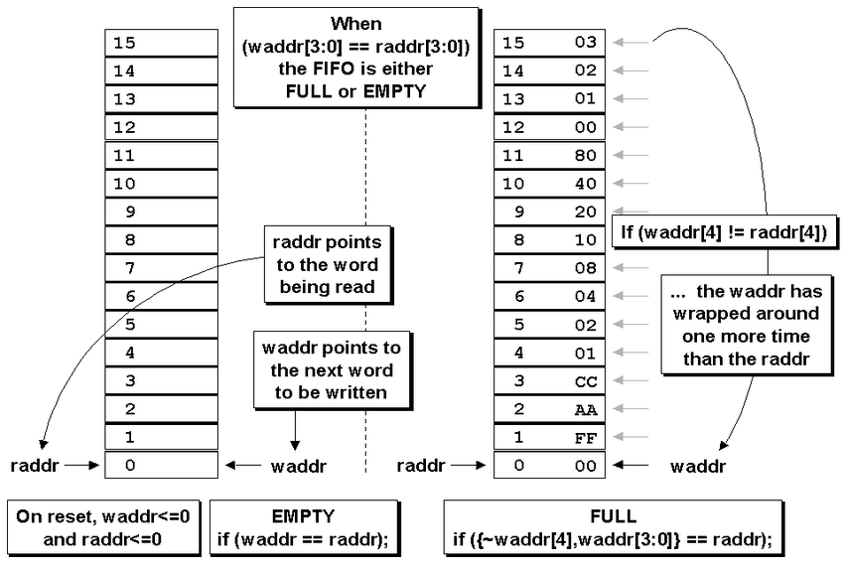
FIFO Structure and Codes

Slide 18
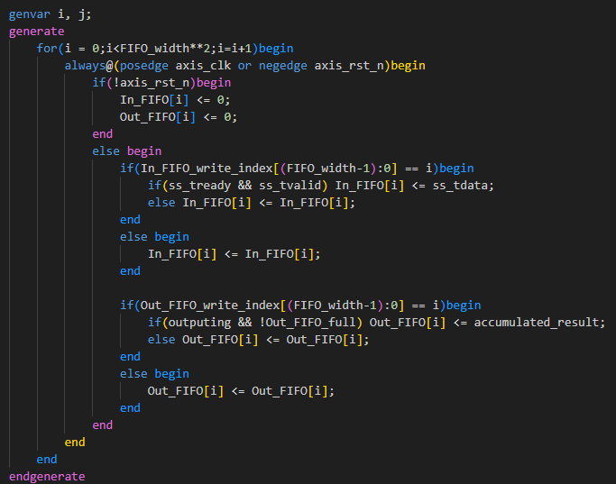
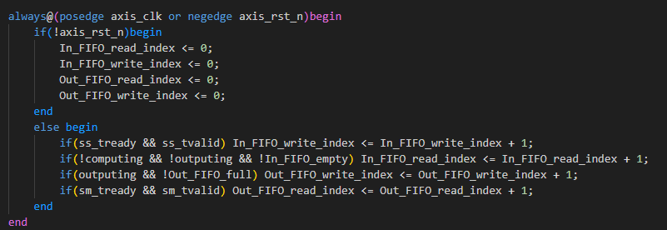
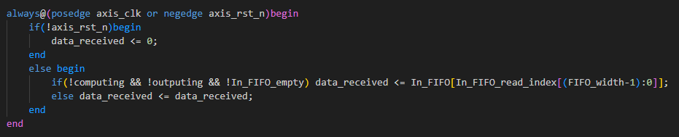

Slide 19
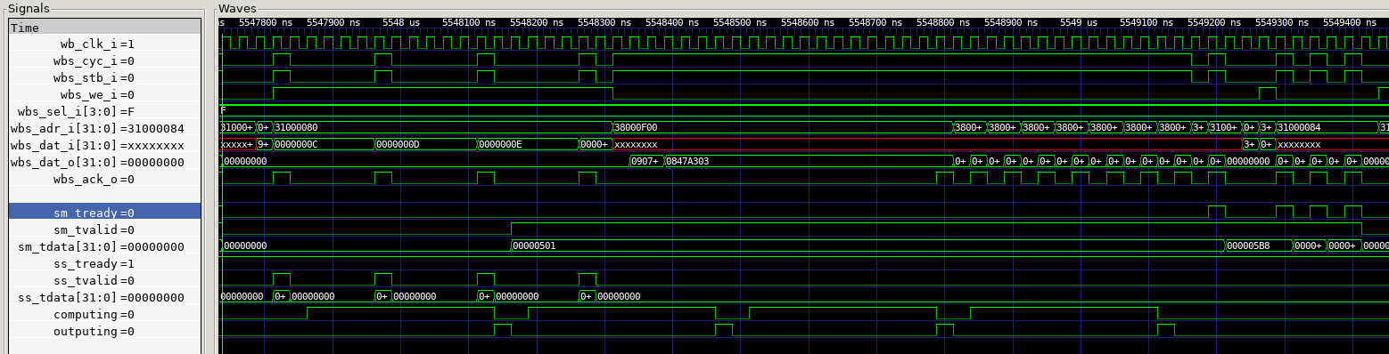
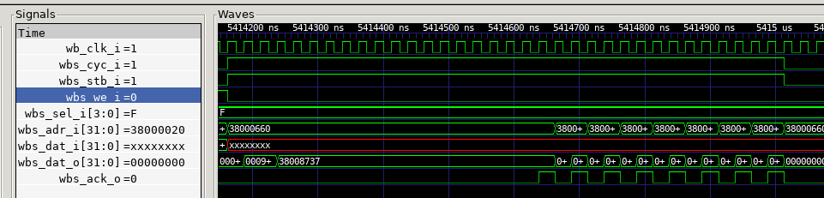
Waveform
FIFO equipped FIR
Prefetch User BRAM
34T for 8 data

Slide 20
Performance Comparison
FIFO for FIR (data in CPU memory)
FIFO for FIR (data in SDRAM)
FIFO Depth | 1 | 2 | 4 | 8
Latency(no opt) | 18185 | 16192 | 14316 | 13343
Latency(-O3) | 2023 | 1772 | 4380 | 4222
FIFO Depth | 1 | 2 | 4 | 8
Latency | 1786 | 1549 | 1743 | 1625
FIFO for FIR (data in user BRAM)
DMA with different storage element
Baseline FIR
With Latency 18185
FIFO Depth \ Operation | 2 | 4 | 8 | MM | QS
Latency (W prefetch) | 4589 | 3235 | 2996 | 18865 | 10470
Latency (Wo prefetch) | 9204 | 5785 | 5585 | 35758 | 14984
Storage Method | User BRAM | SDRAM
Latency | 1039 | 1215

Slide 21
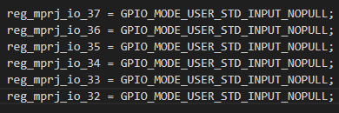
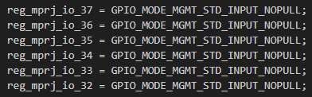
Way to Verify on Host Python
1. Use mprj_io as input signal from host to caravel_soc
Result: testbench✔ Jupyter notebook🗶
+

Slide 22

2. Use GPIO as input signal from host to caravel_soc
Result: testbench✔ Jupyter notebook🗶

Slide 23
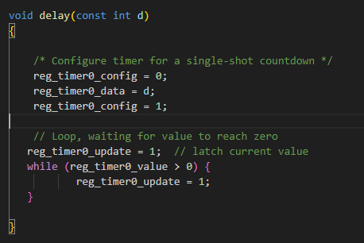
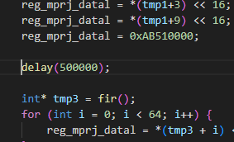
3. Use timer to delay the transition between output values
Result: testbench✔ Jupyter notebook ✔
+

Slide 24
End~

