Slide 1
KNOWLEDGE, GOVERNED AND CITED
Enterprise RAG Platform
A conversational, cited, and governed knowledge layer across documents, policies, and enterprise systems
Document Ingestion
Semantic Search
RAG Generation
Cited Answers
Governance
Prepared for Enterprise Knowledge Modernization Initiative
Jayakumar T

Slide 2




01 — THE CHALLENGE
Problem Statement
Knowledge is everywhere in the organization — but trusted answers are hard to find fast.
Scattered Content
Slow Discovery
Low Trust
Governance Gaps
Documents, emails, wikis, and policies live in disconnected silos across the enterprise.
Employees spend hours searching instead of working, often settling for outdated results.
Answers lack source traceability, so people can't verify accuracy before acting on them.
Sensitive knowledge is exposed without role-based access or audit controls.
The Cost: Knowledge workers lose significant productive time weekly hunting for information that already exists somewhere in the org.
Enterprise RAG Platform
2

Slide 3

Proposed Solution
Enterprise RAG Platform
Documents
Ingests enterprise documents
Converts content into embeddings
Document Processing
Stores vectors in a Vector Database
Retrieves relevant knowledge using Semantic Search
Embeddings
Uses an LLM to generate accurate responses
Provides citations for every answer
Vector Database
Enforces enterprise security and governance
Semantic Search
BENEFITS
Faster search
Trusted responses
Secure access
Enterprise-wide sharing
Large Language Model
Answer + Citations

Slide 4




03 — ARCHITECTURE
Application Architecture
Sources
Ingestion & Processing
Knowledge Layer
RAG Orchestration
Experience & Governance
Documents
Connectors
Embedding Models
Semantic Retriever
Chat / Search UI
Email
▸
Parsing / OCR
▸
Vector Store
▸
Re-ranking
▸
API & Plugins
Wikis / SharePoint
Chunking
Knowledge Graph
LLM Generation
Audit Logging
Databases
Metadata Tagging
Access Policies
Citation Engine
RBAC / SSO
APIs
Data flows left to right: raw enterprise content is ingested, indexed, retrieved, and generated into cited answers delivered through governed interfaces.
Enterprise RAG Platform
4

Slide 5
Technology Stack
Frontend
React / Next.js
Database
PostgreSQL
Backend
FastAPI / Python
Authentication
Azure AD
LLM
Azure OpenAI / OpenAI GPT
Document Processing
LangChain
Embeddings
text-embedding-3-large
Monitoring
Azure Monitor
Vector Database
Azure AI Search / Pinecone
Deployment
Azure App Service / AKS
Storage
Azure Blob Storage

Slide 6





05 — GENAI IN ACTION
GenAI Use Cases
High-impact scenarios where conversational, cited AI transforms how employees find and use knowledge.
Conversational Q&A
Policy & Compliance Lookup
Inbox & Ticket Summarization
Ask policy or process questions in natural language and get direct, cited answers.
Instantly surface the exact clause in HR, legal, or compliance documents.
Summarize long email threads or support tickets with linked source context.
Onboarding Assistant
Executive Briefing Generation
Audit & Discovery Support
New hires self-serve answers about tools, processes, and team knowledge.
Auto-draft briefs and reports grounded in the latest internal documents.
Quickly locate and cite evidence across repositories for audits or investigations.
Enterprise RAG Platform
6

Slide 7
06 — EXPERIENCE
UI Wireframes
A conversational search experience with transparent, citation-first design.
Enterprise Knowledge Assistant
Governance & Access Console
Recent
What is our remote work reimbursement policy?
48,210
12
3,940
HR Policies
Docs Indexed
Active Roles
Queries / Day
Finance Docs
Employees may expense up to $75/month for home-office internet, per the Remote Work Policy.
SOURCE ACCESS POLICIES
Onboarding
HR Policies
HR, All-Staff
[1] HR_Policy.pdf p.4
Read
Legal
[2] Finance_Handbook.docx
Finance Reports
Finance, Exec
Restricted
Legal Contracts
Legal Only
Restricted
Eng Wiki
Engineering
Read/Write
Ask a question about company knowledge...
Conversational Search & Cited Answers
Knowledge Governance Dashboard
Enterprise RAG Platform
7

Slide 8
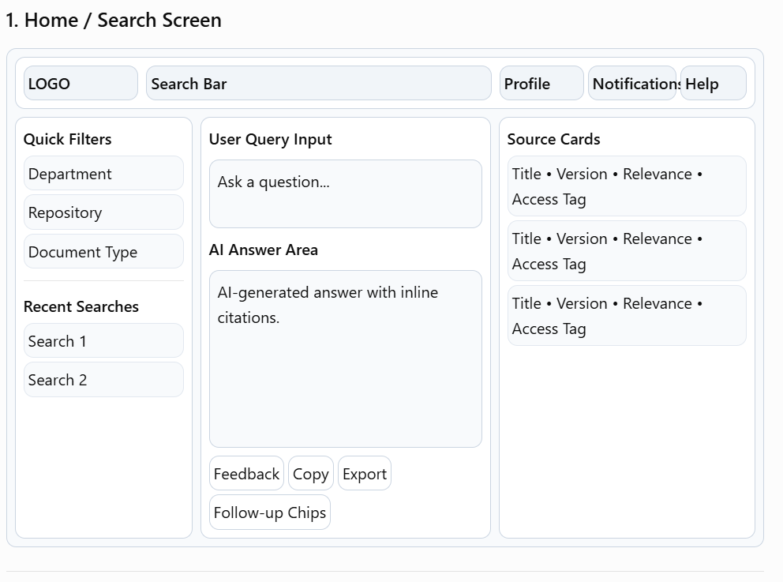
UI Wireframes

Slide 9
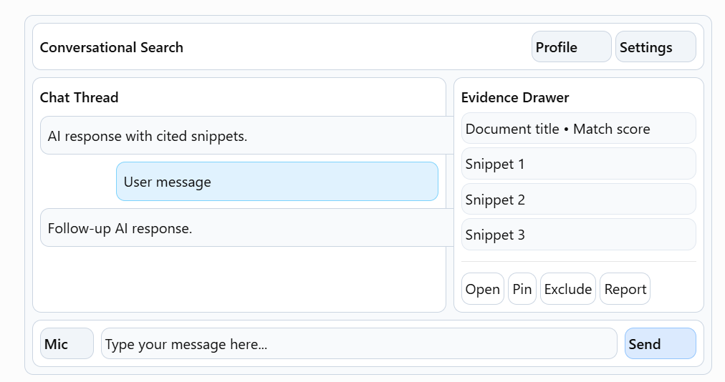
UI Wireframes

Slide 10
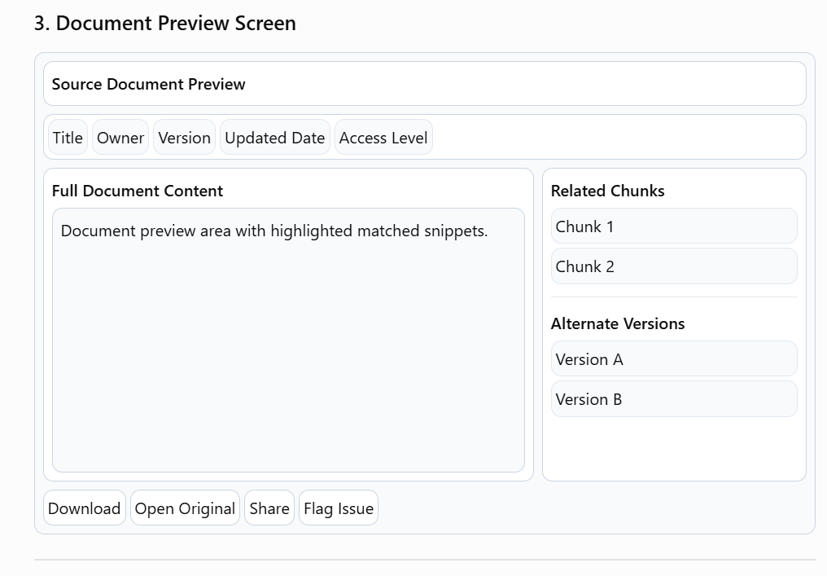
UI Wireframes

Slide 11
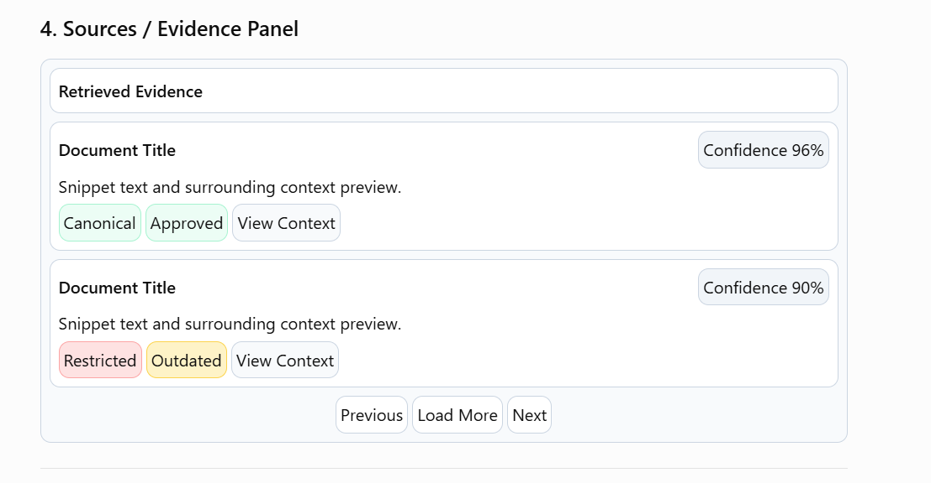
UI Wireframes

Slide 12
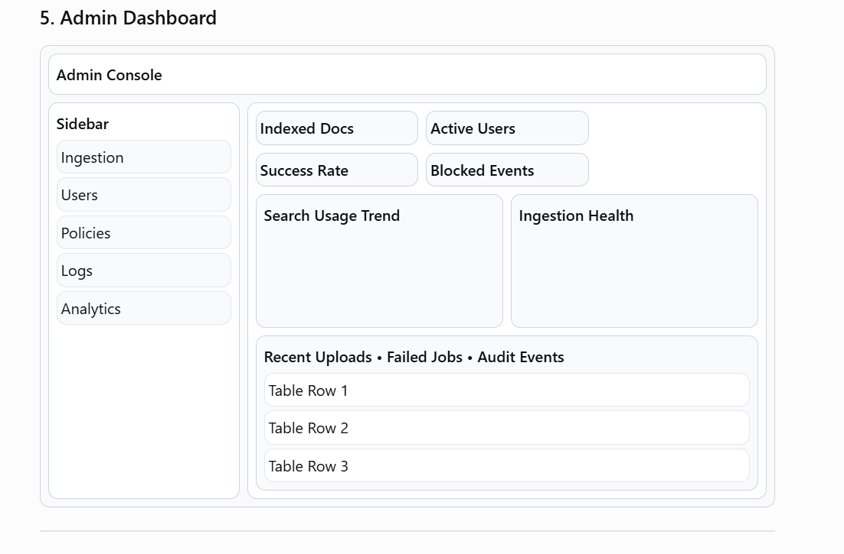
UI Wireframes

Slide 13
07 — ROADMAP
Development Timeline
A phased rollout from foundation to enterprise-wide, governed knowledge access.
PHASE 1
PHASE 2
PHASE 3
Weeks 1
Weeks 2
Weeks 3
Foundation
Ingestion & Indexing
RAG & Citations
UI & Governance
Implement retrieval, LLM orchestration, and citation-linked answer generation.
Ship chat/search UI, RBAC, audit logging, and policy controls.
Define architecture, connect pilot data sources, stand up vector store & security baseline.
Build ingestion pipelines, chunking, embeddings, and metadata tagging at scale.
Enterprise RAG Platform
8

