Slide 1




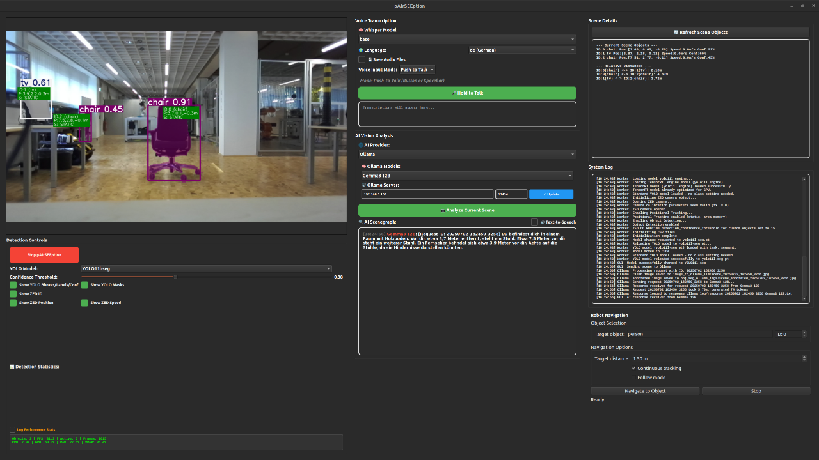

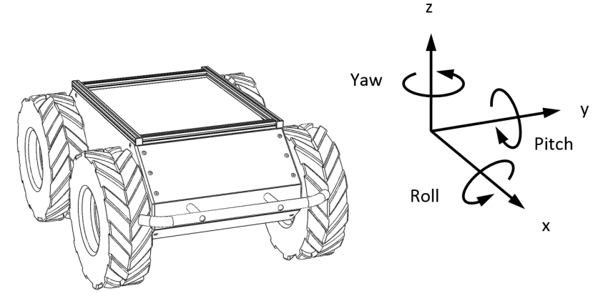

Human
Object detection and localization
Intent analyzer
Hybrid voice assistant (TTS)
How far is the object
($z$-distance)?
a. “There is a car in front of you, 5 meters away.”
d. “Sure, you can give me voice commands to analyze the scene for a blind person, for example, or you can tell me a navigation destination in my field of vision that I should drive to, or I can follow any recognized object by YOLO!”
LLM/VLM answer
Depth Camera
GUI
STT
Intent
AI request?
Possible user input:
“Analyze the scene!”
“Drive to object ABC!”
“What is your current motor temperature?”
“Can you explain how to use your system?”
Rule-based answer and action
b. “I will drive to object ABC.... Destination reached!”
c. “My left motor temperature is 25 °C and my right motor temperature is 26 °C.”
YOLO
What and where is the object in the image plane?
Direct navigation command
or
system status query?
Write and subscribe to ROS2 topics to drive or query status

