Slide 1
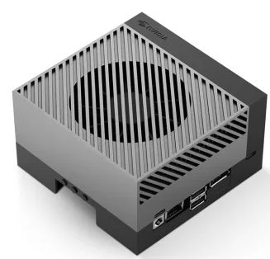

USB
image in Base64 + data of objects as Prompt
analysis of scene with extended context
Nvidia Jetson (Client) AGX Orin 32GB
Ollama Server
Nvidia RTX A5000 24 GB VRAM i9-13900KF and 128 GB RAM

