Slide 1
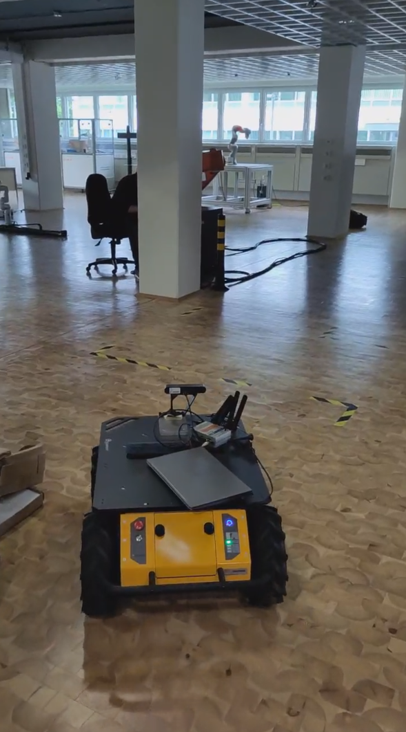
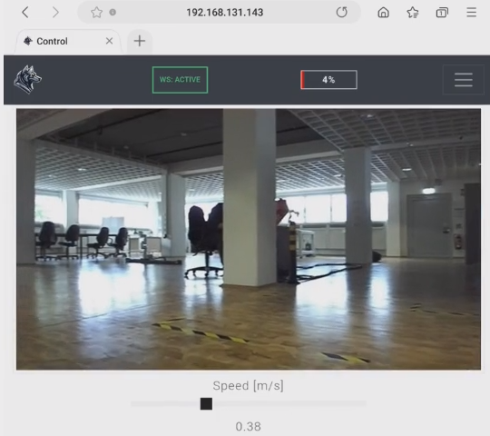

Slide 2
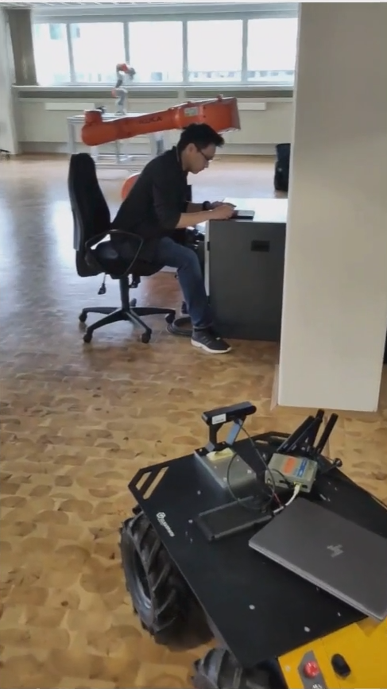
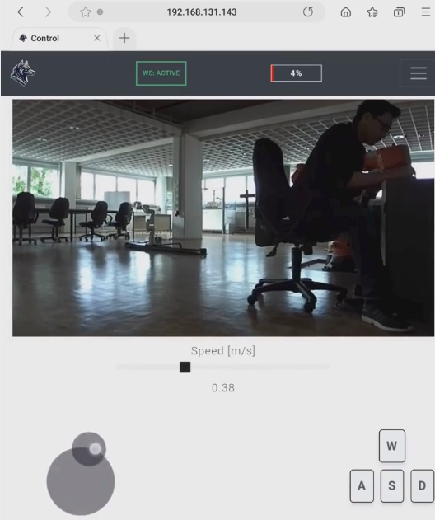
Battery state
device
Perceived live stream on device
Remote
robot operator
Zed2i - camera
Remote mobile robot
Live stream data
5G router
Joystick

Slide 3
Critical situation?
(e.g., pedestrian in fast motion, robot gets stuck, etc)
High trasversability
value?
No
No
Yes
Yes
Full supersivion by the remote operator
Autonomous robot behavior
Shared control

Slide 4
Critical situation?
(e.g., pedestrian in fast motion, robot gets stuck, etc)
High trasversability
value?
No
No
Yes
Yes
Full supersivion by the remote operator
Autonomous robot behavior
Shared control

Slide 5
Cybersecurity, data sovereignty, privacy preservation, etc
Communication interfaces, services, KPI, and applications
Mental models,
Foundation models
Collective and generative AI, Machine Learning-based Reasoning
Semantic and multimodal knowledge management
Connectivity, decentralized data sensing and management

